Slide 1


Replace background image
Click on the frame of the dark gradient area. Right-click on “Send to Back" to move the area to the back.
You now have 2 options for inserting an image
Option 1:
Delete the image and then click on the image symbol in the middle so that you can select an image from
your files.
Option 2:
Right-click on the image. Now you have the option of selecting the image from your files under the term
"Change Picture“.
After you have inserted the image, click on the image and place it in the background.
Setting the brightness of the overlay
The dark gradient overlay can be changed. Images that do not require a dark color gradient overlay can delete it.
How to change the dark gradient overlay: Right-click on the overlay and select "Format shape". In the "Fill" area, you now have the option of changing the gradient.
The font size for title slides
Headline: 44 pts. Subheadline: 28 pts.
Use of colors:
Texts on light-colored slides: Headlines are used in ROSEN GROUP Nightblue and continuous texts in Black.
Texts on dark slides: Texts on dark slides: White. Cyan can be used as a highlight and should be used sparingly. The color Grey is used as a more discreet highlight.
Finding the Needle in the Haystack
Crack Management with Alex Hazeltine
Alex Hazeltine| APGA 2025 | New Plymouth, New Zealand | 20th March 2025
Obere Spichermatt 14 · 6370 Stans · Switzerland · Phone: +41-41-618-0300 · info@rosen-group.com
© 2024 ROSEN Swiss AG All Rights Reserved.
This document is the property of ROSEN Swiss AG who will safeguard its rights according to the applicable civil and criminal law provisions. No part of this document may be reproduced or disclosed to any third party without the prior written consent of ROSEN Swiss AG. The information provided in this document is for general informational purposes only and does not constitute any professional advice or any legally binding offer. While every effort has been made to ensure the accuracy of the information provided, no warranties, guarantees or representations, either expressed or implied, are made as to the completeness, accuracy, reliability, or timeliness of the information. Any data, specifications, and any other information included are subject to change without prior notice. Any liability for damages or losses including but not limited to, compensatory, direct, indirect or consequential damage, loss of income or profit, loss of or damage to property and claims by a third party resulting from the use of the information in this document is excluded to the extent permitted by law.

Slide 2
Agenda
Finding the Needle in the Haystack
Working with tables
By right-clicking in a column/row, you have the option of inserting a new column or row under the "Insert" tab
If you want to insert a new row between the rows in this case, a new row must be added. Under the "Layout" tab, you have the option of determining the height of the row. In this case, this is 0.77 cm.
Cyan can be used as a highlight and should be used sparingly. The color grey is used as a more discreet highlight.
01 | Introduction
02 | What Causes Cracking?
03 | Cracking Mechanisms
04 | In-Line Inspections
05 | Crack Management
06 | Conclusion

Slide 3
Introduction
Headlines
Please use upper and lower case for headlines and subheadlines
Headlines: Arial (bold)
Sub headlines: Arial (not bold)
Bullet List
Bullet points do not necessarily have to be used and can be removed in the “Home" menu bar under the "Bullets" tab.
Font size for
content slides
Please use a consistent font size of 16 pt. for Subheadlines and 14 pt. for body text. For text-heavy slides, a font size of 12 pt. can be used for body text and 14 pt. for Subheadlines.
The minimum size for continuous text should not exceed 12 pts.
Line spacing: 1.1
Spacing between paragraphs: 6 pt.
There have been a number of high profile cracking related failures globally.
Historically, corrosion and third party damage have been the main focus of integrity management plans. Operators are often reactive to the threat of cracking, typically only taking the threat of cracking seriously following a failure.
San Bruno, USA, 2010 – Seam Weld Defect
Australia, 1982 – SCC
Indonesia, 2018 – Third Party Damage (Cracking)
Norway, 2024 – Offshore riser repaired before failure
Integrity management of pipelines with cracks is not simple.
This presentation details an integrated muti-disciplined, framework to proactively manage the threat of cracking. The framework provides a staged process, from building the initial understanding of the cracking threat, inspection, assessment to development of an integrity management plan.

Slide 4
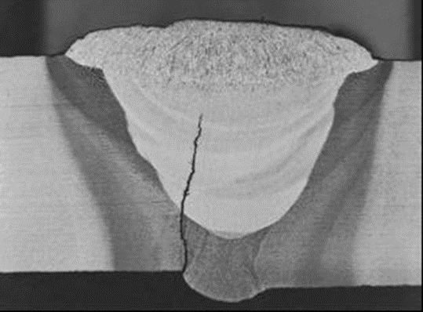
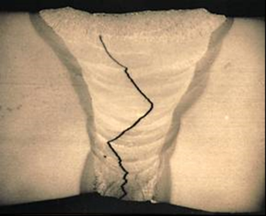
Introduction
What is a crack?
Headlines
Please use upper and lower case for headlines and subheadlines
Headlines: Arial (bold)
Sub headlines: Arial (not bold)
Bullet List
Bullet points do not necessarily have to be used and can be removed in the “Home" menu bar under the "Bullets" tab.
Font size for
content slides
Please use a consistent font size of 16 pt. for Subheadlines and 14 pt. for body text. For text-heavy slides, a font size of 12 pt. can be used for body text and 14 pt. for Subheadlines.
The minimum size for continuous text should not exceed 12 pts.
Line spacing: 1.1
Spacing between paragraphs: 6 pt.
ASME B31.8S defines a crack as a:
  “narrow, elongated defect caused by mechanical splitting into two parts…”
  “…feature has the shape of a crack but where material on opposite face of feature was never fused or bonded…”

Slide 5
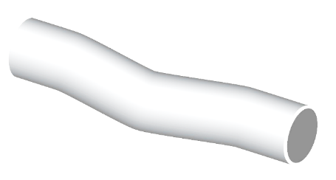
What Causes Cracking?
Without environmental assistance
Headlines
Please use upper and lower case for headlines and subheadlines
Headlines: Arial (bold)
Sub headlines: Arial (not bold)
Bullet List
Bullet points do not necessarily have to be used and can be removed in the “Home" menu bar under the "Bullets" tab.
Font size for
content slides
Please use a consistent font size of 16 pt. for Subheadlines and 14 pt. for body text. For text-heavy slides, a font size of 12 pt. can be used for body text and 14 pt. for Subheadlines.
The minimum size for continuous text should not exceed 12 pts.
Line spacing: 1.1
Spacing between paragraphs: 6 pt.
Axial Cracking
E
Nucleation and propagation is typically a combination of:
  Susceptible initiating flaws created through manufacturing, fabrication or construction quality issues
  Stress concentrations or residual stress fields present at welds
  Difference between design assumptions and operating conditions e.g. pressure cycling
  External loading e.g. land slip or thermal fluctuations
σ_{L}
σ_{H}
ΔT
P

Slide 6
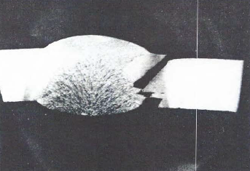
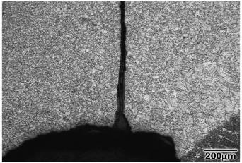
What Causes Cracking?
Without environmental assistance
Headlines
Please use upper and lower case for headlines and subheadlines
Headlines: Arial (bold)
Sub headlines: Arial (not bold)
Bullet List
Bullet points do not necessarily have to be used and can be removed in the “Home" menu bar under the "Bullets" tab.
Font size for
content slides
Please use a consistent font size of 16 pt. for Subheadlines and 14 pt. for body text. For text-heavy slides, a font size of 12 pt. can be used for body text and 14 pt. for Subheadlines.
The minimum size for continuous text should not exceed 12 pts.
Line spacing: 1.1
Spacing between paragraphs: 6 pt.
Fatigue
Caused by repeated cycling of an applied load, causing progressive localised damage – occurs at a stress below that seen in a tensile test.
  Cycling is seen by all pipelines, however, it is most severe in liquid lines with batched operation
Fatigue cracks can initiate on smooth surfaces, however, most commonly initiate at stress concentrators such as:
  Manufacturing or construction flaws (lack of fusion, misalignment, lamination etc.)
  Dents or gouges
  Etc.
Welds (long seam and girth weld) are therefore common locations for fatigue cracking to occur

Slide 7
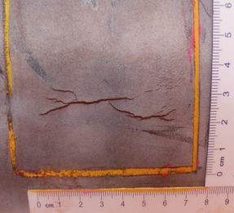
What Causes Cracking?
Environmental assistance – Stress Corrosion Cracking
Headlines
Please use upper and lower case for headlines and subheadlines
Headlines: Arial (bold)
Sub headlines: Arial (not bold)
Bullet List
Bullet points do not necessarily have to be used and can be removed in the “Home" menu bar under the "Bullets" tab.
Font size for
content slides
Please use a consistent font size of 16 pt. for Subheadlines and 14 pt. for body text. For text-heavy slides, a font size of 12 pt. can be used for body text and 14 pt. for Subheadlines.
The minimum size for continuous text should not exceed 12 pts.
Line spacing: 1.1
Spacing between paragraphs: 6 pt.
Materials susceptible to SCC
Corrosive Environment
Materials Susceptible to SCC
  Pipeline steels are susceptible to SCC
Corrosive Environment
  Two main factors:
    Poor coating – age degraded coating ( >10 years), damaged or disbonded coating and low performance coating (e.g. coal tar, asphalt, PE tape)
    CP underprotection (less than -850 mV)
Stress
  High stress (>60% SMYS) typically required, though multiple occurrences below this value are known
    Axial SCC – typically hoop stress driven
    Circumferential – typically stress from soil movement, slopes, bending strain etc.
    Geometric and manufacturing irregularities are common sources of additional of stress (dents, gouges, field bends, weld misalignment)
Crack
Tensile stress
(residual or applied)

Slide 8
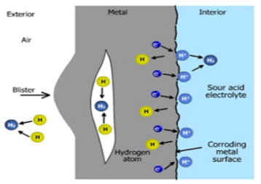
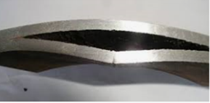
What Causes Cracking?
Environmental assistance – Hydrogen Induced Cracking
Headlines
Please use upper and lower case for headlines and subheadlines
Headlines: Arial (bold)
Sub headlines: Arial (not bold)
Bullet List
Bullet points do not necessarily have to be used and can be removed in the “Home" menu bar under the "Bullets" tab.
Font size for
content slides
Please use a consistent font size of 16 pt. for Subheadlines and 14 pt. for body text. For text-heavy slides, a font size of 12 pt. can be used for body text and 14 pt. for Subheadlines.
The minimum size for continuous text should not exceed 12 pts.
Line spacing: 1.1
Spacing between paragraphs: 6 pt.
HIC
Can be caused internally by sour products (H₂S) or externally by H₂ generation due to CP overprotection (more negative than -1200 mV)
    Stress does not always need to be present
Mid-wall cracking parallel to the steel rolling direction
Significant uncertainty regarding prediction of growth rates.
API 579:
    “A standard method to assess the remaining life of a HIC damaged structure cannot be established”
    “Therefore, unless the determination can be made that the HIC or SOHIC damage is dormant, periodic monitoring is required”
Crack growth rates due to fatigue in a hydrogen environment can be significantly greater than in air

Slide 9
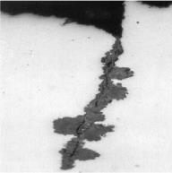
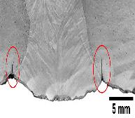
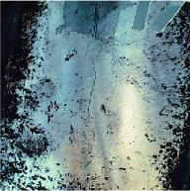
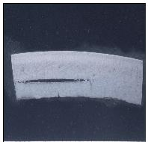
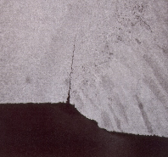
Pipeline Cracking Mechanisms
Typical pipeline cracking mechanisms
Headlines
Please use upper and lower case for headlines and subheadlines
Headlines: Arial (bold)
Sub headlines: Arial (not bold)
Bullet List
Bullet points do not necessarily have to be used and can be removed in the “Home" menu bar under the "Bullets" tab.
Font size for
content slides
Please use a consistent font size of 16 pt. for Subheadlines and 14 pt. for body text. For text-heavy slides, a font size of 12 pt. can be used for body text and 14 pt. for Subheadlines.
The minimum size for continuous text should not exceed 12 pts.
Line spacing: 1.1
Spacing between paragraphs: 6 pt.
Typical time-dependent pipeline cracking mechanisms:
Near-neutral pH SCC
HAZ fatigue cracking
High pH SCC
Hydrogen Induced Cracking
Sulphide Stress Cracking
All associated with either environmental or mechanical growth mechanisms.

Slide 10
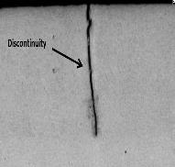
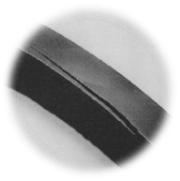
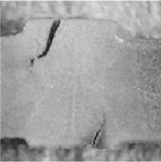
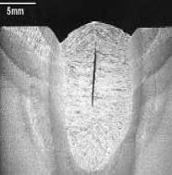
Pipeline Cracking Mechanisms
Typical pipeline cracking mechanisms
Headlines
Please use upper and lower case for headlines and subheadlines
Headlines: Arial (bold)
Sub headlines: Arial (not bold)
Bullet List
Bullet points do not necessarily have to be used and can be removed in the “Home" menu bar under the "Bullets" tab.
Font size for
content slides
Please use a consistent font size of 16 pt. for Subheadlines and 14 pt. for body text. For text-heavy slides, a font size of 12 pt. can be used for body text and 14 pt. for Subheadlines.
The minimum size for continuous text should not exceed 12 pts.
Line spacing: 1.1
Spacing between paragraphs: 6 pt.
Many manufacturing anomalies can appear crack-like but not all are injurious:
Lack of Fusion
Laminations
ERW Hook Cracking
Weld Metal Cracking
These anomalies have been present since manufacturing (passed hydrotest).
Can act as a nucleation point for other time dependant mechanisms (e.g. fatigue, SCC).

Slide 11
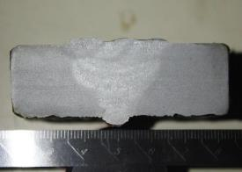
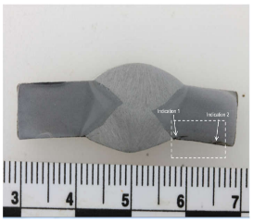
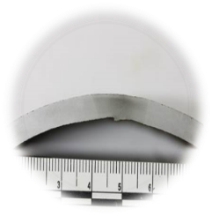
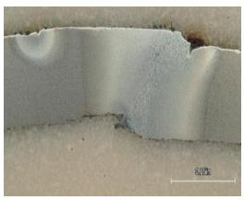
Pipeline Cracking Mechanisms
Cracking Complications
Headlines
Please use upper and lower case for headlines and subheadlines
Headlines: Arial (bold)
Sub headlines: Arial (not bold)
Bullet List
Bullet points do not necessarily have to be used and can be removed in the “Home" menu bar under the "Bullets" tab.
Font size for
content slides
Please use a consistent font size of 16 pt. for Subheadlines and 14 pt. for body text. For text-heavy slides, a font size of 12 pt. can be used for body text and 14 pt. for Subheadlines.
The minimum size for continuous text should not exceed 12 pts.
Line spacing: 1.1
Spacing between paragraphs: 6 pt.
Some weld surface/shape anomalies can appear crack-like to the inspection tools even though they are just edge reflections:
SAW cap/root Inhomogeneity
Rolling laps
ERW Undertrim
Weld Misalignment
These can potentially act as stress concentrators for crack nucleation if the conditions are right.

Slide 12
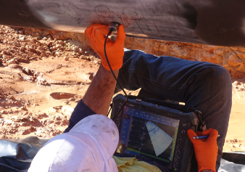
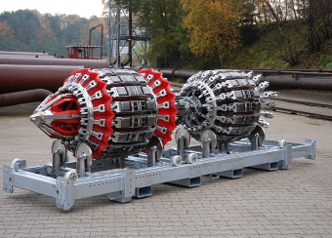
Pipeline Cracking Mechanisms
Cracking Complications
Headlines
Please use upper and lower case for headlines and subheadlines
Headlines: Arial (bold)
Sub headlines: Arial (not bold)
Bullet List
Bullet points do not necessarily have to be used and can be removed in the “Home" menu bar under the "Bullets" tab.
Font size for
content slides
Please use a consistent font size of 16 pt. for Subheadlines and 14 pt. for body text. For text-heavy slides, a font size of 12 pt. can be used for body text and 14 pt. for Subheadlines.
The minimum size for continuous text should not exceed 12 pts.
Line spacing: 1.1
Spacing between paragraphs: 6 pt.
  Unfortunately, it is very challenging for current NDT technologies to differentiate these different types of planar anomalies.
    Cracking features such as SCC and other time-dependent anomalies such as sharp edged corrosion can be challenging due to their similar geometries.
      To complicate matters, this type of corrosion is often associated with SCC, and therefore occurs in the same locations to where you would expect to find SCC.
  This is further complicated by the fact that time-dependent cracks can propagate from initially ‘blunt’ planar flaws under certain conditions.
  The term ‘crack-like’ is therefore used to cover this uncertainty.
    API 579 definition: “A flaw that may or may not be the result of linear rupture, but which has the physical characteristics of a crack when detected by an NDE technique….Examples of crack-like flaws include planar cracks, lack of fusion and lack of penetration in welds, sharp groove-like localized corrosion, and branch type cracks associated with environmental cracking.”

Slide 13
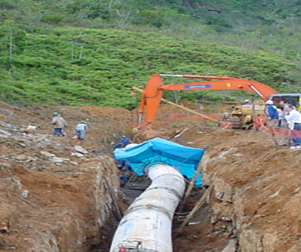
In-Line Inspection of Cracks
How do I find cracks?
Headlines
Please use upper and lower case for headlines and subheadlines
Headlines: Arial (bold)
Sub headlines: Arial (not bold)
Bullet List
Bullet points do not necessarily have to be used and can be removed in the “Home" menu bar under the "Bullets" tab.
Font size for
content slides
Please use a consistent font size of 16 pt. for Subheadlines and 14 pt. for body text. For text-heavy slides, a font size of 12 pt. can be used for body text and 14 pt. for Subheadlines.
The minimum size for continuous text should not exceed 12 pts.
Line spacing: 1.1
Spacing between paragraphs: 6 pt.
Three Typical Approaches
Hydrotest
  Provides confirmation of the immediate integrity of the pipeline
    Provides no information on currently sub-critical anomalies that may grow in-service
  Operationally challenging (requires vast amount of water, pumping and drying)
Direct Assessment
  Targets areas most likely to contain cracks
  Relies on a susceptibility model
    Only as good as the input data available
In-Line Inspection
  Provides a report of cracks along entire the length of a pipeline
    Can only detect anomalies above a certain size threshold
    Some operators utilise In-Line Inspection (ILI) as a viable alternative to hydrotesting if anomaly dimensions are within the service specification
  A combination of approaches is often the most effective method for managing the cracking threat.

Slide 14
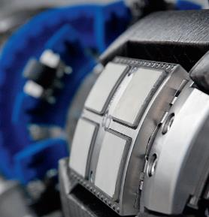
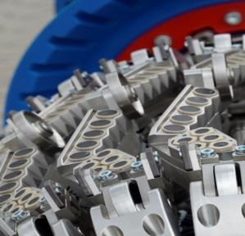
In-Line Inspection of Cracks
Primary Technologies
Headlines
Please use upper and lower case for headlines and subheadlines
Headlines: Arial (bold)
Sub headlines: Arial (not bold)
Bullet List
Bullet points do not necessarily have to be used and can be removed in the “Home" menu bar under the "Bullets" tab.
Font size for
content slides
Please use a consistent font size of 16 pt. for Subheadlines and 14 pt. for body text. For text-heavy slides, a font size of 12 pt. can be used for body text and 14 pt. for Subheadlines.
The minimum size for continuous text should not exceed 12 pts.
Line spacing: 1.1
Spacing between paragraphs: 6 pt.
EMAT Crack Detection
electromagnetic acoustic transducer, dry coupled
Ultrasonic Crack Detection
liquid coupled

Slide 15
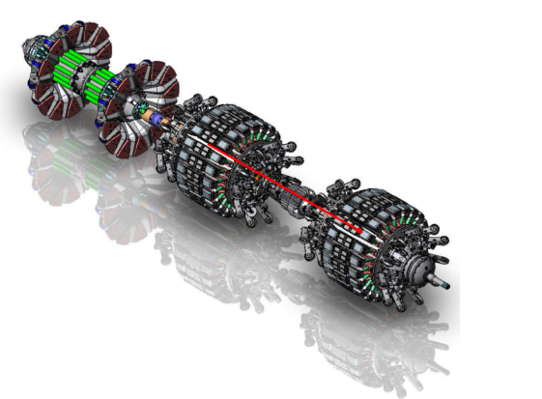
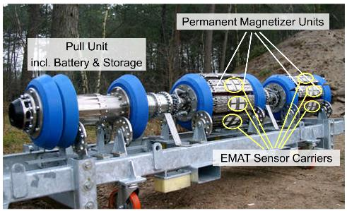
In-Line Inspection of Cracks
Electro-Magnetic Acoustic Transducer
Headlines
Please use upper and lower case for headlines and subheadlines
Headlines: Arial (bold)
Sub headlines: Arial (not bold)
Bullet List
Bullet points do not necessarily have to be used and can be removed in the “Home" menu bar under the "Bullets" tab.
Font size for
content slides
Please use a consistent font size of 16 pt. for Subheadlines and 14 pt. for body text. For text-heavy slides, a font size of 12 pt. can be used for body text and 14 pt. for Subheadlines.
The minimum size for continuous text should not exceed 12 pts.
Line spacing: 1.1
Spacing between paragraphs: 6 pt.
Compatible with both liquid and gas mediums
Currently limited to axial cracking only. Capabilities for circumferential cracking in development.
Available in 6” upwards
Up to 16.4 mm wall thickness
Max tool velocity 2m/s
No internal/external discrimination
Able to detect coating disbondment and locations of coating changes

Slide 16
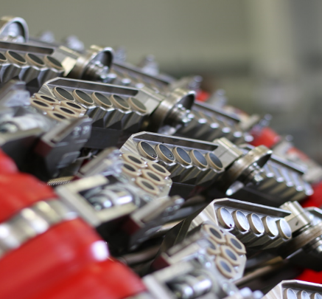
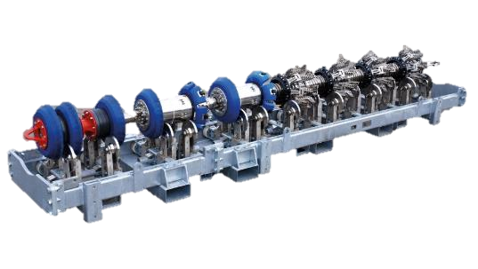

In-Line Inspection of Cracks
Ultrasonic Crack Detection
Headlines
Please use upper and lower case for headlines and subheadlines
Headlines: Arial (bold)
Sub headlines: Arial (not bold)
Bullet List
Bullet points do not necessarily have to be used and can be removed in the “Home" menu bar under the "Bullets" tab.
Font size for
content slides
Please use a consistent font size of 16 pt. for Subheadlines and 14 pt. for body text. For text-heavy slides, a font size of 12 pt. can be used for body text and 14 pt. for Subheadlines.
The minimum size for continuous text should not exceed 12 pts.
Line spacing: 1.1
Spacing between paragraphs: 6 pt.
Axial or circumferential crack detection and sizing in liquid mediums only.
Requires liquid coupling to pipe wall
Internal and External Discrimination
Available in 6” upwards
Max inspection velocity 2 m/s
Sensitive to presence of debris on the pipe wall

Slide 17
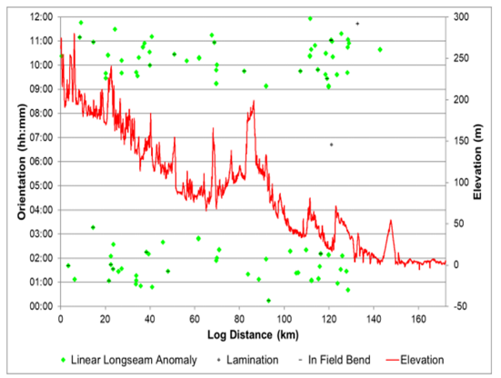
Crack Management
How do I respond to the data?
Headlines
Please use upper and lower case for headlines and subheadlines
Headlines: Arial (bold)
Sub headlines: Arial (not bold)
Bullet List
Bullet points do not necessarily have to be used and can be removed in the “Home" menu bar under the "Bullets" tab.
Font size for
content slides
Please use a consistent font size of 16 pt. for Subheadlines and 14 pt. for body text. For text-heavy slides, a font size of 12 pt. can be used for body text and 14 pt. for Subheadlines.
The minimum size for continuous text should not exceed 12 pts.
Line spacing: 1.1
Spacing between paragraphs: 6 pt.
A high number of “reflectors” may be reported by an inspection.
Investigating all features is typically not realistic from a commercial or logistical perspective.
  Has the inspection tool performed to specification in terms of detect, classification and sizing?
  Which features require immediate remediation/repair?
  Which features are time-dependent (growing), and if so, how fast?
  Do I need to implement a pressure reduction or worst-case shut down the pipeline to maintain safety whilst I respond to the threat?
    UNCERTAINTY AND THEREFORE RISK
ILI should therefore be used as part of a coordinated multi-discipline integrity management framework, linking ILI, direct assessment, integrity assessment, root cause and risk.
  The aim of the framework is to increase knowledge, understanding and communication relating to the threat of cracking for a particular system.

Slide 18
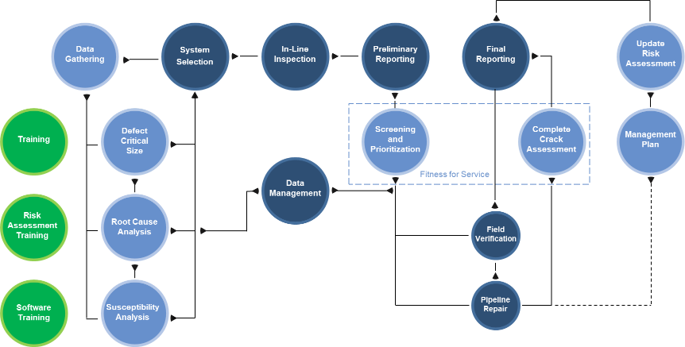
Crack Management
Multi-discipline framework approach
Headlines
Please use upper and lower case for headlines and subheadlines
Headlines: Arial (bold)
Sub headlines: Arial (not bold)
Bullet List
Bullet points do not necessarily have to be used and can be removed in the “Home" menu bar under the "Bullets" tab.
Font size for
content slides
Please use a consistent font size of 16 pt. for Subheadlines and 14 pt. for body text. For text-heavy slides, a font size of 12 pt. can be used for body text and 14 pt. for Subheadlines.
The minimum size for continuous text should not exceed 12 pts.
Line spacing: 1.1
Spacing between paragraphs: 6 pt.
Understand the integrity history of the pipeline?
Review suitable inspection technologies
Screening and Prioritisation of Features
Development of Management Plan
Understand integrity threat(s)

Slide 19
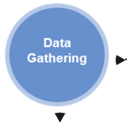
Crack Management
Data gathering – building the picture
Headlines
Please use upper and lower case for headlines and subheadlines
Headlines: Arial (bold)
Sub headlines: Arial (not bold)
Bullet List
Bullet points do not necessarily have to be used and can be removed in the “Home" menu bar under the "Bullets" tab.
Font size for
content slides
Please use a consistent font size of 16 pt. for Subheadlines and 14 pt. for body text. For text-heavy slides, a font size of 12 pt. can be used for body text and 14 pt. for Subheadlines.
The minimum size for continuous text should not exceed 12 pts.
Line spacing: 1.1
Spacing between paragraphs: 6 pt.
The first stage of the framework involves gathering and reviewing the available data, and highlighting any key data gaps that be closed throughout the process.
  The aim is to start to build a picture of the integrity history of the pipeline to understand the threat of cracking to the pipeline.
  Key types of data include:
    Design and construction records
    Operational (e.g. pressure and temperature)
    Inspection history
    Failure reports
    Material testing
    Etc.

Slide 20
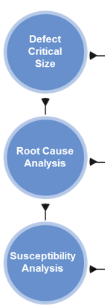
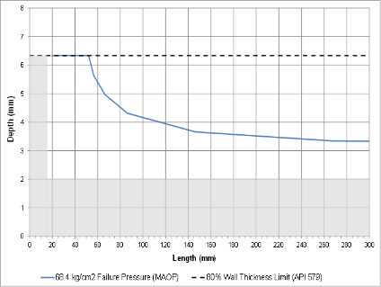
Crack Management
Understanding the cracking threats
Headlines
Please use upper and lower case for headlines and subheadlines
Headlines: Arial (bold)
Sub headlines: Arial (not bold)
Bullet List
Bullet points do not necessarily have to be used and can be removed in the “Home" menu bar under the "Bullets" tab.
Font size for
content slides
Please use a consistent font size of 16 pt. for Subheadlines and 14 pt. for body text. For text-heavy slides, a font size of 12 pt. can be used for body text and 14 pt. for Subheadlines.
The minimum size for continuous text should not exceed 12 pts.
Line spacing: 1.1
Spacing between paragraphs: 6 pt.
Defect Critical Size
  Calculation of the critical defect sizes for each pipe population
  Based on pipeline design, material properties and operational data
  Serves two purposes:
    Important input for inspection technology selection
    Quickly determine if an anomaly is acceptable

Slide 21
Crack Management
Understanding the cracking threats
Headlines
Please use upper and lower case for headlines and subheadlines
Headlines: Arial (bold)
Sub headlines: Arial (not bold)
Bullet List
Bullet points do not necessarily have to be used and can be removed in the “Home" menu bar under the "Bullets" tab.
Font size for
content slides
Please use a consistent font size of 16 pt. for Subheadlines and 14 pt. for body text. For text-heavy slides, a font size of 12 pt. can be used for body text and 14 pt. for Subheadlines.
The minimum size for continuous text should not exceed 12 pts.
Line spacing: 1.1
Spacing between paragraphs: 6 pt.
Root Cause Analysis
In order to manage the cracking threat(s), an operator needs to be able to define the active degradation mechanisms in the pipeline.
Causal analysis attempts to identify the given threat types using available information.
  Failure analysis report/failure morphology
  Material testing results
  Historical excavation reports
  Knowledge of pipe ‘vintage’
  Knowledge of construction practices
  Knowledge of operational regime
  Environmental sampling data
  Route information
Unlikely that all of this data is available when the cracking threat is newly discovered.

Slide 22
Crack Management
Understanding the cracking threats
Headlines
Please use upper and lower case for headlines and subheadlines
Headlines: Arial (bold)
Sub headlines: Arial (not bold)
Bullet List
Bullet points do not necessarily have to be used and can be removed in the “Home" menu bar under the "Bullets" tab.
Font size for
content slides
Please use a consistent font size of 16 pt. for Subheadlines and 14 pt. for body text. For text-heavy slides, a font size of 12 pt. can be used for body text and 14 pt. for Subheadlines.
The minimum size for continuous text should not exceed 12 pts.
Line spacing: 1.1
Spacing between paragraphs: 6 pt.
Susceptibility Analysis
Using knowledge of the threat ‘drivers’ to segment and prioritise locations along the pipeline most likely to experience the threat.
  Relies on high quality data, granular data is required for a granular output
Feed into ILI data evaluation to target ‘high-threat’ areas
Example – Girth weld fatigue Cracking:
  location of pump stations
  areas of ground movement and strain
  operating stress range profile (including process upset conditions)
  distribution of weld types along the line
  likelihood of weld quality issues / manufacturing flaws in each pipe type
    knowledge of similar pipe vintage
    manufacturing/construction/NDT records
    previous material testing
  known presence of stress concentrators:
    Out-of-roundness
    Misalignment

Slide 23
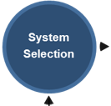
Crack Management
System selection
Headlines
Please use upper and lower case for headlines and subheadlines
Headlines: Arial (bold)
Sub headlines: Arial (not bold)
Bullet List
Bullet points do not necessarily have to be used and can be removed in the “Home" menu bar under the "Bullets" tab.
Font size for
content slides
Please use a consistent font size of 16 pt. for Subheadlines and 14 pt. for body text. For text-heavy slides, a font size of 12 pt. can be used for body text and 14 pt. for Subheadlines.
The minimum size for continuous text should not exceed 12 pts.
Line spacing: 1.1
Spacing between paragraphs: 6 pt.
System Selection
Track record of the technology for expected defect morphologies?
Can I detect ‘critical features’ with the technology?
Will measurement conditions be optimal? Line cleanliness, wall thickness, fluid velocity.
Can supporting technologies assist with feature discrimination? - e.g.
  MFL for identifying low-level corrosion usually associated with certain types of SCC
  UT compression wave for volumetric manufacturing anomalies at the weld (lack of fusion, inclusions)
  Geometry, mapping tools to identify areas of pipe-movement or out-of roundness that could generate additional stress concentrations at the crack

Slide 24

Crack Management
In-line inspection
Headlines
Please use upper and lower case for headlines and subheadlines
Headlines: Arial (bold)
Sub headlines: Arial (not bold)
Bullet List
Bullet points do not necessarily have to be used and can be removed in the “Home" menu bar under the "Bullets" tab.
Font size for
content slides
Please use a consistent font size of 16 pt. for Subheadlines and 14 pt. for body text. For text-heavy slides, a font size of 12 pt. can be used for body text and 14 pt. for Subheadlines.
The minimum size for continuous text should not exceed 12 pts.
Line spacing: 1.1
Spacing between paragraphs: 6 pt.
In-line Inspection
The pre-inspection data review and assessments have built a picture of the threat of cracking to the pipeline (mechanisms, critical sizes, susceptible locations etc.), enabling the most appropriate inspection technology to be selected.
Once the inspection has taken place, the data recorded must be evaluated by data analysts; a complex and time-consuming task.
To maximise efficiency and ensure the inspection findings ‘make sense’ in terms of the knowledge of the cracking threats, integrity engineers work closely with the data analysts to share understanding of:
    Expected cracking types (mechanisms, surface location, etc.)
    Areas of increased susceptibility in which analysts should pay special attention
    Credible defect sizes
    Impact of any data quality issues

Slide 25
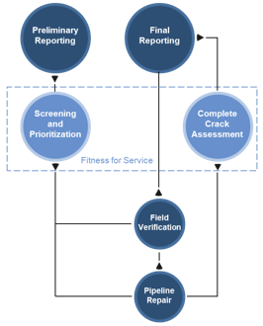
Crack Management
Screening and prioritisation of features
Headlines
Please use upper and lower case for headlines and subheadlines
Headlines: Arial (bold)
Sub headlines: Arial (not bold)
Bullet List
Bullet points do not necessarily have to be used and can be removed in the “Home" menu bar under the "Bullets" tab.
Font size for
content slides
Please use a consistent font size of 16 pt. for Subheadlines and 14 pt. for body text. For text-heavy slides, a font size of 12 pt. can be used for body text and 14 pt. for Subheadlines.
The minimum size for continuous text should not exceed 12 pts.
Line spacing: 1.1
Spacing between paragraphs: 6 pt.
Engineering Critical Assessment
Two key areas drive the assessment process:
  Feature classification:
    what am I trying to assess?
    can it credibly be assessed?
  Materials classification:
    resistance of the materials to fracture.
Both can result in over or under conservatism if incorrectly specified.
Level of knowledge of both aspects is usually limited when cracking is a newly identified threat to the pipeline
    Confidence in the assessment inputs is required to “sentence” a feature, otherwise a prioritisation style approach much be used.

Slide 26
Crack Management
Screening and prioritisation of features
Headlines
Please use upper and lower case for headlines and subheadlines
Headlines: Arial (bold)
Sub headlines: Arial (not bold)
Bullet List
Bullet points do not necessarily have to be used and can be removed in the “Home" menu bar under the "Bullets" tab.
Font size for
content slides
Please use a consistent font size of 16 pt. for Subheadlines and 14 pt. for body text. For text-heavy slides, a font size of 12 pt. can be used for body text and 14 pt. for Subheadlines.
The minimum size for continuous text should not exceed 12 pts.
Line spacing: 1.1
Spacing between paragraphs: 6 pt.
Engineering Critical Assessment – Feature Classification
What are the appropriate assessment model(s)?
    Sharp cracks (e.g. Fracture mechanics models – API 579, BS 7910)
    Blunt planar anomalies (e.g. Pipeline specific empirical models e.g. Batelle)
    Volumetric metal loss (e.g. Pipeline specific models - Mod B31G)
What loading are my features subject to?
What is an appropriate growth model to use to calculate remaining life?
    Fatigue?
    Environmental?
    Both?
    None?
Are the features interacting with other anomaly types (e.g. corrosion, dents)?
Over/under-sizing of features?

Slide 27
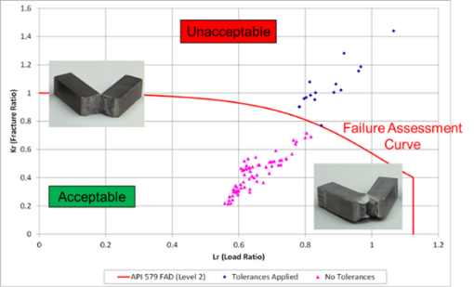
Crack Management
Screening and prioritisation of features
Headlines
Please use upper and lower case for headlines and subheadlines
Headlines: Arial (bold)
Sub headlines: Arial (not bold)
Bullet List
Bullet points do not necessarily have to be used and can be removed in the “Home" menu bar under the "Bullets" tab.
Font size for
content slides
Please use a consistent font size of 16 pt. for Subheadlines and 14 pt. for body text. For text-heavy slides, a font size of 12 pt. can be used for body text and 14 pt. for Subheadlines.
The minimum size for continuous text should not exceed 12 pts.
Line spacing: 1.1
Spacing between paragraphs: 6 pt.
Engineering Critical Assessment – Material Classification
Is the material resistance to failure by brittle fracture understood?
  Ideally fracture toughness (CTOD, Jcrit, J-R)
  Common to have no toughness related information at all
  Charpy Impact Energy is usually the best you can hope for (only inferred toughness – assuming you select an appropriate correlation!)
Many lines are sourced from a number of different pipe-mills, weld types and wall thicknesses – is the data actually representative of the feature locations?
Not mandatory to undertake Charpy or fracture toughness testing in linepipe codes (e.g. API 5L) and lower bound assumptions tend to be over-conservative

Slide 28
Crack Management
Screening and prioritisation of features
Headlines
Please use upper and lower case for headlines and subheadlines
Headlines: Arial (bold)
Sub headlines: Arial (not bold)
Bullet List
Bullet points do not necessarily have to be used and can be removed in the “Home" menu bar under the "Bullets" tab.
Font size for
content slides
Please use a consistent font size of 16 pt. for Subheadlines and 14 pt. for body text. For text-heavy slides, a font size of 12 pt. can be used for body text and 14 pt. for Subheadlines.
The minimum size for continuous text should not exceed 12 pts.
Line spacing: 1.1
Spacing between paragraphs: 6 pt.
Screening and Prioritisation Feedback Loop
Combine all elements into an iterative cycle to remove uncertainty, increase confidence and therefore lower risk.
1. Prioritisation of reported features
2. Target sites for investigation
4. Feedback and refinement
3. Feature Validation
Screening & Prioritisation Loop

Slide 29
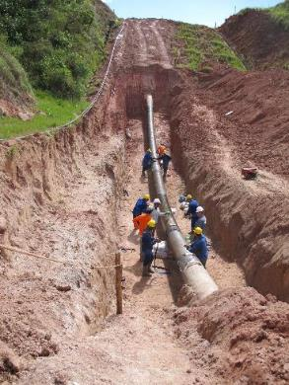
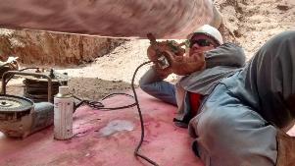
Crack Management
Screening and prioritisation of features
Headlines
Please use upper and lower case for headlines and subheadlines
Headlines: Arial (bold)
Sub headlines: Arial (not bold)
Bullet List
Bullet points do not necessarily have to be used and can be removed in the “Home" menu bar under the "Bullets" tab.
Font size for
content slides
Please use a consistent font size of 16 pt. for Subheadlines and 14 pt. for body text. For text-heavy slides, a font size of 12 pt. can be used for body text and 14 pt. for Subheadlines.
The minimum size for continuous text should not exceed 12 pts.
Line spacing: 1.1
Spacing between paragraphs: 6 pt.
The Feedback Loop – Feature Validation
Key to successful crack management.
    Validation of tool performance (detection, identification and sizing) is crucial in providing confidence in the inspection results.
      API STD 1163 “In-Line Inspection Systems Qualification”
Cost implications for digging mean that site selection is paramount.
Site accessibility is also often a primary driver e.g. at crossing-points.
Three main activity groups:
    Non-Destructive verification
    Destructive verification
    Collection of environmental data (e.g. SCC)

Slide 30
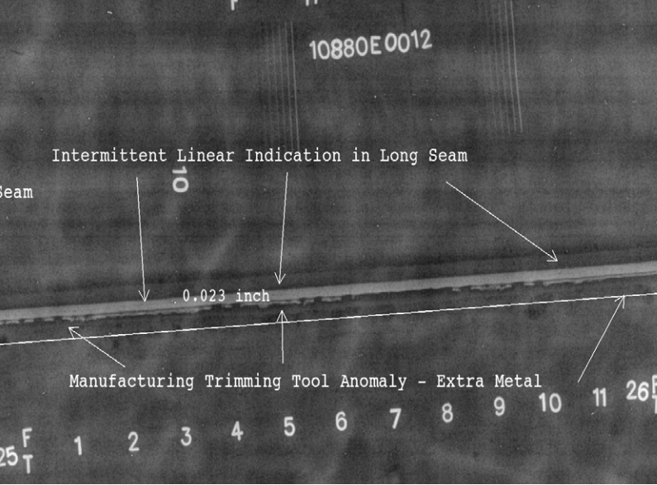
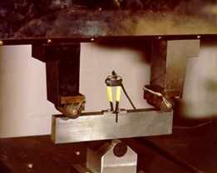
Crack Management
Screening and prioritisation of features
Headlines
Please use upper and lower case for headlines and subheadlines
Headlines: Arial (bold)
Sub headlines: Arial (not bold)
Bullet List
Bullet points do not necessarily have to be used and can be removed in the “Home" menu bar under the "Bullets" tab.
Font size for
content slides
Please use a consistent font size of 16 pt. for Subheadlines and 14 pt. for body text. For text-heavy slides, a font size of 12 pt. can be used for body text and 14 pt. for Subheadlines.
The minimum size for continuous text should not exceed 12 pts.
Line spacing: 1.1
Spacing between paragraphs: 6 pt.
Feature Validation
Primarily validation of ILI feature sizing using external NDT techniques.
  PAUT, TOFD, manual shear-wave, MPI and sometimes radiography most common field applied techniques for pipelines.
  Progressive grinding (destructive) also undertaken to size as well as preventing growth of low-level features.
Can provide some input into feature classification in terms of feature morphology depending on inspection conditions and inspector experience.
NDT OF CRACKING IS NOT THE GROUND TRUTH – NDT requires use of appropriate equipment with well trained operators who understand cracking.
True confidence in feature morphology and growth mechanisms often requires cut-out and laboratory-based metallography of the features, with the benefit of enabling material testing to be performed
    Proactive crack management tip: Consider using MPI over the entire spool during every dig – cracking may be found when least expected.

Slide 31
Crack Management
Management plan
Headlines
Please use upper and lower case for headlines and subheadlines
Headlines: Arial (bold)
Sub headlines: Arial (not bold)
Bullet List
Bullet points do not necessarily have to be used and can be removed in the “Home" menu bar under the "Bullets" tab.
Font size for
content slides
Please use a consistent font size of 16 pt. for Subheadlines and 14 pt. for body text. For text-heavy slides, a font size of 12 pt. can be used for body text and 14 pt. for Subheadlines.
The minimum size for continuous text should not exceed 12 pts.
Line spacing: 1.1
Spacing between paragraphs: 6 pt.
3 in-field repairs
Revise the CDM
Update crack growth and susceptibility Model
13 In-field repairs
Update crack growth and susceptibility Model
2018
2019
REVIEW AND UPDATE PLAN
2020
Hydrotest 8 km section
7 In-field repairs
Material Testing
Data Management System
2021
2022
6 In-field repairs
2 SCC-DA sites
Update crack growth and susceptibility Model
2024
Re-inspection IMU/GEO/MFL/EMAT
Axial Cracking, corrosion, geometry
Pipe movement and Bending strain monitoring
FFP/Risk/Susceptibility Update

Slide 32
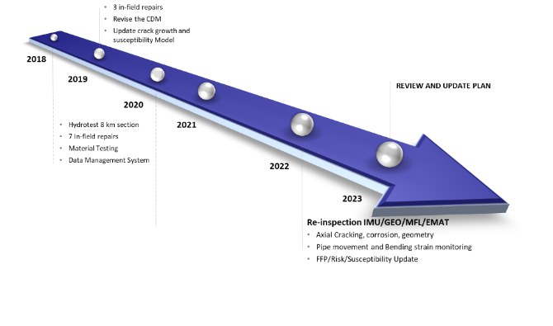
Crack Management
Conclusion
Headlines
Please use upper and lower case for headlines and subheadlines
Headlines: Arial (bold)
Sub headlines: Arial (not bold)
Bullet List
Bullet points do not necessarily have to be used and can be removed in the “Home" menu bar under the "Bullets" tab.
Font size for
content slides
Please use a consistent font size of 16 pt. for Subheadlines and 14 pt. for body text. For text-heavy slides, a font size of 12 pt. can be used for body text and 14 pt. for Subheadlines.
The minimum size for continuous text should not exceed 12 pts.
Line spacing: 1.1
Spacing between paragraphs: 6 pt.
Crack detection ILI tools are constantly progressing in terms of their performance and accuracy
Feature classification still presents a challenge to all crack-detection ILI which presents uncertainty and therefore risk.
Integrity management of cracks is challenging:
  Variety of cracking mechanisms;
  Uncertainties in inspection;
  Uncertainties in assessment – ECA is only a small part of crack management
An integrated multi-discipline approach which links ILI, direct assessment, integrity assessment, root cause and risk is required to increase knowledge and understanding in order to support the ILI.
This enables successful long-term integrity management of the cracking threat

