Slide 1
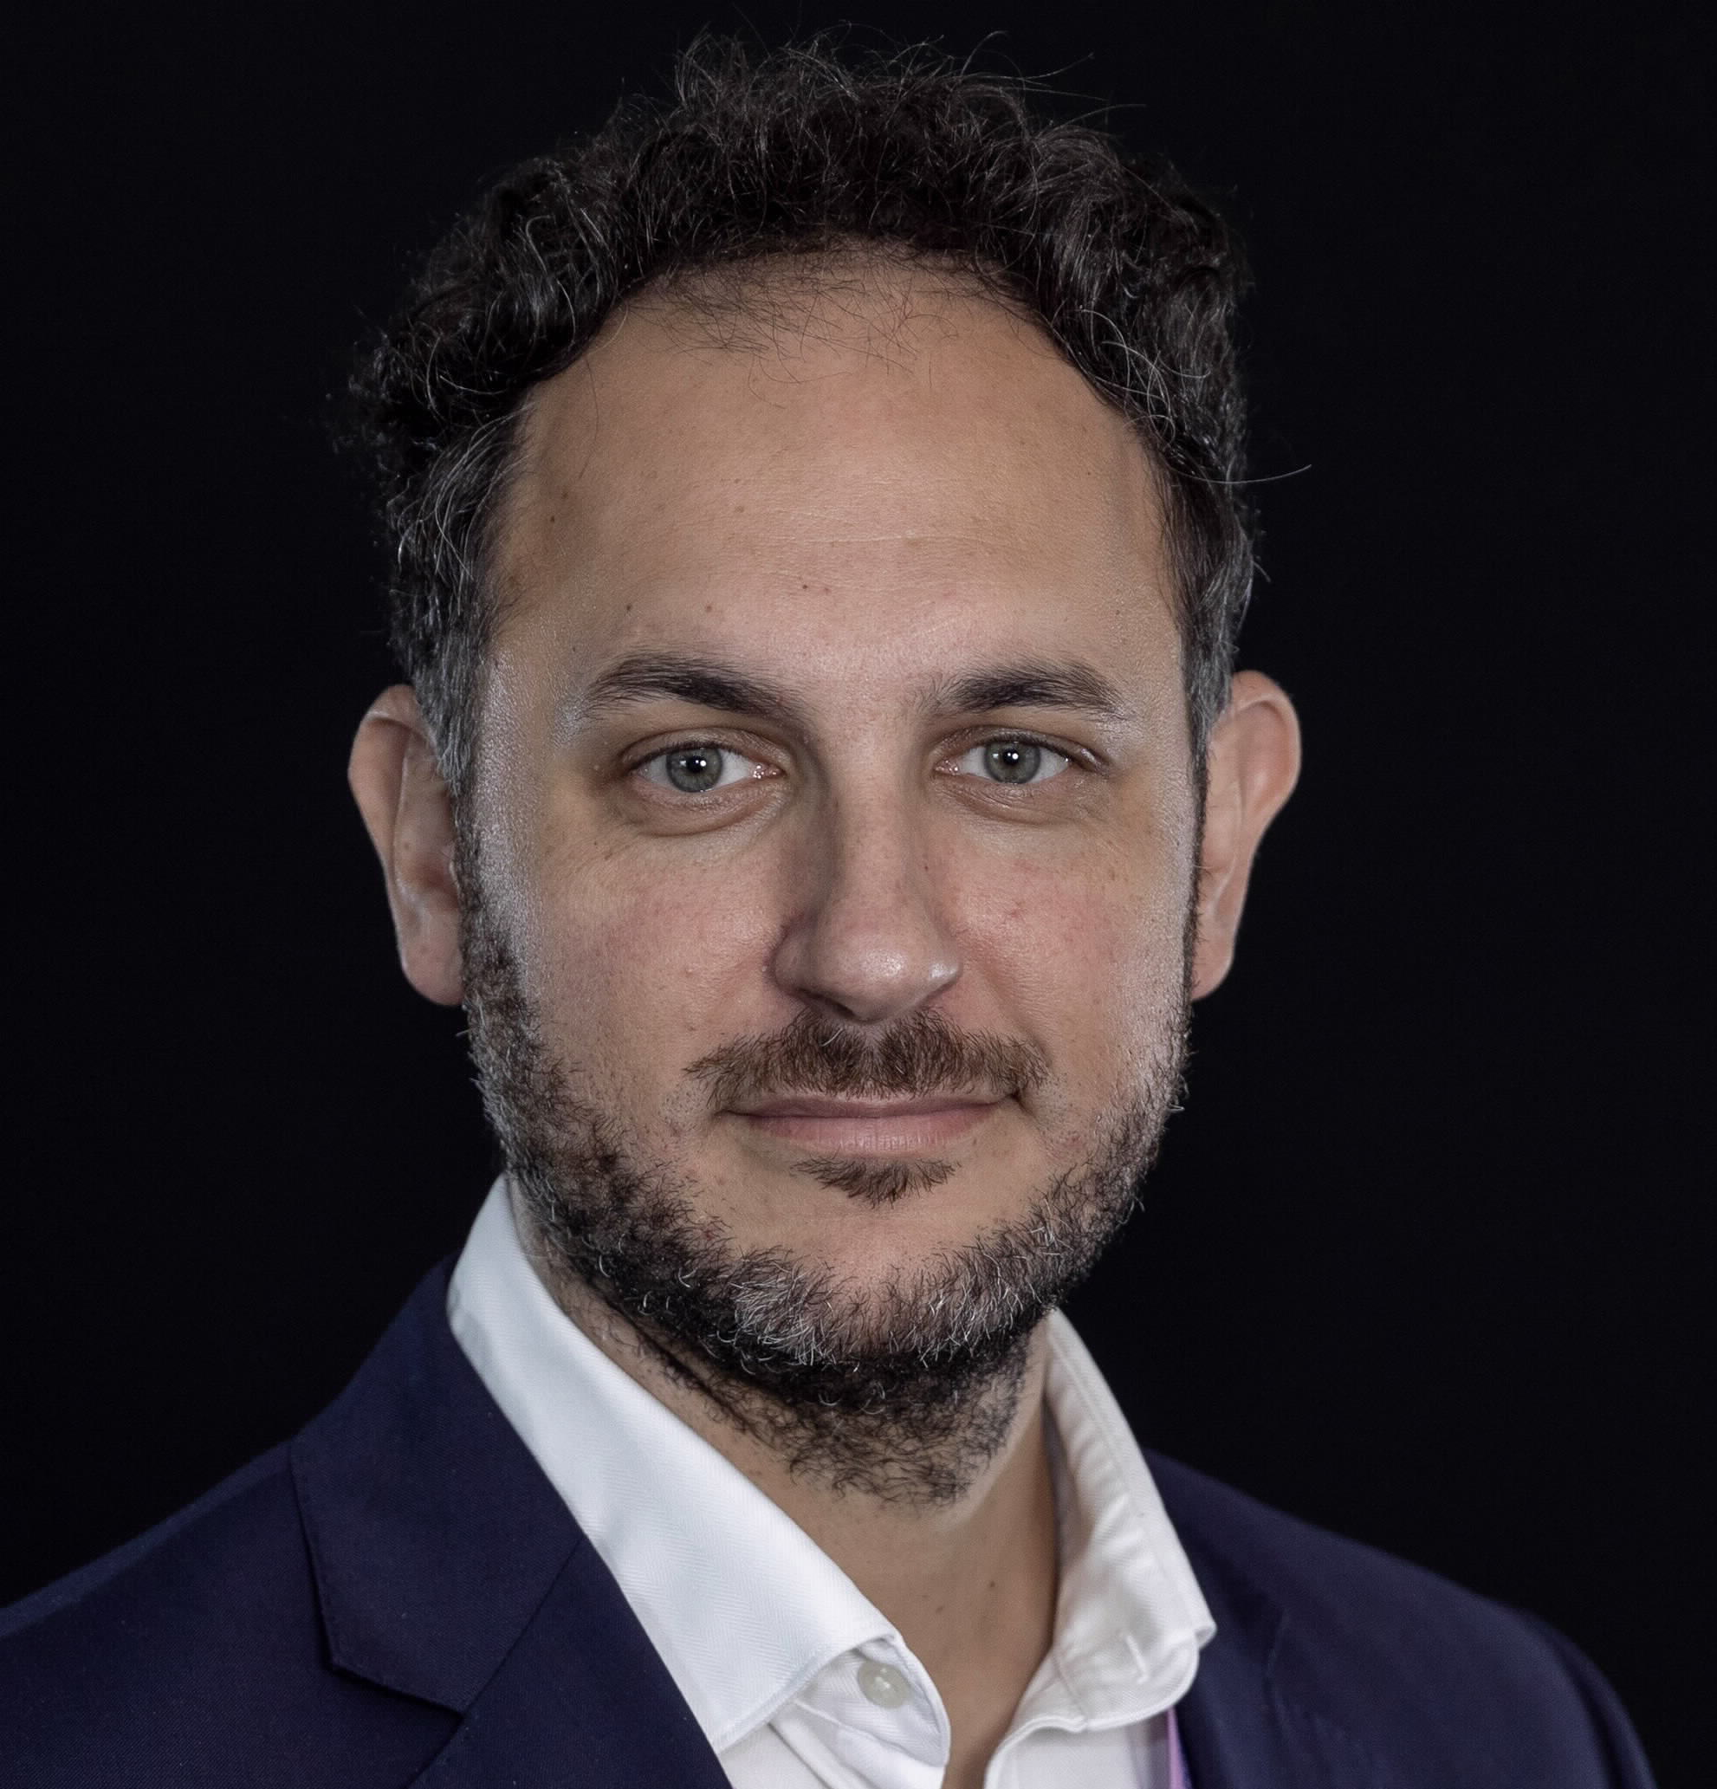
Mark Dragar
General Manager – Asset & Operations Distribution
Jemena
        Mark is a senior leader with broad commercial experience in capital-intensive energy businesses and is currently the General Manager Asset & Operations Gas Distribution at Jemena, and is the Person In Charge, responsible for the safety and integrity of approximately 26,000km of gas mains, servicing 1.4 millions customers.
        Combining his strong technical background and commercial minded approach, Mark looks to implement innovative solutions to traditional problems, focusing on leveraging technology to develop robust life-cycle asset strategies, optimising the trade-off between risk and expenditure to achieve the needs of stakeholders, namely driving customer and business value.
        Mark is formerly a subject matter expert in pipeline integrity and corrosion protection systems, where he has been actively involved in numerous Australian Standards including
        AS/NZS 4645 parts 1, 2 & 3 (Chairman for Part 2)
        AS 2885 parts 1, 3 & 6
        AS/NZS 2832.1
        AS/NZS 4853

Slide 2
AS 2885.3 Seminar
Section 5 – Pipeline System Integrity Management
Presented By – Mark Dragar

Slide 3
Basis of Section
Integrity management is a critical activity to enable a safe and reliable PIPELINE SYSTEM throughout its lifecycle.
Details the requirements for maintaining the PIPELINE SYSTEM in a ‘fit for purpose’ condition.
Key Concepts
Integrity management is plan, do, check, act.
Requirements now established in accordance with PDCA cycle.
PIMP is still the key output NOT the process.
Tighter integration with Sections 6-10.
RLR replaced with FFP assessment

Slide 4
Objective of 2022 Update
SECTION 5 PIPELINE INTEGRITY MANAGEMENT
5.1 BASIS OF SECTION
5.2 PIPELINE INTEGRITY MANAGEMENT PROCESS
5.3 REVIEW OF PIPELINE INTEGRITY MANAGEMENT PLAN (PIMP)
Simplification – removal of circular references and consolidation.
Process focus – improved detail regarding integrity process.
Requirements based – uplift in requirements in supporting sections 6 through 10.
Alignment to system – uplift and focus on PMS and integration with integrity process, including on-going actions.
Fit for purpose – stepping away from remaining life and confirming continued shorter term suitability.
SECTION 5 PIPELINE SYSTEM INTEGRITY MANAGEMENT
5.1 BASIS OF SECTION
5.2 PIPELINE INTEGRITY MANAGEMENT PROCESS
5.3 INTEGRITY MANAGEMENT PLANNING
5.4 EXECUTING INTEGRITY ACTIVITIES
5.5 DELIVERY MONITORING
5.6 FIT FOR PURPOSE ASSESSMENT
5.7 CORRECTIVE ACTION DETERMINATION
Recognised previous and existing RLR and MAOP reviews!

Slide 5
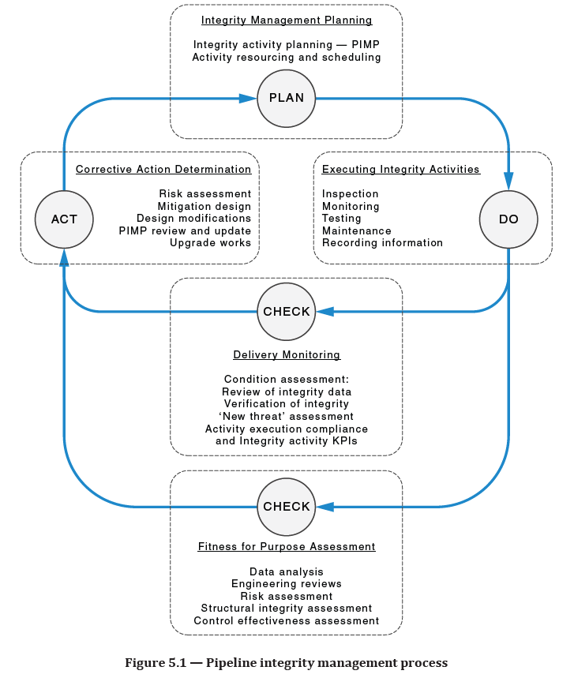
Integrity Management Planning
Key Objective is to:
  Document a PIMP
  Identify the integrity activities to be performed
  Frequency, performance criteria, criticality
  Records to be produced
  Identify resources and equipment
Executing Integrity Activities
Key Objective is to:
  Impacts from restrained delivery to be assessed
  Manage safety and integrity as a result

Slide 6
Delivery Monitoring
Key Objective is to IDENTIFY:
  Deficiency in delivery of integrity activities
  Corrective actions
Fit for Purpose
Key Objective is to DOCUMENT:
  Confirming the PIPELINE SYSTEM can continue operate safely at the MAOP until the next review;
  If that cannot be achieved without corrective actions, detail interim operating strategy and actions; and
  Schedule for the next FFP, not exceeding 10 years.

Slide 7
Corrective Action Determination
Key Objective is to:
  Take action – assessments, modifications or upgrades/downgrades
  Review and re-APPROVAL of PIMP as required but not exceeding 5 year interval

Slide 8
Any Q & A on the horizon?

