Slide 1
AS 2885.3 Seminar
Section 2 Pipeline Management System (PMS)
Presented By – Jeff Jones

Slide 2
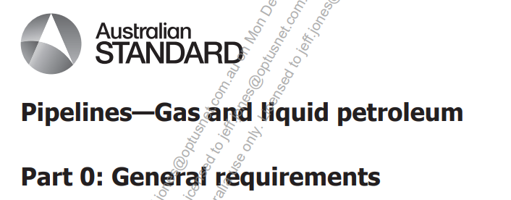
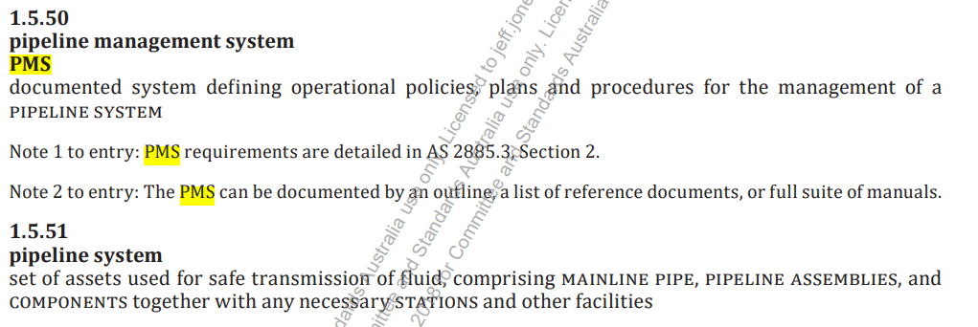
AS 2885.0: 2018
Section 1.5 Terms & Definitions

Slide 3
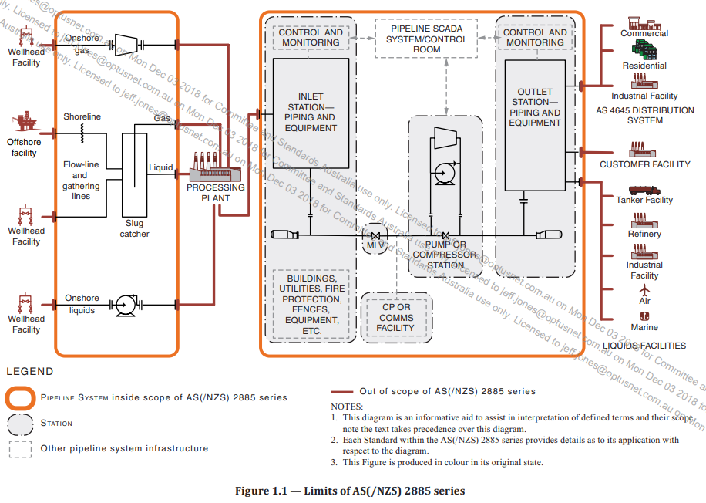

Slide 4




AS 2885 Suite
Use of Terms & Abbreviations – PMS & PIMP
TERM | Part 0 2018 | Part 1 2018 | Part 3 2012 2022 | Part 3 2022 | Part 6 2018
PMS | 3 +Abb | - | - | 78 | 6 +Abb
Pipeline Management System | 5 | 11 | 79 | 4 | 16
PIMP | - | - | 31 +Abb | 69 | 2 +Abb
Pipeline Integrity Management Plan | 1 | 4 | 9 | 3 | 4
TOTAL | 9 | 15 | 119 | 154 | 28

Slide 5
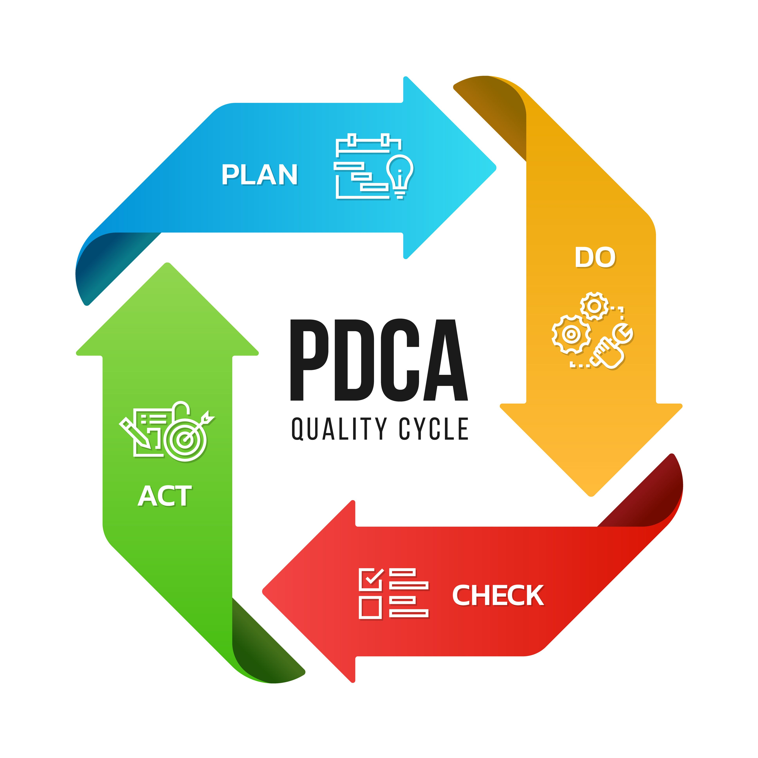
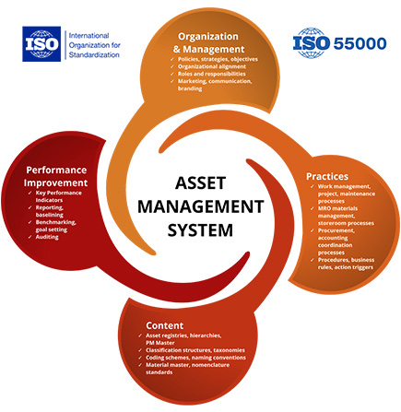
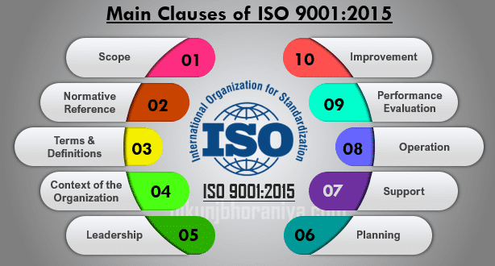
Basis of Section
  A “management system” is necessary for O&M
  Details key requirements; APPROVED, in place before COMMISSIONING & for full life-cycle
  PIPELINE SYSTEM; fit-for-purpose condition
  78 references to PMS requirements in Part 3-2022
Key Concepts
  PMS must detail LICENSEE’s approach
  Note 1 – can embed “PMS” in corporate systems & structure documentation to suit, providing full intent is satisfied eg AMS, Safety Case (App C)
  Structure flexible, shall conform to PMS Elements
    General
    Management
    Planning
    Measurement & Evaluation
    Consultation, communication and reporting
    Implementation => ie inherent in Sections 3-12

Slide 6



Objectives of 2022 Update
  More contemporary approach to Management System/s, with increased Licensee flexibility
  New policy commitments – Process safety management, Legal & Regulatory requirements
  Change management – refers to Part 0 with specific O&M triggers (a) to (h). Note re Design Changes per Section 10.
  Review of PMS – every 2 5 years or change trigger
Planning for normal Operation
  Preparation for Operation of new or re-commissioned PIPELINE SYSTEMS => Section 3
  Identification of OH&S & Env Hazards & risk mitigation => Section 4 prior to any activity
  Identification of threats & risk mitigation to PIPEINE SYSTEM integrity => Sections 6,7,8
Planning & preparation for abnormal Operation
  Plan & prepare per examples (a) to (e)
Planning: Isolation Plan per AS2885.1 – review 5 years
Planning: Identify process for managing emergency events (Section 11) & managing records (Section 12)
Measurement & Evaluation: process for Audits
  Note – AS/NZS ISO 9001 & ISO 19011 auditing guidance

Slide 7
Legislative “PMS” & Audit Requirements Requirements
STATE | LEGISLATION – ACT/REGULATIONS | PLAN / AUDIT DELIVERABLE
Vic | Pipelines Act 2005 Pipelines Regulations 2017 -> refers to AS2885 1&3 | Operated in accordance with Part 3 (= PMS) & SMP. Surveillance reports to be submitted to the Regulator
NSW | Pipelines Act 1967 Pipelines Regulation 2023 –> refers to AS2885 | External Auditor to conduct a periodic audit (certification) of the Pipeline Management System
ACT | Gas Safety and Network Operation Code 2021 -> Refers to AS2885 | Conformance with AS 2885.3 and approved PMS. 5-year audit plan and periodic audit by approved auditor
WA | Petroleum Pipelines Act 1969 Petroleum Pipelines Regulations 2010 -> nominate Std | Requires a pipeline Safety Management System. Must provide for auditing of the operation
QLD | Queensland Petroleum and Gas (Production and Safety) Act 2004 & P&G Regulations 2018 | Operator to implement and maintain a Safety Management Plan. External Audit typically by RSHQ.
NT | Energy Pipeline Act 1981 Energy Pipelines Regulations 2001 -> ref to AS2885.1 | Requires a Pipeline Management Plan to be submitted. Must include arrangements for auditing the PMP.
SA | Petroleum and Geothermal Energy Act 2000 Petroleum and Geothermal Energy Regulations 2013 | O&M carried out in accordance with AS2885 Annuakl report including system audits undertaken
Tas | Tasmanian Gas Pipelines Act 2014 -> refers AS2885 | Requires a Facility Safety Case Written audit reports of FSC to be retained

Slide 8
PMS – Examples....

Slide 9
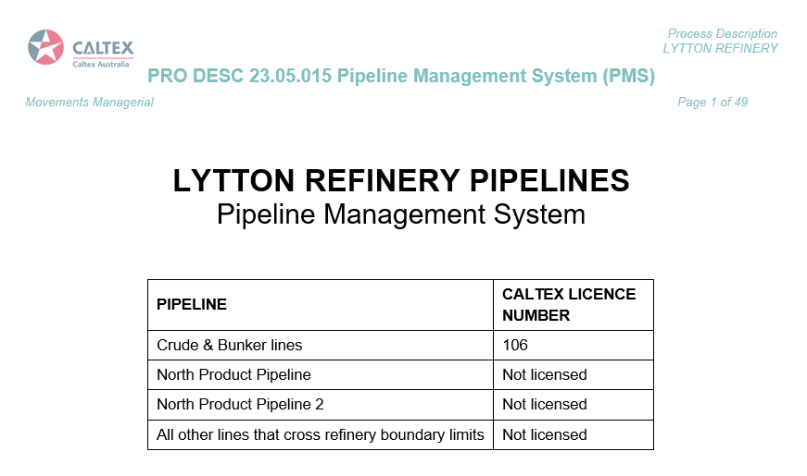

Slide 10
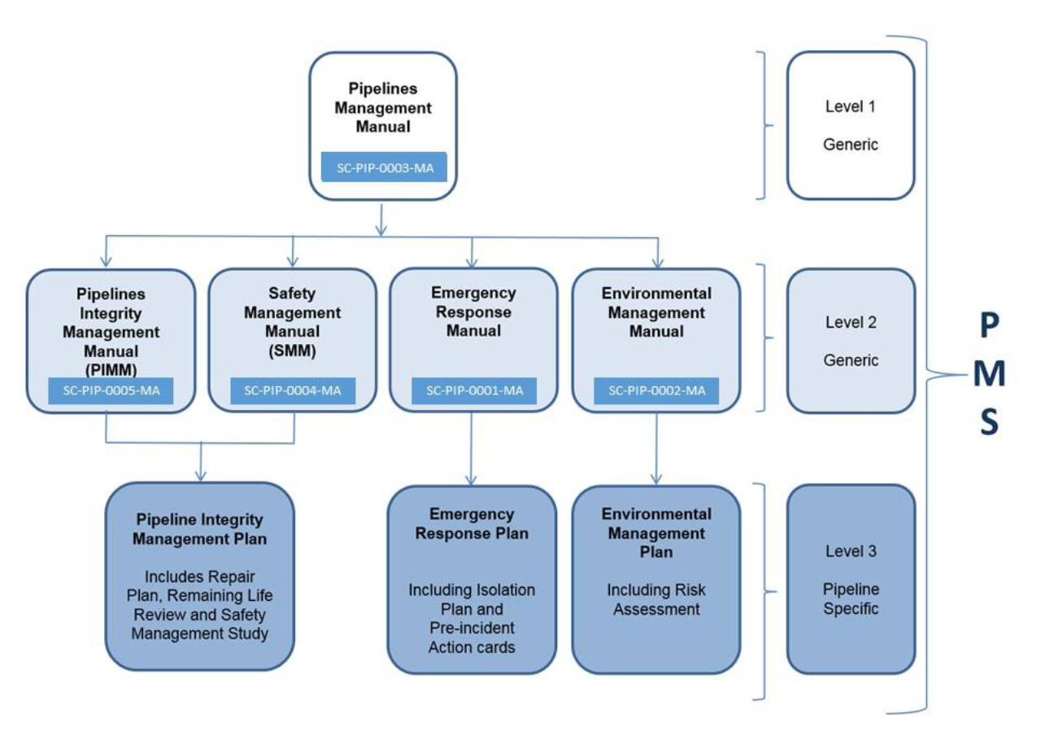
Example PMS Framework – 3 x Tier approach

Slide 11
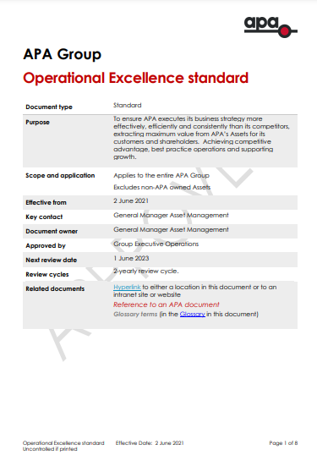
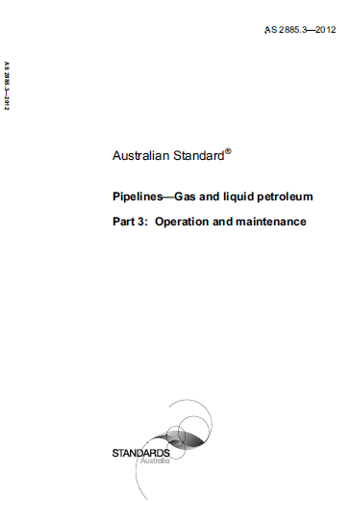
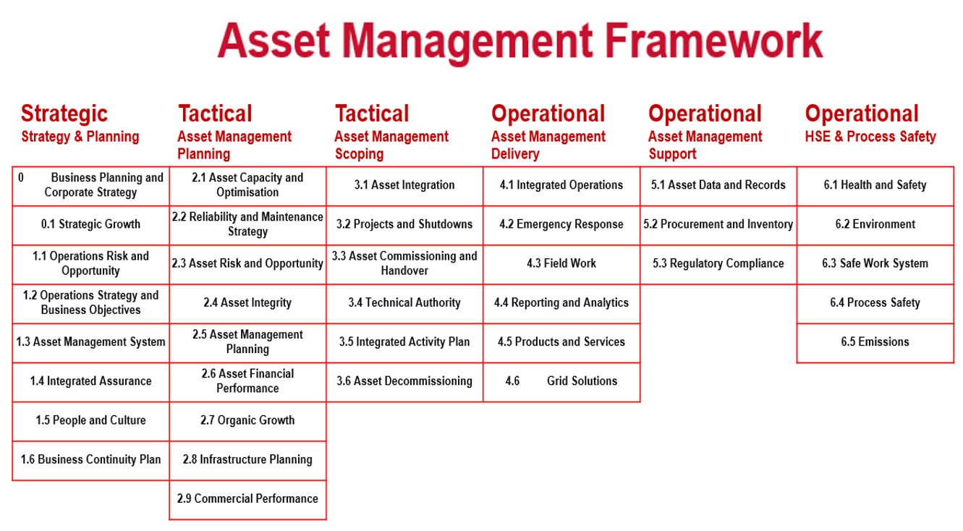
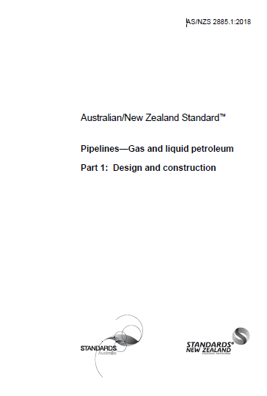
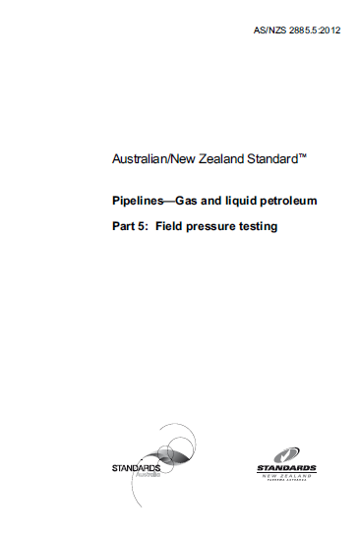
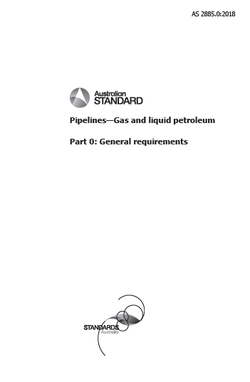
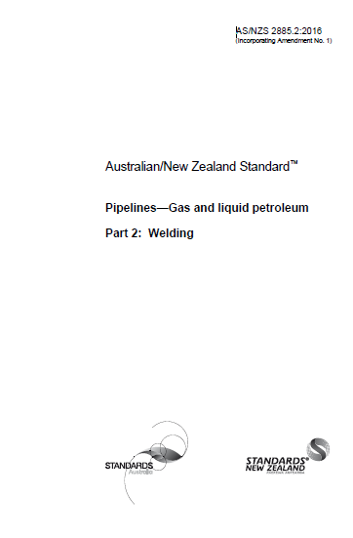
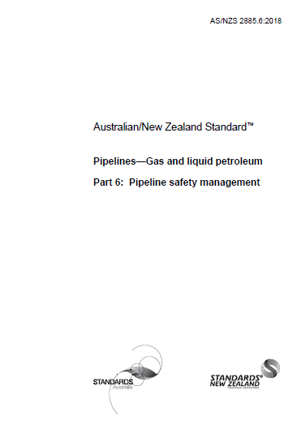
AS2885 Part 3: 2022
Pipeline Management System
requirements
PMS requirements
AMF integration
AS2885 (all parts) obligations
AS(NZS) 2885
Pipelines - Gas and liquid petroleum
Example PMS Framework – an Asset Management Framework under an Operational Excellence standard

Slide 12
Pipeline Management System: “devil in the detail”
Approvals Structure
Policies & Standards
Acts & Regulations
APA Policies & Standards
Acts & Regulations
Pipeline Integrity
Mgt Systems
eg Health & safety, Compliance Register, Action Tracking
Asset Management Framework
AS/NZ Standards etc…
APA Mgt Systems
eg HSEMS / Safeguard
AS/NZ Standards etc…
Safety Cases
Pipeline Mgt Plans
Pipeline system integrity management
Pipeline structural integrity
Anomaly assessment and defect repair
External interference management
Preparation for operation
Station operation and maintenance
Site safety management
Emergency response preparedness
Changes to approved operating conditions
Records management
Maintenance Regimes
Job Plans
Operational Procedures
Projects

Slide 13
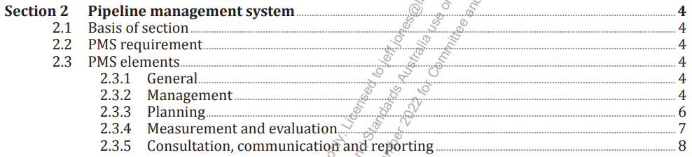
Section 2 Pipeline Management System (PMS)

