Slide 1
High-pressure Hydrogen Pipeline Systems
The status quo and the new Code of Practice

Slide 2
It all begins with…
AS(/NZS) 2885…

Slide 3
AS(/NZS) 2885 series Standards are not intended to prohibit the use of any materials, designs, methods of assembly, procedures or practices (items) that do not conform with specific requirements of the AS(/NZS) 2885 series, or are not mentioned in it, but do give equivalent or better results to those specified.
High Pressure Hydrogen Pipeline Systems

Slide 4
The Licensee shall ensure the suitability of the item is determined against the fundamental principles of the AS(/NZS) 2885 series, and any additional requirements (including technical, quality, procedural, safety, maintenance) needed to satisfy the fundamental principles shall be developed. Prior to the item being used it shall be approved.
What “fundamental principles” ?
High Pressure Hydrogen Pipeline Systems

Slide 5
Design is finding solutions
Function
Storage capacity
Energy delivery capacity
Dysfunction
Plastic collapse, Fracture, Fatigue, Impact, Ground-movement, Flotation, Corrosion, Erosion, Internal blockage, etc. etc.
Design solution
Diameter, MAOP,
Pressure cycling
Design solution
Strength, Toughness, Thickness, Cathodic protection, Coating, etc. etc.
Design for function
Design against dysfunction
High Pressure Hydrogen Pipeline Systems

Slide 6
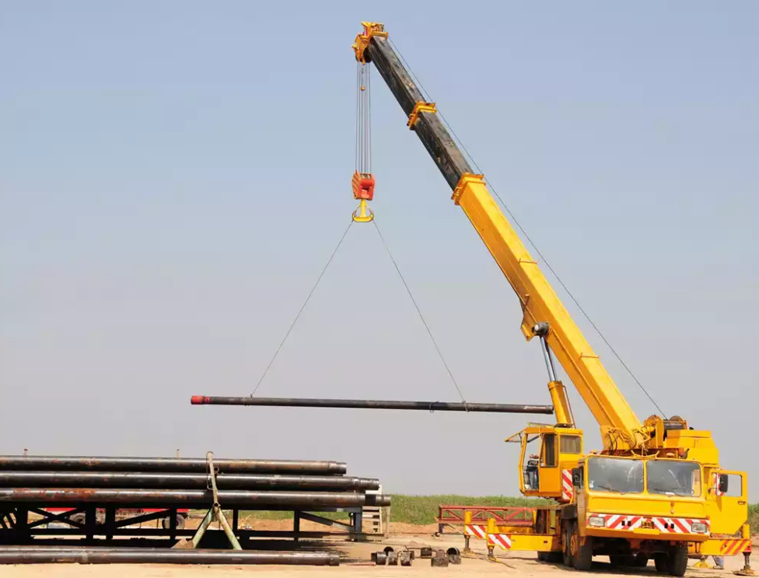
Design for function
AS 2885:
Doesn’t say much about function…
DESIGN CAPACITY
(but the new code of practice does)
LOAD
High Pressure Hydrogen Pipeline Systems

Slide 7
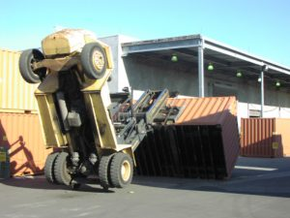
Design against dysfunction
AS 2885:
Provides methods to determine design capacity, and
Is a repository of industry ‘best-practice’ methods.
DESIGN CAPACITY
BUT not all dysfunction can be “solved”.
Events that exceed the design capacity will always be possible.
THREAT
High Pressure Hydrogen Pipeline Systems

Slide 8
Fundamental principles…
“Residual” risk

Slide 9
Solving problems managing “residual” risk
Minimal risk (ALARP)
Acceptable risk (individual, societal, environmental)
High Pressure Hydrogen Pipeline Systems

Slide 10
Incident sequence
Cause
Threat controls
Material properties
Failure Mode
Design controls
Gas properties
Effect
Mitigation controls
Consequence
H2-affected inputs
Fault sequence
Responsive actions
High Pressure Hydrogen Pipeline Systems

Slide 11
Hydrogen service is different to natural gas
Gas properties
Material properties
Lower energy density
(1/3 x nat. gas)
Lower toughness
(e.g. to ~55 MPa(m)^{0.5})
Higher volumetric flow
(3x nat. gas)
Higher fatigue rate
(e.g. 1/10x fatigue life)
Lower ignition energy
(more auto-ignition)
Lower ductility
(though generally post-necking)
Higher flame-speed
(more explosion harm)
+ Other adverse effects on other materials
High Pressure Hydrogen Pipeline Systems

Slide 12
Changes to gas properties…
Design for function
When a leak occurs…

Slide 13
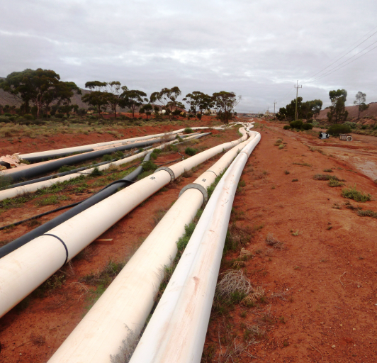
Design for function
At the same pressure…
Energy storage capacity… approx. 1/3rd of NG for same volume/pressure
Energy flow capacity… approx. same as NG, though requires higher velocity
(But a design may not be permitted to operate at the same pressure)
NOTE:
For blended pipelines, the worst energy flow rate is not 100% NG, nor 100% H₂.
The lowest energy flowrate would typically occur at about 80% H₂ (20% NG).
High Pressure Hydrogen Pipeline Systems

Slide 14

When a leak occurs…
Initially…
Dispersed cloud size… larger,
Ignition becomes much more likely
Energy release rate… approximately the same as NG (1/3x and 3x cancel each other out)
High Pressure Hydrogen Pipeline Systems

Slide 15
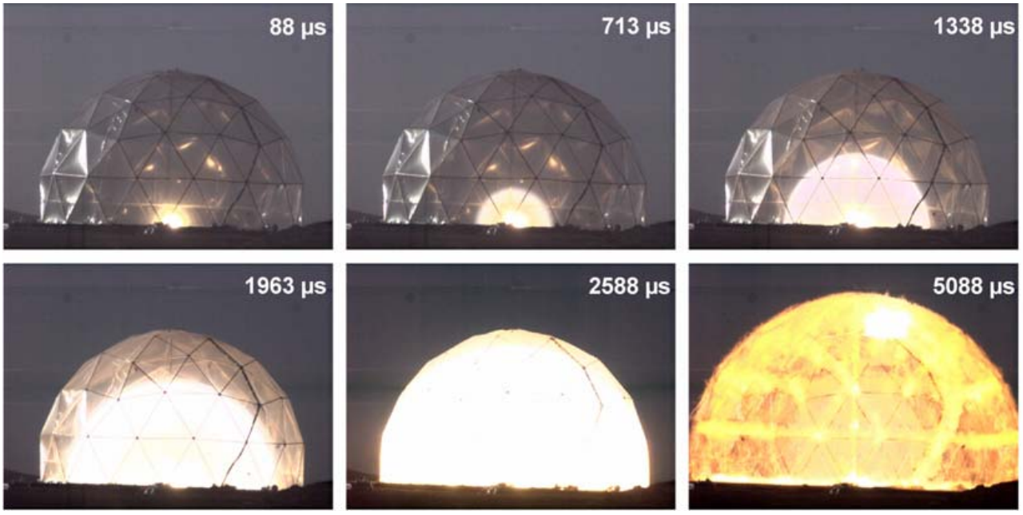
When a leak occurs…
Higher flame-speed also means…
Greater potential harm from over-pressure waves
Depends on ‘delayed ignition’ potential, which seems unlikely
Q: What is detonation?
A: A speed-of-sound explosion that occurs if the over-pressure wave ahead of the flame-front becomes hot enough for auto-ignition.
High Pressure Hydrogen Pipeline Systems

Slide 16
Changes to material properties…
Toughness
Fatigue crack growth

Slide 17

Importance of material property changes - toughness
What it is:
When a pipe fails, the difference between rupture (“burst”) and leak is affected by toughness.
‘Hydrogen embrittlement’ may mean rupture occurs when it previously would not have.
Hence, toughness affects:
Safety management – the “critical defect length” reduces!
“No rupture” determinations
Fitness for service assessments of sharp defects (e.g. SCC)
Hydrotest effectiveness. Is it still a proof test?
High Pressure Hydrogen Pipeline Systems

Slide 18
Importance of material property changes - toughness
Measuring the toughness… what a ride!
Historical Charpy testing – not suitable, cannot be done in hydrogen
ASME B31.12 – endorsed AS1681, also not suitable
    Loaded before charging, hence non-conservative
    Designed for sub-critical growth, which doesn’t generally occur in H2-gas
    55 MPa(m)^{0.5} is a low bar, equivalent to about 1.2J Charpy!
ASTM1820 – tensile toughness test
    Provides J-R curve
    But, single-variable representation is most commonly reported (K_{IC}, J_{IC}, δ)
    And single-variable removes data, and underestimates total resistance to fracture
So… we must use complex ductile tearing analysis, or conservative assumptions!
High Pressure Hydrogen Pipeline Systems

Slide 19
Importance of material property changes - toughness
DAMAGE
How bad is it?
Toughness is not the only factor! Reduced stress design.
Current evidence: hydrogen is an equalizer.
Effect reduces at low partial pressures, though difficult to account for, with…
No predictive models ☹.
Size &
sharpness
Failure mode factors
PRESSURE
Hoop stress
Decompression
FLUID
Toughness
& Strength
MATERIAL
High Pressure Hydrogen Pipeline Systems

Slide 20
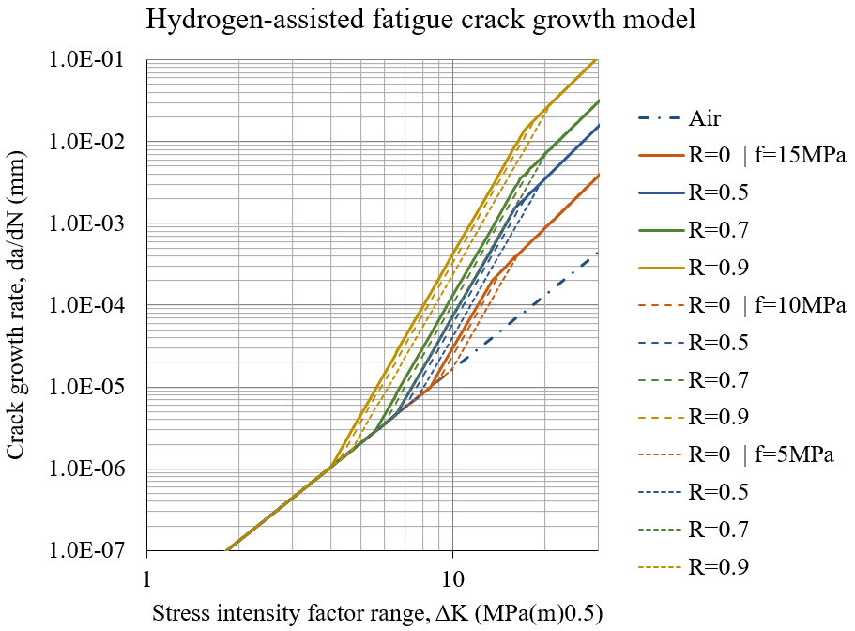
Importance of material property changes – fatigue growth
What is it?
The growth rate of existing cracks is accelerated in the presence of hydrogen!
In this case, good predictive models exist ☺ e.g. SANDIA (ASME CC2938) and
NIST (ASME B31.12).
High Pressure Hydrogen Pipeline Systems

Slide 21
Importance of material property changes – fatigue growth
Fatigue life affects:
Most concerning/pertinent for gas storage applications.
Complex analysis is required:
  Initial defect size?
  Final defect condition?
  Use outside the models’ calibrated parameters.
There are mitigating factors that can’t be accommodated in analysis (e.g. crack rounding from hydrotest, internal vs external, etc.)
Q: Does concentration matter?
A: Not directly. For material effects, the partial pressure matters.
AND the effects of H₂ become apparent even at low partial pressures.
High Pressure Hydrogen Pipeline Systems

Slide 22
So, about the code of practice…

Slide 23
Integrating into the “fundamental principles”
Cause
Threat controls
Material properties
Failure Mode
Design controls
Gas properties
Effect
Mitigation controls
Consequence
H2-affected inputs
Fault sequence
Responsive actions
High Pressure Hydrogen Pipeline Systems

Slide 24
Example: excavator strike
Excavator hit
Marker signs and tape
Decreased toughness (HE)
Pipe burst
Wall thickness and toughness
Increased ignition frequency
Ignited leak
Automatic line-break valves
1 burn injury
H2-affected inputs
Fault sequence
Responsive actions
High Pressure Hydrogen Pipeline Systems

Slide 25
The Code of Practice!
Developed by FFCRC, with GPA leading the project execution
Addresses both function and dysfunction
Addresses a lot more than this presentation has!
Provides methods for analysis, broad assumptions, guidelines for material testing, and commentary
Matches/complements the performance-based standardization of AS/NZS 2885
But is NOT a standard
Hasn’t yet been published…
High Pressure Hydrogen Pipeline Systems

