Slide 1

Michael Jarosz
        Michael has over 15 years experience in the oil and gas pipeline industry with both SEA Gas and the SA technical regulator. He is a chartered mechanical and oil and gas pipeline engineer and a member of both the ME38.1 and ME38.3 Australian Standard sub-committees. He also holds an AMPP (formerly NACE) CP2 (technician) certificate.
        Michael’s technical experience is in pipeline integrity and risk assessment, with a focus on cathodic protection and corrosion mitigation, pipeline inspection, assessment and repair as well as pipeline corridor management. He was a key contributor to SEA Gas being awarded the 2022 APGA Safety Award for work on Planning Policy Changes in South Australia pertaining to development around high-pressure gas pipelines.
Senior Pipeline Engineer
SEA Gas

Slide 2
AS 2885.3 Seminar
Section 11 – Emergency Response
Presented by Michael Jarosz

Slide 3
Section 11 – Emergency Response
Scope
  Requirements for emergency preparation and response to enable such events to be conducted in a coordinated and safe manner
Key Concepts
  Emergency Planning
  Emergency Response Plan and Procedures
  Regular liaison with emergency services
  Communicating during emergency response
Objectives of 2022 Update
  Clarify wording
  Link to SMS
  Add new requirements and additional guidance

Slide 4
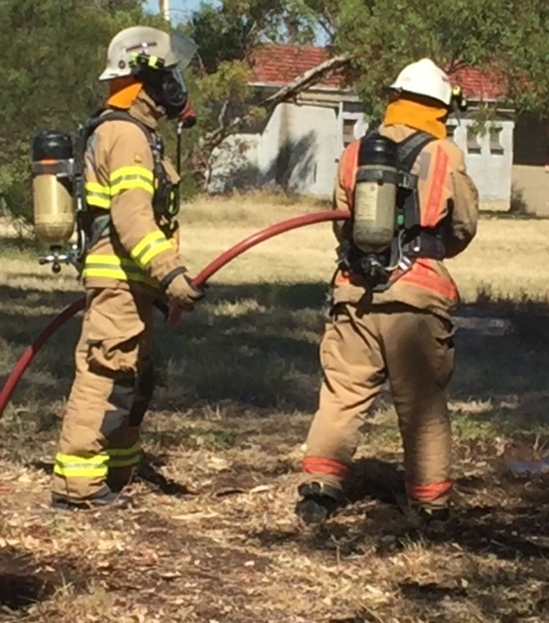
Emergency Planning and the ERP
  Loss of containment
  Full bore rupture
  Fires
  Natural events
  Failure events identified by SMS where ERP provides consequence mitigation
  Review requirements
Notes:
This section of the standard details the requirements for emergency preparation and response to enable such events to be conducted in a coordinated manner
ERP Shall be developed and implemented sha shall address….
Review requirements spelled out a bit more clearly…..
- 2 years or in responses to exercise debriefs, incident reviews, or updates to the SMS that are relevant to emergency response. If changes are required, it shall be revised and approved.

Slide 5
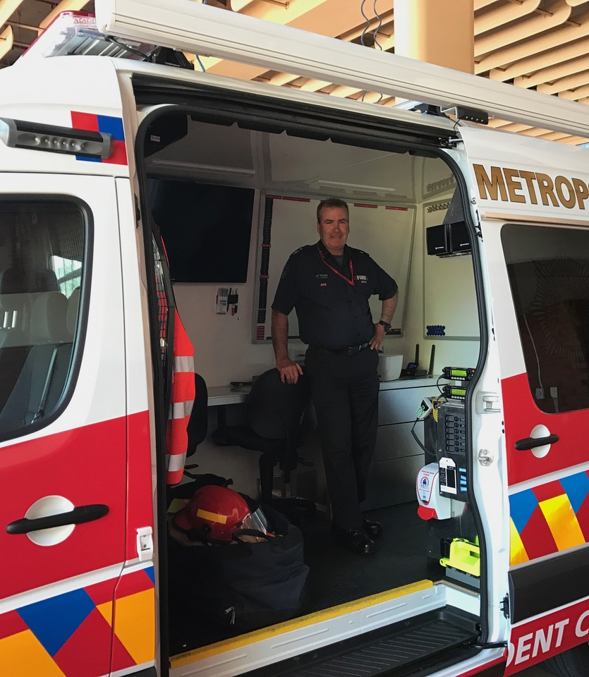
ERP requirements
ERP shall address
  Emergency command, controls and communications
  Safety of public and personnel
  Coordination with key stakeholders, such as emergency services.
  Recovery and restoration of operations.
  Protection and remediation of the environment.
  Training and competency of emergency response personnel.
  Fluid characteristics and toxicity.
  Measurement length and fluid release consequences data.
  Isolation, shutdown and recovery, including limitations and consequences together with effects of venting and purging.
  Equipment required for emergency response
  Emergency exercises and their frequency
  Maintenance or curtailment of supply

Slide 6

Supporting Procedures
Procedures shall address:
  Maintaining an up-to-date contact list of pipeline personnel / stakeholders.
  Provision of 24-hour emergency contact
  Establishment of emergency control center.
  Securing the site
  Prompt and expedient action to prevent escalation.
  Minimization of the extent of environmental damage
  Reduction of the pressure in the pipeline.
  Liaising with stakeholders (e.g. regulatory authorities, emergency services, etc.)
  Performing exercises that simulate the emergency event
  Having emergency equipment and pipe and fittings available (MDR)
  Expeditious transport of equipment, materials and personnel to site.
  Recovery from the emergency (supply and restoration of damage)
  Training of personnel, contractors and emergency services
  Relevant details from the isolation plan (e.g. location of isolation valves, response time).
Notes:
Point 1 used to say availability..
Maintaining an up-to-date contact list of pipeline personnel, contractors, relevant emergency services and key stakeholders.
Provision of 24-hour emergency contact, and establishment of emergency control centre.
Securing the site to make it safe for personnel and allow for evacuation, exclusion, and rescue operations if necessary.
Prompt and expedient action to prevent escalation of the emergency event.
Minimization of the extent of environmental damage, including the safe disposal of any discharged fluid.
Reduction of the pressure in the pipeline.
Liaising with regulatory authorities, emergency services, media, landholders
Performing exercises, regular intervals to determine adequacy and testing of ERP
Having emergency equipment and pipe and fittings, fit for the intended purpose and readily available at all times, complete with traceable material test certificates.
Expeditious transport of repair equipment, materials and personnel to the site.
Recovery from the emergency, including restoration of supply and remediation of damage to property and the environment.
Training of personnel, contractors and emergency services required to implement the plan, including any specific actions required to safely and effectively manage the emergency event.
Relevant details from the isolation plan to assist personnel and emergency services required to implement inventory isolation and control as part of emergency response plan, such as the location of isolation valves, method of actuation, and indicative response time for operational response to each valve.

Slide 7
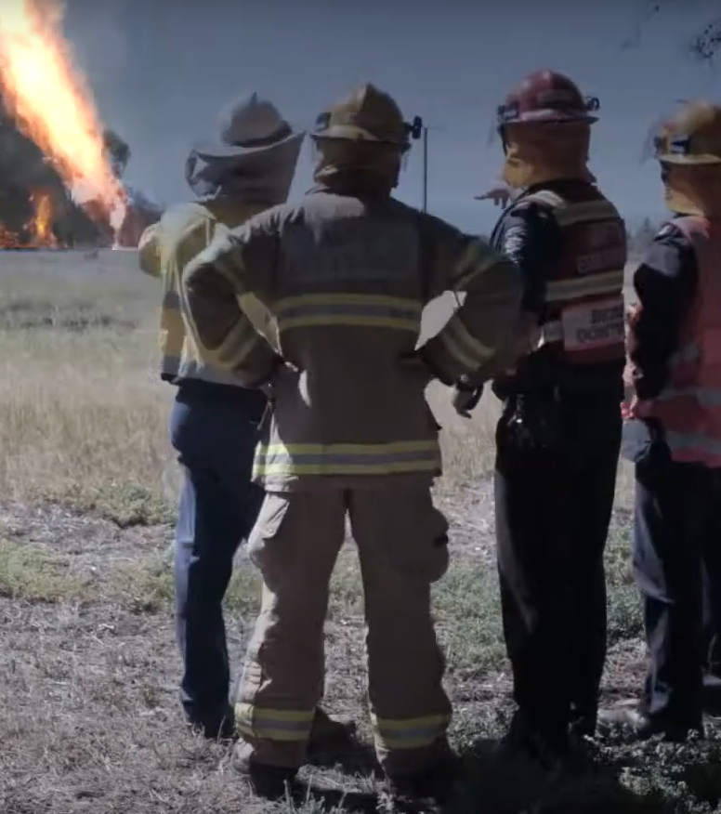
Liaison with Emergency services
Processes shall be in place to identify relevant agencies
New clause outlining mandatory information to be given to emergency services / environmental agencies on a regular basis
  Location of the Pipeline System
  Fluid characteristics
  Potential impact of failure
  Methods for recognizing threats
  Appropriate emergency response
  Contact information for pipeline operator, including 24-hour number
Notes:
New guidance material
Fluid characteristics – flammability toxicity etc, (eg given are CO2 and HVPL)
Potential; impacts – thermal radiation contours for credible threats

Slide 8
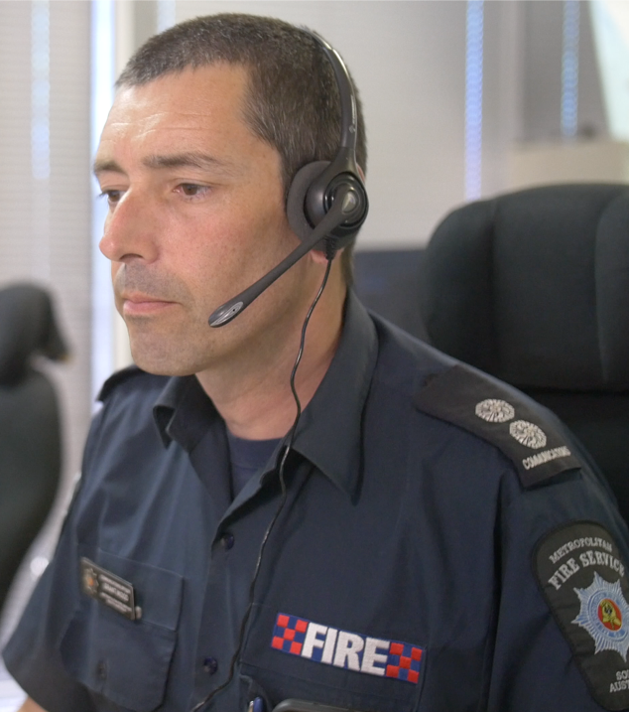
Communicating During Emergency Response
In the event of emergency, responders and emergency response personnel shall be briefed
New clause outlining mandatory information to be given to emergency services during an emergency
  Nature of the event
  Credible worst case
  Other credible consequences
  Remediation steps proposed
  Properties of fluid, radiation contours, etc.
  Responders to be kept up to date
  JHA requirements
  Mitigative measures to minimize impact on public and environment

Slide 9
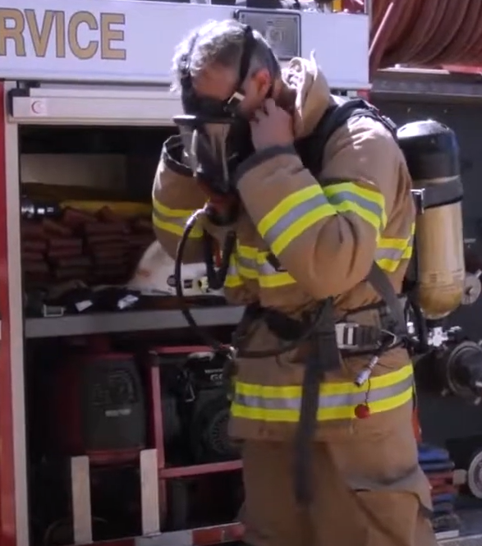
Objectives of the 2022 Update
  Minor improvements to wording for existing requirements
  Improve information required in ERP, including fluid properties and consequence zones, isolation plan
  Link back to the SMS
  Specify information required to be given to emergency response personnel
  Consistency with standard practice in other hazardous industries (e.g. MHF Regulations)
Notes:
Any additional notes here…
Consistency with good existing practice
MHF regulations -

Slide 10
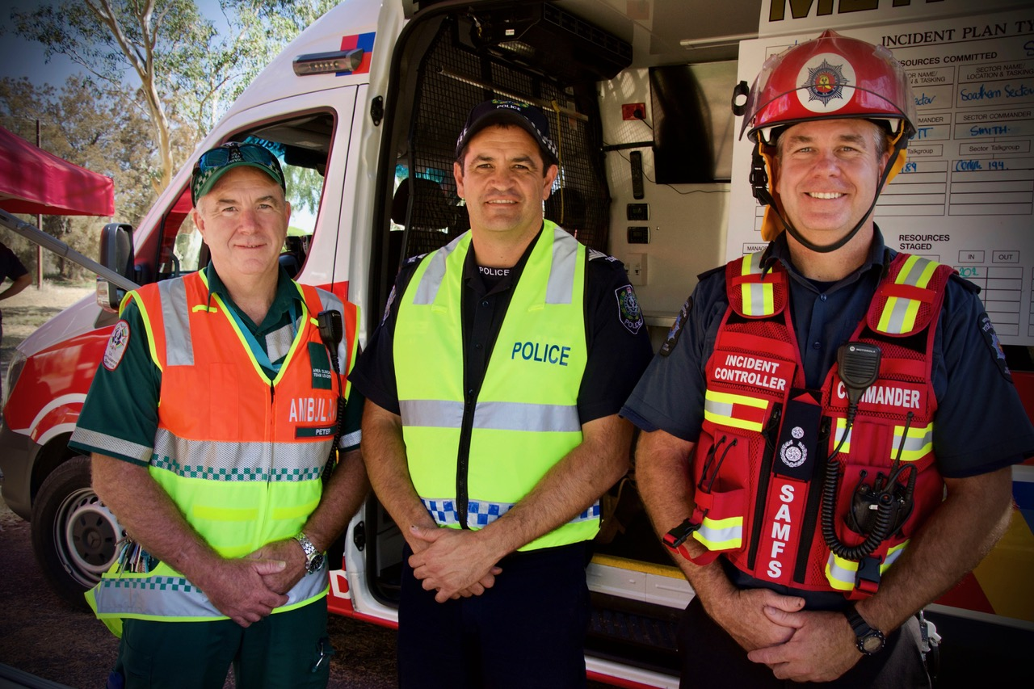
Questions

