Slide 1
Alan Creffield
Integrity Manager
APA Group
Alan is an experienced leader within the oil and gas industry. With over 15 years of experience, working for various operators, Alan currently is the Integrity Manager with APA Group.
He has experience with all things integrity – project delivery, In Line Inspections, pipeline repairs, cathodic protection and risk management.
Alan now leads a team of 20 that has overall accountability for SMS delivery, pipeline integrity, facility integrity, corrosion engineering and 3rd Party Projects.

Slide 2
AS 2885.3 Seminar
Section 6
Presented By - Alan Creffield

Slide 3
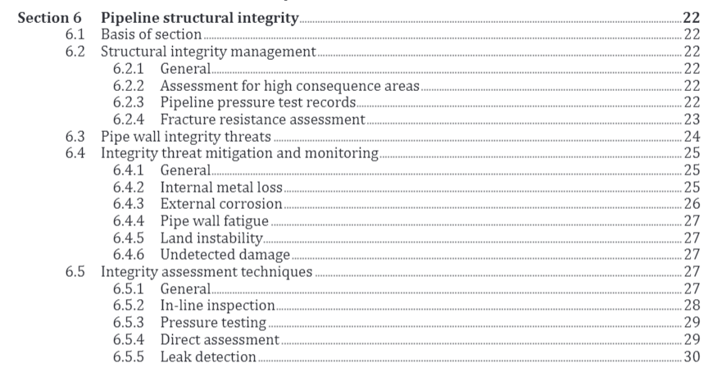
Section 6 – Pipeline Structural Integrity
Basis of section: controlling structural integrity threats to the MAINLINE PIPE and PIPELINE ASSEMBLIES
Integrity threats identified in SMS (AS2885.6)
Outlines common integrity threats and details respective controls
Defect assessment in Section 9
Addresses gaps from vintage pipelines (no hydro, no FCP)

Slide 4
Key changes to Section 6
High Consequence Area assessment (no rupture and energy release rate) (6.2.2)
Engineering Assessments for Pipelines without hydrotest (6.2.3)
Fracture Resistance Assessments for pipelines that do not have a Fracture Control Plan (6.2.4)
Engineering Assessments for Pipelines without In-Line Inspection Data (6.5.1)

Slide 5
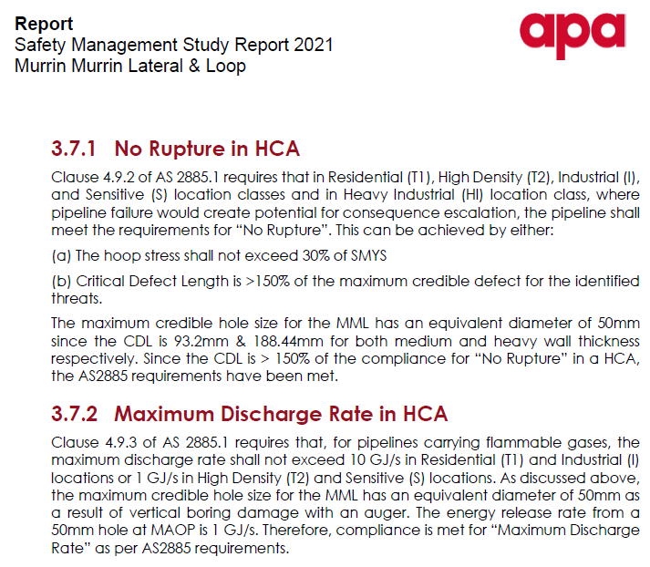
High Consequence Area Assessment
High Consequence Assessment in accordance with AS2885.1 Section 4.9
No Rupture through <30% hoop stress or calculated critical defect length is not less than 150% of maximum credible hole size.
Maximum discharge rate <10GJ/s for residential and industrial, <1GJ/s for high density and sensitive

Slide 6
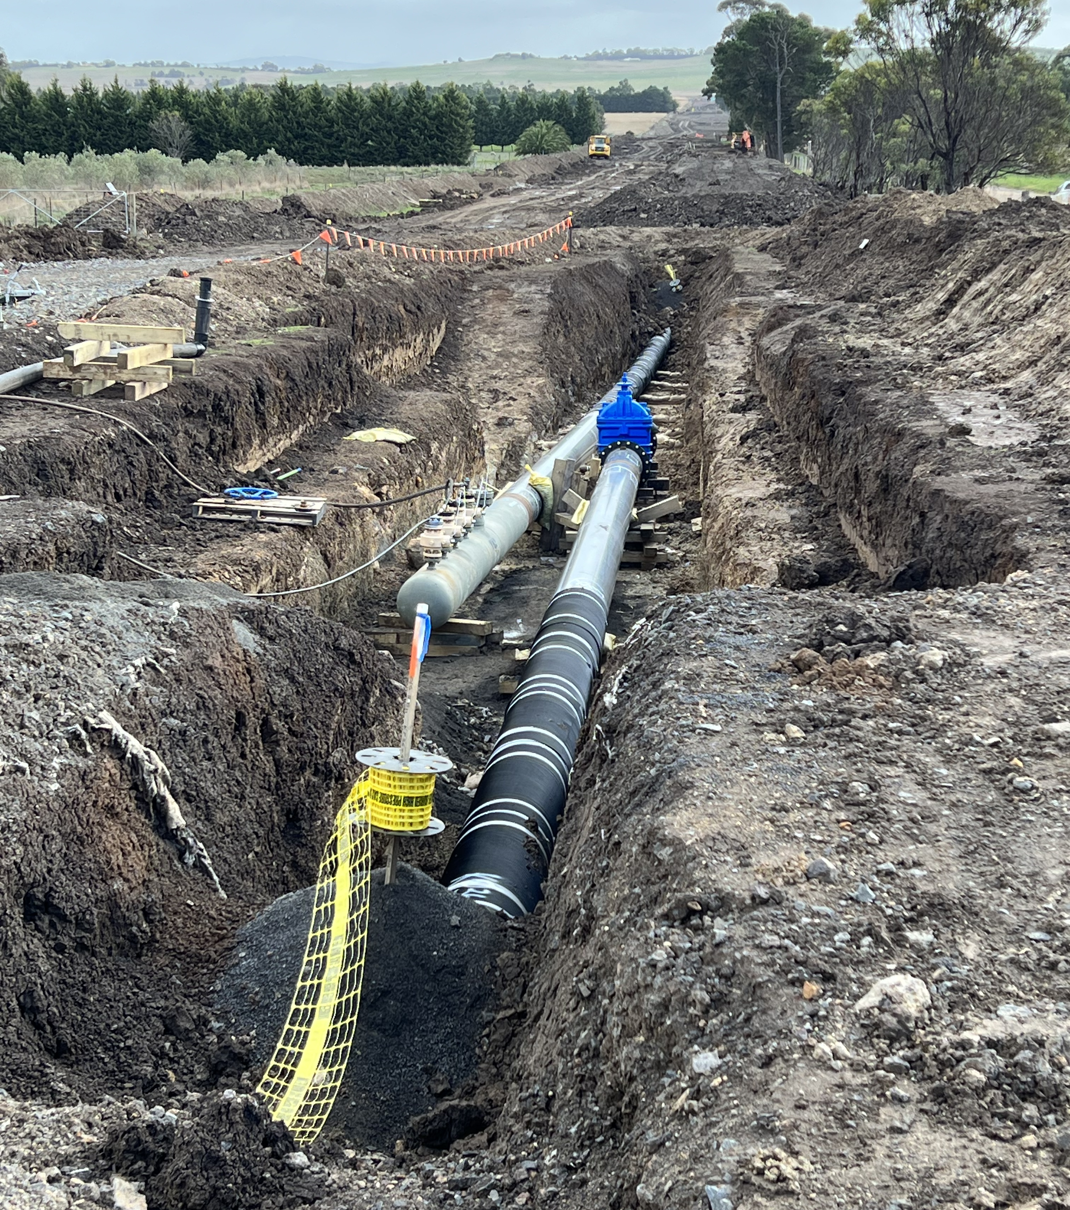
Assessments for Pipelines without pressure test
Purpose of hydrotest is to confirm pipeline is free from critical manufacturing and construction-related defects e.g., milling anomalies, laminations and weld defects (6.2.3.3)
Objective is to review existing controls (eg. ILI) and history (eg. digs/failures/construction QA) then determine whether additional controls are needed
ILI – consider what might be missed by current inspection regime
ALARP Assessment is required (AS2885.6)
Any additional controls shall be documented in the PIMP
Notes:
Guidance at high level is review threats, understand asset condition and understand risk associated with not performing ILI and identify potential alternate controls

Slide 7
Fracture Resistance Assessments
Required for pipelines that do not have a Fracture Control Plan conforming to AS2885.1. First FCP requirement was in AS2885.1:1997.
Performing a gap analysis on AS2885.1 FCP, assessing gaps through risk assessment in AS2885.6
ALARP could be demonstrated through testing samples, comparing similar vintage pipelines, increasing external interference controls, minimizing fracture initiating events
Requires 5-yearly review and reference in the PIMP
Notes:
Guidance includes reviewing design, understand existing data through test samples, reviewing equivalent pipelines test data

Slide 8
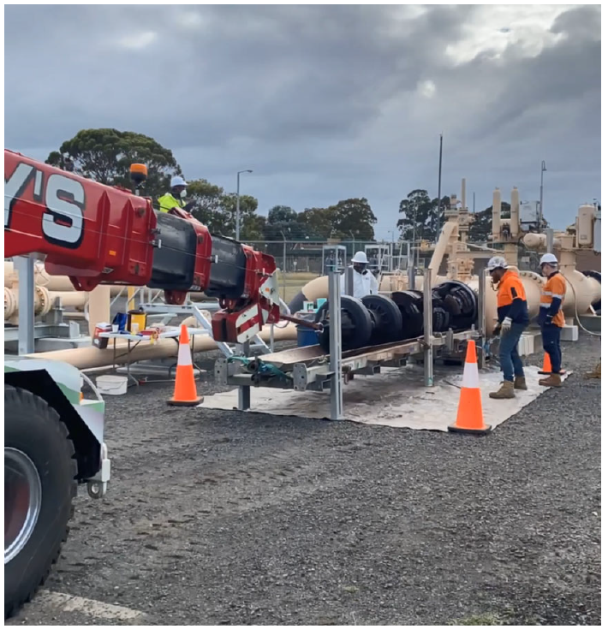
Assessments for Pipelines unable to be inspected with ILI
Requirement to undertake an assessment where a pipeline is unable to be inspected with in-line inspection (6.5.1)
Documenting limitations of alternate strategy (ECDA, hydrotest, reducing pressure, emerging technologies)

Slide 9
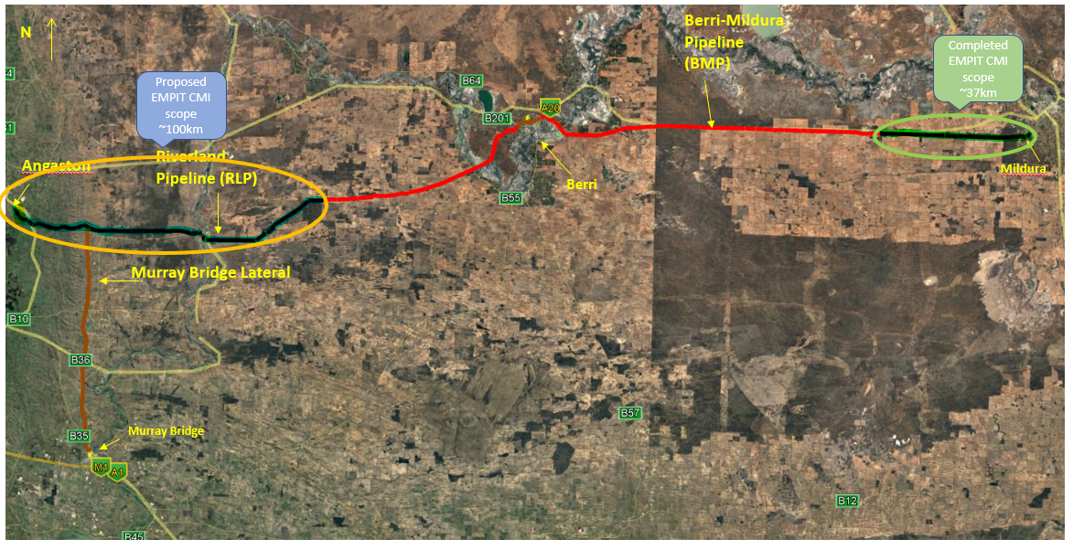
Example– In Line Inspection Assessment
Riverland Pipeline - sole supply pipeline to Mildura
400km long and 4” in diameter
MAOP of 10,000kPa
ROP of 9525kPa (due to pressure vessel limitation)
Determined as unpiggable due to diameter (history of stuck pigs)

Slide 10
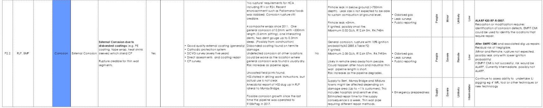
Example– In Line Inspection Assessment
Safety Management Study – outcome intermediate risk
External corrosion threat
Intermediate Supply Risk

Slide 11
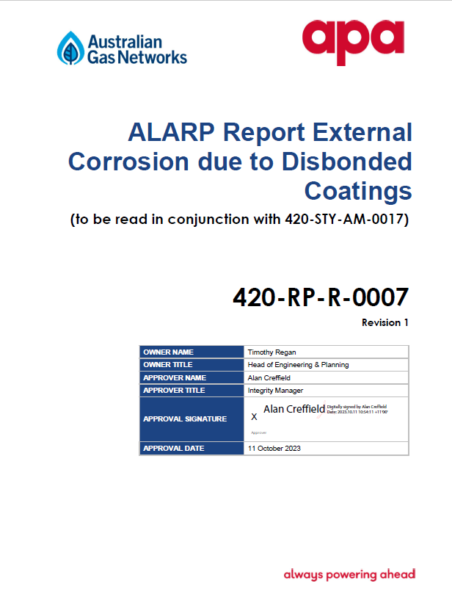
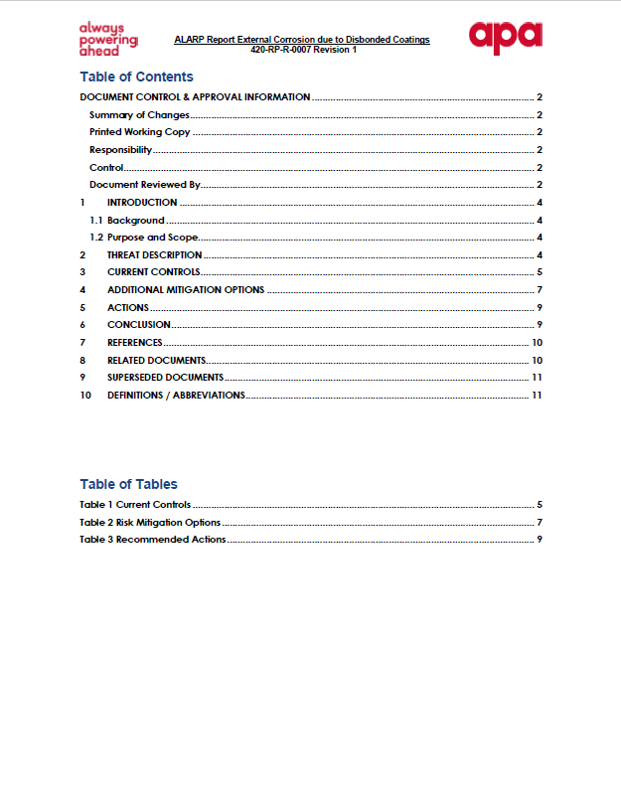
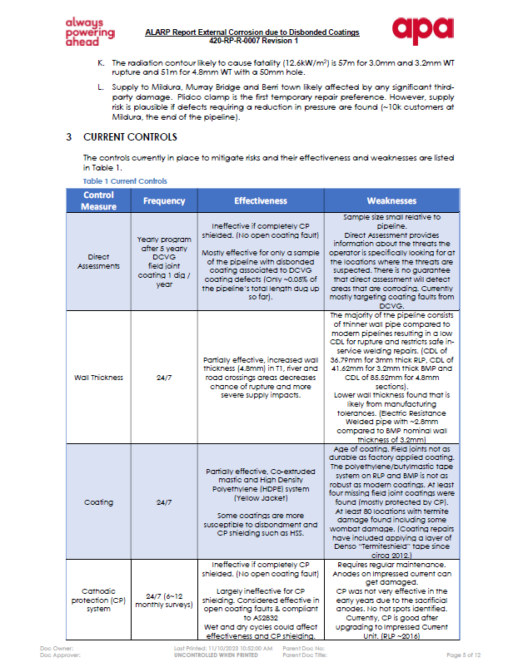
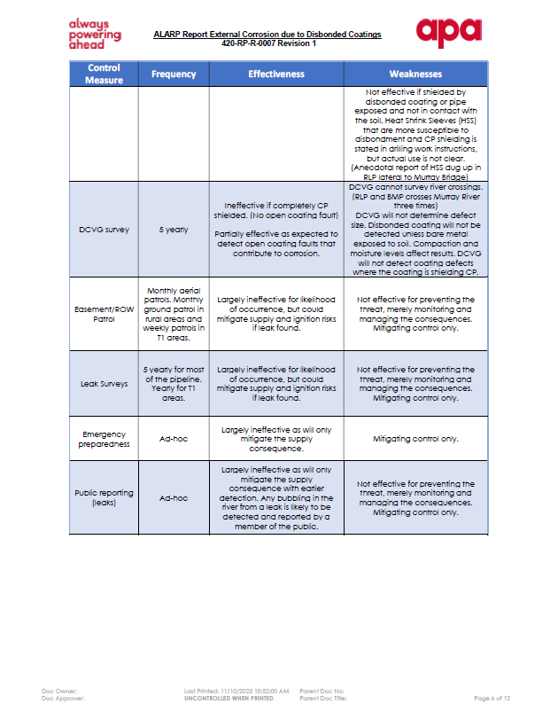
Example – In Line Inspection Assessment
Perform an ALARP assessment in accordance with AS2885.6
Options study – reduce pressure, replacement, hydrotest, ILI conversion, more digs, other
Supply risk of stuck pig deemed intermediate

Slide 12
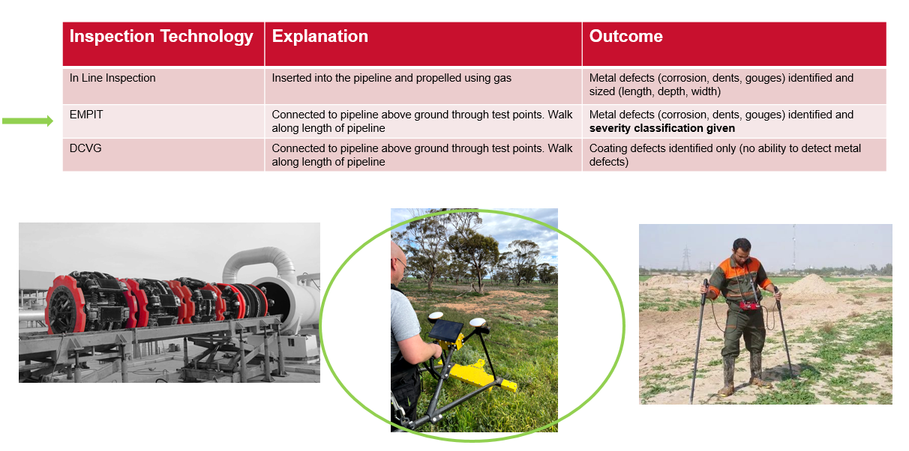
Example – In Line Inspection Assessment
Considered alternate technologies (CMI)
A technology that injects varying AC current into the pipeline and is intended to identify defects in the steel
Connects to test points and walk along Right of Way
Limitation is that it struggles to identify type of defect (eg. corrosion, dent, weld defect)
Utilising CRC research and an APA pilot trial in 2022 – performed inspection of 100km of AGIT
APA will validate technology with other pipelines that will undergo ILI

Slide 13
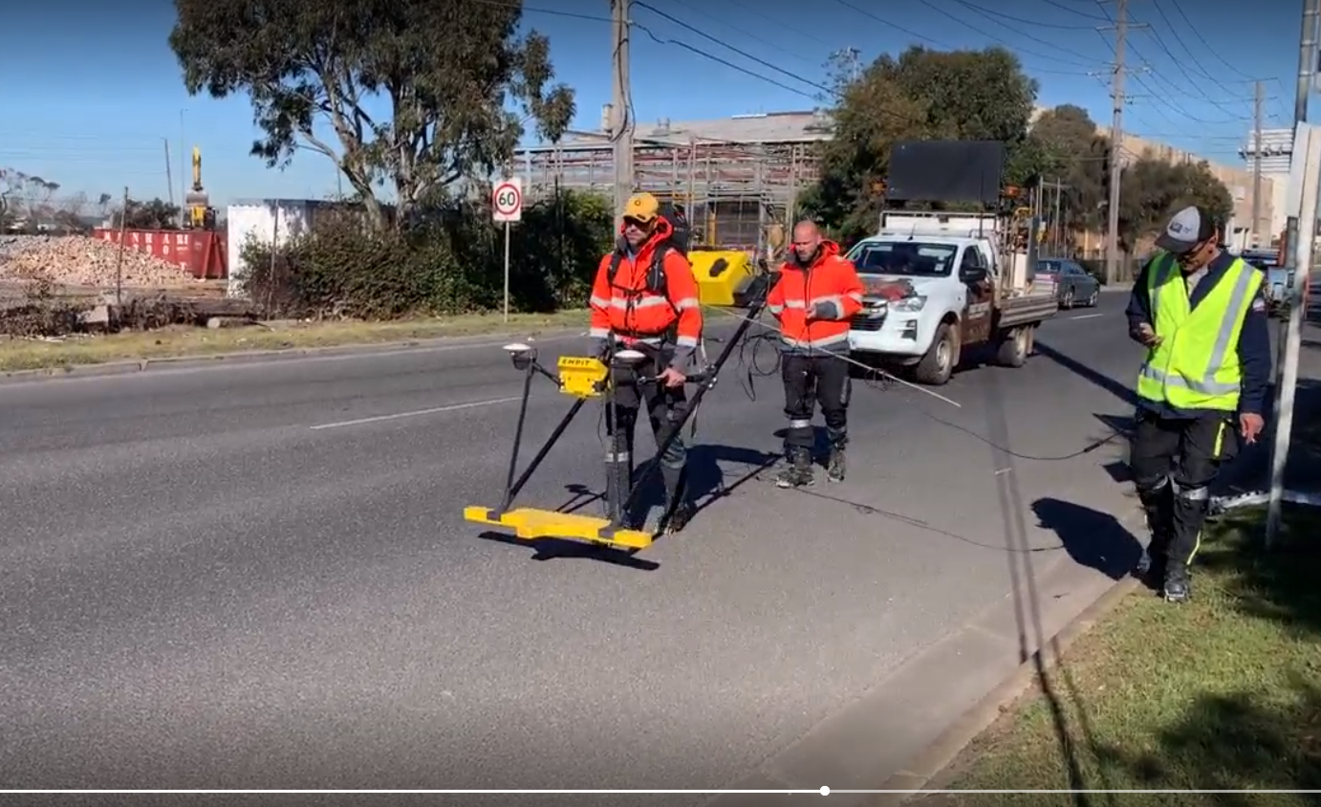
Example – In Line Inspection Assessment
Inspection completed in September 2023
Awaiting results – due in February 2024
Upon further validation of results – future SMS to reassess risk

Slide 14
Q & A

