Slide 1

Allison Selman
Allison is a Materials Engineer with 25 years’ experience in the resource and offshore energy industries in Australia and overseas. She is a Fellow of Engineers Australia and a Chartered Professional Engineer in Oil and Gas Pipeline Engineering (Offshore Pipelines).
Allison’s technical expertise is in the integrity management and decommissioning of subsea equipment, onshore and offshore pipelines. She has published and presented on widely these topics.
Allison joined the ME-38.3 Sub-Committee for the 2022 update. She represents Standards Australia on the working group of ISO/TS 12747 Pipeline Life Extension, which is currently being updated. For APGA, she managed the delivery of the competency framework for Offshore Oil and Gas Pipeline Engineering.
She received the 2018 WA Engineering Medal and was the 2019 WA Professional Engineer of the Year, recognizing her contributions to the engineering profession and work as a diversity and inclusion champion.
Executive Director, Asset Integrity & Decommissioning Manager
Atteris Pty Ltd

Slide 2
AS 2885.3 Seminar
Section 10 Changes to Approved Operating Conditions
Presented By Allison Selman

Slide 3
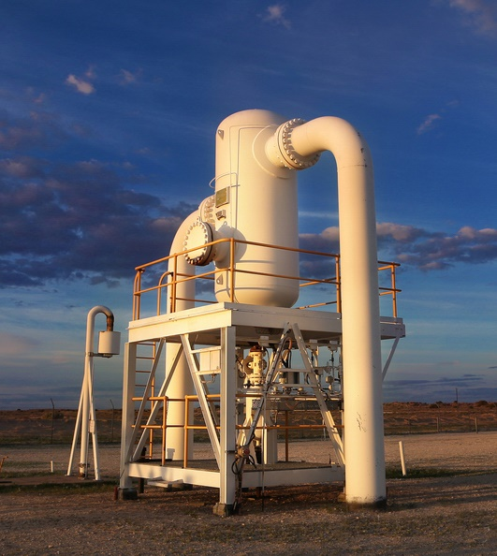
Basis of Section 10
Objective: Ensure that implementation of a change does not have an undesired / unintended impact elsewhere in the Pipeline System.
Guidance on:
Minimum requirements to enable the impact of any proposed or enforced change to be understood.
How changes to the operating pressure (temporary or permanent) should be managed.
Return to service requirements following a pipeline suspension or failure event.
Pipeline abandonment.

Slide 4
Key changes to Section 10
Content moved:
Remaining life review – replaced with Fitness for Purpose assessment (Section 5)
Refurbishment – moved to Anomaly Assessment and Defect Repairs (Section 9)
Clarified pressure definitions:
“Maximum Operating Pressure (MOP) restriction” replaced with Restricted Operating Pressure (ROP)
Improved guidance on:
Pipeline suspension and return to service
Pipeline failure response
Pipeline abandonment

Slide 5
Design change assessment
Review the following to consider a proposed change:
Physical characteristics and condition of the pipe
Effectiveness of corrosion mitigation controls (past and anticipated future)
Maximum Allowable Operating Pressure (MAOP)
Safety Management Study (SMS)
Conformance to the no-rupture and maximum energy release rate requirements for high consequence areas
Overpressure relief facilities and pressure control systems
Adequacy of operational controls
Operating history (e.g., temperatures, pressures).
Isolation plan
Fracture control plan / resistance assessment.

Slide 6
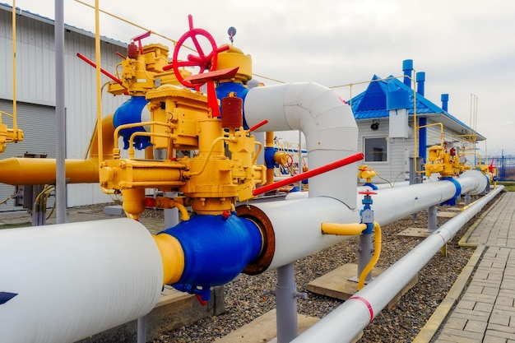
Pressure Definitions
Design Pressure (P_{D})
Pressure nominated in the design basis for the purpose of performing calculations on the mechanical and process design of the pipeline system
Maximum Allowable Operating Pressure (MAOP)
Maximum pressure at which a pipeline system or section of a pipeline system may be operated, following pressure testing OR after an MAOP review
Maximum Operating Pressure (MOP) - 2012
No longer used
Restricted Operating Pressure (ROP) - 2022
Operating pressure limit (lower than MAOP) imposed by Licensee from time-to-time for Pipeline System safety or process reasons

Slide 7
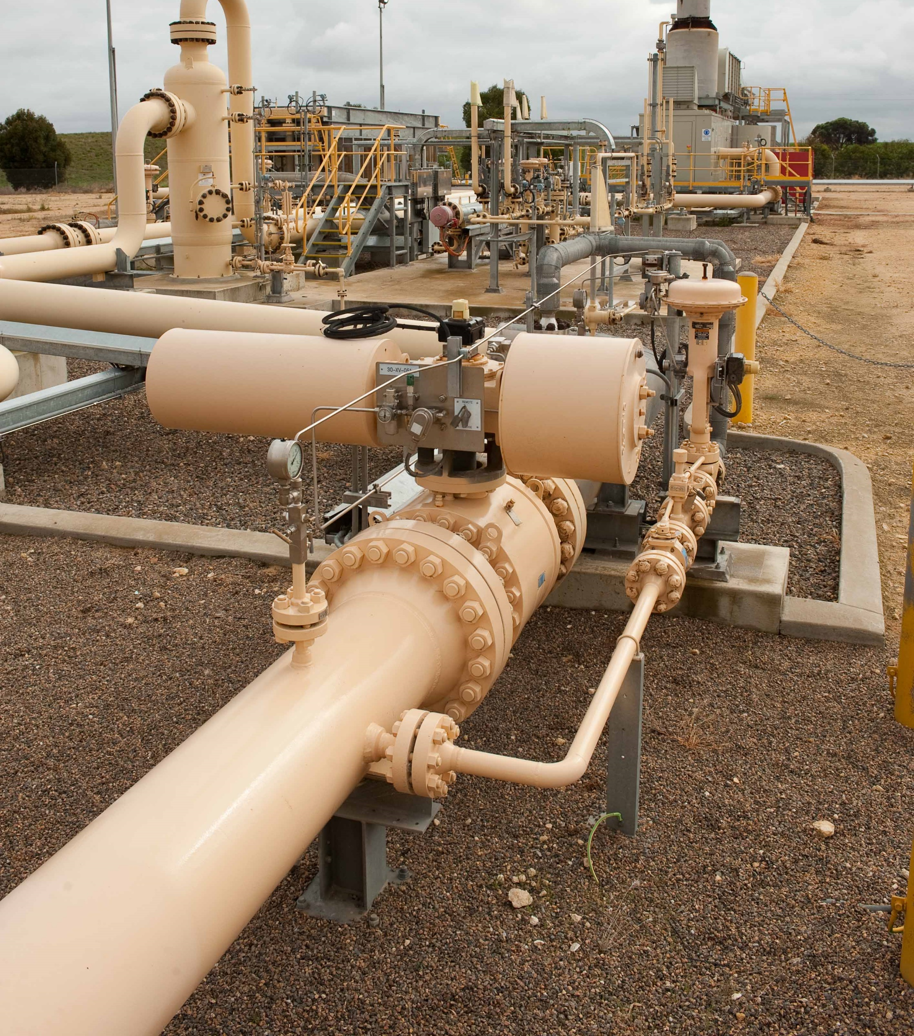
Maximum Allowable Operating Pressure (MAOP) Upgrade / Changes
Where MAOP is to be upgraded beyond what was originally designed / established – follow the process in AS2885.1
Where MAOP has been previously reduced, the MAOP can be increased after the reason(s) for the reduction has been rectified
Implementation of the proposed MAOP shall be supported by a change management process.

Slide 8
Restricted Operating Pressure (ROP)
New terminology to eliminate reported confusion with the “maximum operating pressure” (MOP) terminology (v2012)
Short-term temporary pressure limits are still referred to in Section 9.2 (Anomaly Management) i.e. for applying safety factor at times of an anomaly identification or in-field investigation
A Restricted Operating Pressure (ROP) is defined in Section 10.6 as a value that is below the MAOP, implemented as an interim (non-permanent) safety critical control

Slide 9
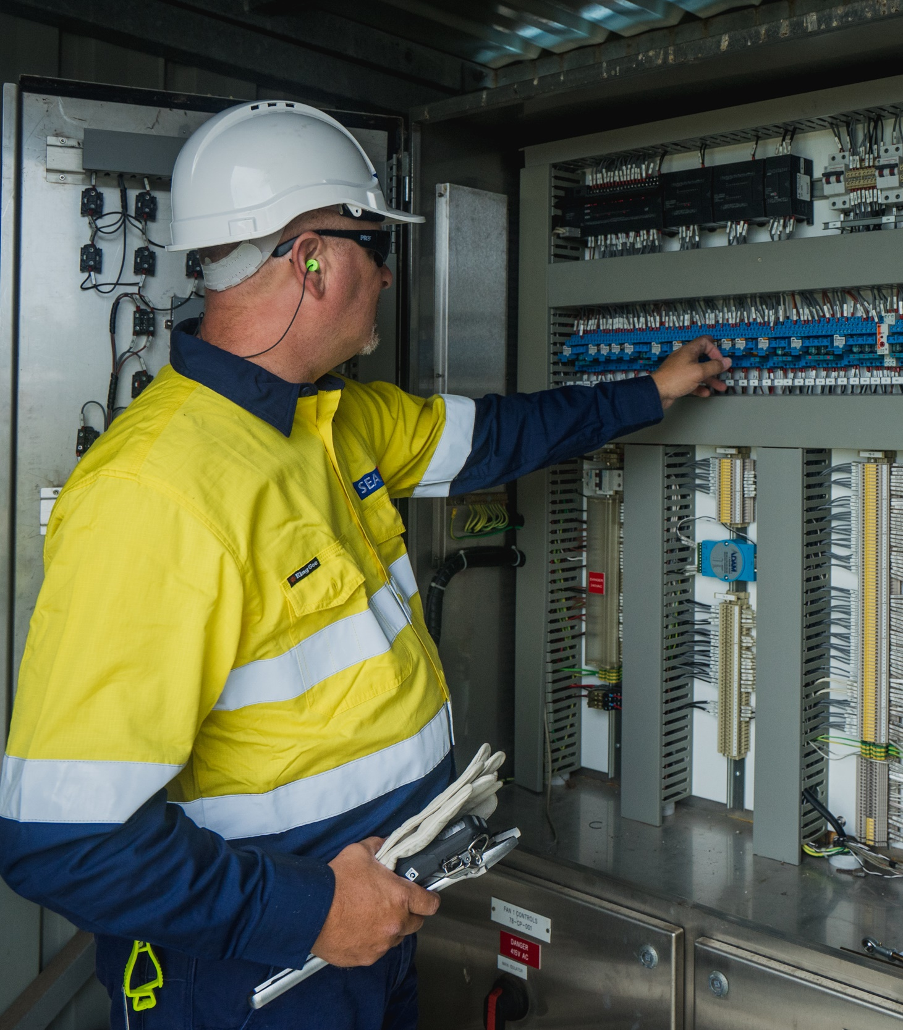
Restricted Operating Pressure (ROP)
Implemented to address integrity defect/s, when an MAOP reduction is not desirable OR to mitigate a newly identified threat / consequence, until permanent controls can be applied.
Detailed “engineering assessment” and Management of Change Processes shall be followed
ROP shall remain in place until such time as a permanent control is implemented, the threat no longer exists, or the integrity of the line is re-established
While an ROP is in place, the MAOP will remain the basis for all repairs and defect assessments, measurement length, fracture control and maximum discharge energy assessment

Slide 10
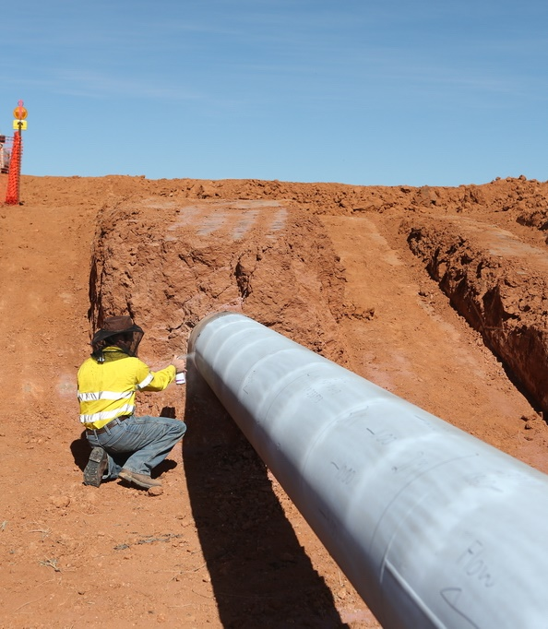
Restricted Operating Pressure (ROP)
Detailed Engineering Assessment:
Document reason for the ROP, justification for not applying a formal MAOP reduction
Analyse effectiveness provided by the ROP
Full description of the required changes i.e. pressure control & OPP devices
Identify the anticipated duration of the ROP
Outline requirements to be addressed prior to the ROP being removed
Make an allowance in the ROP for potential transient conditions
Pressure may exceed 100% ROP, but not 110% ROP

Slide 11
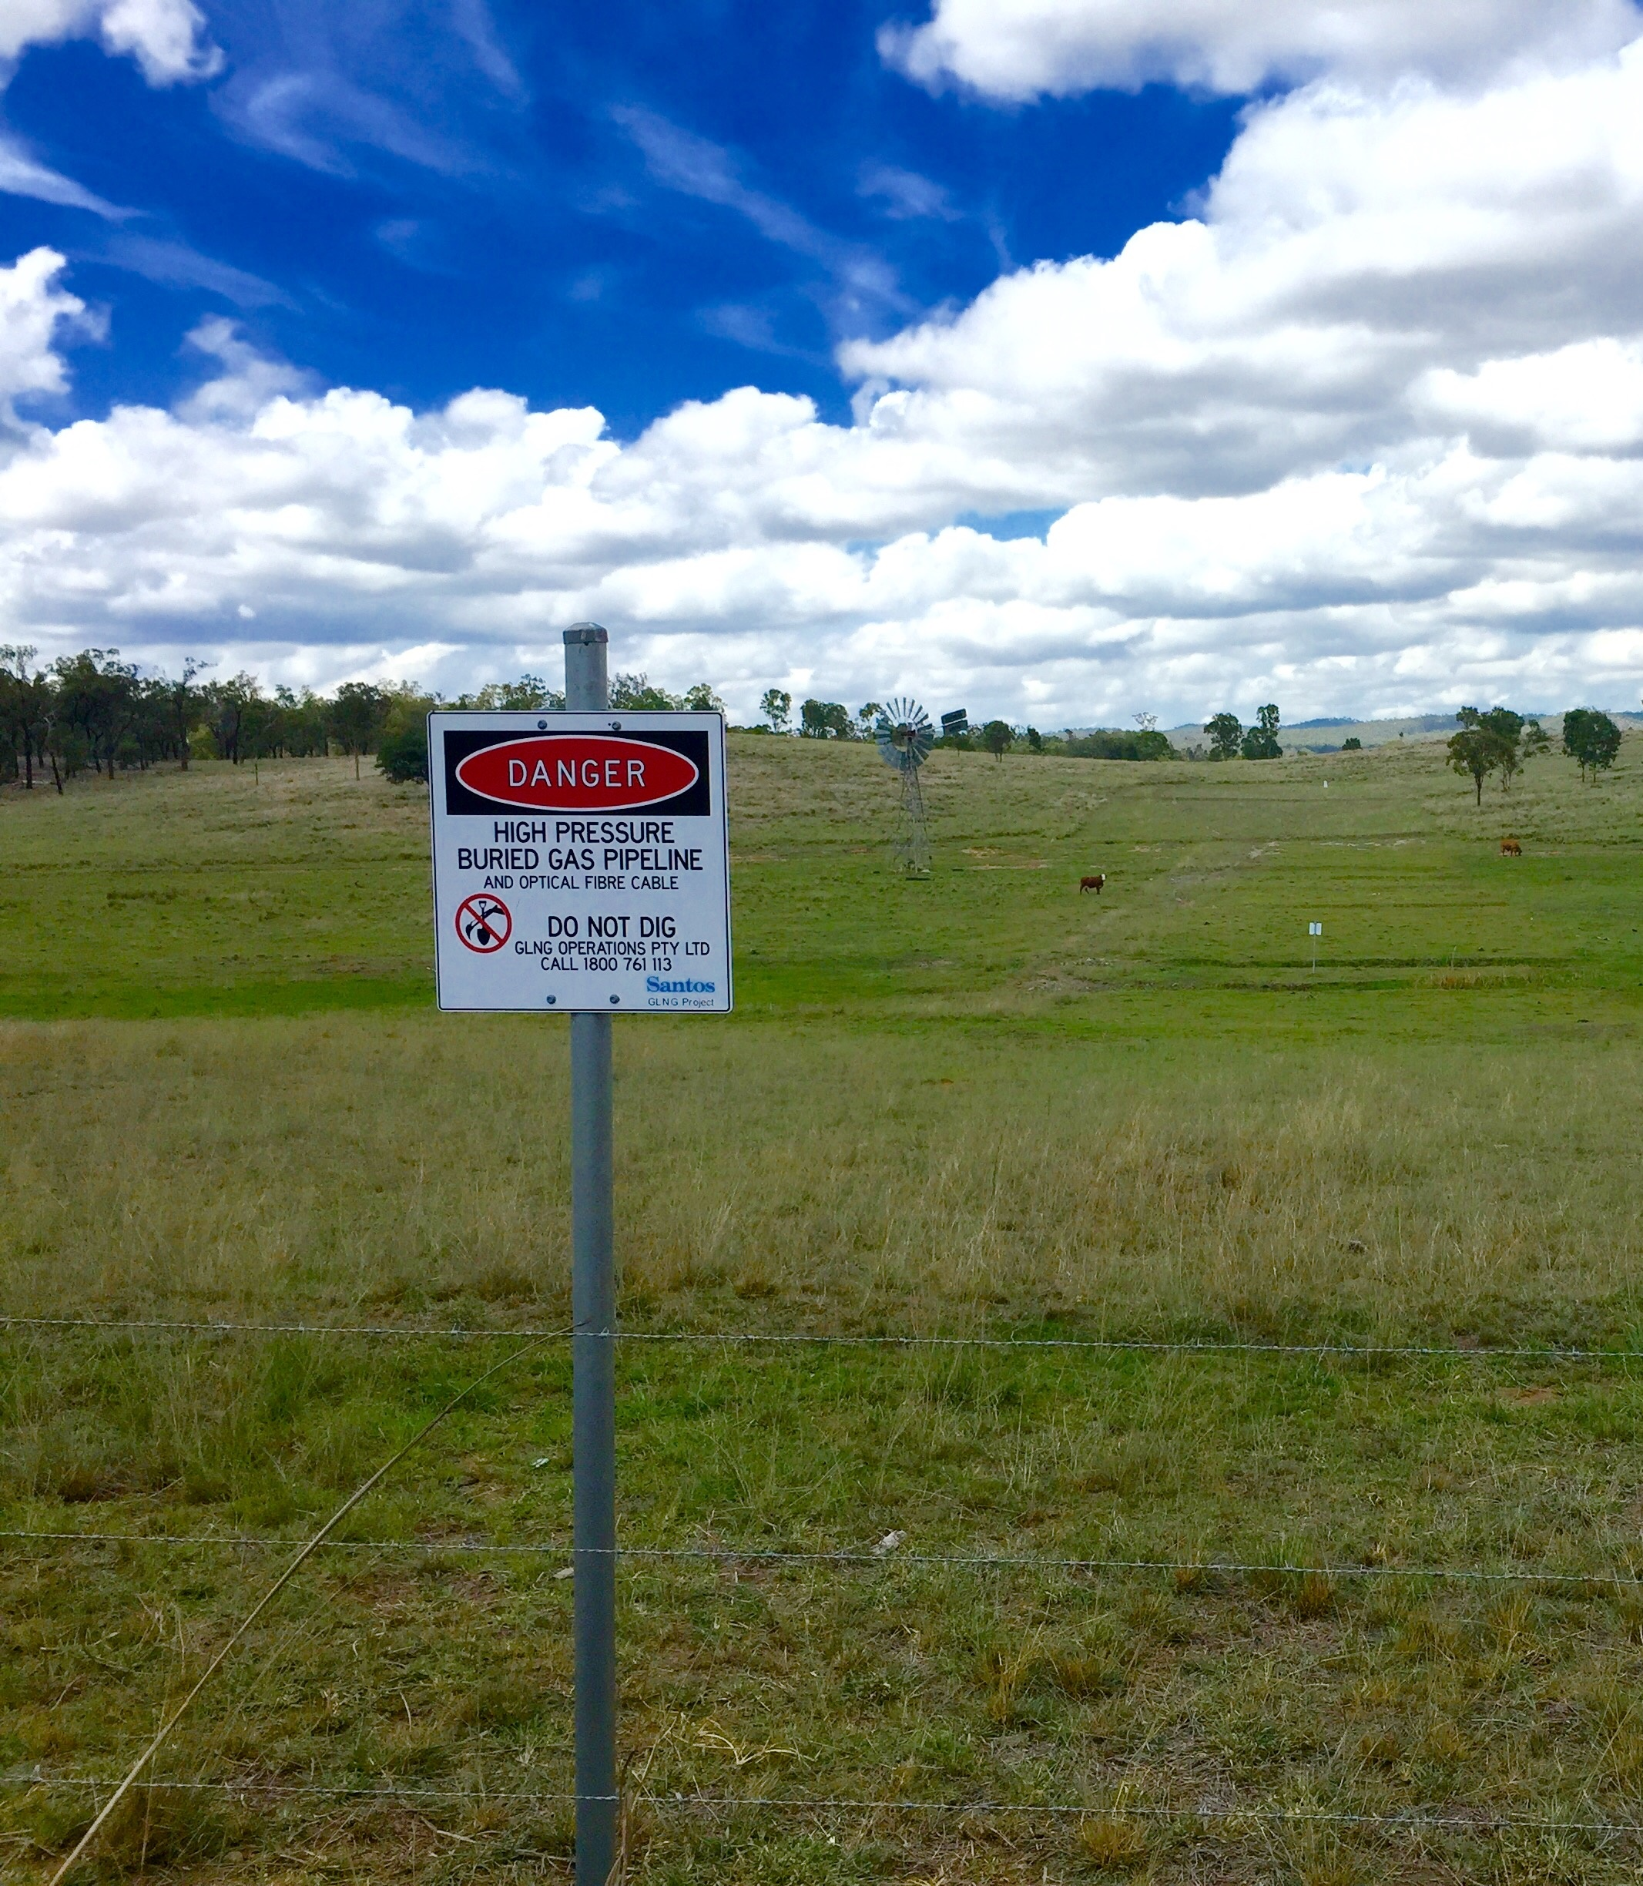
Restricted Operating Pressure (ROP)
Management of Change Process:
All relevant personnel shall be made aware of the APPROVED ROP
Pressure control and overpressure protection system set points shall be reviewed and adjusted
Removal of a ROP shall be Approved
Closure of all actions
Confirmation that safe working pressure is satisfactory for the intended MAOP or revised ROP
ROP’s in place > 12 months require a change of operating conditions SMS

Slide 12
Pipeline Suspension
Pipeline is suspended when it is taken out of service and no longer available for normal operations
The primary aim is to preserve the integrity of the pipeline for future use.
Conditions for suspension are outlined
Return to service requires change management process (see Section 10.8.2) and must be approved by the applicable regulatory body.

Slide 13
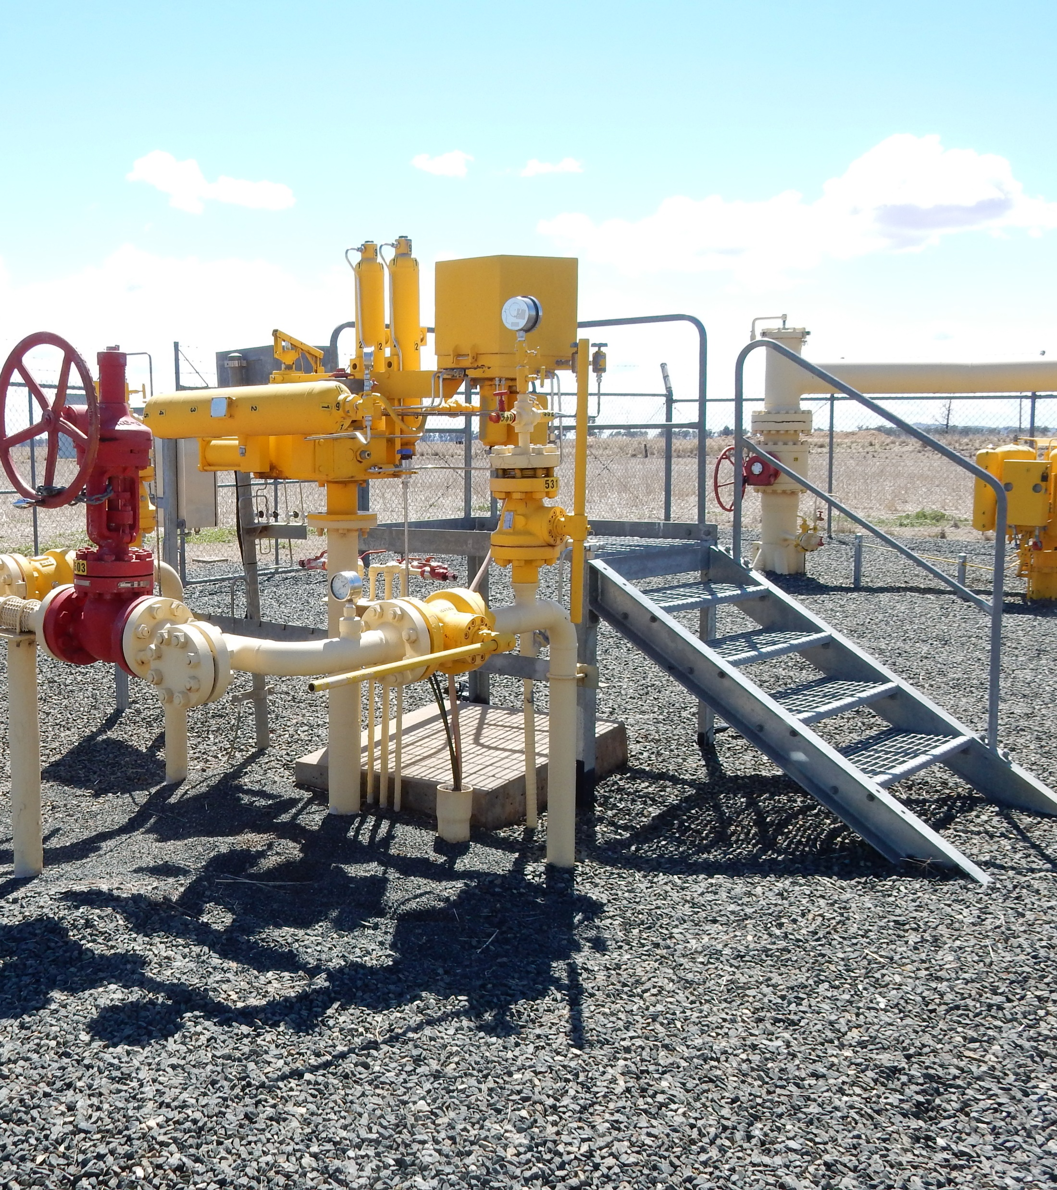
Pipeline Failure
Complete an investigation.
Review SMS to identify root cause(s).
Implement actions to address root cause(s) and prevent re-occurrence.
Review and update PMS.
Return to normal operation requires:
An engineering assessment to confirm pipeline is fit for purpose at the required MAOP (or ROP)
Residual risks are reduced to ALARP in accordance with AS 2885.6
The PIMP and associated activities have been reviewed to confirm integrity management remains appropriate.

Slide 14

Pipeline Abandonment
Requires approved Decommissioning / Abandonment Plan and an environmental rehabilitation plan.
Confirm it is disconnected from all sources of pressure and hydrocarbons.
Purge the pipeline of all hydrocarbons and vapour with a non-flammable fluid.
Complete segment analysis as part of the plan for buried pipeline.
Abandon in-place or by removal - requirements for both detailed
Records for pipelines abandoned in-place shall be prepared and made publicly available.

Slide 15
Q & A

