Slide 1

Marshall Holmes
Marshall is an experienced manager with over 35 years involvement in the Petroleum and Gas industry in a key industry sectors including gathering systems, pipelines, distribution systems and processing facilities.
Marshall has been actively involved in a number of Australian Standards and Codes of Practice including ME 38, AG 08, ME 93, ME 92, MS 011 and the APGA CoP for Gathering Systems from both an industry and regulatory perspective.
Marshall currently works as the regulator for the Petroleum and Gas industry in Queensland and is the subject lead for several areas including pipelines (gathering, transmission and distribution), Distribution Systems, Processing Facilities and Measurement with oversight over the growing Biogas and Biomethane sectors.
Marshall is a professional RPEQ engineer as well as a corrosion technologist. He has a passion for applying a practical application of the technical standards in the petroleum and gas industry.
.
Executive Petroleum Engineer

Slide 2
AS 2885.3 Seminar
Section 12
Presented By - Marshall Holmes

Slide 3

Section 12 – Records Management
Basis of Section
This section details the records keeping requirements specific to operations and maintenance, to provide a basis for informed decision making and to demonstrate conformance with this standard.
Key Principals
Procedures established for the identification, collection, storage, and disposal of records pertinent to the PMS.
Cover both paper and electronic records.
Records necessary to :
Safely operate and maintain the pipeline,
Demonstrate conformance to all parts of the standard,
Identify decisions made and actions taken,
Confirm the fitness for purpose of the pipeline at any stage of the pipeline’s life.

Slide 4

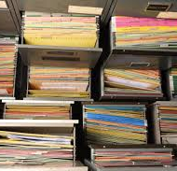
Section 12 – Records Management
Objectives of 2022 Update
Reduce overlap with other sections.
Section 12.3 Design, construction and commissioning – refer part 1
Section 12.4 Operation and maintenance records
List of records required to be maintained
Section 12.5 Abandonment records
List of records required to be maintained

Slide 5
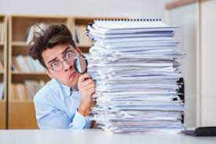
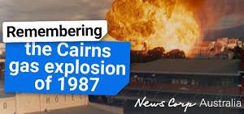
Section 12 – Records Management
Records are the licensee's best method of demonstrating compliance to state regulators in the advent of an incident.

