Slide 1

Liz Brierley
Liz is an experienced leader with demonstrated capability in building effective teams to manage high risk assets in a regulated environment across multiple State jurisdictions. She has an extensive knowledge of pipelines, gas networks and related energy systems that has been developed through more than 20 years working for gas network and pipeline operators, with more than fifteen years’ experience in leadership roles.
A proven ability to work collaboratively to influence change in organisations, standards and legislation. Liz has been actively involved in the development of Australian Standards for pipelines for more than 10 years, recently appointed chair of the ME-38.3 Sub-Committee.
One of the first Chartered Professional (Oil and Gas Pipeline) Engineers in Australia, she follows a passion to promote high quality engineering education and professional development as a member of the National Engineering Registration Board Assessment Panel for Oil and Gas Pipeline Engineers.
Head of Asset Management
SEA Gas

Slide 2
AS 2885.3 Seminar
Section 7 – Pipeline Corridor Management
Presented By – Liz Brierley

Slide 3
Section 7 – Pipeline Corridor Management
Basis of Section
The control of threats associated with first and third party activity or natural events both on or adjacent to the pipeline corridor that have the potential to impact pipeline integrity.
Key Concepts
Managing external interference in a pipeline corridor
Corridor surveillance for natural hazards
Vegetation management
Controlling external loads
Managing the threat of vibration and blasting
Management of land use change within the measurement length

Slide 4
Objectives of 2022 Update
Clarify the scope
Improve structure
Align with AS2885.6 and the SMS process.
Address non-external interference threats
Other Minor Changes
Emergency Services Liaison has moved to Section 11
Added guidance remote intrusion monitoring

Slide 5
Pipeline corridor management vs External interference management
Pipeline corridor management is broader than just External Interference:
External Interference is the removal of, or penetration of, the protective ground cover and potential contact with the pipe
Other activities occur on or near the pipeline corridor which may impact the operation of the pipeline
Procedural controls apply specifically to external interference threats
But may also reduce the risk associated with other threats
Section 7 details the minimum requirements for pipeline corridor management to control and monitor activities near pipeline systems, including, but not limited to external interference and procedural controls.

Slide 6
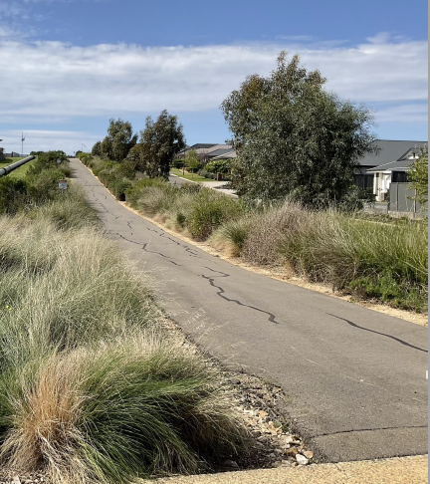
Interface with AS2885.6
AS 2885.6
EI threat identification and controls
Risk assessment and risk management for EI threats
Determination of appropriate controls for EI threats
Triggers for SMS review
AS2885.3
Procedures for identification of new EI threats
Minimum requirements for EI procedural controls
Requirement to review and ensure EI threat controls are effective

Slide 7
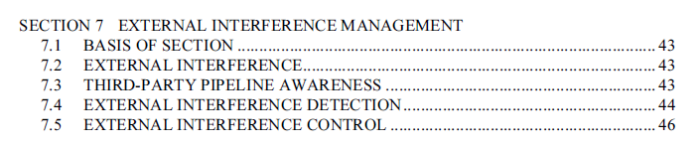
Section 7 - 2022 Structure
7.1 Basis of Section
7.2 External interference management
7.3 Procedural controls
7.3.1 General
7.3.2 Liaison (Landowner and occupier liaison/Planning and development liaison/Third party liaison)
7.3.3 One-call services
7.3.4 Pipeline marking
7.3.5 Agreements with other entities
7.3.6 Pipeline system patrol program
7.3.7 Remote Intrusion monitoring
7.4 Corridor surveillance
7.5 Controlling activities near pipeline systems
7.5.1 Procedures for controlling third party activities
7.5.2 Licensee’s own activities
7.5.3 Stress and strain
7.5.4 Placement of material on or near the pipeline system
7.5.5 Vibration in the vicinity of the pipeline system
7.5.6 Vegetation on or near the pipeline system
7.5.7 Pipeline corridor access
7.5.8 Temporary pipelines installed above ground or with reduced depth of cover
Section 7 - 2012 Structure

Slide 8

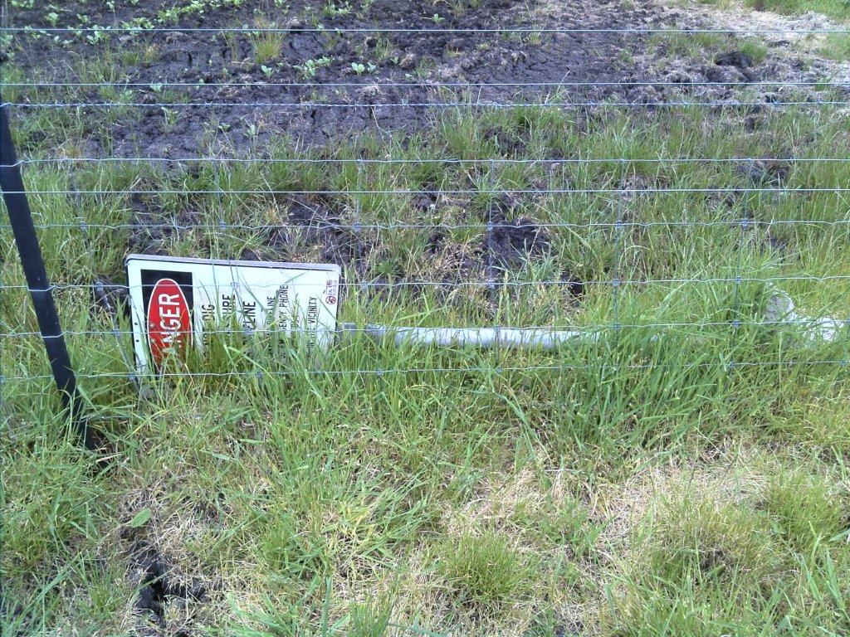
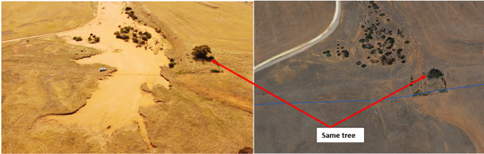
Patrols
Corridor Surveillance
Frequency determined by SMS documented in PIMP
Seeks to identify:
Construction Activity
Land use change
Effectiveness of marker signs
Security of sites
Records must be maintained for 10 yrs and inform SMS Review
Minimum frequency is annual.
Method and frequency must be designed to identify:
Variations in surface conditions
Indications of leaks
Excessive growth of vegetation
Impediments to site access.
Changes to landform resulting in axial or bending strain.
Must have a clearly defined scope and observations must be recorded.

Slide 9
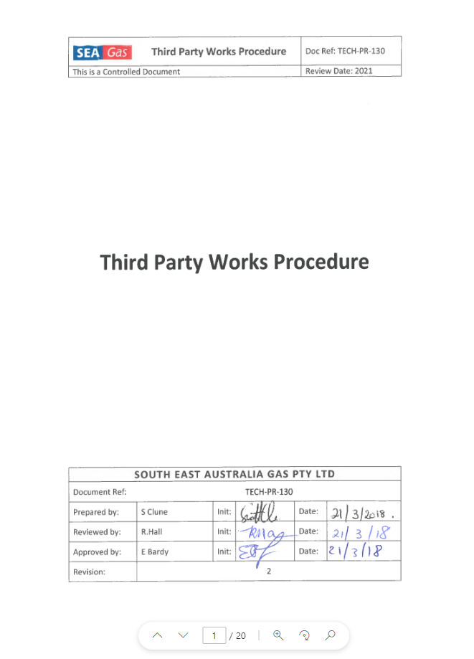
7.5.1 - Procedures For Controlling Third Party Works
Work procedures shall be documented in the PMS and shall include:
Minimum notice period for intended activities near a pipeline system
Requirements for pipeline operator site supervision
Requirements for third party procedures
Restrictions on the use of mechanical equipment
Requirements for and acceptable methods of pipeline location
Minimum separation distances to above ground permanent structures
Requirements for installing buried services that cross or are parallel to the pipeline.
Pipeline minimum depth of cover
Pipeline stress and strain limits
Backfill and compaction requirements
Notification requirements if a pipeline is damaged
Vibration limits
Restrictions on placement of spoil in a pipeline corridor
Requirements for work adjacent to a pipeline corridor
Requirements for directionally drilling across a pipeline
Requirements for ground disturbing activities deeper than 300mm

Slide 10
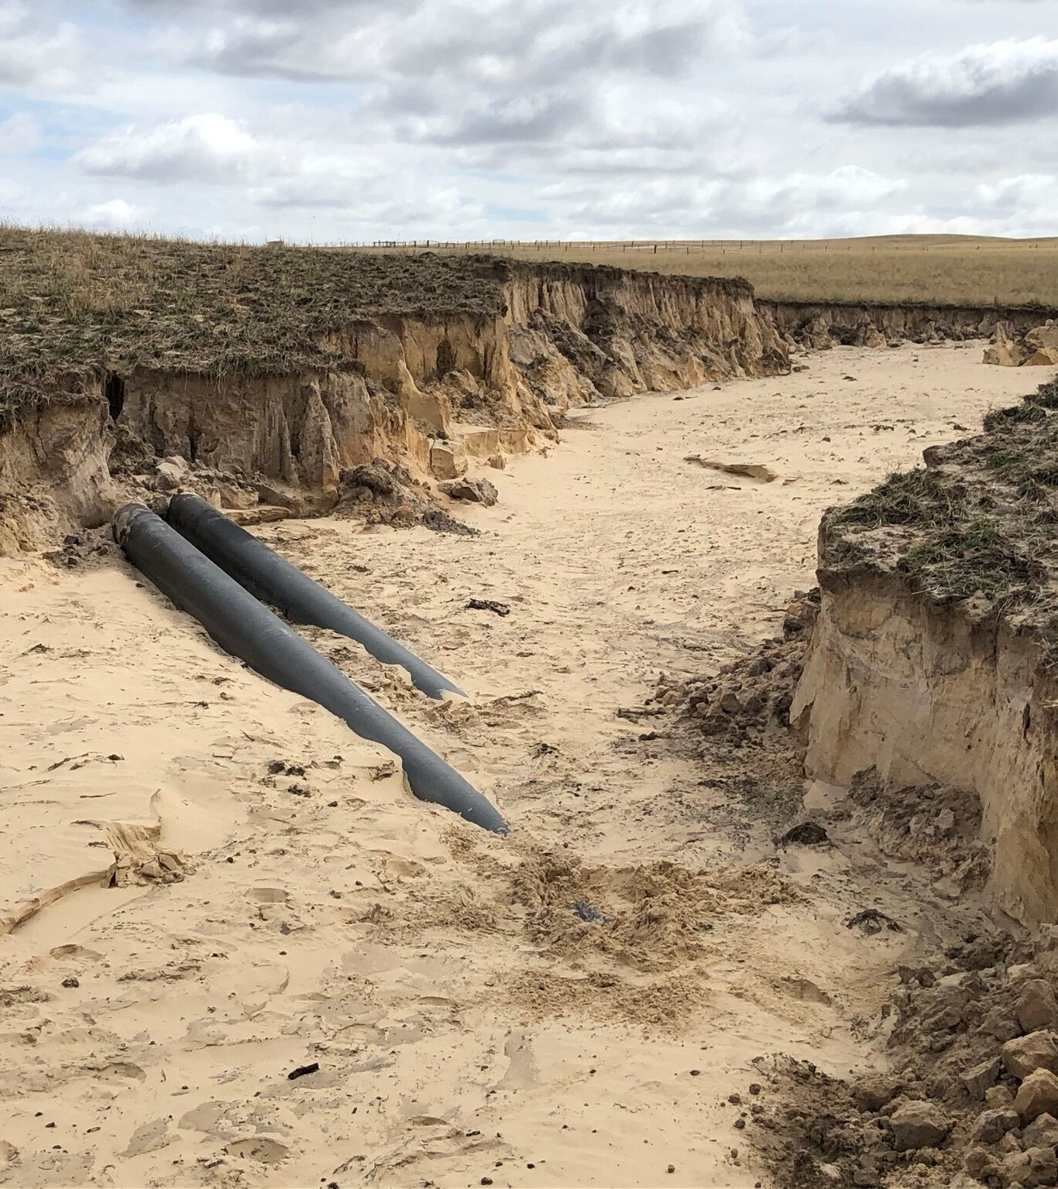
Additional requirements and guidance on corridor management for non-External Interference threats
Stress and strain due to external loads
Placement of material on or near the pipeline system
Vibration
Vegetation management
Electrical interference
Land movement
Common infrastructure corridors
Temporary pipelines

Slide 11
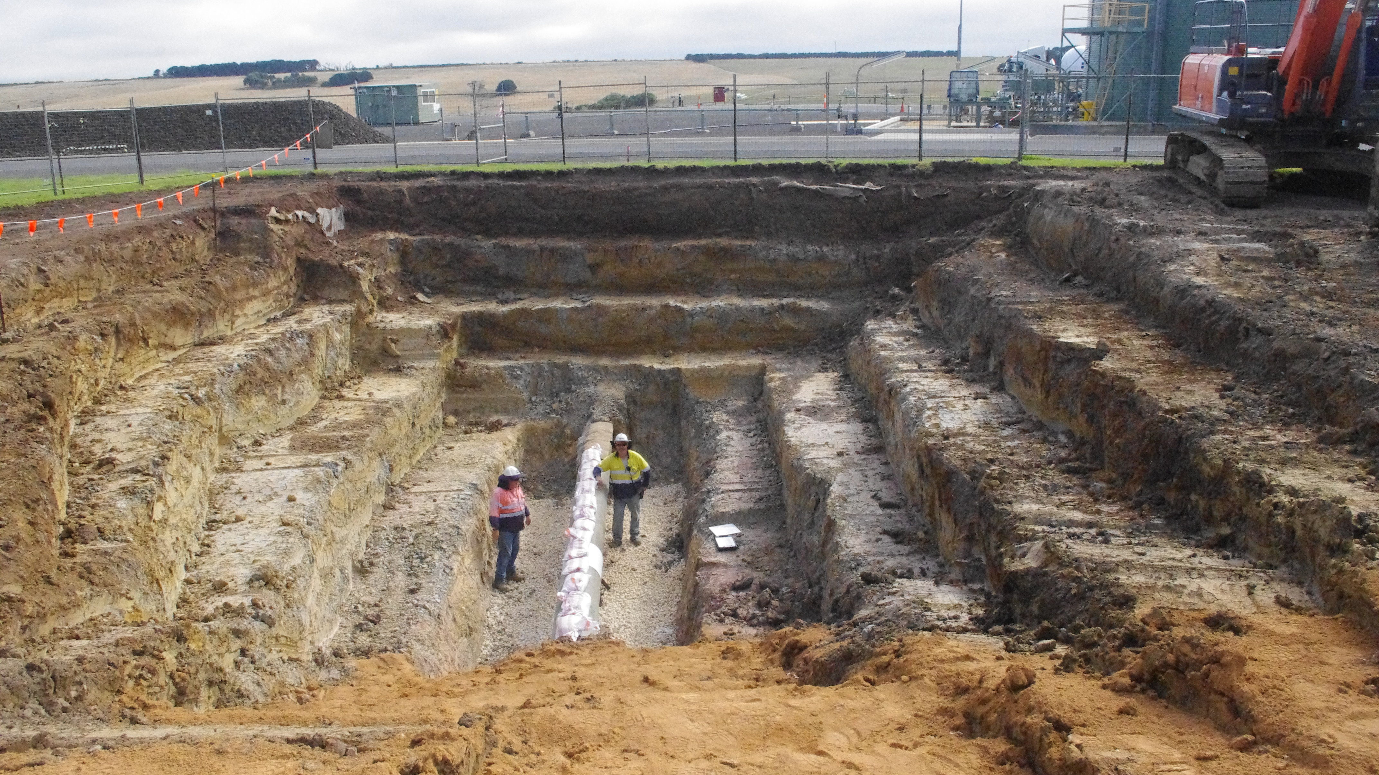
Questions?

