Slide 1

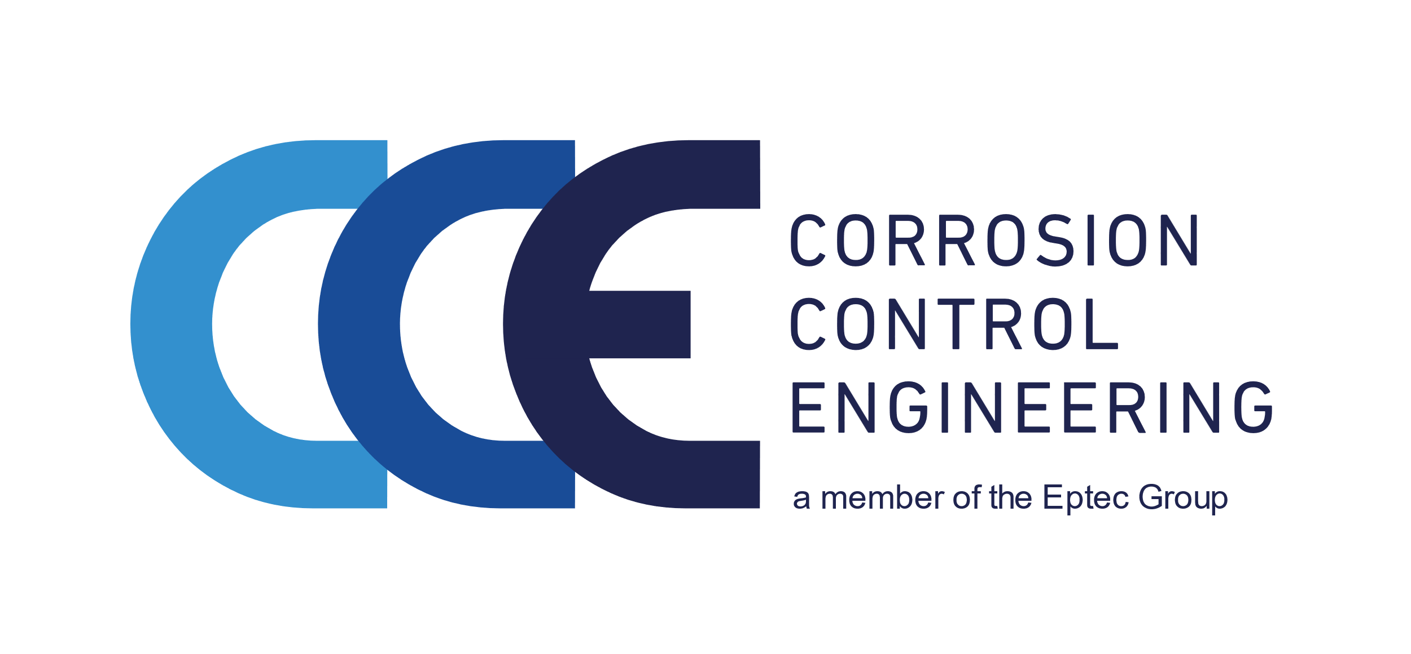

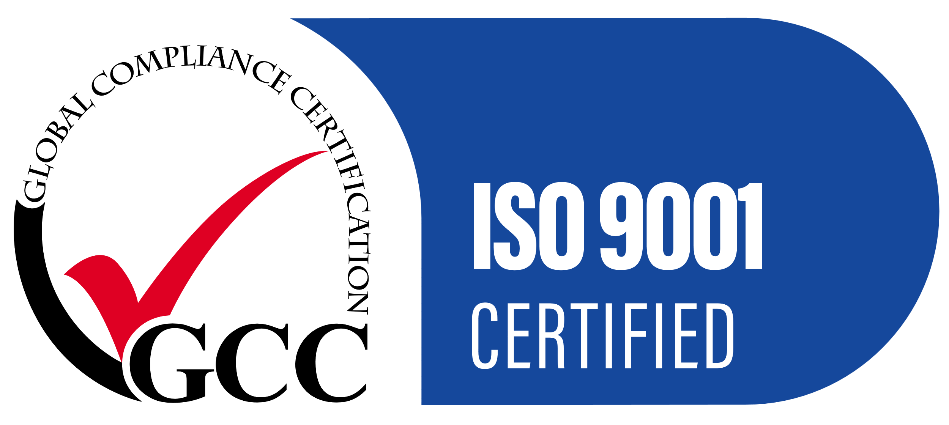
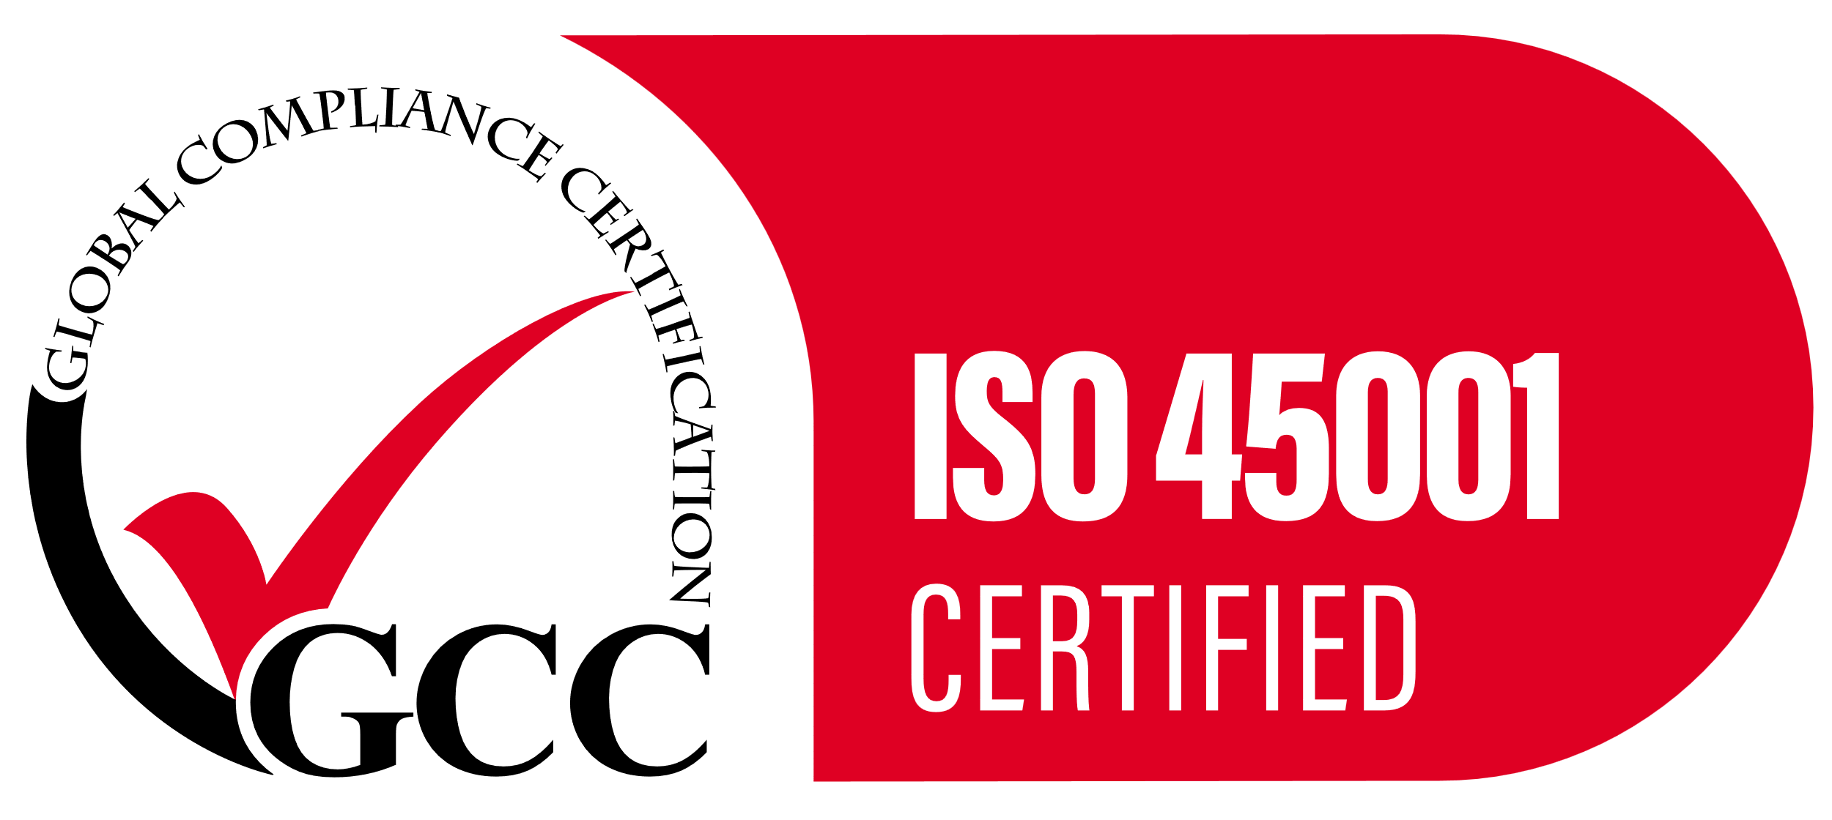
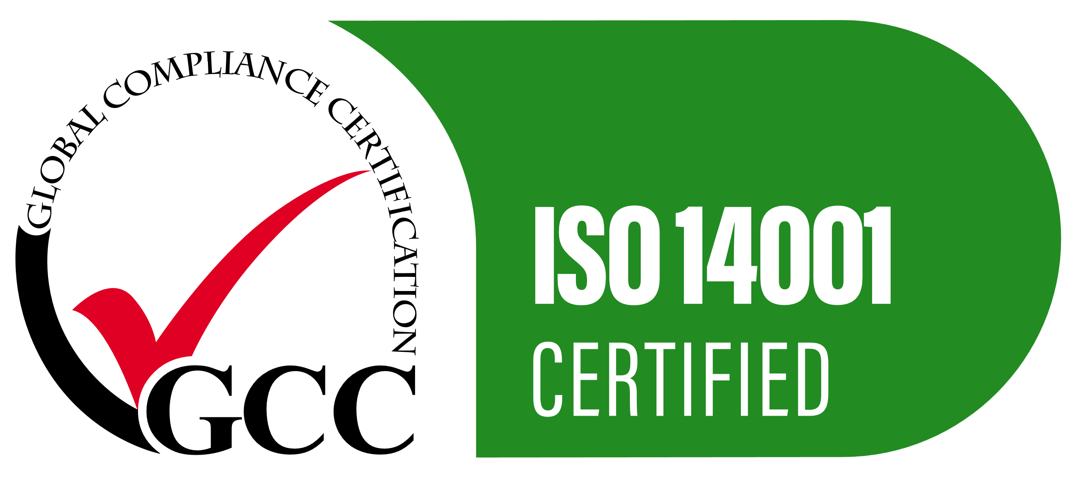
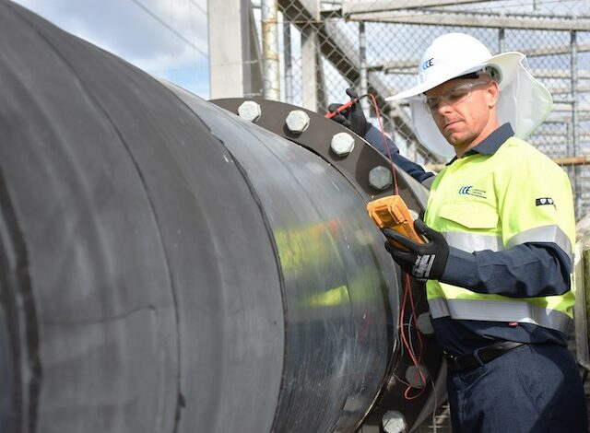



Introduction to
Remote Monitoring
Presented by Alan O’Connor - Principal Engineer CCE NZ
Defence and Infrastructure, Asset Remediation & Corrosion Mitigation Solutions

Slide 2
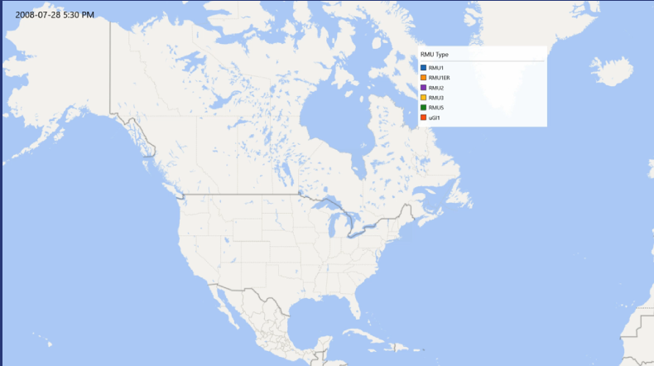
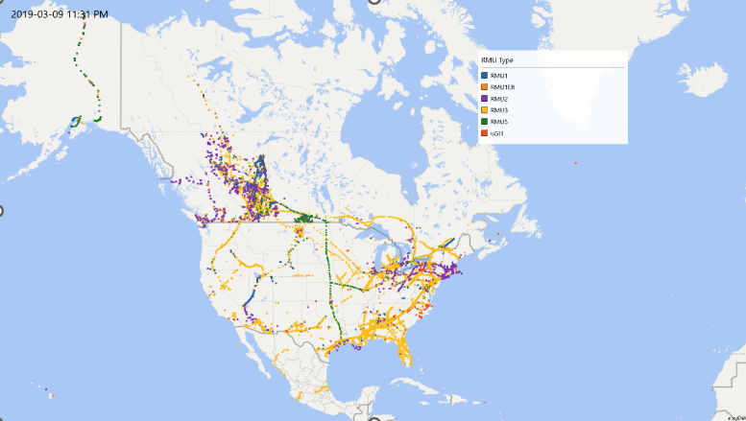
Remote Monitoring Implementation 2009-2019

Slide 3
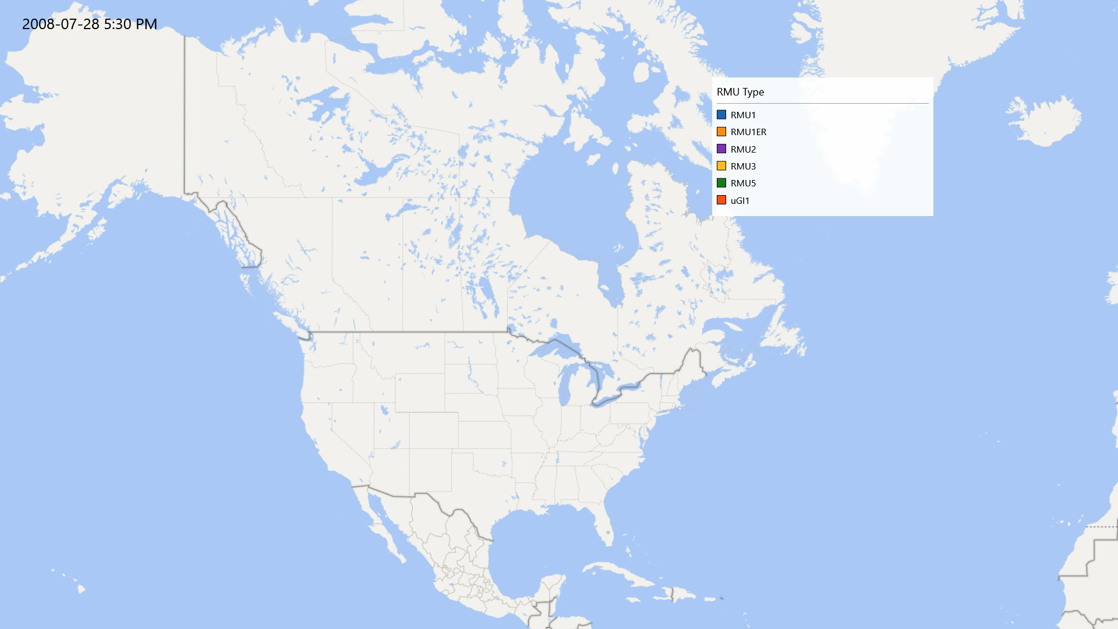
Remote Monitoring Implementation 2009-2019

Slide 4
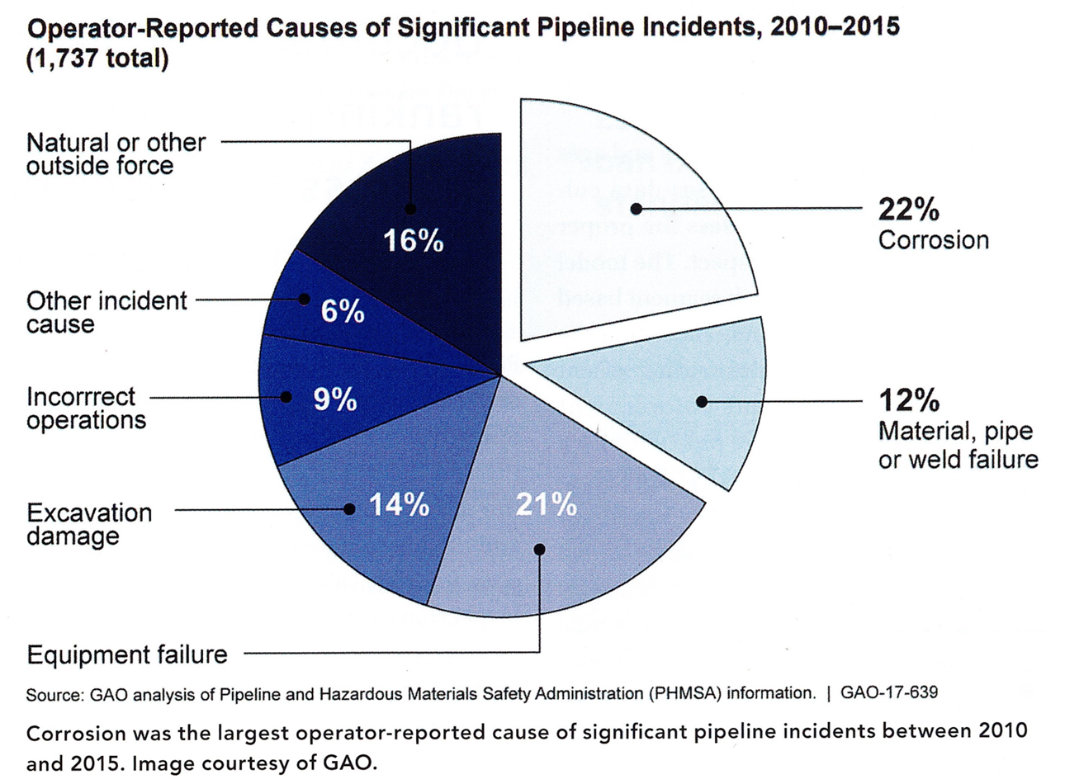
Why Remote Monitoring

Slide 5
Cathodic Protection System Risks
CP system is causing accelerated corrosion on non bonded structures
CP system is not achieving protection
Environmental Impact
Health and Safety Risks
CP Systems operated without adequate documentation and/or by persons not adequately trained

Slide 6
Introduction To Remote Monitoring
Corrosion/Cathodic Protection Basics
What Is Remote Monitoring
Cathodic Protection Operation
When Is The Right Time / What Is The Right System

Slide 7
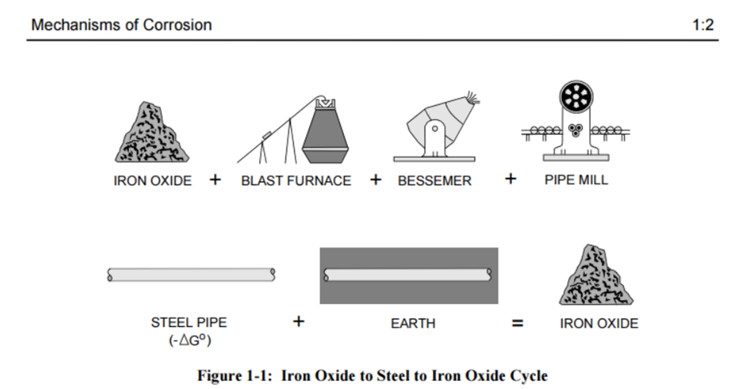
Corrosion Basics
Source: NACE

Slide 8
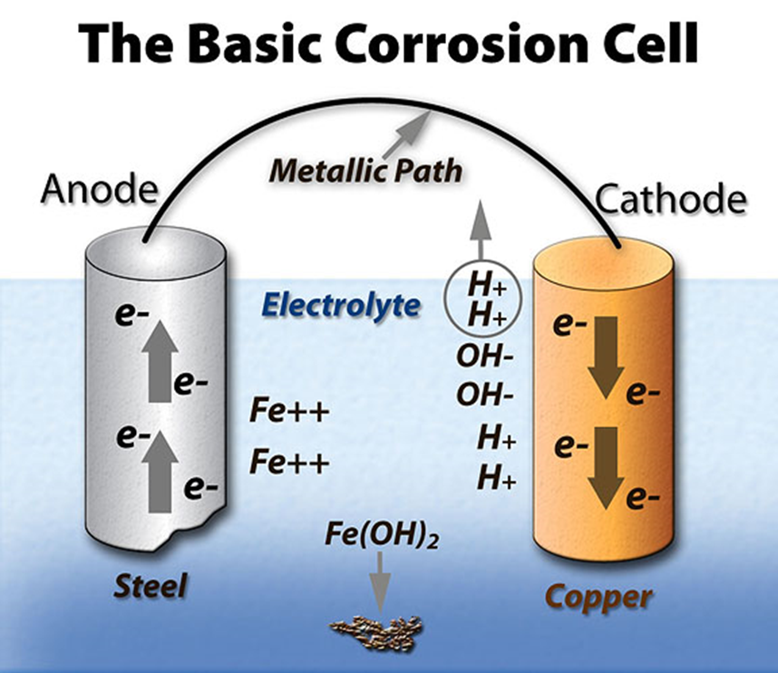
Corrosion Basics
REQUIREMENTS FOR CORROSION
Anode – Location where positive ion transfers charge to electrolyte
Cathode – Location where excess electrons bond with ions from electrolyte
Electrolyte – Electrically conductive medium
Electrical Bond – Anodic and cathodic sites must be electrically continuous

Slide 9
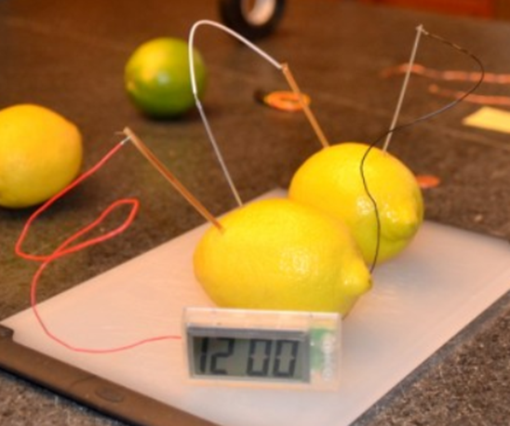

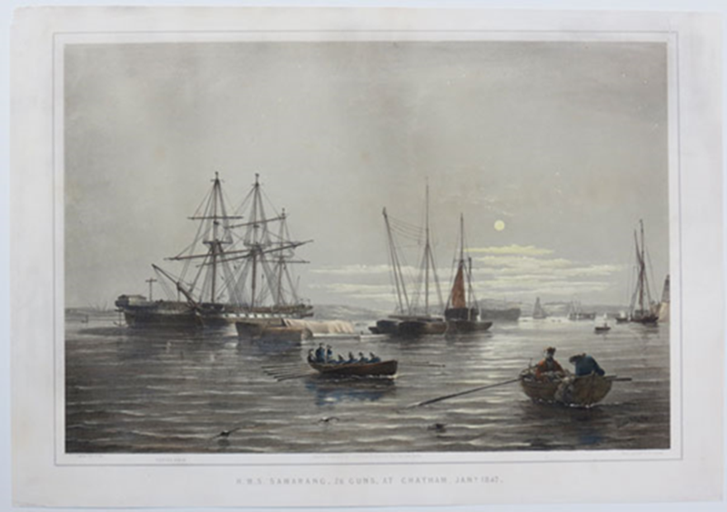
Cathodic Protection

Slide 10
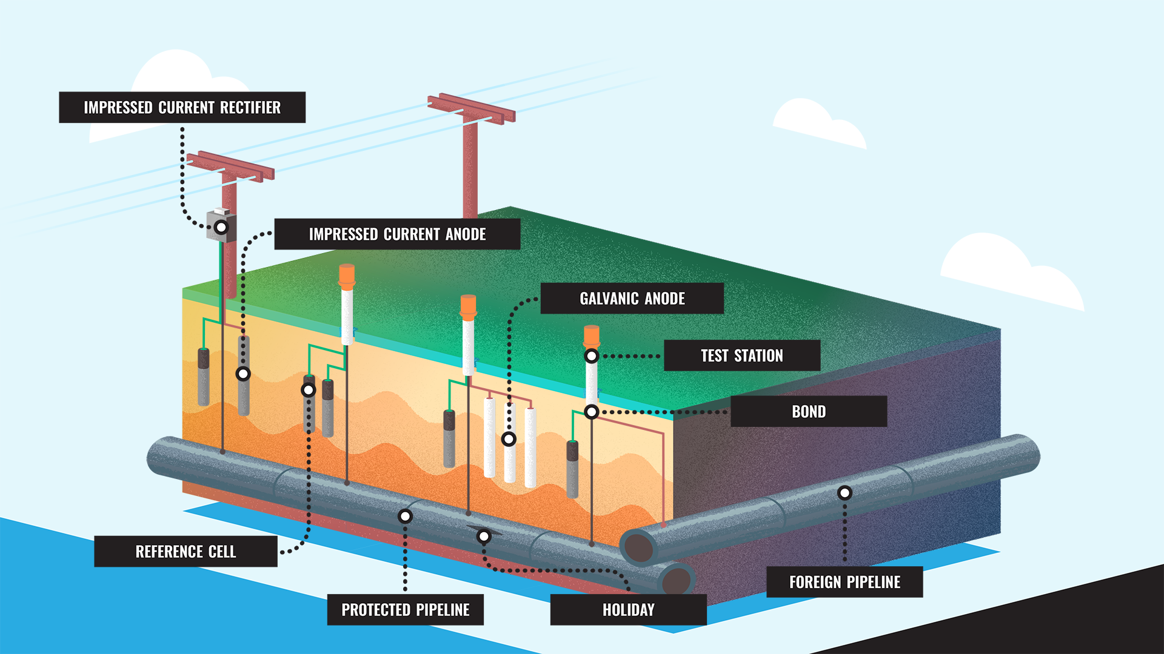
Common Cathodic Protection Assets

Slide 11
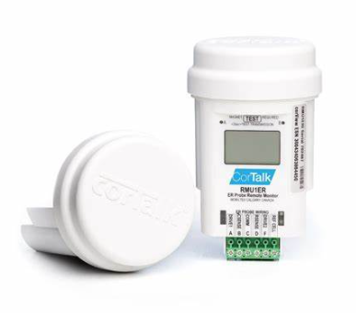
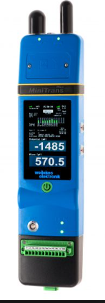
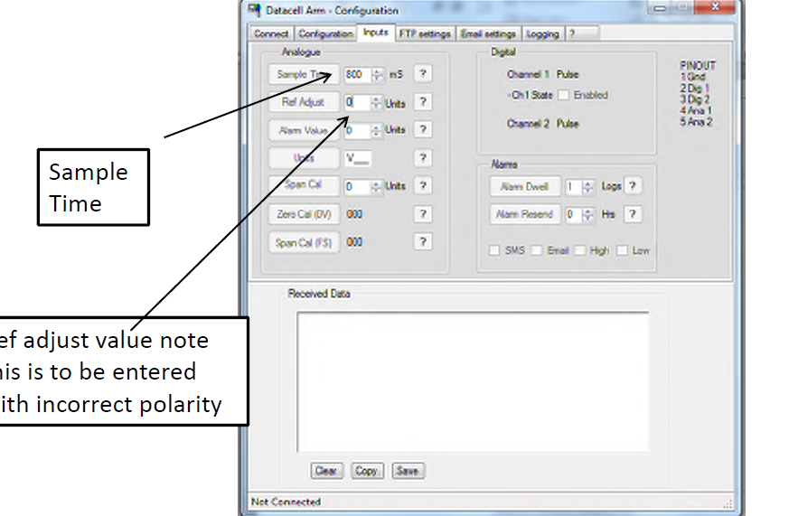
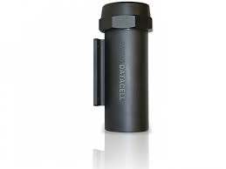
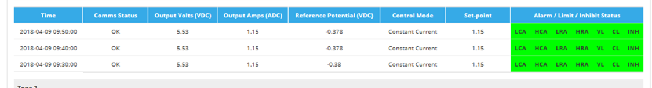
What is a CP Remote Monitoring and Control System
Remote monitoring automates measurement tasks and uses collected data to enhance system performance and understanding.
CP Strategy – The strategy document ensures the CP team has a clear plan to operate and maintain the CP system
Hardware – Retrofit / factory installed test unit that takes measurements, communicates to the cloud, and actions instructions
Software – For communicating with the hardware, usually web based. In some cases this may only be used for fault finding set up etc
Database – Repository of all measurements

Slide 12
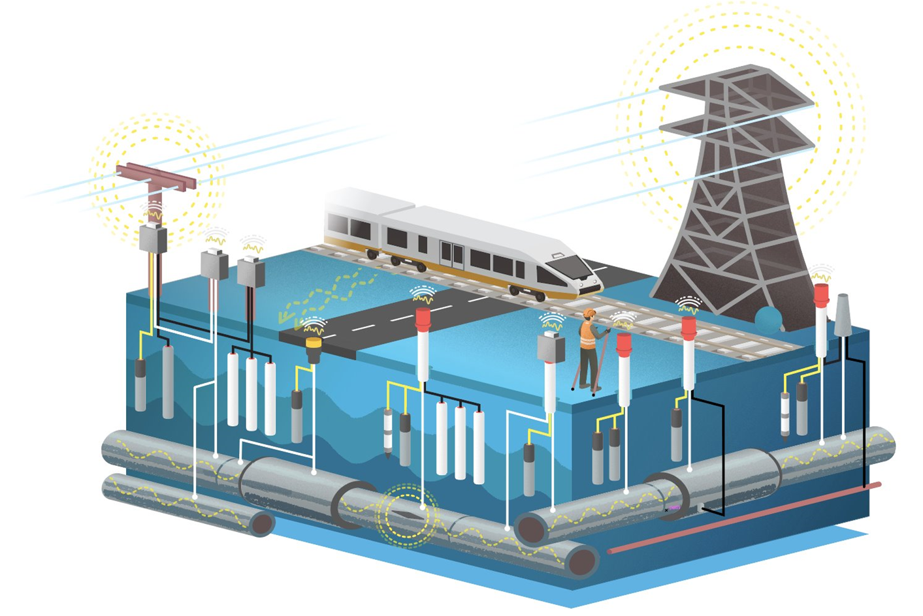
Remotely Monitored CP System

Slide 13

CP System Operation And Maintenance
AS 2832.1 Section 10.3 – Correct operation of all CP system equipment must be checked including
  Isolation(s)
  Casings
  Continuity bonding (where accessible)
  TR Units, electrical equipment
  AC earthing

Slide 14

CP Operation Manuals
AS 2832.1 Section 9.6 Operation manuals shall include the following:
      Detailed description of the system and its components
      Detailed As Built drawings to show
        TR units
        Anode ground bed/support details
        Test point arrangements
        Details of insulating joints, casings, earthing and stray current devices
      Locations of all items shall also be shown in drawings or GIS
      TR Unit O&M manuals (incl electrical supply line diagram)
      System adjustment and control information
      Alarm conditions and fault finding
      Recommended routine inspection schedule and tests required

Slide 15
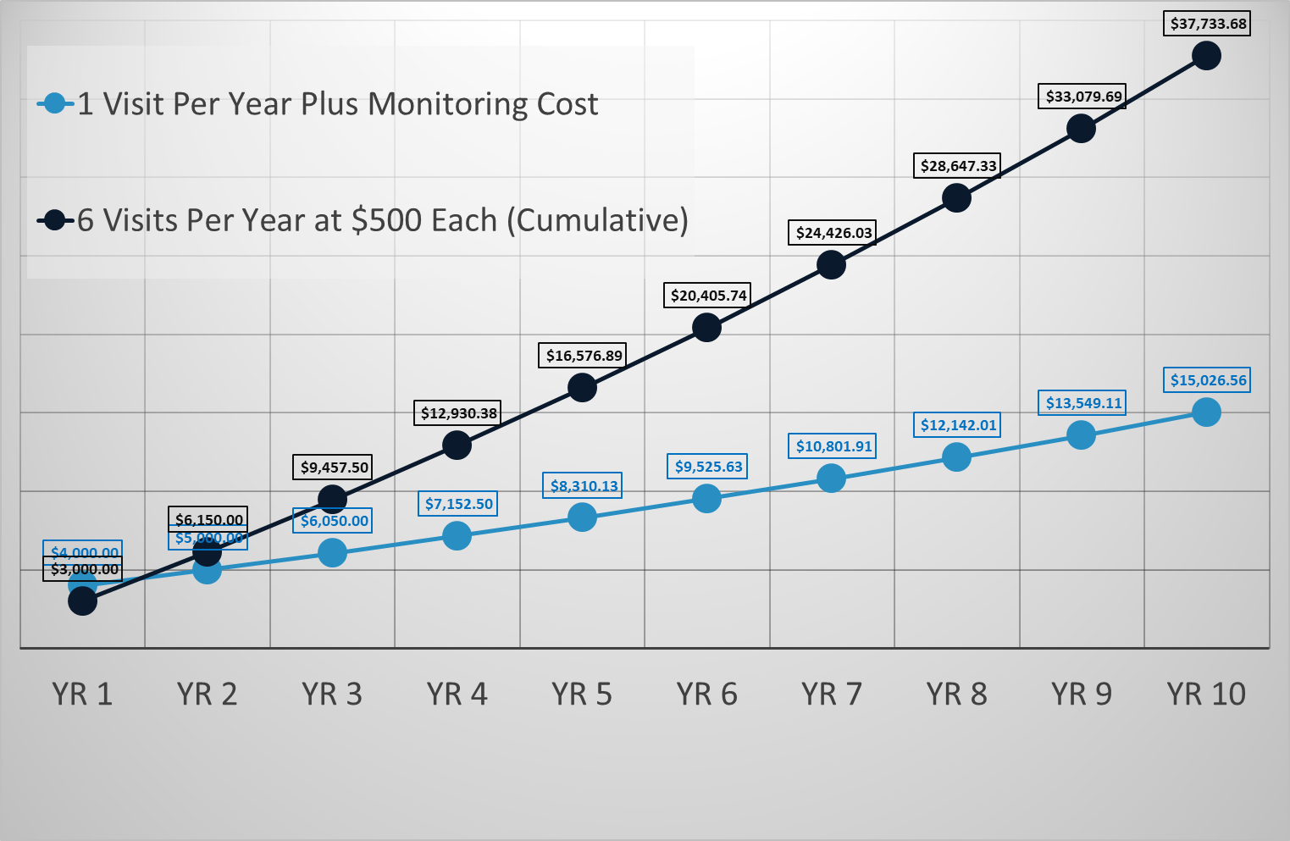
Cost Comparison

Slide 16
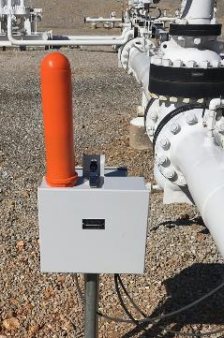
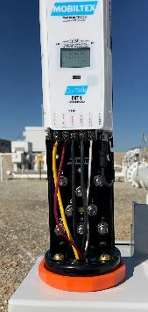
History Of Remote Monitoring In CP
1990
2007
2018
1st & 2nd Generation
3rd Generation
4th Generation
High power private radio networks
Local hosted server
Garage Industry
Cellular & Satellite Solutions
Web-based data management
Lower power, scalable solutions
BT field configurations
IoT-centric Cellular & Satellite Solutions
Secure Commercial Cloud data management
Ultra low power for long autonomy
Potential for analytics, visualization, insight

Slide 17
History Of Remote Monitoring In CP
1990
2007
2018
1st & 2nd Generation
3rd Generation
4th Generation
Ad hoc implementation
Best efforts approach
Silo’d soluton based implementation
Incorporated into CP system design
CP systems designed around maintenance, data management and risk reduction
Assets and Applications
Rectifiers
Bonds
Coupons
AC Mitigation
Test Stations

Slide 18
Operating And Capital Improvements
Operating Efficiency
Capital Efficiency
Avoid manual tasks (e.g. data collection, install interrupters)
Reduce or eliminate admin
Improved incident response via Alarms
Proactive O&M
Shift workload to high impact areas – help prioritize CP
Better data to drive high value decisions (e.g. mitigate digs)
Informed risk matrix
Asset life extension (e.g. pipeline or groundbed)
Capital planning & deferral
Increasingly
impactful

Slide 19
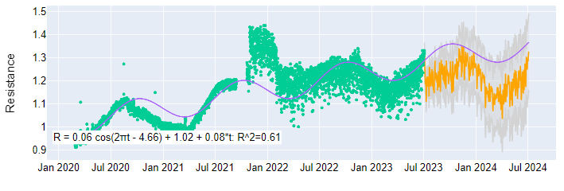
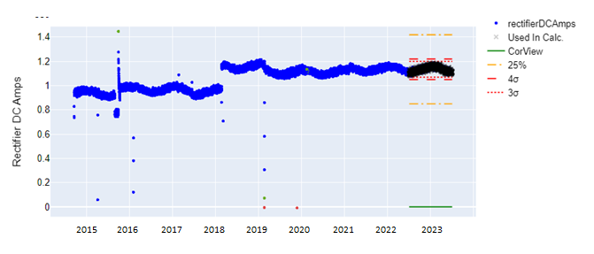
Asset & Data Integrity
Groundbed Remaining Life Forecast
Enabling Better Data Collection
Data quality
Consistency
Removed human interpretation
Data quantity
Helps counter compliance-only mindset
Increased visibility
Data on assets where previously ‘visible’ once a year
Enables new activities
Statistically Derived Alarm Limits

Slide 20
Environmental Impact
Remote Monitoring Contributes to Reduction of GHG Emissions:
CO2 emissions from reducing windshield time, helicopter access
Reduce fugitive gas emissions from leaks, bursts
Established communications backbone across remote pipeline assets
Ensure delivery of natural gas is as efficient, safe, and sustainable as possible
Protect hydrogen pipelines of the future
Compared with manual data collection, an install base of 20 RMUs offsets over 8.5 Metric Tons of CO2 emissions per year, equal to the total annual energy consumption of 1 home.

Slide 21
Health And Safey Risk
Reduced exposure to field hazards due to reduced field based maintenance requirements
Reduced exposure to field hazards due to remote fault identification
Better understanding of pipeline corrosion risk allows for better planning of remediation

Slide 22
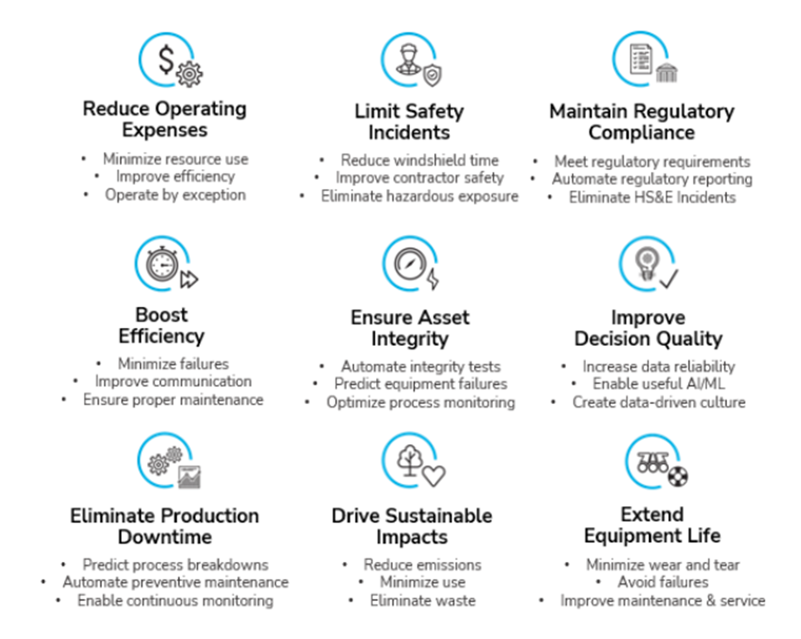
Benefits of Remote Monitoring

Slide 23
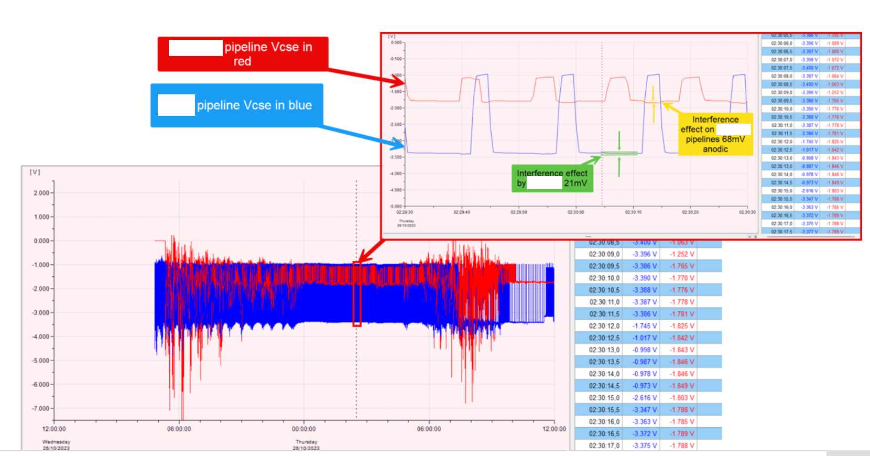
Case Study – Stray Traction & Third Party Interference

Slide 24
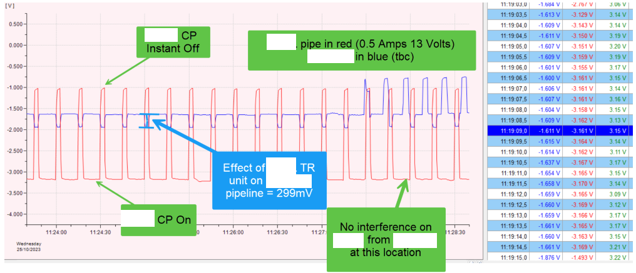
Case Study – Stray Traction & Third Party Interference

Slide 25
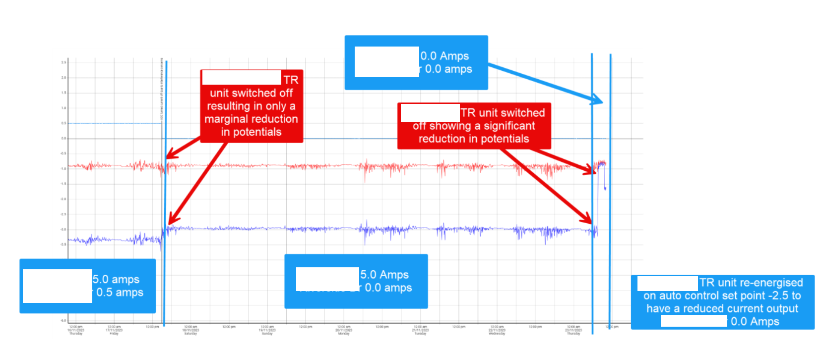
Case Study – Stray Traction & Third Party Interference

Slide 26
Outcome
Field Works required in road - eliminated
Night works - eliminated
Excessive interference on foreign structure – eliminated
Impact on community - eliminated

Slide 27
When To Transition To Remote Monitoring
Considerations Of The Below
Age/Design Life Of CP System
Modifications to original design
Anachronisms/modifications in original CP system designs
Environmental impact
Health and Safety incidents / trends
In house knowledge

Slide 28
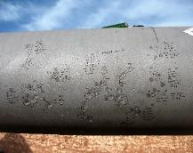
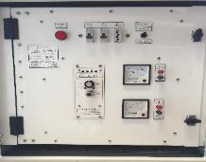
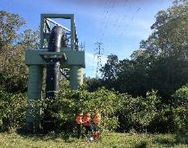
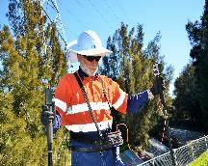
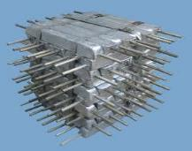
THANK YOU
Presented by: Alan O’Connor
Corrosion Control Engineering
www.cceng.co.nz
Corrosion Consultancy
Cathodic Protection
Maintenance & Inspections
Pipeline Surveys
Products & Equipment
Alan O’Connor
Principal Engineer
Tel: +64 6 755 3988. Mobile: +64 27 604 1338
alanoconnor@cceng.co.nz

