Slide 1

Scott Mitchell
        Scott is an experienced engineering manager with a career based on natural gas transmission. He has worked in every state and territory in Australia and has gained close first-hand experience with many of Australia’s major transmission pipelines.
        Scott’s career highlights include being the package engineer for Australia’s first mega pipeline order from China for the QCLNG project. Also, Scott also took the role of commissioning engineer for all 11 of the APLNG transmission pipelines.
        Scott now leads the Project Design team within APA’s Engineering and Planning (Operations). His delight for the technical detail is now matched by his enjoyment of developing a new tranche of engineering leaders.
Team Lead Design (Operations)
APA

Slide 2
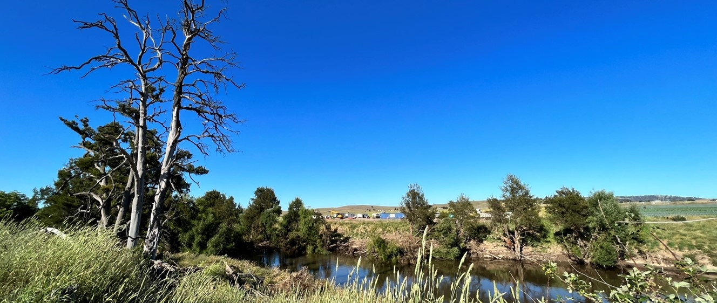
APGA Seminar – AS2885.3 Rollout
Emergency Response
YLP Case Study
Nov 2023

Slide 3
Disclaimer
This presentation is for educational purposes only for the attendees of the APGA seminar on AS2885.3 (2022) roll-out
The images, descriptions or other information within this presentation is and remains the intellectual property of APA Group (including any of its related bodies corporate)
APA does not grant consent or permission for the images, descriptions or other information in this presentation to be duplicated by any person or entity outside APA Group (and its related bodies corporate)

Slide 4
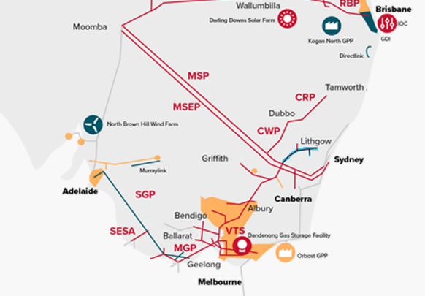
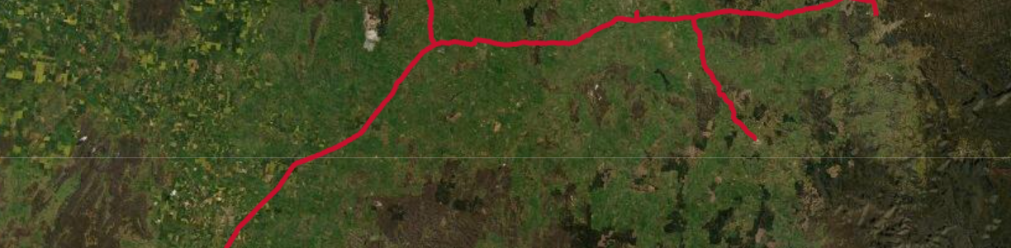
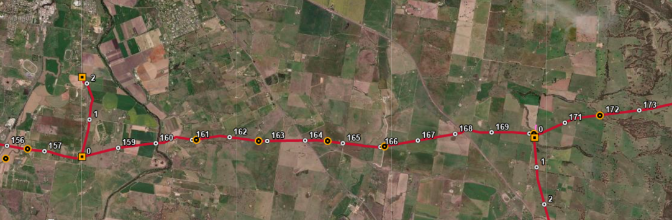
Young Lithgow Pipeline – Runs from Moomba Sydney Pipeline
Bathurst
Wallerawang
Lithgow
Oberon
Bathurst
Wallerawang
Macquarie River
Notes:
TALKING POINTS:
Happened in cold snap
Major towns cut off from supply
Jemena managing networks issues
Widespread coverage

Slide 5
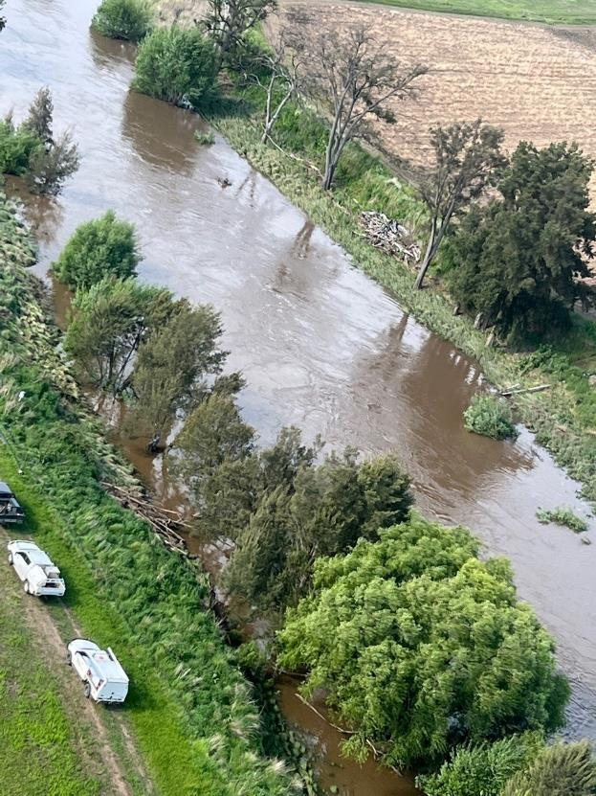
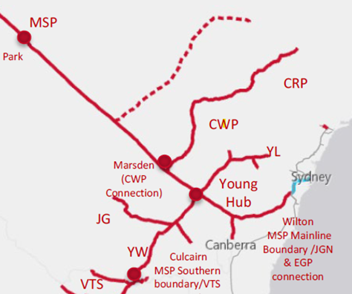
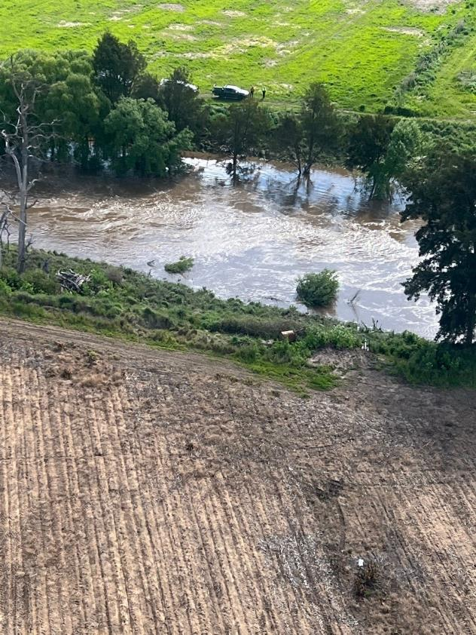
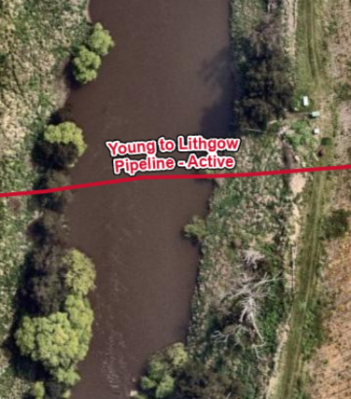
YLP crossing the Macquarie river
Notes:
TALKING POINTS:
Failure in Macquarie River during flood
Location of failure inaccessible
Gas release witnessed by landholder (and subsequently operations tech)
Line isolated by automatic line breaks on MLV’s

Slide 6
Stages of Recovery

Slide 7


Multiple engineering solutions worked through concurrently
In Situ
Temporary crossing
LNG solution
Supplying all residential customers, not the large industrial customers.
Temporary HDD
Permanent HDD
clamping leak mid-stream – solution abandoned when confirmed pipe was fully broken
Catenary, pipe-sinking and pipe flotation assessed to be too risky due to existing river conditions
Location changed
Online in 8 days from rupture
Completed within 18 days from first rupture
Completed in under 7 weeks
CNG for Lithgow
Linked up Jemena with CNG for Lithgow Hospital
Notes:
TALKING POINTS:
Many moving parts
In-situ repair not practicable
Insertion not practicable
LNG
Temporary HDD selected in preference to dragging string across
Perm repair quite conventional

Slide 8
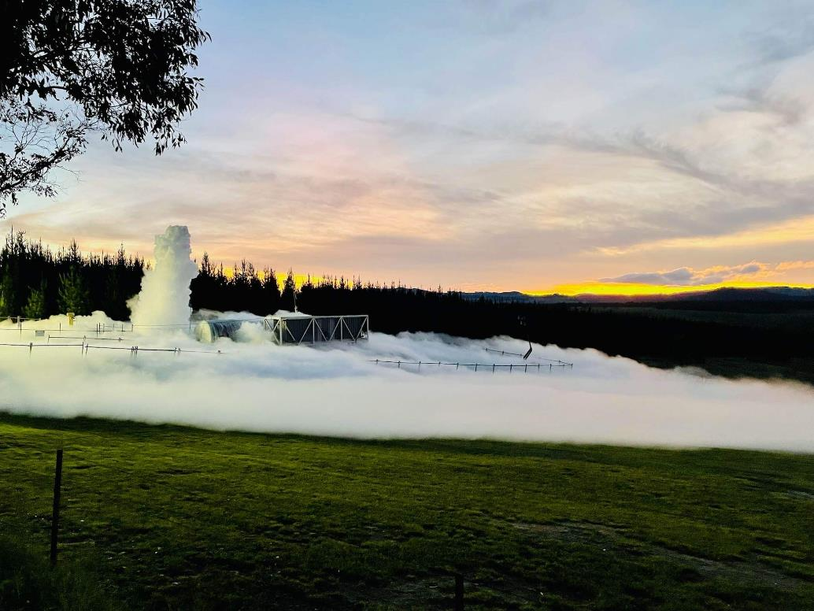
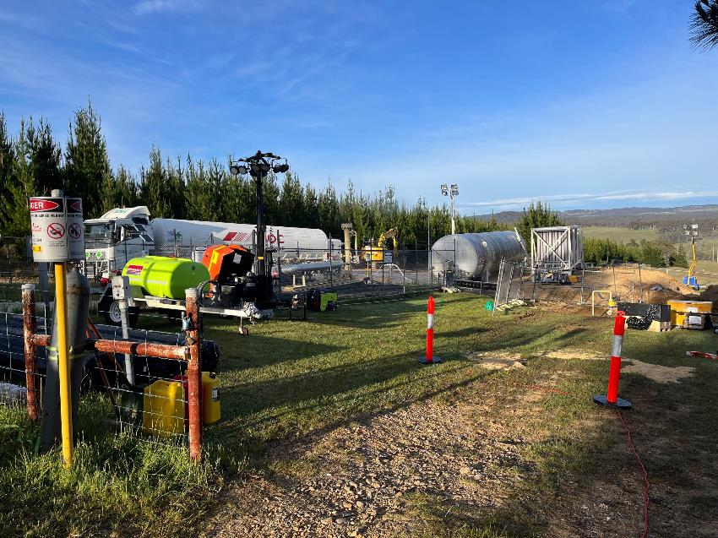
LNG Injection at Wallerawang (8 days)
Notes:
TALKING POINTS:
LNG solution very quick
Maintained min supply and allowed re-lighting

Slide 9
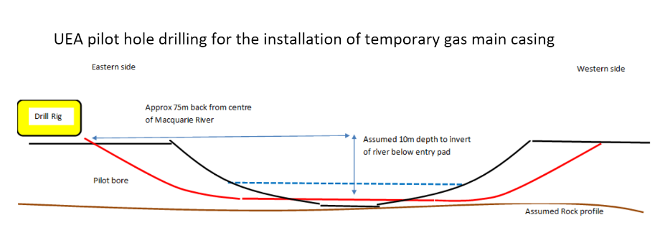
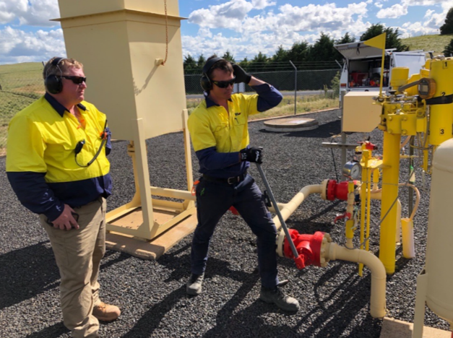
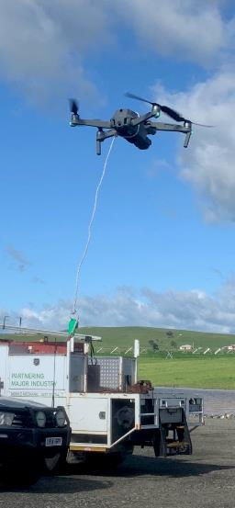
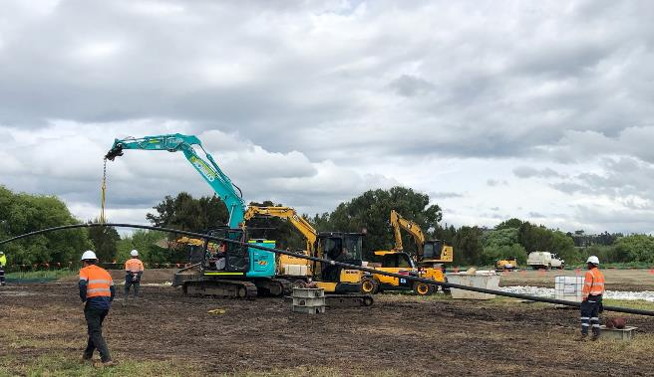
Temporary Solution (18 days)
Horizontal Directional Drilling with a 4in pipe pull-through
Notes:
TALKING POINTS:
Selected HDD given that rig was there. Just to smooth out profile. No drill – just pushed through banks
Utilised drill pipe and inserted
Tricky with river – novel use of drones for isolations

Slide 10
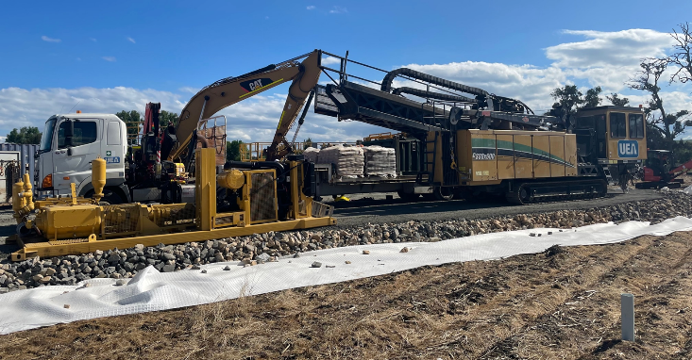
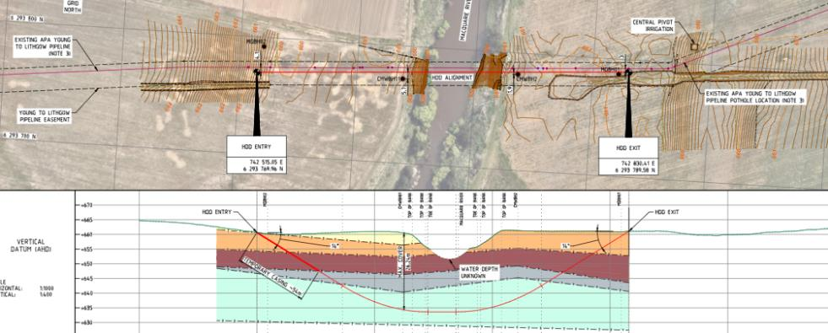
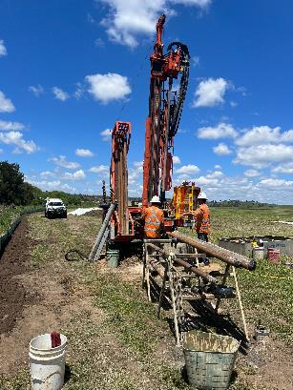
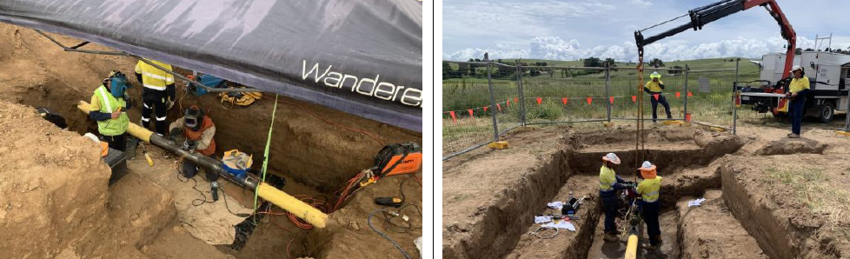
Permanent HDD repair (7 weeks)
Notes:
TALKING POINTS:
Conventional HDD
Needed Geotech dill first
Needed to stay within easement and avoid existing pipe
Running concurrently with temporary solution

Slide 11
Key Aspects of AS2885.3 (2022)

Slide 12
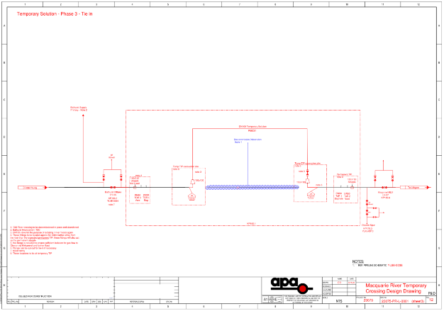
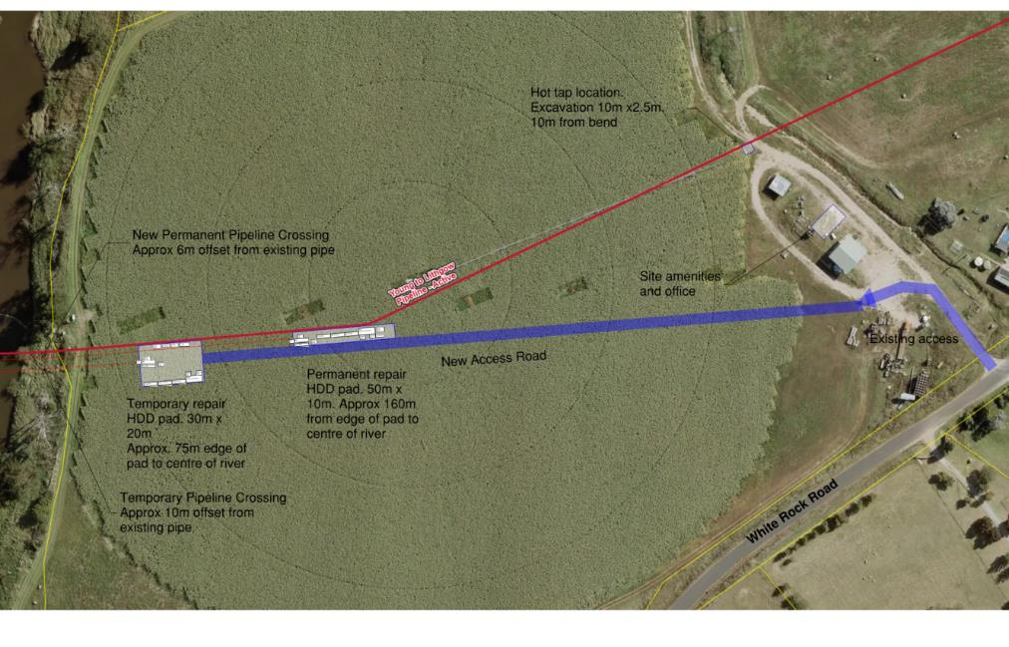
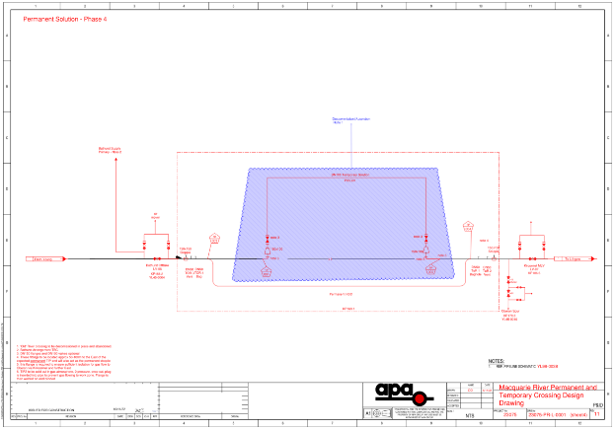
Clause 12 – Records Management
Notes:
TALKING POINTS:
Needed open pathway to communicate between Site and Office design teams
2 critical documents – layout and P&ID
Changing daily
Too frequent for formal document control – needed light method

Slide 13
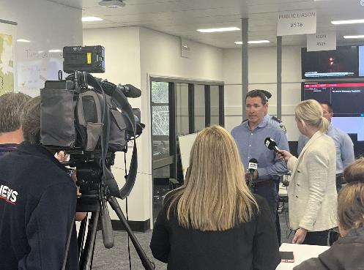
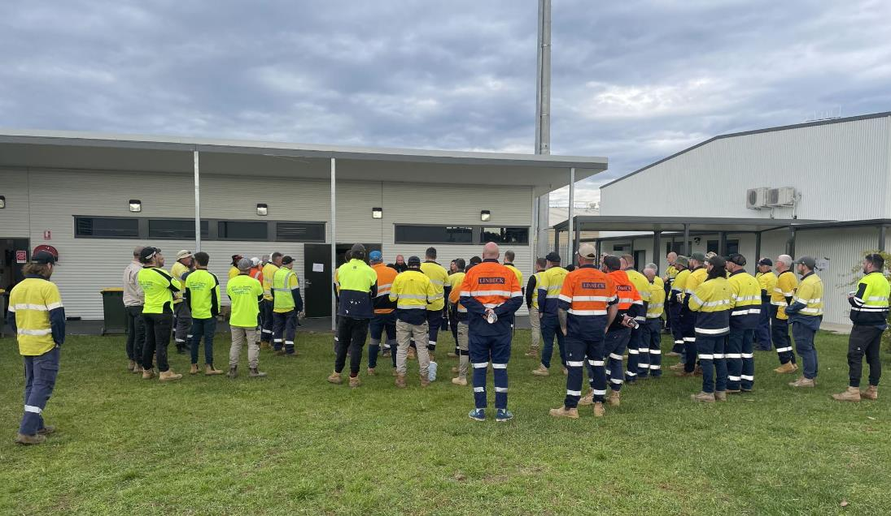
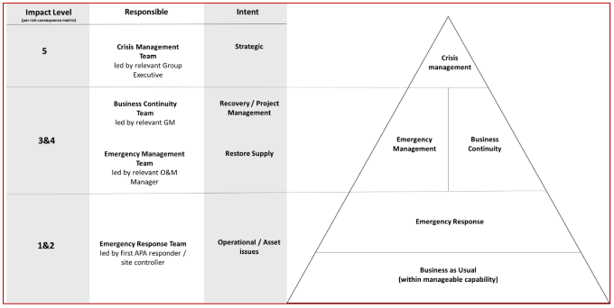
Clause 11.4 - Communication
Notes:
TALKING POINTS:
Seems like a strange inclusion in the standard
Responders and Emergency Services
State Authorities
APA’s Emergency structure – Emergency and Business Continuity (twice daily)
BE PREPARED – resource accordingly

Slide 14
Clause 9.4 Defect Repairs
EXPECTATION
Project Risk Assessment
Construction HAZID
Commissioning HAZID
AS2885 SMS
DESIGN
CONSTRUCTION
COMMISSIONING
Notes:
TALKING POINTS:
Flow chart in the standard.
Seems simple and logical

Slide 15
Clause 9.4 Defect Repairs
REALITY
Project Risk Assessment
(Part 1)
Environmental Risk Assessment
Project Risk Assessment
(Part 2)
Pre-site Establishment HAZID
Construction HAZID
AS2885 SMS
Commissioning HAZID
TEMP DESIGN
TEMP CONSTRUCTION
TEMP COMMISSIONING
Environmental Risk Assessment
Construction HAZID
AS2885 Change of Operating Conditions SMS
Commissioning HAZID
AS2885 Failure SMS
PERM DESIGN
PERM CONSTRUCTION
PERM COMMISSIONING
POST-WORKS
Notes:
TALKING POINTS:
In reality, much more complex
Multiple repairs and activities
Permanent Risk Engineer to manage it all
SMS’ prior to commissioning the chance to catch all actions
Failure SMS came later

Slide 16
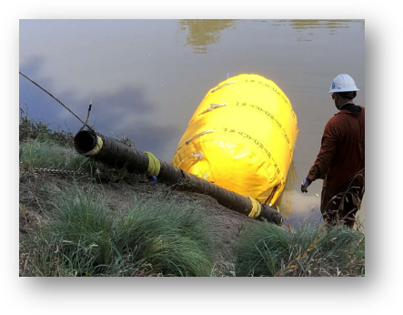
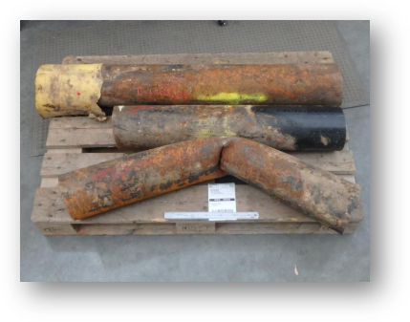
Clause 10.9 – Pipeline Failure
Notes:
TALKING POINTS:
Clause 10.9 says Failure Review SMS needs to identify root cause
For YLP Emergency we could only proceed on apparent cause – break in river crossing
Tended to rest of clause obligations – FFS @MAOP, Residual risks ALARP, PIMP review
Root cause still under investigation
Needed access to the ends of the mainline pipe (metallurgical)

Slide 17
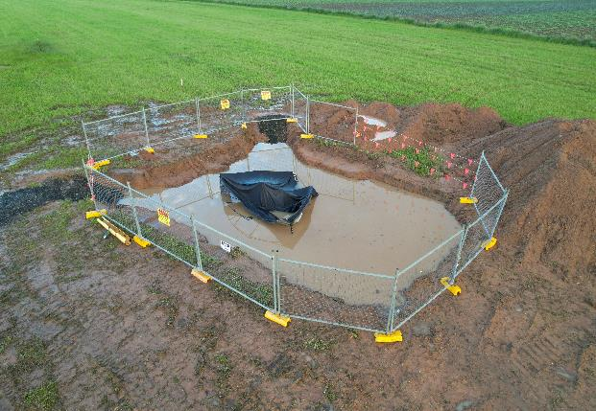
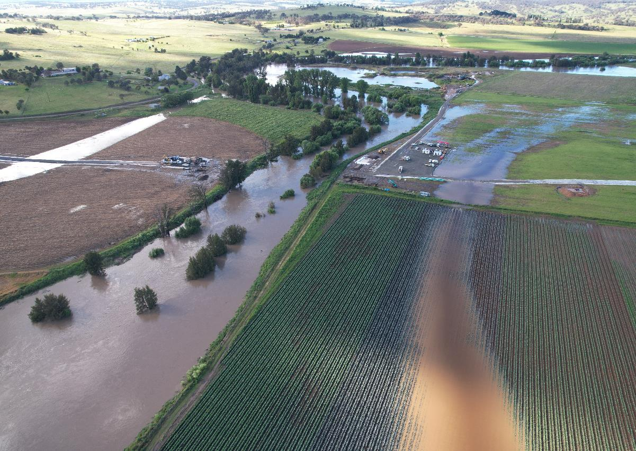
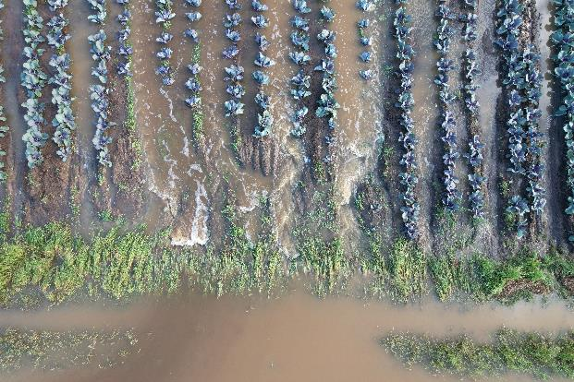
Road to Recovery May Not Be Smooth
Notes:
TALKING POINTS:
Second flood – just after temporary string installed
Needed to demobilise & lost 2 -3 days of progress
Hazards still exist in emergency environment

Slide 18
Clause 11.3 Emergency Response Plan
Communications
Roles and Responsibilities
Operational Readiness
REGULAR UPDATES
Notes:
TALKING POINTS:
No better time to review and update
Emergency still fresh in our minds
Exceptional performance, but always opportunities to improve

