Slide 1

Tom Amrein
        Tom is an experienced pipeline engineer with proven capability in managing high risk assets in a regulated environment. He has a comprehensive knowledge of pipeline design, construction, operation and maintenance that has been developed through more than 15 years working for pipeline operators and contractors.
        Tom is responsible for pipeline integrity, assessment and repair as well as overseeing design and QA on new projects. He is also the subject matter expert on all welding across the network, including in-service.
        As a Chartered Professional (Mechanical) engineer and Certified International Welding Engineer (CIWE) Tom has been actively involved in the development of Australian Standards for pipelines having recently become a member of the ME-38 Committee.
Principal Engineer - Pipelines
Jemena Gas Networks

Slide 2
Case Study:
Integrity Management – The JGN Northern Trunk Pipeline

Slide 3
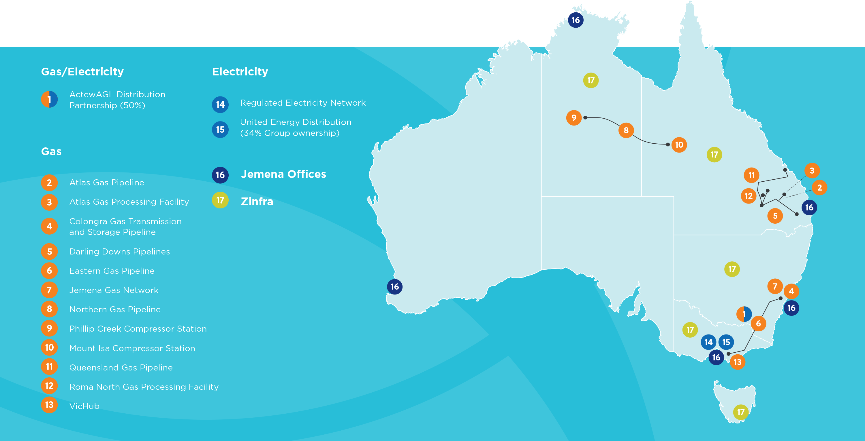
Jemena
Notes:
Jemena
Spiel
JGN - Sydney, NSW
Case Study - JGN Northern Trunk Pipeline
Good study for all section of the standard…
Only Section 5, 6, 9, 10
Pipeline System Integrity Management
Structural Integrity
Anomaly Assessment and Defect Repair
Changes to Approved Operating Conditions

Slide 4
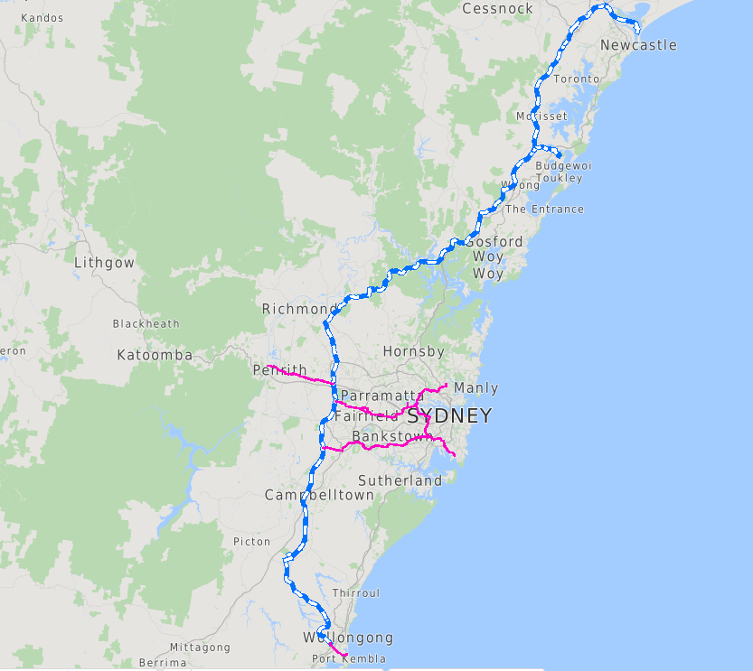
JGN Pipelines
Trunk | Primary
Central Trunk (L1) | Sydney Primary Main
Northern Trunk (L3, 7, 8) | Sydney Primary Loop
Southern Trunk (L2) | Western Sydney Primary Main
 | Wollongong Primary Main
Notes:
JGN – 1.5 Million Customers
- Backbone of the network
Trunk – licenced – 270km Wollongong to Newcastle via Western Sydney
Primary – unlicenced – 150km, part of the Network SOAP, but managed to AS2885

Slide 5
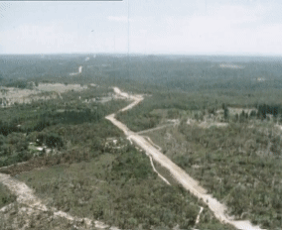
The Northern Trunk
Stats
  DN500
  172km
  5.3 - 8.5mm WT
History
  Built 1976-1981
  AS CB28 - 1972 (Lic 3)
  AS 1697 - 1975 (Lic 7&8)
  DF - 0.8 for 5.3mm WT section
  MAOP: 6895kPa
    ROP: 4500kPa since 2007
    Longwall mining -> subsidence
Notes:
Stats
DN500
172km
5.3 - 8.5mm WT
History
Built 1976-1981
AS CB28 - 1972 (Lic 3)
AS 1697 - 1975 (Lic 7&8)
DF - 0.8 for 5.3mm WT section
MAOP 6895kPa
MOP/ROP - 4500kPa – 2007 – Pressure limiting station built
Mine subsidence – longwall mining in the southern highland
Completed and reinstated 2017
ROP remains in place - no need to increase… until now

Slide 6
Chapter 10 - Changes to Approved Operating Conditions
Kurri Kurri Power Station -> Driver for needing more capacity -> more pressure
  Remove (raise) ROP - § 10.6
AS2885.3 - Removal of a ROP shall be APPROVED
  Closure of all actions required to return to the MAOP that were identified in the engineering assessment that set the ROP
  Confirmation that the safe working pressure for the pipeline is satisfactory for the intended MAOP or a revised ROP, where necessary.
  Where an ROP was in place for more than 12 months, a change of operating conditions SMS shall be completed covering all relevant factors regarding the impact of the proposed increased operating pressure. In accordance with AS/NZS2885.6
Notes:
Starting back to front - New Customer
Driver for needing more capacity - more pressure
Remove (raise) ROP - § 10.6
Thin wall pipe sections now in T1 areas - Original MAOP will never be achieved
AS2885.3 - Removal of a ROP shall be APPROVED
Closure of all actions required to return to the MAOP that were identified in the engineering assessment that set the ROP
Longwall mining works complete, strain assessment complete, pipeline reinstated in 2017
Confirmation that the safe working pressure for the pipeline is satisfactory for the intended MAOP or a revised ROP, where necessary.
The other chapters -
Integrity Management System
Structural integrity
Defect Assessment and Repair
Where an ROP was in place for more than 12 months, a change of operating conditions SMS shall be completed covering all relevant factors regarding the impact of the proposed increased operating pressure. In accordance with AS/NZS2885.6
Formalising the points above

Slide 7
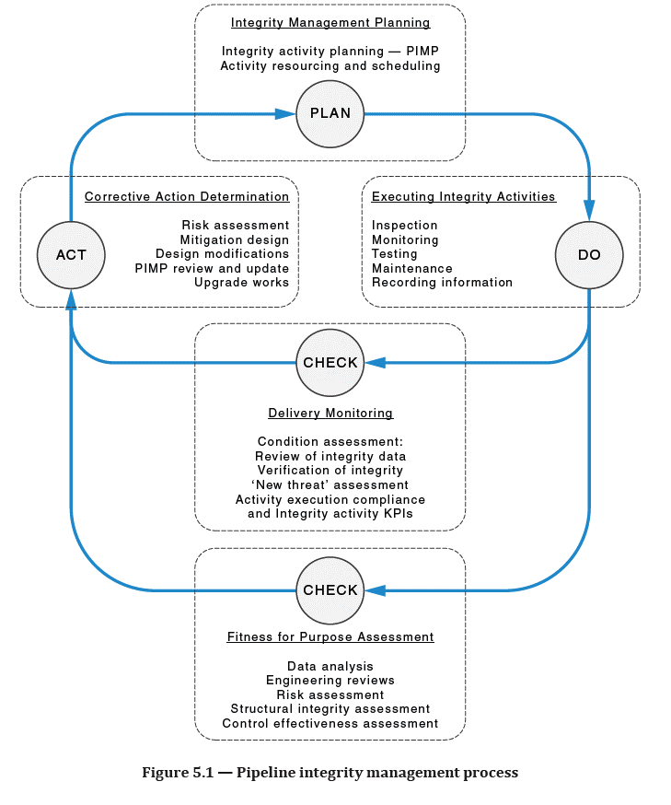

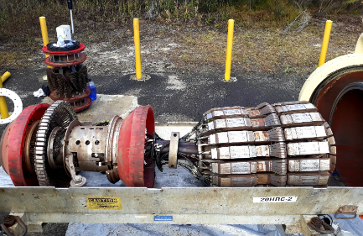
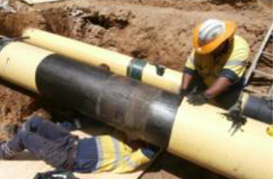
Chapter 5 - Pipeline System Integrity Management
Notes:
Pipeline System Integrity Management - outlines the need for and Pipeline Integrity Management Plan (PIMP)
We do not have a PIMP - in the purest form
Series of documents with different names that meet the same objective as part of our businesses Asset Management System
Operates on the same basis -> Plan - Do - Check - Act
Plan = PIMP
Do =
10 yearly ILI
Dig up programme
Girth weld corrosion
Heat shrink sleaves
Leads into defect assessment and repair
CP surveys 3,4, 6 months
DCVG on unpiggable section - last 1.6km
Project online to look at this more closely
Check = Review of integrity data collected in the last step
5 yearly SMS
RLR
Line identified threats against what your inspections are telling you.
Encroachments
HSS - FJC - ILI results
Validation digs from ILI
Act = Updated to the Plan to reflect findings
ILI frequency increased

Slide 8
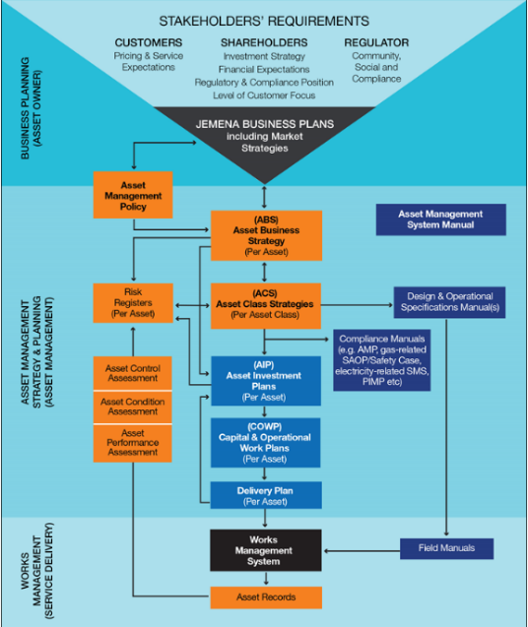
Jemena Asset Management System
Asset Business Plan
Asset Class Strategy
Field Operation and Maintenance Spec
Operational Monitoring, Control and Response Plan
Asset Class Strategy Recommendations
Traditional MLF ILI (regular 10 yearly)
Analysis and recommendations
Integrity Digs
Analysis and recommendations
Ultra-MFL ILI (5yrs after previous)
Analysis and recommendations
Integrity Digs
Safety Management Study
Reset of MOP
Notes:
No Pimp → substitute documents
Organisation on the right -> main documents on the left
Plan – ABP, + ACS
Do – ACS + FOMS
Check – FOMS + OMCR
Act – Feeds back in to updates of ACS + FOMS
Planed sequence for MOP reset at the bottom

Slide 9
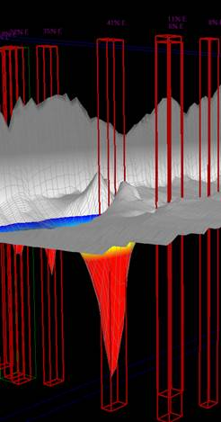
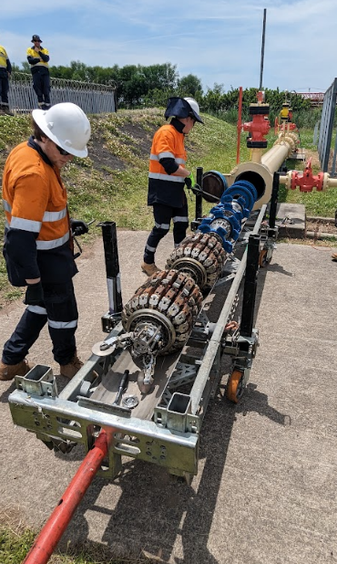
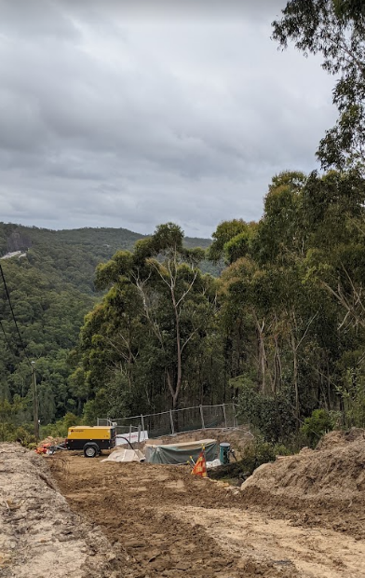
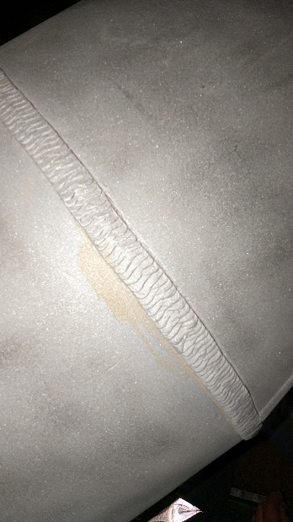
Chapter 6 – Pipeline Structural Integrity
BH Chainage (m) | Up Weld Distance (m) | Joint Length (m) | Min GW distance (m) | Weld # | Feature ID | Feature Class | Clock Position (hh:mm) | Nominal Thickness (mm) | Length (mm) | Width (mm) | Depth (%)
303.54 | 12.40 | 12.42 | 0.02 | 390 | COCL | GENE | 06:22 | 8.5 | 39 | 55 | 14
389.51 | 0.01 | 12.90 | 0.01 | 480 | GWAN | PITT | 08:42 | 8.5 | 13 | 19 | 21
4889.41 | 0.01 | 12.39 | 0.01 | 4240 | GWAN | PITT | 01:07 | 8.5 | 19 | 23 | 24
13054.52 | 0.02 | 12.89 | 0.02 | 11140 | CORR | PITT | 03:45 | 5.9 | 20 | 22 | 16
40463.32 | 12.42 | 12.43 | 0.01 | 34250 | CORR | PITT | 00:29 | 5.3 | 13 | 23 | 13
56594.46 | 12.83 | 12.85 | 0.02 | 47950 | CORR | GENE | 03:03 | 5.9 | 31 | 41 | 13
83842.68 | 0.02 | 12.72 | 0.02 | 71700 | CORR | PITT | 06:35 | 8.5 | 27 | 33 | 20
95339.14 | 0.03 | 12.75 | 0.03 | 81660 | CORR | GENE | 11:45 | 5.3 | 42 | 46 | 18
95647.64 | 0.01 | 12.36 | 0.01 | 81920 | CORR | PITT | 06:16 | 5.3 | 10 | 19 | 21
95976.70 | 10.52 | 10.53 | 0.01 | 82200 | CORR | CISL | 06:57 | 5.3 | 8 | 37 | 15
97013.37 | 12.69 | 12.71 | 0.03 | 83110 | CORR | GENE | 05:45 | 5.3 | 32 | 32 | 25
163738.89 | 0.01 | 11.96 | 0.01 | 142620 | COCL | GENE | 05:29 | 8.5 | 70 | 96 | 26
Notes:
New version of standard has a focused-on pressure test records - what to do if you don’t have them
Under the lens of an Operating Change - I think of this as the "Do" & "Check" operations
"Check" that the pipe wall is structurally sound to withstand the pressure by "Do"ing inspections
Following on from ILI
Direct Assessment
Coating condition
CP performance
Remain life review

Slide 10
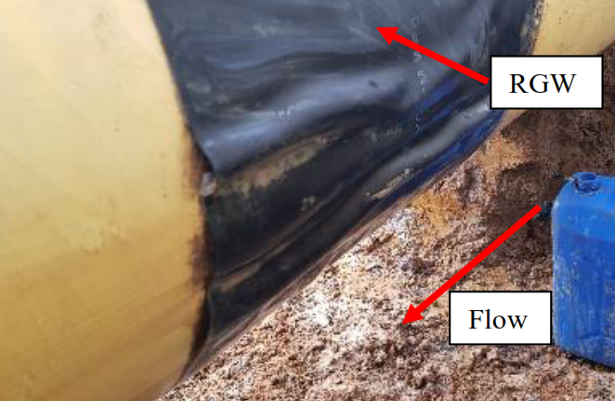
Threats
Dry sales gas
  Internal corrosion is not considered credible
Preferential girth weld corrosion
General pitting corrosion
  Disbonded heat-shrink sleave field joint coating
Often not sized corrected by traditional MFL
Notes:
Understanding Threats to the pipeline
Includes a review all stations and facilities to ensure they are still fit for the proposed pressure, ie no one has decided to install a CL300 flange instead of the standard CL600

Slide 11
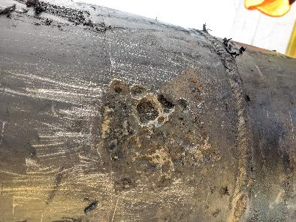
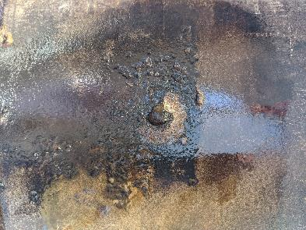
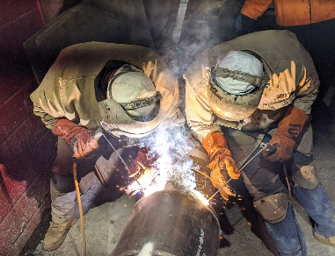
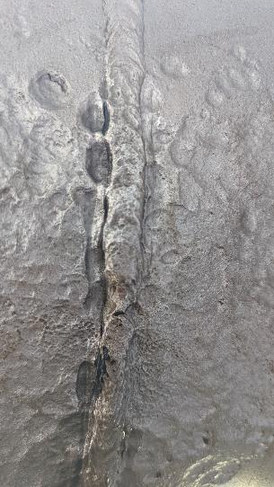
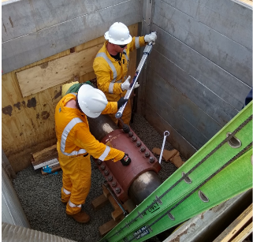
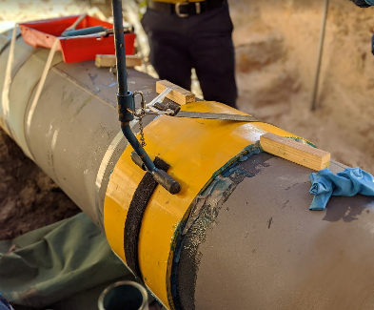
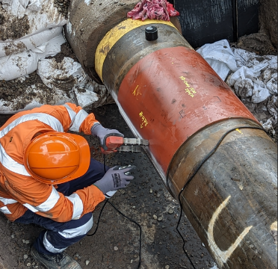
Chapter 9 – Anomaly Assessment and Defect Repair
Notes:
“Check” & “Act” Stage
Based on 2028 ILI
12 Direct inspection locations
Type B sleeve repairs x2
Kooragang Island
Minmi
7 more composite repairs

Slide 12
Summing Up
Urban pipelines have unique challenges
  Also, traditional challenges
  Age
Plan Do Check Act

Slide 13

Questions
Thank You

