Slide 1

Mike Peoples
Mike is a Chartered Mechanical Engineer with 26 years experience in transmission pipelines, gas processing and renewable gas.
Mike is a past member of the Part 3 committee (2012 edition), and past chair of POG. He is a current member of ME-038 main and Part 1 committees.
Mike has experience in all phases of pipeline projects, from concept, design, construction, commissioning, asset handover and operations.
He has never decommissioned a pipeline but has one pipeline in “suspended animation” at the moment.
His current role as Engineering Manager at Zinfra encompasses both major gas and electricity projects, with around $350m of projects currently in progress.
Engineering Manager
Zinfra

Slide 2
AS 2885.3 Seminar
Section 3 – Preparation for Operation and Environmental Management
Presented By - Michael Peoples

Slide 3
Section 3
Basis of Section
Transitioning a pipeline from Commissioning to Operation and Maintenance
Minimum requirements for operational readiness
Key Concepts
Environmental Management (relocated from Section 4)
Readiness for Operation
Handover to Operations
Delayed Commencement of Operation

Slide 4
Section 3
Objectives of 2022 Update
Environmental Management - relocated from Section 3
New section – ‘Preparing for periodic reviews of management documentation’
New requirement - PMS and PIMP must be in place before operation
Delayed Commencement of Operation:
- Requirement for a change in operating condition SMS
- Requirement to update the PIMP to reflect any changes to controls
Notes:
Environment was shifted to Section 3 in light of the fact that some of the environmental obligations stem from construction, such as rehabilitation or management of Net Gain sites

Slide 5

Environmental Management
Identify where there is potential to cause environmental harm
Identify requirements to avoid, minimise or mitigate risk
Identify rehabilitation requirements from construction
In practice it is likely to be held in a structure prescribed by Acts and Regulations
Notes:
with Environment, there is a change to the list of Emissions, obligations have expanded beyond noise (2012), Clause 3.4.3 (2022) now lists emissions of greenhouse gases, odour, vibration, dust and light, ...and the PMS shall identify controls to manage these emissions.

Slide 6
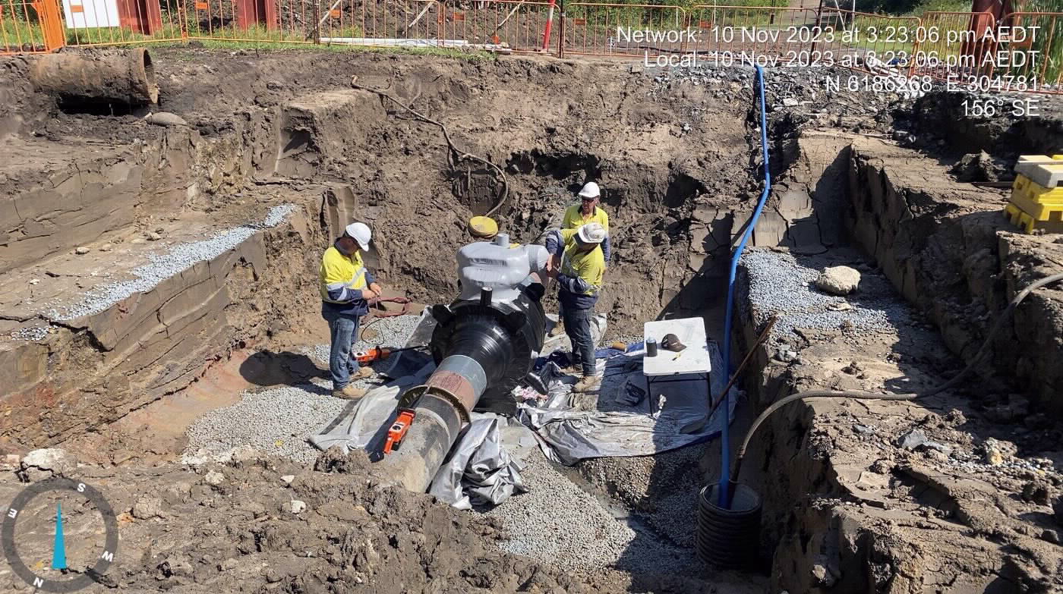
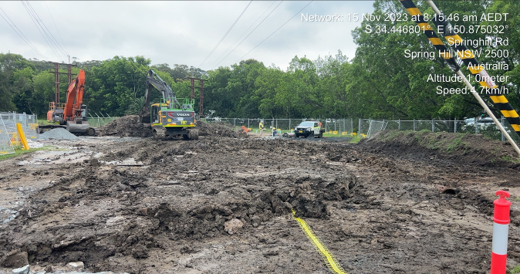
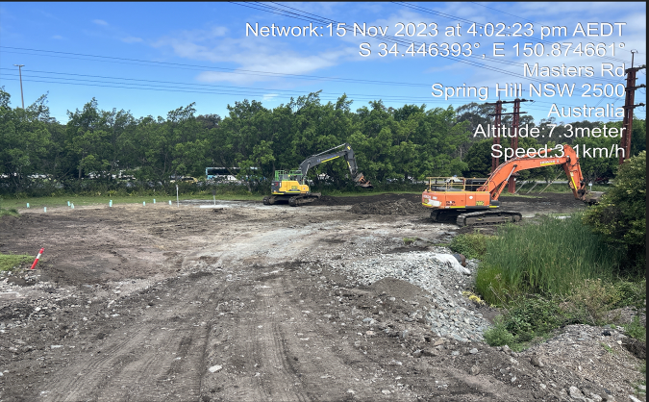
Transition from Construction – Jemena Implementation
Regulatory Approvals Matrix
Commitments Register
Maintained through Construction
Update OEMP prior to handover
Close all elements related to construction and hand over documents
Introduce operational team into interface meetings with authorities

Slide 7
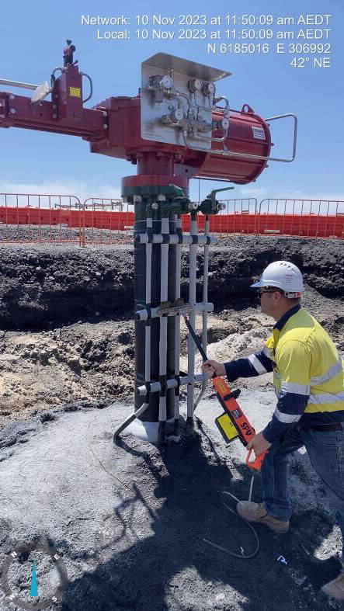
Readiness for Operation
SMS Reviewed by Operating personnel (operations actions implemented)
PMS, PIMP, Operating Plans and Procedures in place
Pipeline control procedures in place
Isolation Plan in place
Conformance with AS 2885
Strength / leak test to AS2885.5
MAOP established
Pressure control and overpressure protection systems operational
Golden welds inspected by NDE and conforming.
Notes:
Readiness for Operations is the O&M Charter.
These are the things the O&M team need to do or to have in place before they can start operating a pipeline.

Slide 8
Readiness for Operation
Operating and emergency personnel are trained
Pipeline is cathodically protected
Threat mitigation measures from SMS are implemented e.g.:
DBYD, Patrols, Land Liaison
Pipeline is Commissioned
Punch List close out is underway
Documentation is “as-built” and stored
Spares stored

Slide 9
Jemena Implementation
Appoint an Integration Manager
Develop a Register and Schedule
Constant stakeholder meetings
Using the Project Gating system
Between Gate 5“introduction of gas” and Gate 6 “completion of handover”
Gate 5 –post hydro, pre-commissioning completed and MDR accepted
Licensee approves Gate 5
Key Stakeholders approve Gate 6
Completion of Integration Register key to Gate 6
Reality – operations have taken over before Gate 6 is completed
Notes:
Handover to operations is about receiving that handshake from the construction team and it is a list of all the things that the O&M team should expect to be supplied by the construction team.

Slide 10
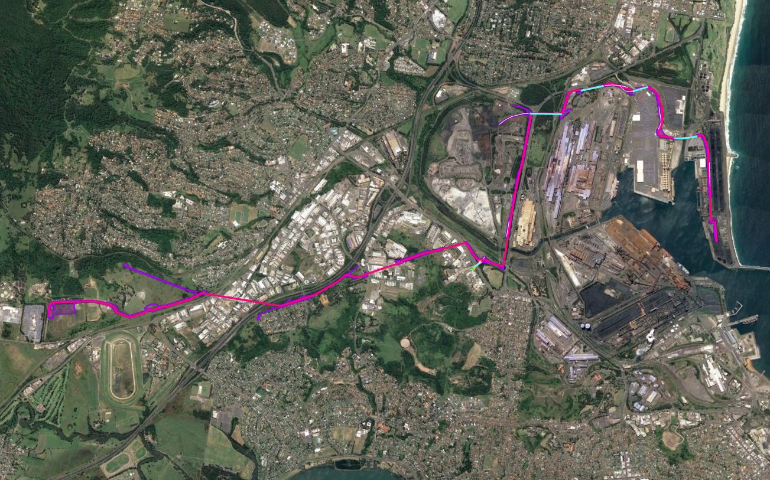
Where Commencement of Operations is Delayed
Compliance with AS 2885.3 is required once the pipeline is commissioned
A change in operating condition SMS is required.
PIMP shall be updated to reflect any necessary changes to control (ie. additional controls or suspension of controls)

Slide 11
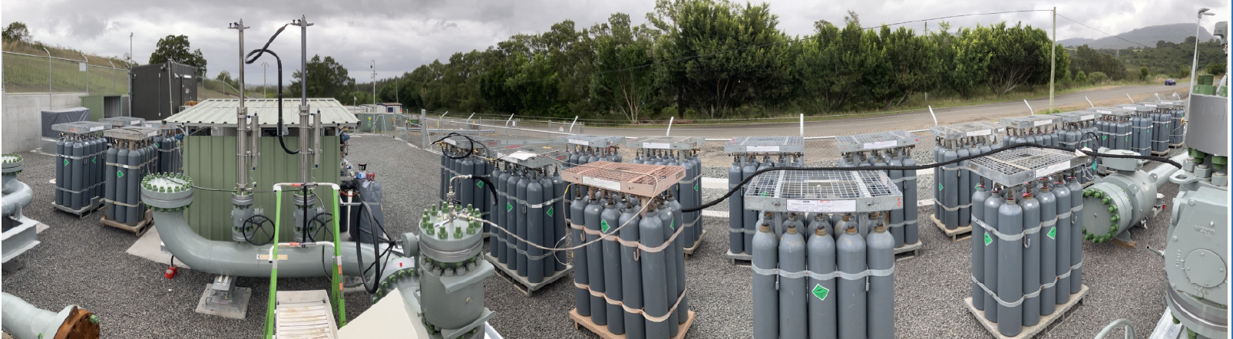
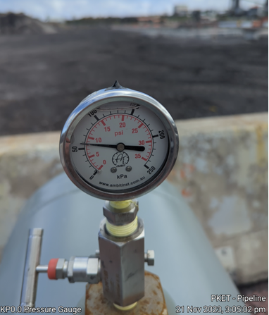
The Port Kembla Pipeline
Delayed operation post commissioning
Completed pre-comm and moved asset into “care and maintenance” mode
Filled the pipeline with low pressure N2
Isolated the Port Kembla Meter Station
Preservation Plan documented each piece of equipment and Isolation Plans for the site
Handed over to operations as a running asset, minus some maintenance
Commissioning procedures written

Slide 12
Section 4
Basis of Section
Work environment must be considered when planning O&M activities
Personnel must be informed and competent to manage specific hazards
Key Concepts
Identify and mitigate risks to personnel, the pipeline system and public
Pipeline specific hazards associated with remote travel and work
Other safety hazards (venting and purging, electrical hazards, etc)
Objectives of 2022 Update
Focus on Planning for Safety
New Appendix F – Permit to Work
Notes:
Emphasize that Pipelines are on public land

Slide 13
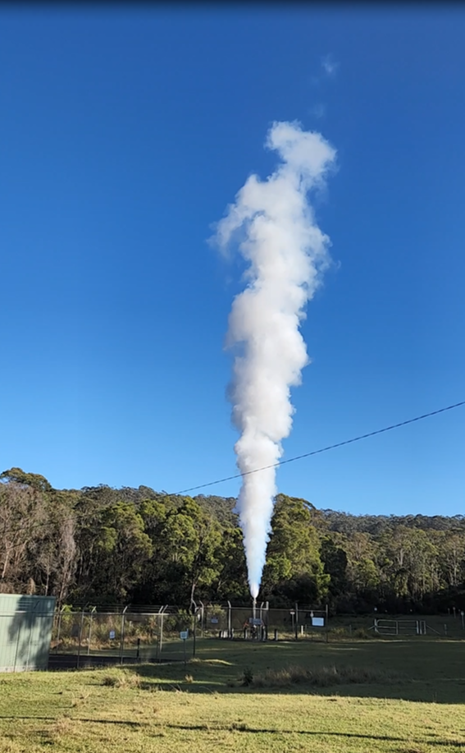
Fundamental Concepts
Offsite planning component, preliminary JHA (or SWMS) preparation
Apply Hierarchy of Controls
Onsite component
Review of JHA
Work Permit system, enforces communication on and off site, see Appendix F
Venting and Purging
In-service Welding
Hot Tapping

Slide 14
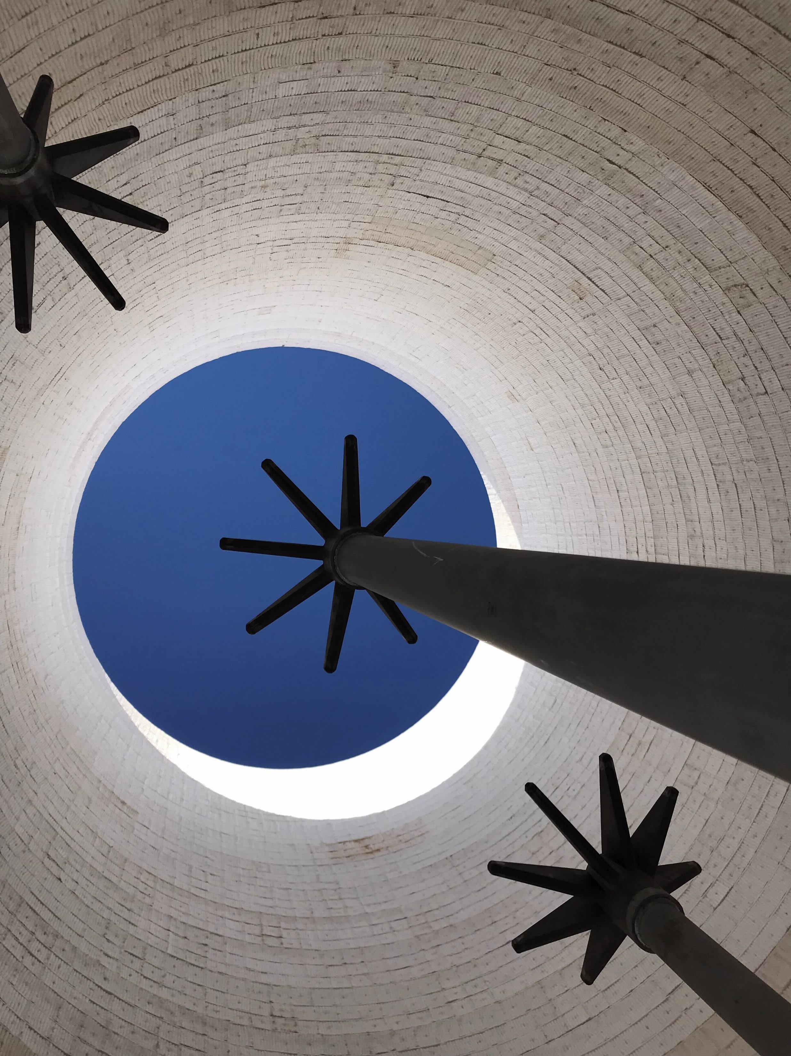
Jemena PTW Implementation
To become authorised under the Permit System, Induction and training, competency assessment
Permit Authority for Gas, Hydrogen and Biogas permit classes
Interaction – on plant shutdowns a more comprehensive PTW process is introduced
Commissioning PTW system with more tagging and boundary isolations

