Slide 1

Liz Brierley
Liz is an experienced leader with demonstrated capability in building effective teams to manage high risk assets in a regulated environment across multiple State jurisdictions. She has an extensive knowledge of pipelines, gas networks and related energy systems that has been developed through more than 20 years working for gas network and pipeline operators, with more than fifteen years’ experience in leadership roles.
A proven ability to work collaboratively to influence change in organisations, standards and legislation. Liz has been actively involved in the development of Australian Standards for pipelines for more than 10 years, recently appointed chair of the ME-38.3 Sub-Committee.
One of the first Chartered Professional (Oil and Gas Pipeline) Engineers in Australia, she follows a passion to promote high quality engineering education and professional development as a member of the National Engineering Registration Board Assessment Panel for Oil and Gas Pipeline Engineers.
Head of Asset Management
SEA Gas

Slide 2
AS 2885.3 Future Direction
Presented By - Liz Brierley

Slide 3
Future Drivers of Change to AS 2885.3
1. Transition to lower emission energy
2. Technology advancements
3. International/ local experience
6. Errors / Clarifications
5. Encroachment and heightened public awareness
4. Aging Assets / more pipelines reaching end of life
The pace of change is so great, there is always something going on. What that says to me is that you have to have strategic vision and peripheral vision. Strategic vision is the is the ability to look ahead and peripheral vision is the ability to look around, and both are important. Carly Fiorina

Slide 4
Future Drivers of Change to AS 2885.3
1. Transition to lower emission energy
2. Technology advancements
3. International/ local experience
6. Errors / Clarifications
5. Encroachment and heightened public awareness
4. Aging Assets / more pipelines reaching end of life

Slide 5
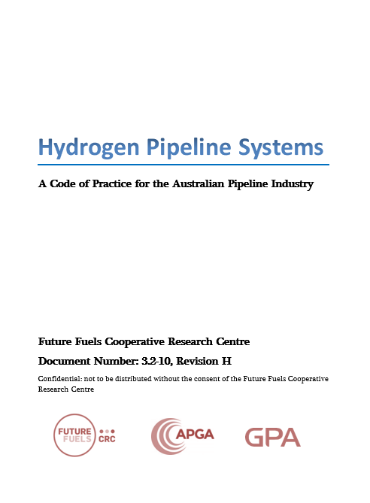
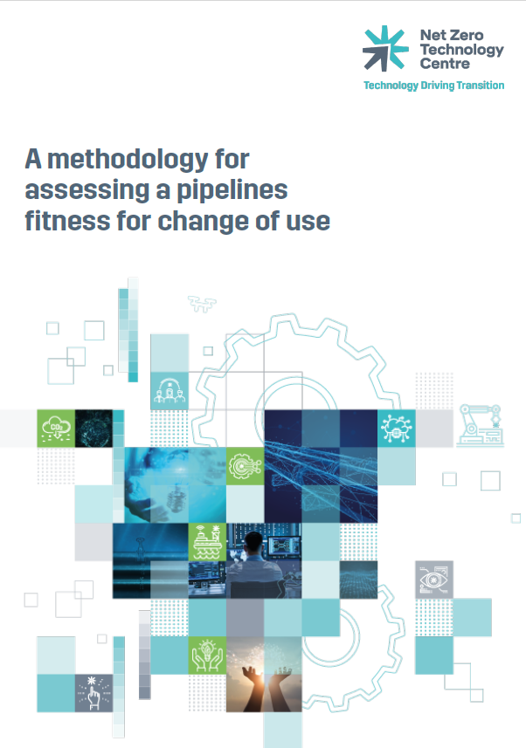
Transition to lower emission energy
Changing demand is driving pipeline usage for energy storage and intermittent gas flow is increasing station start-ups and pipeline fatigue cycles.
More pipelines will be required for transporting future fuels (H2, Ammonia, biomethane, methanol) or CO2 for carbon capture and storage. The standard may need to include requirements for assessing:
Suitability of pipelines for repurposing.
Suitability of stations (e.g. impact of H2 on elastomers).
The impact of varying gas compositions on fracture control, internal corrosion, metering (e.g. H2 blending, biomethane impurities).
Fracture control and fatigue life for pipelines transporting future fuels.
Operating requirements for future fuels and CO2 pipelines (e.g. operational readiness, safety, integrity management, emergency response).

Slide 6
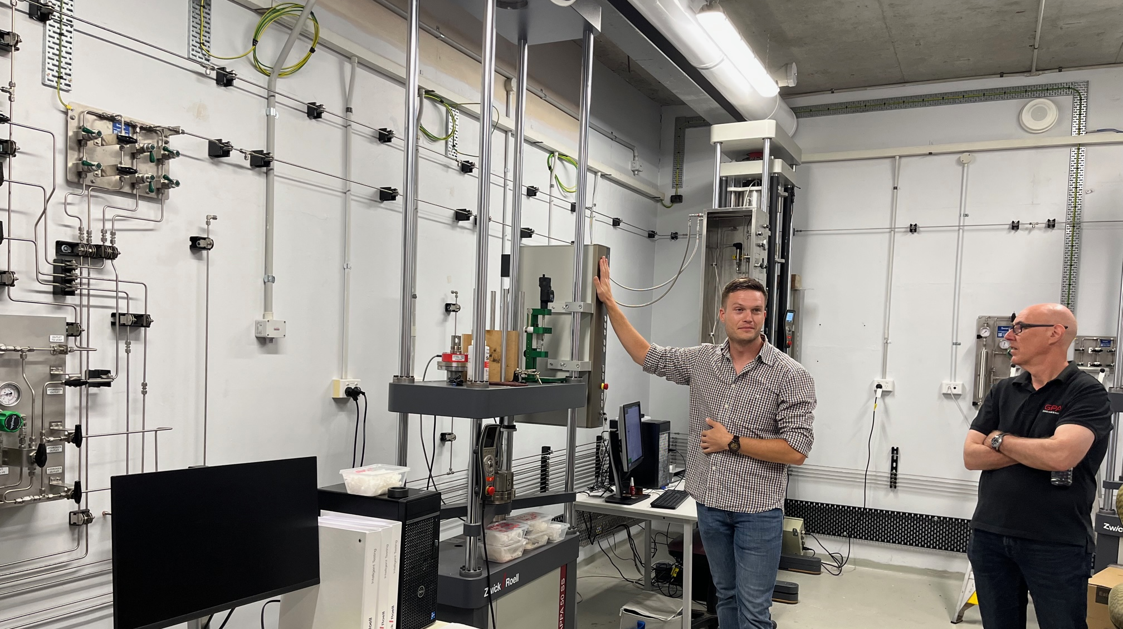
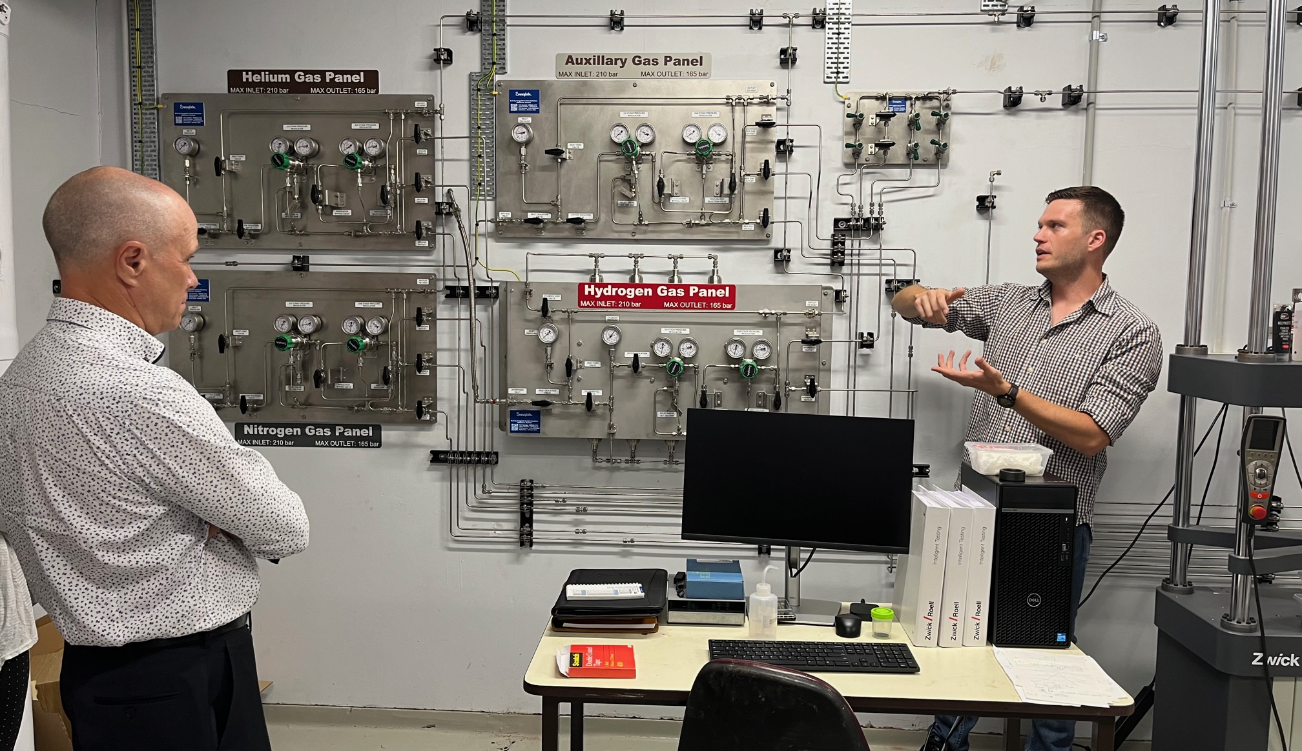

Adopting Future Fuels Research Outcomes
Outcomes of FFCRC Research will be considered for adoption in AS 2885.3 e.g.
3-2-09: Biomethane Impurities
3-2-11: Fitness for Service assessment of repurposed pipelines to H2
3-4-10: Effects of Common Impurities Found in High Density CO2 Pipelines on the Rate of Internal Corrosion
3.2-10: Hydrogen Pipeline Code of Practice: Design, Construction and Operation

Slide 7
Future Drivers of Change to AS 2885.3
1. Transition to lower emission energy
2. Technology advancements
3. International/ local experience
6. Errors / Clarifications
5. Encroachment and heightened public awareness
4. Aging Assets / more pipelines reaching end of life

Slide 8
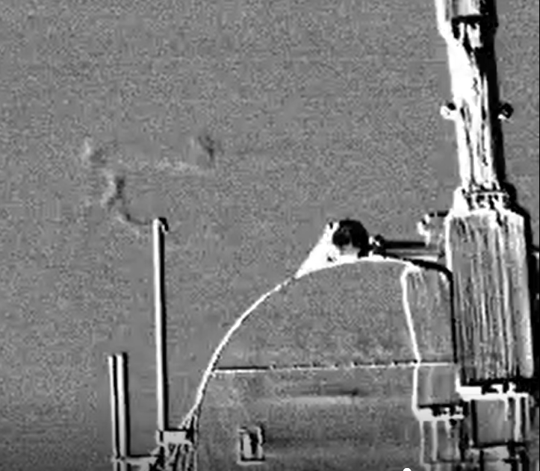
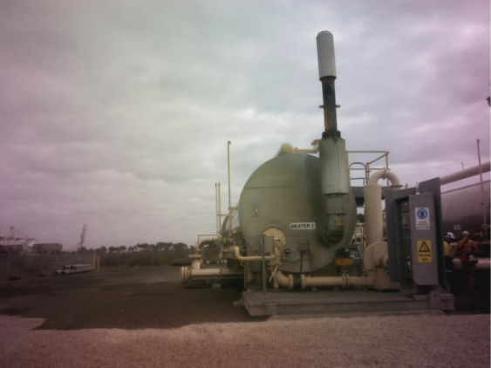
Technology Advancement
Inline inspection tools (Appendix D)
More accessible patrol / leak survey technologies (drones, satellite etc)
Carbon emission management
retro- fitting electric drives
leak measurement,
In field monitoring (CP, third party activity etc.)
Advancements in Emergency Management
Optical Gas Imaging
Notes:
The current version of the standard doesn’t prohibit the use of new technology, and we are now seeing wider adoption of new technologies such drone usage for both surveillance and gas detection.

Slide 9
Future Drivers of Change to AS 2885.3
1. Transition to lower emission energy
2. Technology advancements
3. International/ local experience
6. Errors / Clarifications
5. Encroachment and heightened public awareness
4. Aging Assets / more pipelines reaching end of life

Slide 10
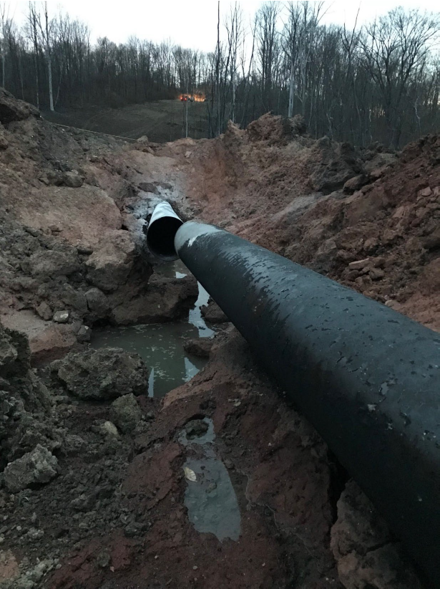
International Experience
Leverage International experience including:
Review of the PHSMA Mega Rule that has arisen from the San Bruno pipeline failure in 2010.
Respond to concerns arising from recent pipeline failures in the US:
Weld undermatching
Weld tensile strain capacity
Climate / natural hazard induced strain events
Review the need for better guidance on failure analysis, given recent failures have highlighted the importance of a robust failure investigation and reporting.
Notes:
PHMSA's Gas Mega Rule outlines new regulatory changes in the US resulted from the San Bruno incident in 2010. In the US they have added requirements for pipeline operators to complete and document activities such as MAOP reconfirmation, Material Testing and Verification and integrity assessments in locations where this was not previously been required. While this ruling won’t be adopted in Australia, the ME038.03 Subcommittee will look at comparing the new US requirements with the existing requirements of the Australian Standard to understand what the differences are and whether there is anything we can learn from the approach taken in the US.

Slide 11
Factors Impacting Weld Joint Strength
Parent Pipe Strength
Pipe Composition
TMCP
Consumable composition
Weld Joint Strength
Weld Metal Strength
Parent pipe dilution
Weld Strength Matching
Welding conditions
Welding conditions
Heat Affected Zone Strength
Pipe composition
Pipe wall thickness

Slide 12
Factors Affecting Strain on a Girth Weld
Weld Joint Strength
Weld Strength Matching
Lift / lowering in
Strain on a Girth Weld
Construction
Trench alignment
Weld Cap Reinforcement
Weld soundness
Crack (HAC)
Defect Size
High-low misaignment
Operation
Service Conditions
Ground Movement

Slide 13
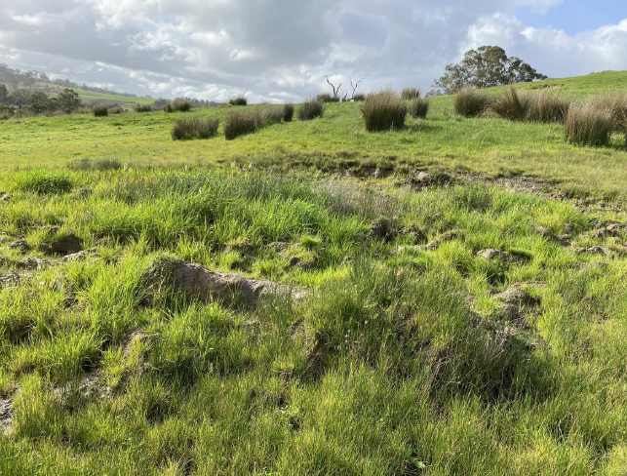
Weld Tensile Strain Capacity
For existing pipelines there have been opportunities identified for the ME038.03 sub-committee to consider highlighting the requirements for:
Ongoing corridor surveillance and risk management during pipeline operations,
Effective use of ILI / IMU or strain gauges / inclinometers for pipeline monitoring in conjunction with available geotechnical reports.
Assess landform/geotechnical landscapes for high strength (>X65) pipelines, welded throughout with cellulosic consumables, particularly areas of potential ground instability and uneven loading such as crossings.
Undertake non-destructive inspection of girth welds during routine pipeline digs to ensure girth weld integrity, with respect to the potential existence of HACC, particularly in areas of ground instability.
Early signs of land slip

Slide 14
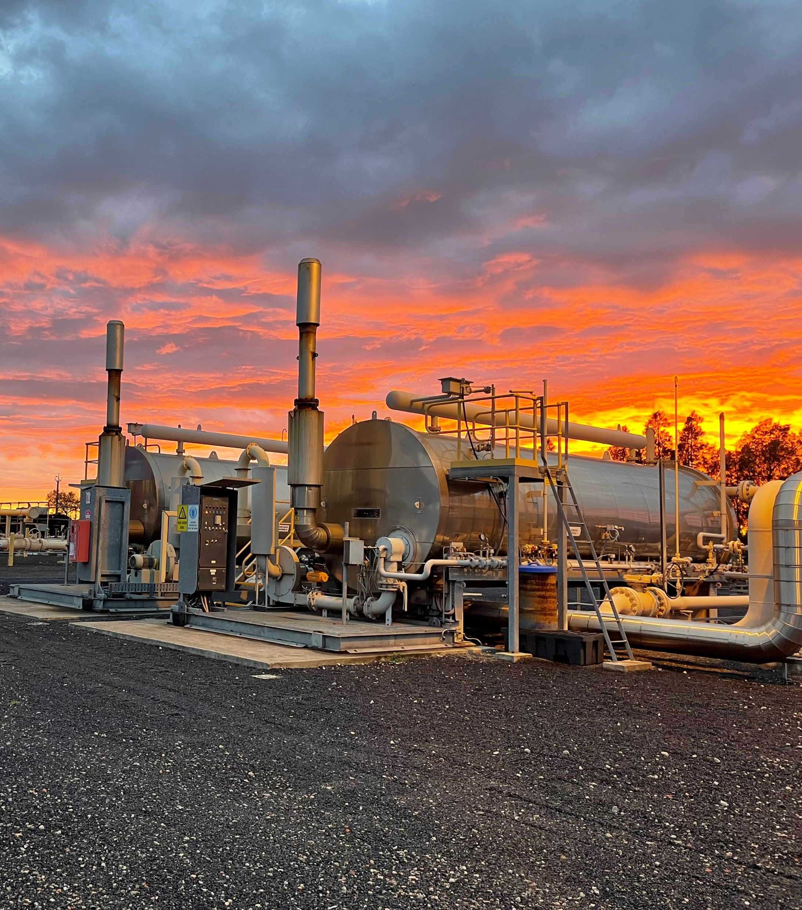
Local Experience
Draw on the experience of our operators e.g.:
Improve guidance on waterbath heater management.
Leverage Australian operator experience to ensure AS 2885.3 reflects best practice for SCC Management.
Incorporate industry learnings on preparedness for isolation.

Slide 15
Future Drivers of Change to AS 2885.3
1. Transition to lower emission energy
2. Technology advancements
3. International/ local experience
6. Errors / Clarifications
5. Encroachment and heightened public awareness
4. Aging Assets / more pipelines reaching end of life

Slide 16
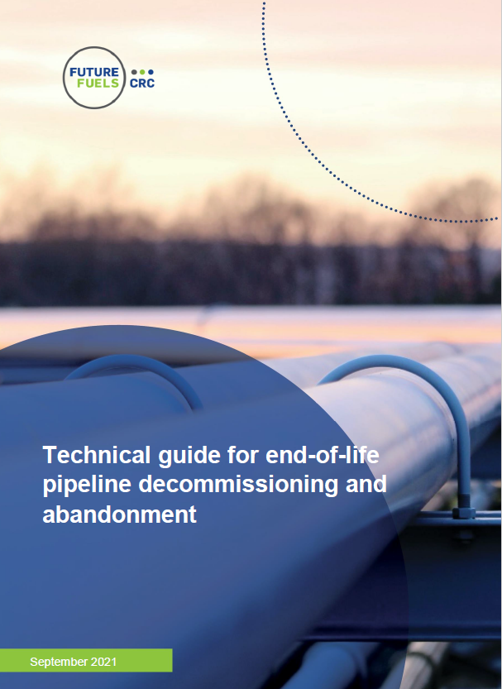
Ageing Assets / Managing Pipeline End of Life
Drawing on overseas experience through International benchmarking
ISO 13623:2017
B31.8S
CSA Z662:19
API 1173
Enhancing FFP guidance for stations.
Drawing on recent publications e.g.
3-2-08: Development of efficient and effective methodologies for the abandonment of pipelines
HB 216 - Submarine Pipeline Decommissioning Handbook (available soon)

Slide 17
Future Drivers of Change to AS 2885.3
1. Transition to lower emission energy
2. Technology advancements
3. International/ local experience
6. Errors / Clarifications
5. Encroachment and heightened public awareness
4. Aging Assets / more pipelines reaching end of life

Slide 18
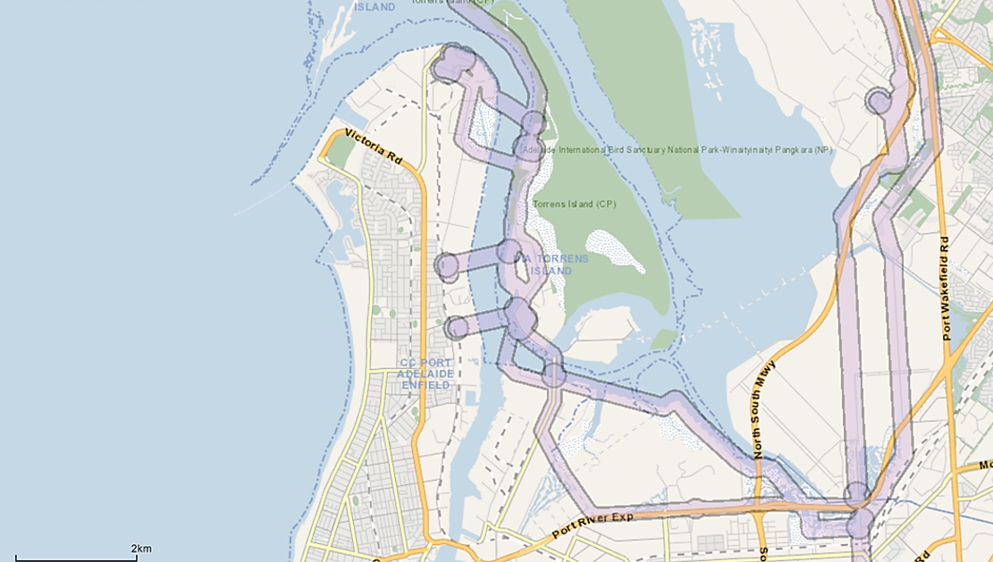
Encroachment and Heightened Public Awareness
Work with the AS 2885.1 subcommittee to update guidance on easement requirements for effective management of encroachment.
Review the limits for proximity of different types of structures.
Work with the AS 2885.6 subcommittee to incorporate learnings from work undertaken in SA, Victoria on an effective overlay in built up areas.
Review guidance on liaison given heightened public awareness of infrastructure corridors.
Update guidance for encroachment on pipeline vents based on EPCRC research.

Slide 19
Future Drivers of Change to AS 2885.3
1. Transition to lower emission energy
2. Technology advancements
3. International/ local experience
6. Errors / Clarifications
5. Encroachment and heightened public awareness
4. Aging Assets / more pipelines reaching end of life

Slide 20
Errors / Clarifications
Subsection | Paragraph / table / figure/commentary/note | Page No | Required Amendment
4.5 | Paragraph 2 of 3, list item (b) | 14 | Fix Duplicate numbering 4.5(b)
4.6 |  |  | Make 'approved' small caps
4.10 | 1 | 16 | Make 'approved' small caps
5.6 | (B) Note 2 | 19 | The correct terminology throughout the standard is ‘MAOP reduction’ Change to ‘MAOP reduction’
5.7.2 | Para 2 / Note | 21 | Add 'maximum' ahead of '10-year cycle' and '5-year cycle'.
9.2 | 5 Note 1 | 48 | Remove duplication - Delete Paragraph 5 of 6. 'The likely failure mode may impact the determined temporary pressure limit (e.g. failure likelihood due to local buckling could be increased at lower pressure under certain scenarios).’ Retain Note 1
9.3.4 | Figure 9.1 | 52 | Replace Figure 9.1 with Figure 9.2 in the 2012 edition.
9.3.4 | (a) | 51 | The appropriate terminology in 9.3.4 (a) should be 'temporary pressure limit' consistent with 9.2.
9.5.6 | 1 | 61 | Correct reference to Clause 10.6 Rather than Clause 10.5
10.8.1 | (f) | 65 | Add 'be'
Appendix G | Table G.1 ( 7.5.3) | 89 | Change reference from 7.5.3 to 7.5.4
Appendix G | Table G.1 (10.2) | 89 | Amend to read 'changes to approved operating conditions.'
9.5.6 | Title | 61 | Change title from 'Pipeline de-rating' to 'MAOP reduction'.
ME-038.03 Sub-committee is working through a list of 54 potential amendments, these include:
Corrections / errors
Proposed revisions to clarify text
Inconsistencies with other parts of the standard
The sub-committee will propose an amendment to the Main Committee in 2024.

Slide 21
Future Drivers of Change to AS 2885.3
1. Transition to lower emission energy
2. Technology advancements
3. International/ local experience
6. Errors / Clarifications
5. Encroachment and heightened public awareness
4. Aging Assets / more pipelines reaching end of life
Questions?

Slide 22





Thankyou

