Slide 1
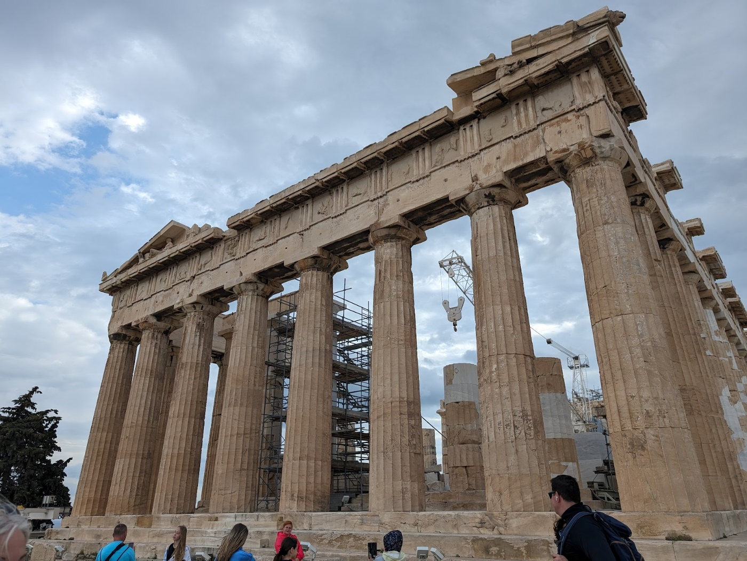
Emerging Fuels Symposium 2024 Recap
APGA Webinar - Standardisation

Slide 2

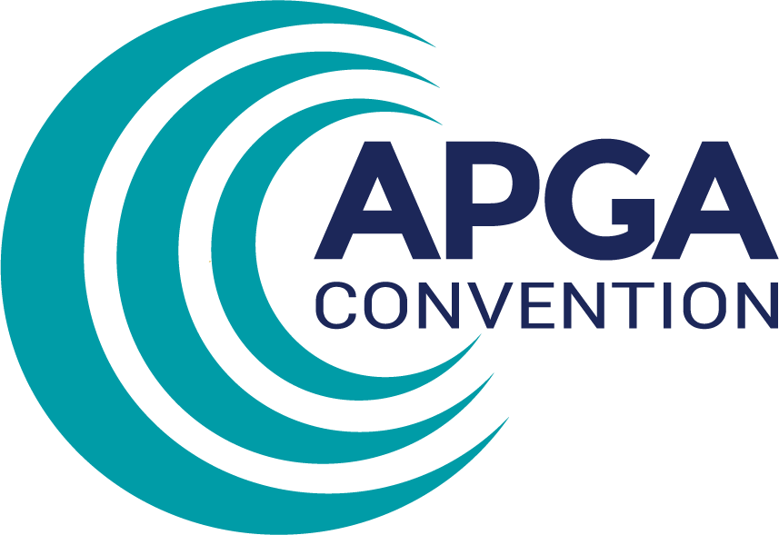
Standardisation
  Challenges
  Sharing information
  Getting things done in an environment of change
  ASME B31.12 status update & key points from CER presentation
Notes:
Today I will provide a summary of the symposium session on Standardisation and some reflections I made throughout the conference. The session covered the challenges of standardization, how we can try to improve methods of distributing research and background information that is generated during the development of new or revised standards, and I will close with an overview of a presentation that was provided by Simon Slater from Rosen on the future plans for ASME B31.12.

Slide 3
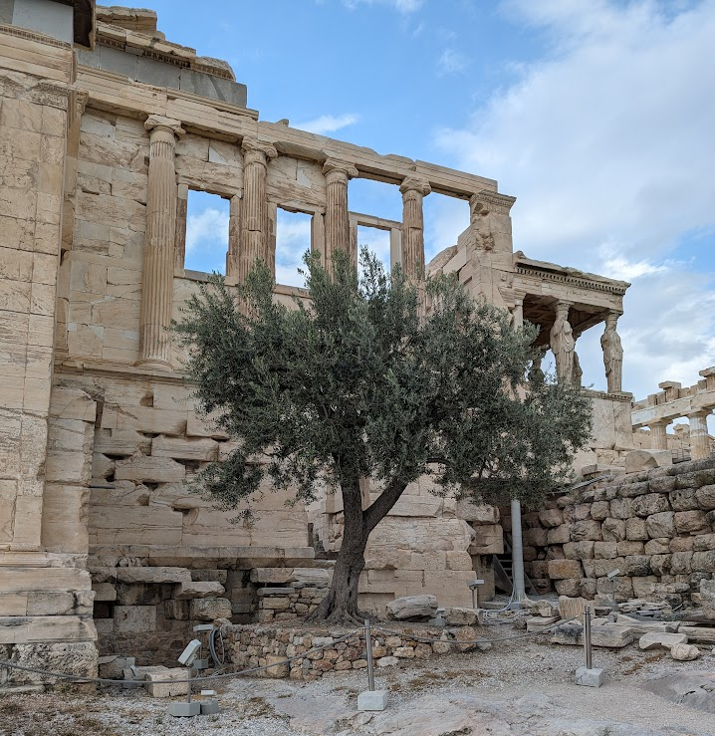
Challenges
Standards age, applications at time of creation are not necessarily the same as applications now.
Background or basis of requirements is not always traceable or transparent.
Interpretation and intent are not always the same.
Everybody has an opinion – diversity in standards committees is essential.
Difficult to change the status quo when the industry is set up for certain test methods; requires building new facilities, new test apparatus. Can constrain and delay projects.
Notes:
The first challenge that was discussed was that standards age and applications change over time. A good example of this is ASME B31.12, which was written for transmission/distribution pipelines application, but not really set up for cyclic service storage pipelines, an application that is now being considered by industry as we work out how to store vast volumes of H2.
Background behind requirements is not always transparent or easy to find. Users of standards, particularly newer engineers, may be oblivious to the amount of research, meetings, and papers that go on to get to a succinct paragraph in a standard, let alone where to go to find that background information – this is something that became even more apparent to me attending this symposium.
Interpretation and intent are not always the same, not matter how diligent the writers are, it’s always possible it may be misinterpreted, highlighting the importance of sharing the background and reasoning behind requirements written into standards.
Everybody has their own opinions, and the way a standard or requirement effects a party often depends on their vocation. Owners vs. constructors vs. suppliers vs. designers all have their own drivers so it’s important to have a diverse team developing the standards so we can understand the impact across the industry as a whole. It’s also important not to over-compromise on the evidence or physics to please a majority.
Finally, and more specific to testing requirements, for an established industry like the gas pipeline industry, that is set up with relatively standardised materials and test methods, it can be a big challenge to change these, and involves building new facilities, test apparatus, training personnel. The reality of this can constrain and delay projects significantly.

Slide 4
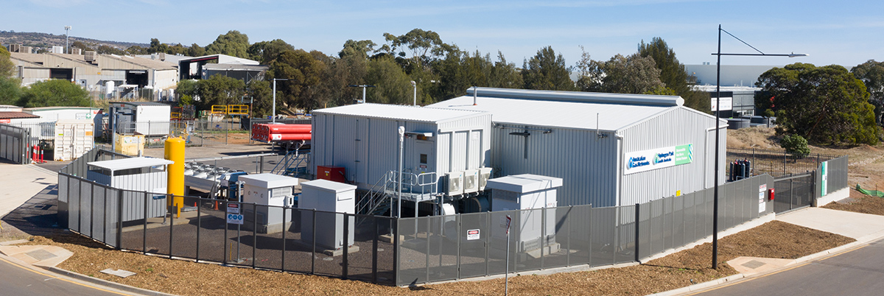
Challenges
Having a prior operating example can be a hinderance rather than a benefit, as people may assume that you can just do what was done before or even extrapolate from that example without sufficient consideration of the implications of the changes, no matter how small. E.g. a similar project with slightly higher operating pressure, or slightly different H2/NG composition, or slightly larger diameter shouldn’t be a big problem, right?
When starting from scratch, we are forced to do the work and engineering to understand what we don’t know and establish, with sufficient justification and evidence, the requirements and “right way” to design the new thing.
Notes:
This is something that Marion shared (paraphrasing), and stuck with me.
*read slide*.
The public or people from outside our world often don’t understand why we put so much effort into design or research to prove that something that doesn’t sound like a big change, is actually still going to be safe. For example, blending 5%, 10% H2 into natural gas networks.

Slide 5
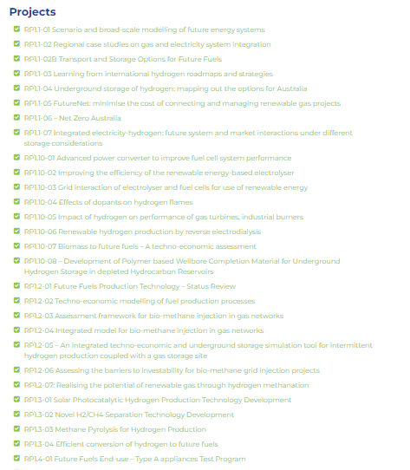
Sharing Background Information
Current methods
  Revisions to standards
  Interim documents (research papers, CoPs, CERs)
    FFCrC Portal, signup is easy!
  Conferences (like this symposium)
  Involvement in standards committees (anyone can get involved, you don’t need to be an “expert”!)
Notes:
Next I will talk about how we already do share information and how we might be able to change the way that we share and disseminate information behind standards.
The first one is pretty obvious, we get the information through new revisions of existing standards.
There are a lot of resources developed separate from standards, which are more guidance documents spreading information in lieu of a standard update. They are NOT standards, so care should be taken. The FFCRC for example publish papers from all their research projects to the FFCRC Research portal. Shameless plug, Sign-up is easy (and free?). Additionally, documents like the H2 Pipeline Code of Practice (now available from the FFCRC website, other distributions to come) and ASME B31.12 CERs (not publicly available but EFI team currently discussing how to share effectively across industry) provide the latest thinking from key industry groups.
One of the best and easiest, but maybe not cheapest, ways to get a status update is attending conferences and symposiums like this one.
Getting involved in standards committees is another great way to stay up to date on what developments are being made or where industry thinking is at. You don’t need to be a technical expert to join these, often the organizational part is just as tricky as the technical part. I had this opportunity as part of the code of practice, and can attest to the value of this. I was not an expert in the area, but arranged meetings, managed minutes and actions, and assisted in drafting sections for SME review.

Slide 6
Sharing Background Information
Ideas (not all mine!)
  Informative appendices (sometimes done but could we do better?)
  Training courses could be provided by the standards bodies themselves (one off investment and recoups some costs)
  Wiki’s or FAQ portals, particularly useful for interpretation (AS2885.info is one example)
  Establish “Collaboration Leads” for each standards committee to liaise with their global counterparts
Remember, many committee members are volunteers with day jobs!

Slide 7
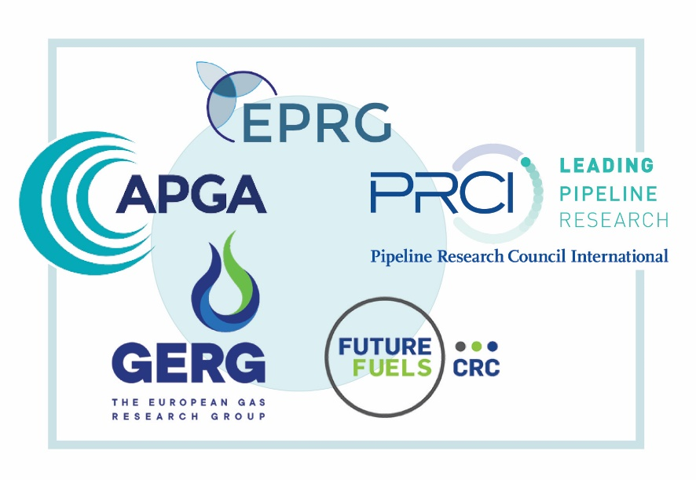
Getting things done in a changing landscape
Pressure is on designers, suppliers and operators to keep up to date with the latest research, and have a deep understanding of fundamentals (not just the standards) to inform decision making.
More important than ever to stay connected across the industry and help each other out, share information.
Sharing learnings from pilot or first mover projects (number of these presentations at this conference)
R&D in parallel to project delivery and regular assessment of implications to project (cost and time vs. benefit analysis)
Notes:
Lastly before I jump into the summary of the B31.12 presentation, some reflections on getting things done in the state of flux we seem to be in in this industry at the moment.
Read as-is. This means more than just picking up a standard.
Read as-is
Read as-is
Research and standards are going to be constantly evolving in the emerging fuels industries. By the time a project has gone from inception to construction, a standard may be revised or new information may be available that could change the current design. Regular assessments of current design or in-service assets against newly available guidance will be needed. And calls are going to need to be made as to the impact of the new information, cost and time associated with implementing a change to rectify the misalignment, and weighing up the risk to the project or public of not doing anything.

Slide 8
B31.12 Changes

Slide 9
B31.12 Changes
Presentation by Simon Slater from Rosen – Consensus Engineering Requirements for Hydrogen and Hydrogen Blend Pipelines
Presentation covered:
  Background of issues with B31.12 currently
  Intent for B31.12 moving forward
  Key stakeholders involved in developing the CERs
  Process for developing CERs and implementing into next revision
  Summary of key technical items identified to date
Notes:
The presentation I will share a summary of was originally presented by Simon Slater from Rosen on the top of Consensus Engineering Requirements for Hydrogen and Hydrogen Blend Pipelines.
The presentation covered….

Slide 10
B31.12 Changes
First published 2008
When B31.12 was created, applications and requirements were limited compared to the current requirements for using hydrogen directly as an emerging fuel (different pressures, materials, cycle requirements)
There has been a significant change in representation at B31.12 meetings, with gas transmission operators joining industrial gas companies.
Agreement reached to incorporate the pipeline section of B31.12 into B31.8 to ensure comprehensive guidance for pipeline operators to blend hydrogen to new and existing assets.
Notes:
First, a bit of background on ASME B31.12 and the changing landscape from it’s first creation to now.

Slide 11
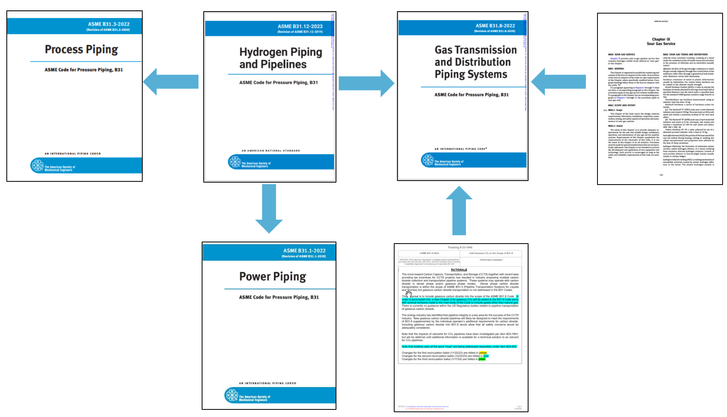
B31.12 Changes
Sour Service
2026 Rev
Gaseous CO2
Credit: Simon Slater (Rosen)
Notes:
So what will this look like moving forward?
Station piping sections will be moved to B31.3 and B31.1.
Pipelines will be moved to a new hydrogen exceptions chapter in B31.8.
Working to implement before next B31.8 revision date which is 2026.

Slide 12
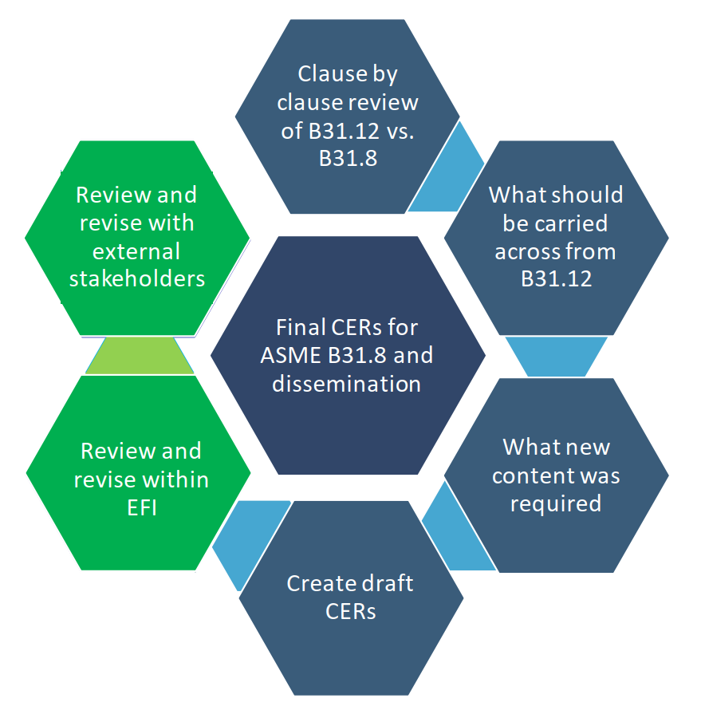
B31.12 Changes
The goal is a H2 Pipeline exception chapter for B31.8
Process
  Develop CERs (Consensus Engineering Requirements) document, reviewed and approved by the EFI technical committee.
    Work packages aligned with B31.8 main sections (Materials, Welding, Design, O&M, General, Appendices, Repourposing)
    Based on existing sour gas chapter structure
    Package teams comprised: EFI, ASME, PHMSA, SMEs
  Progress the CERs through the ASME approval proves for 2026 revision of B31.8.
Credit: Simon Slater (Rosen)
Notes:
The process for progressing the B31.12 changes and consolidation into B31.8 are as described here.
Detailed clause by clause review of B31.8 vs B31.12 to identify what new content of amendments were required.
Work packages were set up to align with B31.8 main sections, with a focus on differences associated with Hydrogen service.
A similar approach and structure to the sour gas chapter is being used.
Package teams were made up of members from EFI, ASME, PHMSA (Regulator - Pipeline and Hazardous Materials Safety Administration) and other SMEs from across industry.
Draft CERs prepared
The CERs are being reviewed by the EFI committee, will now look to be progress through the ASME approval process for the next revision of B31.8.

Slide 13
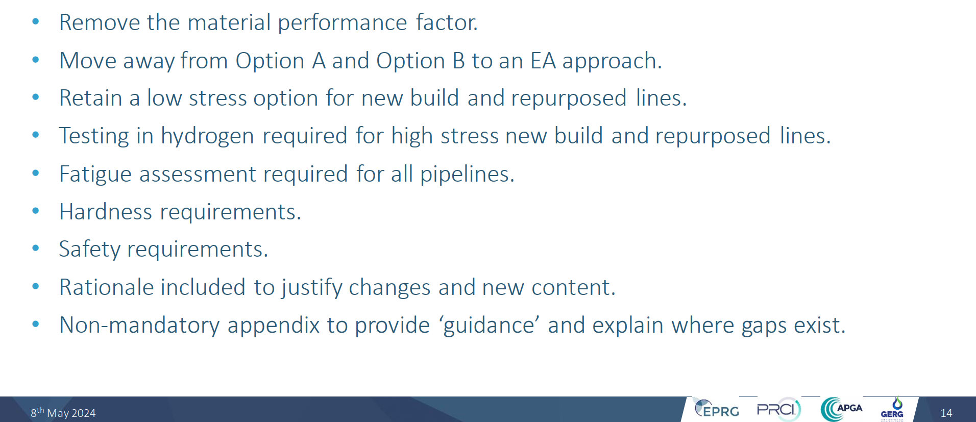
B31.12 Changes
B31.12 Consensus engineering Requirements for H2 Pipelines – Big Ticket Items:
Credit: Simon Slater (Rosen)
Notes:
Some key big ticket items from the CERs include:
Removal of material performance factor which derates materials above X52.
Replacing Option A and Option B approaches with an Engineering Assessment (EA) approach. Standard to specify content and provide guidance for an Engineering Assessment, without being overly prescriptive.
Retain a low stress (<30%SMYS) option for new build and repurposed pipelines.
You can read the rest.
I will talk to one of these briefly which is the change to the hardness limit currently provided in B31.12.

Slide 14
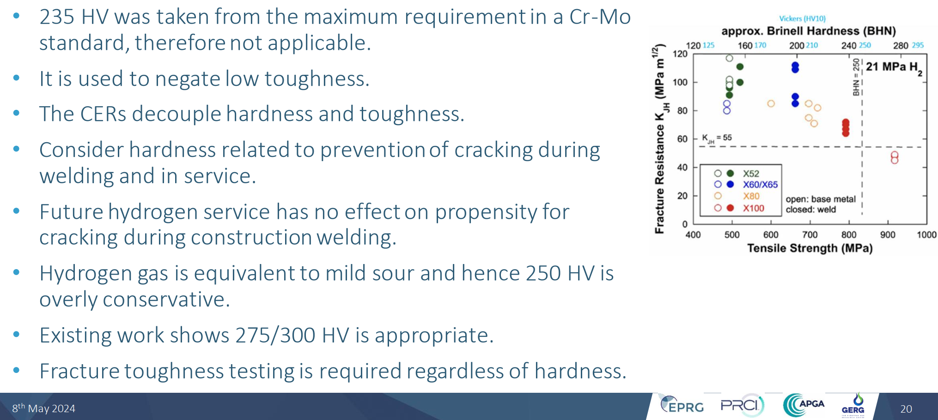
B31.12 Changes
One example, Hardness:
Credit: Simon Slater (Rosen)
Notes:
B31.12 specifies a hardness value even lower than that used for sour service (250HV).
The limit for carbon steels, 235HV10, was taken from a chrome moly standard and used to negate low toughness.
Toughness testing will be mandatory in the new revision, and minimum toughness will be specified. The CERs intend to decouple hardness and toughness, so such a conservative hardness limit is not justified (hardness will not be the controlling property).
Revised Hardness limit will likely be 275HV.

Slide 15
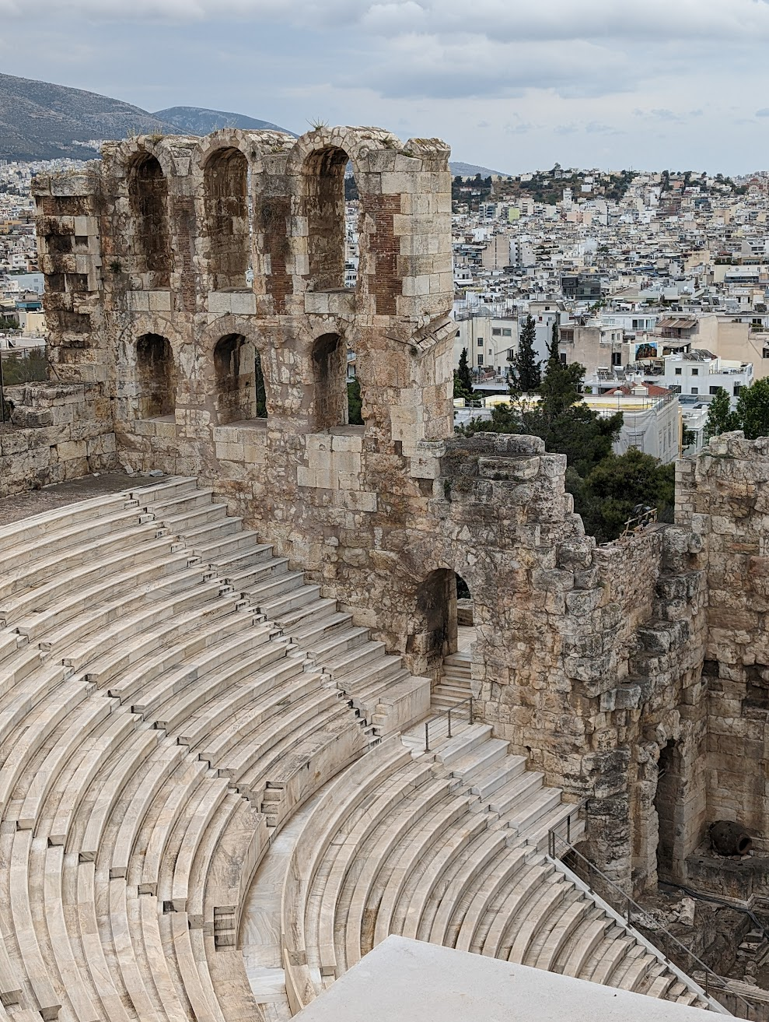

Thank You
Notes:
Thank you to all who have dialled in for listening today and thank you to APGA for providing this opportunity.

