Slide 1
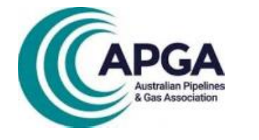
Emerging Fuels Symposium Webinar
26 JUN
2024
Natural Gas to Hydrogen Pipelines
Presented by Neville Shah - Enscope
Notes:
Hi everyone, my name is Neville and I’m an E&I Project Engineer working for Enscope, and I’ll be presenting some of my learnings as part of the emerging fuels symposium last month.
In particular I will be discussing how we can look to utilise existing natural gas pipelines for hydrogen service

Slide 2
Agenda
Background
  Demand Drivers
  Existing Situation
Conversion of Natural Gas Pipelines to Hydrogen Pipelines
  Review of Gasunie’s approach in Netherlands
  Application to Australian Infrastructure
Implementation
  Considerations
  Challenges
  High Level Execution
Conclusion

Slide 3
Demand Drivers
There is an increasing push towards the use of emerging fuels such as hydrogen, including:
Expected commitment of producers and users
Presence of industry
Opportunities for storage and export
Favourable conditions for import through the use of renewables
Closure of existing gas plants
Climate agreements reducing demand for natural gas
Notes:
Expected commitment of producers and users as they look to future proof their energy supply
Presence of industry – as market share and financial incentives grow, availability of hydrogen specific products and services grow
Opportunities for storage and export – in Australia we have a vast array of wind, solar, hydro and other renewable energy sources that can be tapped into for production of hydrogen and subsequent excess export
Favourable conditions for import through the use of renewables – always an option as the renewable industry grows, and very region specific
Closure of existing gas plants (eg Exxon Mobil closure of Longford facility in South Gippsland during 2028)
Climate agreements reducing demand for natural gas- Reducing methane GHG emissions as part of Paris agreement targets

Slide 4
Existing Situation
With the move to emerging fuels already underway, a key consideration is how the existing infrastructure and landscape will be able to handle this transition
There will be many opportunities for widespread improvements in newly installed pipelines based on the significant research ongoing and conducted to date by EFS member organisations
Notes:
While committees develop and refine standards, companies invest in research and development, how will the mainstream producers and users even have access to emerging fuels?

Slide 5
Background
There will always be a constraint to mainstream emerging gas distribution due to limited physical land
To assess how Australia could approach this problem, we can leverage the work conducted across the world.
This presentation will detail and look to explore the work conducted by Gasunie in Netherlands in making their pipelines suitable for hydrogen transport as presented in the EFS at Athens
Notes:
However, there will always be a constraint to mainstream emerging gas distribution due to limited physical land
It is important to note that this problem is not isolated to this industry, blending greenfield and brownfield sites while achieving operational capacity and quality outcomes is a challenge so many engineers face across all disciplines.
It is also something I have personally faced in my career and from experience it has never been smooth sailing, so it is pivotal to plan upfront as much as possible

Slide 6
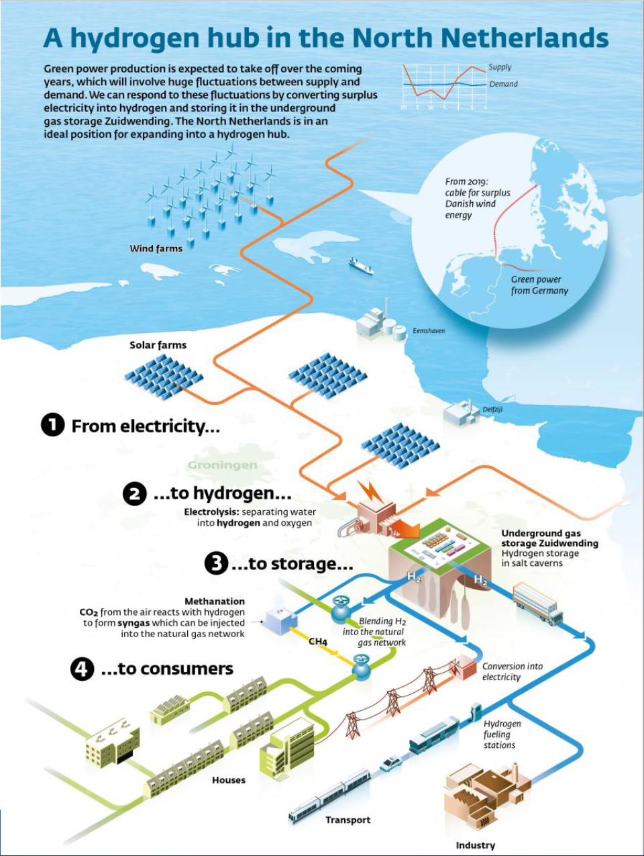
Overview
Netherlands Hydrogen Hub
Renewable (green) supply
Electrolysis to Hydrogen
Hydrogen Gas Storage
Distribution to consumers

Slide 7
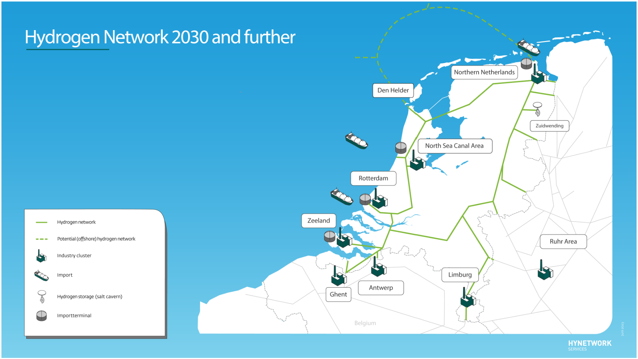
Overview
Netherlands Hynetwork
Demand Drivers in Action
  Energy Import
  Industrial Hubs
  Hydrogen Storage
  Pipeline Network

Slide 8
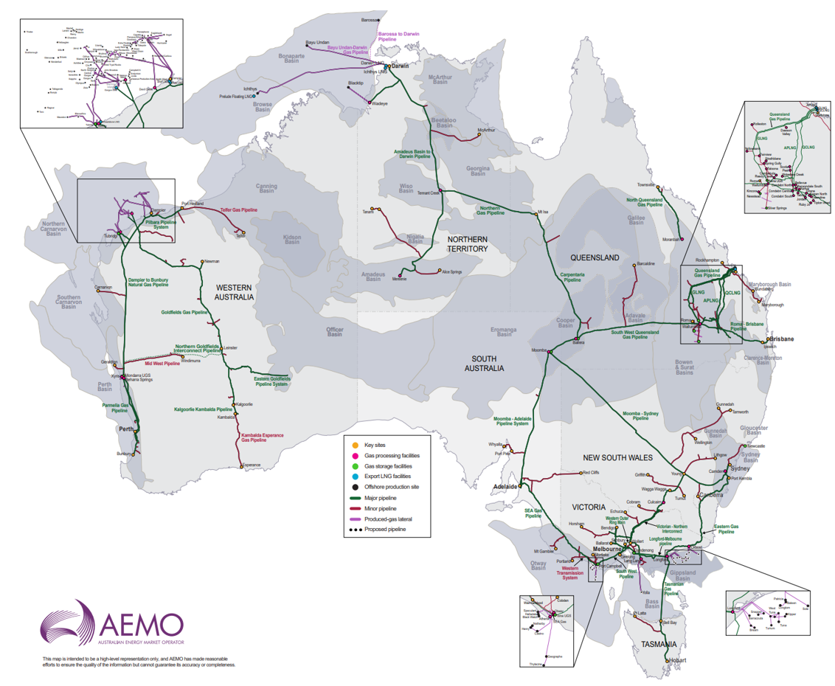
Application to Australian Pipelines
Scalability
Around 42,000km of natural gas transmission pipelines
Typically DN300+ and operating under a high pressure
  To optimise the amount of gas transported over long distances
Notes:
It is quite clear having a look at this map from the Australian Energy Market Operator that the sheer volume and size of our gas pipelines in operation make this an important exercise.

Slide 9
Application to Australian Pipelines
Can leverage Gasunie’s Europe approach to the existing work in this space in Australia, to develop a solution of scale
  APA – Parmelia Pipeline
  AGIG – Dampier to Bunbury Natural Gas Pipeline (DBNGP)
  FFCRC
With appropriate re-use of pipelines, can realise energy transition while minimising
  Social costs
  Ecological footprint
  Environmental impact
  High initial construction capital costs
Notes:
If the learnings from abroad in countries such as Netherlands can be successfully applied here, a solution of scale would be very significant.
New pipelines can typically cost between $1-2 million per km, so recognising the opportunity to re-use a portion of 42,000 km network is a massive economical consideration.
To avoid land clearing of that size is a significant social and environmental positive too

Slide 10
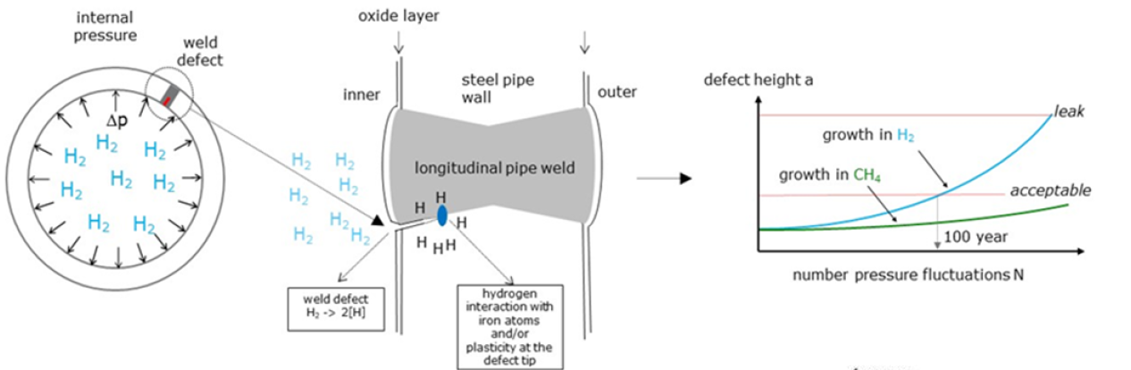
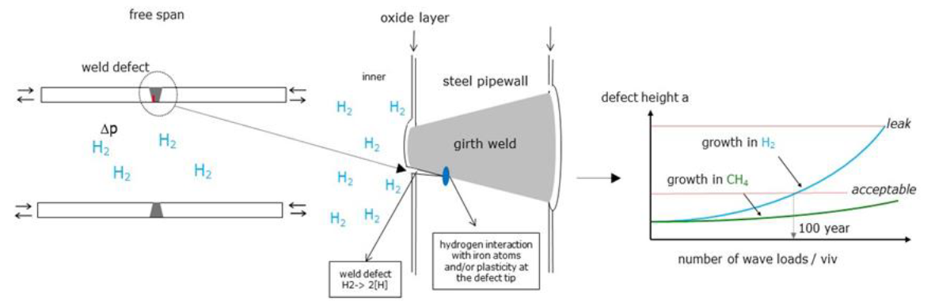
Considerations
The potential for hydrogen to embrittle the steel and welds used to fabricate the pipelines
  Hydrogen-enhanced fatigue crack growth
  Controlling hydrogen permeation and leaks
A number of ways derived to estimate crack fatigue rate including
  Naturalhy project (2004) EU sponsored using existing European network
  ASME B31.12 Option A/B
  Sandia/B31 code case 220
  German DVGW G464
Notes:
So looking towards the implementation – we have to analyse the material properties of the pipeline as it was designed for natural gas not hydrogen.
There is the potential for hydrogen to embrittle the steel and welds used to fabricate the pipelines, so some considerations are hydrogen-enhanced fatigue crack growth and controlling hydrogen permeation and leaks
You can see some images in the slide illustrating this situation for different weld types.
There has been extensive research in ways to estimate this impact through standards and projects as discussed in the symposium

Slide 11
Considerations
Engineering assessments based on new hydrogen gas design and standard requirements will be key to confirming the suitability of existing pipeline sizing for re-use (eg higher pressure and flow rates)
Key takeaway is to determine and maximise asset life expectancy
Hydrogen pipeline integrity and associated technology is a continually growing field in industry – with additional duration and demand there will be additional quality certifications and product offerings
Furthermore, there will be a push for lower cost, more reliable, and more durable hydrogen compression technology

Slide 12
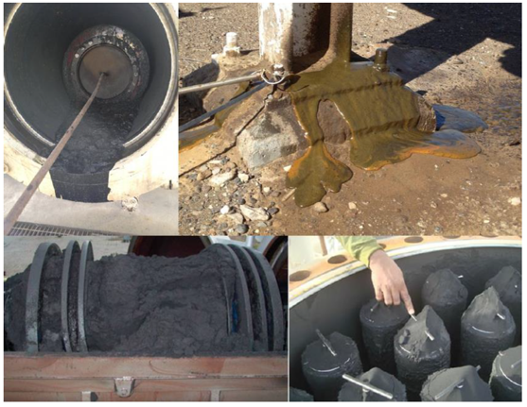
Challenges
Natural gas condensate
Oils and greases
Glycol
Black Powder
Radioactive substances
Methanol
Mercury
Sand and earth
Welding electrodes
Flow coating
Notes:
Looking at some challenges – need to consider contaminants from natural gas operation
Natural gas condensate(formed during gas treatment)
•Oils and greases(compressors, valves, turbine meters)
•Glycol (drying)
•Black powder (corrosion products)
•Natural radioactive substances(gas production)
Other contaminants: Methanol (hydrate prevention)
Mercury (gas fields)
Sand and earth (construction)
Welding electrodes
Flow coating

Slide 13
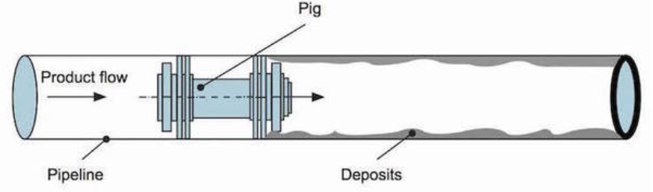
NG to H2 Implementation
Contaminants left in-situ risk compromising flow integrity of the future hydrogen transport, so how can we resolve this on an existing natural gas pipeline? Simply start by cleaning, measuring and visualising the situation at hand
The “pig” or a pipeline inspection gadget is a key component to achieve this. This cylindrical device inserted at the pig launcher travels the length of the pipeline propelled by the pressure flowing through the pipeline, cleaning contaminants along the way
The first recommended basic operation will be pre-cleaning under natural gas atmosphere by executing at least two cleaning “pig” runs
This allows direct measuring of contamination in the form of liquids and solids, and if needed a camera can be utilised as part of the pigging system to assess accumulation of liquid or visual interior inspection

Slide 14
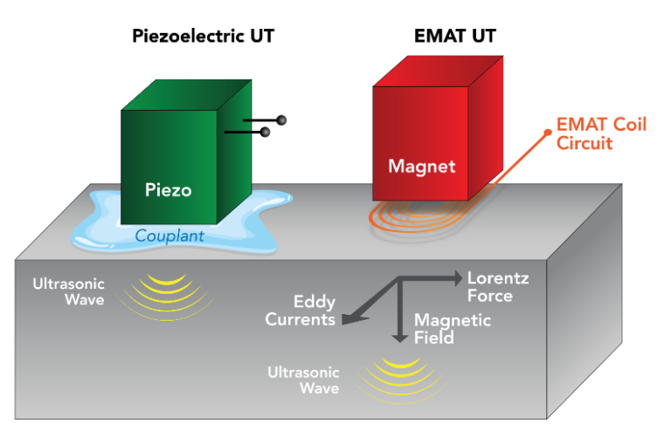
NG to H2 Implementation
  The next step is to perform an in-line inspection (ILI) to assess integrity of the existing pipeline
  An ILI pig is equipped with an array of sensors and onboard memory to detect cracks, corrosion or other anomalies. This shows the operator where and how severe the extent of defects are in the pipeline
  Magnetic flux leakage detection (MFL), while a popular non destructive testing technique in natural gas pipelines is not reliable to detect crack-like defects
  Instead an Electro-Magnetic Acoustic Transducer (EMAT) is recommended for the baseline inspection. This is a technique which induces ultrasonic waves into a test object with two interacting magnetic fields, which generates a Lorentz force inducing current in the receiving EMAT coil circuit.

Slide 15
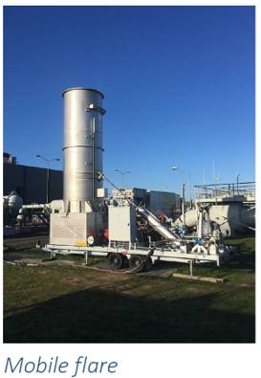
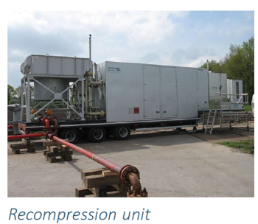
NG to H2 Implementation
  The pipeline is still flowing with natural gas! In order to make the changeover, first depressurise by means of
    buffering
    recompression
    flaring

Slide 16
NG to H2 Implementation
  Displacement with nitrogen using separator pig in combination with recompression (or flare)
  Keep nitrogen pressure at 30 bar to minimise inflow of natural gas
  Monitor hydrocarbon concentration and mercury levels in nitrogen for two weeks
    Maximum 1000ppm in accordance with first draft hydrogen specification
  Reduce nitrogen pressure to 1 atm allowing a “modification” period in preparation for hydrogen service, cleaning and evaporating volatile components
  Finally introduce hydrogen using a Bi-Directional (BiDi) pig and increase hydrogen pressure to operational pressure
Notes:
Why use nitrogen? Nitrogen is inert and non-combustible. The displacement or purging of combustible gases will prevent an unstable and potentially ignitable atmosphere, and creates a more stable climate.
Additionally nitrogen is dry and purging with it helps control moisture levels, minimising the potential for rust, mold and other issues.
Helping to eliminate oxygen also prevents corrosion and other unwanted degradation of the pipeline

Slide 17
Conclusion
Investigating changes from natural gas to hydrogen service using existing pipelines presents many opportunities for positive environmental impacts and economical benefits
With growing demand for emerging fuels, shared development of international hydrogen standards, technical advances by industry but restrictions in physical infrastructure, exploring these type of solutions can help push forward the energy transition in the right direction

Slide 18

Closing
Thankyou to APGA, Enscope, and the wider Australian team for making this possible & shoutout to my fellow scholarship recipients, Elizabeth, John, Zach and Morgan for making this such a memorable event and experience!

