Slide 1

Emerging Fuels Symposium Webinar
Ammonia Transmission Pipelines
John Rutherford, Spiecapag Australia

Slide 2
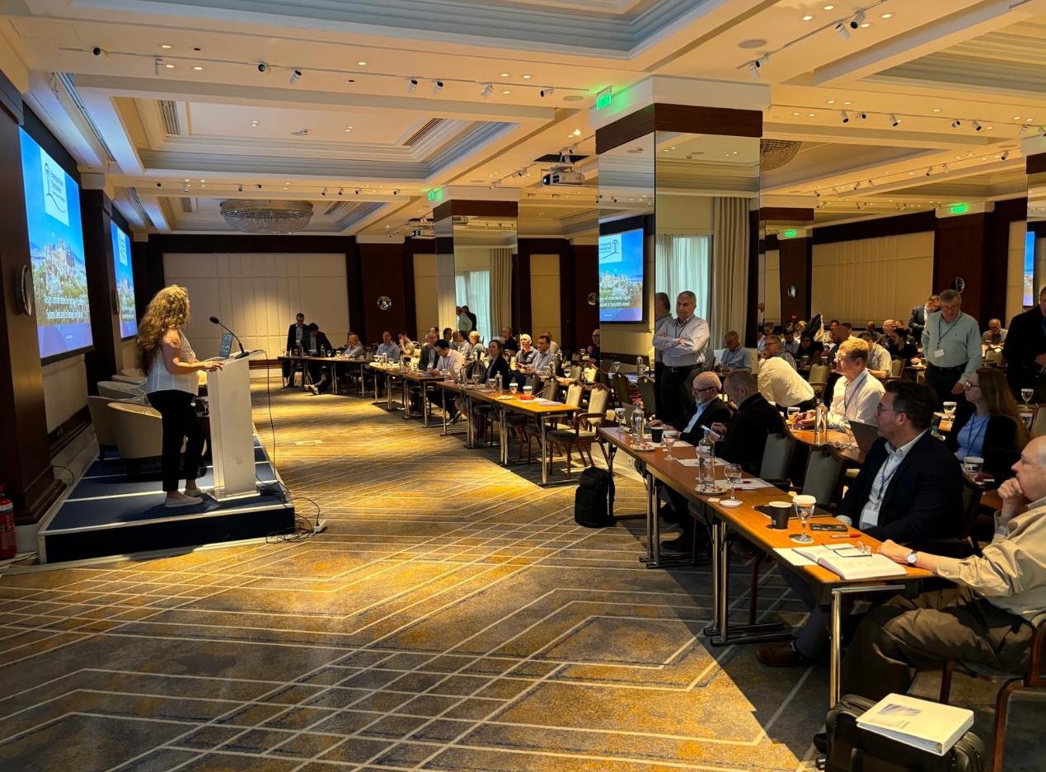
Agenda
Overall interest points
Scope of Symposium Presentation – Ammonia transmission pipelines
Uses and Market
Current Infrastructure
Risks
Notable Failures
What is Required
Closing and Thanks

Slide 3
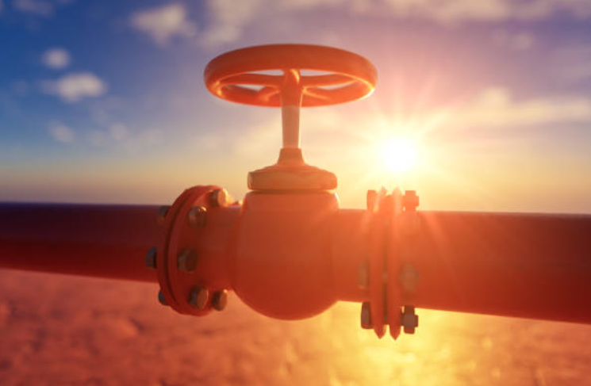
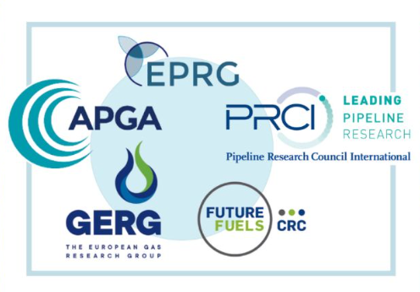
Overall Interest Points
Emerging fuel pipelines (CO2, Hydrogen, Ammonia)
Conversion of existing pipelines vs. new pipeline construction
Requirements for pipelines carrying CO2, Hydrogen and Ammonia
Stakeholder engagement, publicity and politics relating to these emerging fuels
Notes:
The following is a high level summary of some of the areas covered within the symposium, of which I found interesting and applicable to our industry. The remainder of the content will focus more specifically on the ammonia side, however many of the key interest points were concurrent across CO2, Hydrogen and Ammonia

Slide 4
Ammonia – Scope of Presentation
Josh Wickham from GPA presented on the Ammonia transmission pipelines – assessing dispersion characteristics and threat mitigation
Project initiated by Future Fuels Cooperative Research Centre (FFCRC) joint with GPA and Adelaide University Research
Scopes with:
  Literature review of existing ammonia transmission pipelines
  Identify toxicity limits and dispersion behaviour
  Investigate past failures (pipelines and other vessels)
  Assess main threats to public safety / legislation in place to mitigate
  Define best practice approach to threat assessment and response
  Assess changes needed to AS2885 Series
This presentation will cover:
  Summary of the findings
  Further application to pipeline construction sector
  Market viability and potential for construction
Notes:
This presentation covers the usage of ammonia pipelines as either dedicated ammonia source or as a high density energy carrier for Hydrogen. By summarising the presentation from the symposium and relating the content to our construction industry, the two tie together well to start investigating opportunities and how these opportunities will be managed in a broader context. This presentation takes both the learnings from the symposium in conjunction with research undertaken after to present a viewpoint on the viability and market for ammonia in Australia, along with the risks and challenges of ammonia transmission pipelines entering the Australian marker.

Slide 5
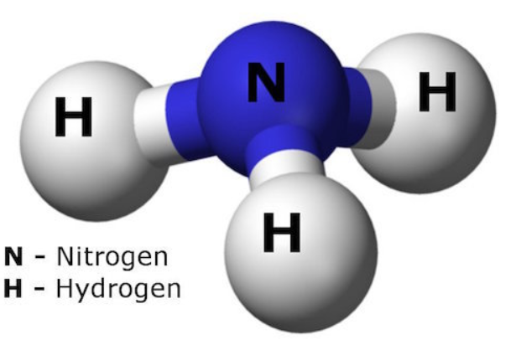
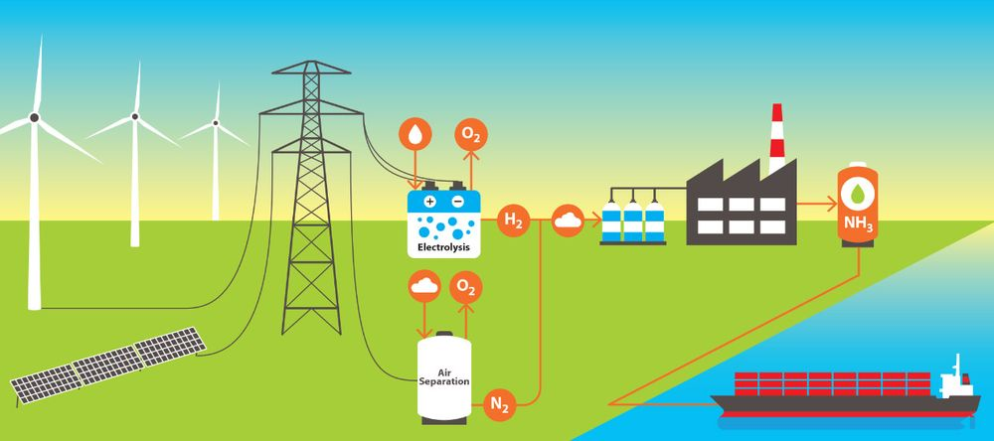
Ammonia – Uses and Market
Green ammonia is emerging as a low carbon fertilizer and energy carrier
To produce green ammonia, hydrogen is produced by electrolysis from 100% renewable sources and combined with nitrogen extract from ambient air using an air separator
With the focus on hydrogen and its place in the energy transition, ammonia can be used to transport hydrogen (combined with nitrogen) in a more compressed form

Slide 6
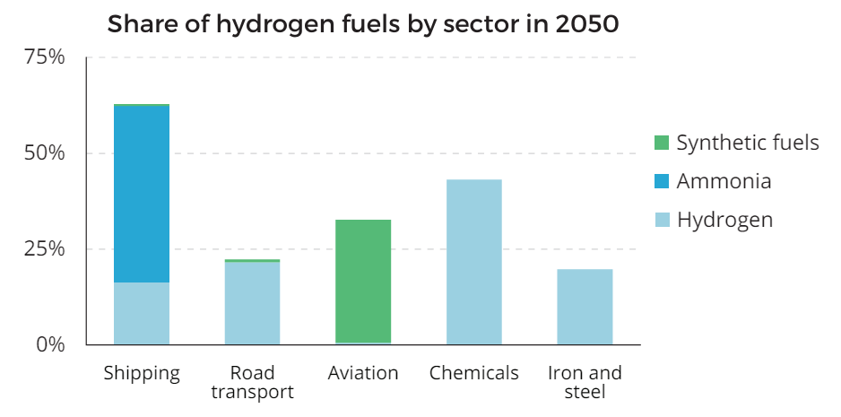
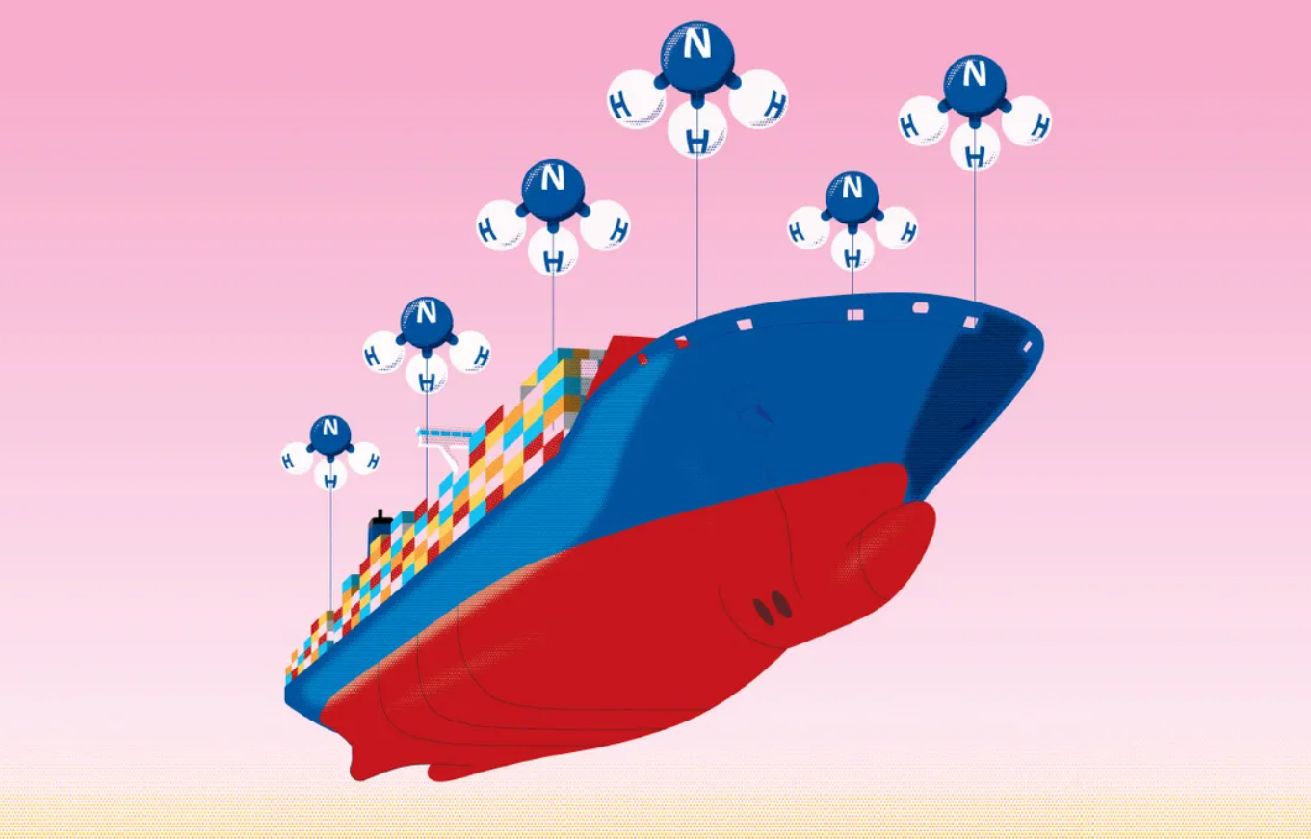
Ammonia – Uses and Market
Australia is in a good position for export and agricultural use based on the existing LNG port export facilities and high industrialised agriculture
Japan is targeting ammonia use of 3 million tonnes by 2030 for use in coal-firing power plants with a co-firing level of 20%¹
“By 2050, hydrogen and hydrogen-based fuels, notably ammonia, will power 60% of global shipping demand”²
If todays long haul shipping is converted to ammonia as fuel, it will consume 500m – 600m tonnes of ammonia per year
1 Minerals Council of Australia 2022, Australia’s Emerging Hydrogen and Ammonia Industry
2 IEA Special Report, Net Zero by 2050: A Roadmap for the Global Energy Sector, 2021

Slide 7
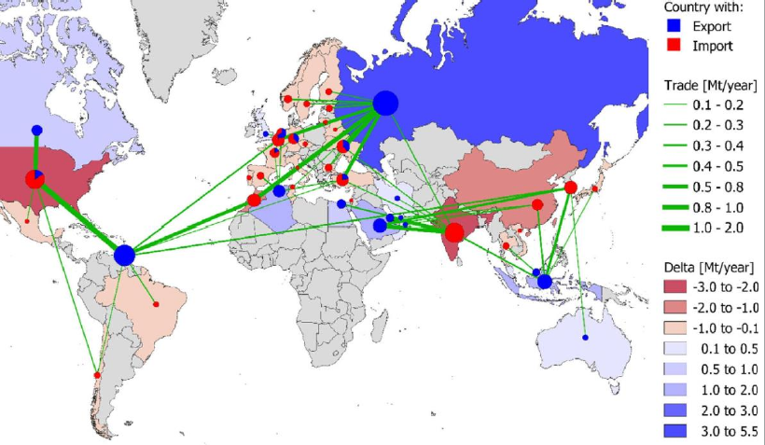
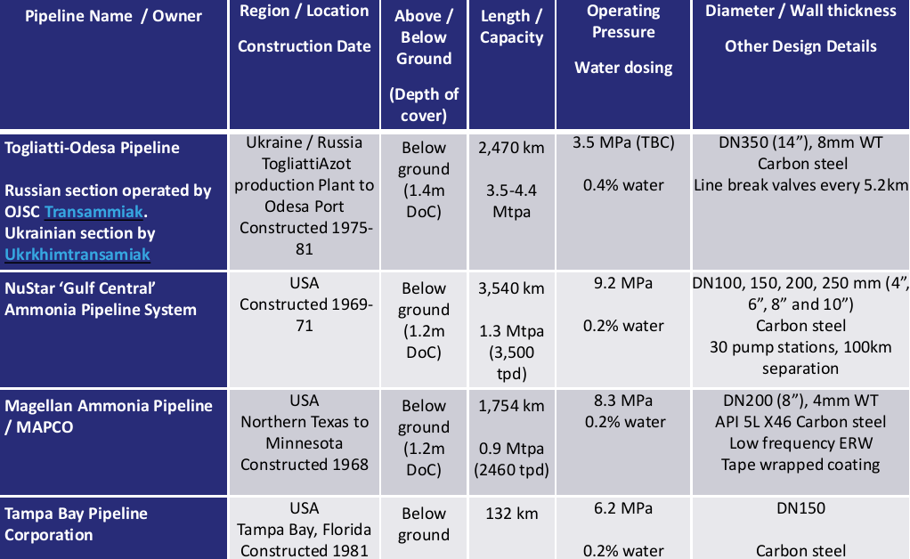
Ammonia – Current Infrastructure
Currently there are no ammonia pipelines or infrastructure in Australia
Australia is setup well for export of ammonia through existing LNG shipping infrastructure
Currently no coverage under AS2885 for ammonia pipeline specifications
Overseas (Europe & USA) have been operating ammonia pipelines successfully for decades

Slide 8
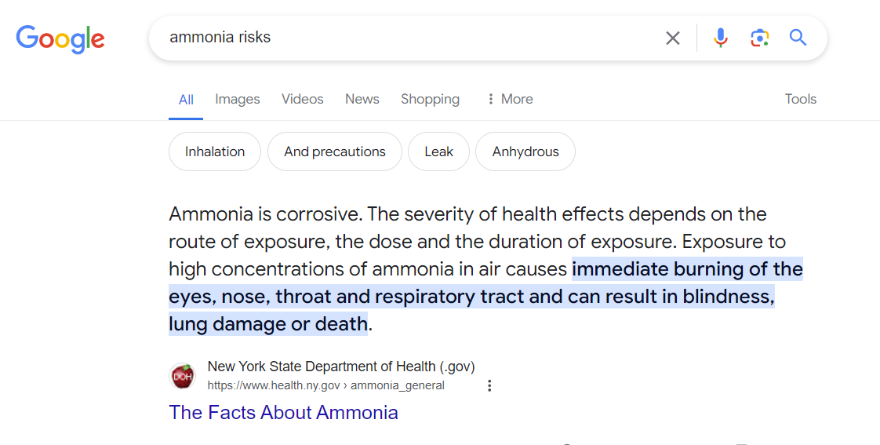
Ammonia – Risks
Importance, as with hydrogen, of ‘no mistakes’ approach for construction and maintenance of new infrastructure
Ammonia does pose a high risk to health, safety and environment if exposure occurs
Public perception will be a key driver in government funding and regulatory approval for both ammonia and hydrogen energy sources
Safe Work Australia
300ppm is identified limit
50-100ppm tolerable for < 2 hours, irritation
3000-4000ppm fatal at 30 minutes
>5000ppm is fatal within minutes

Slide 9
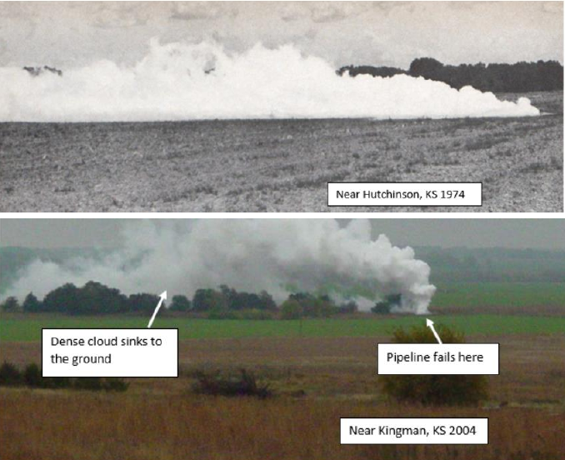
Ammonia – Notable Failures
85 Major release events in Europe since 1985
16% fatality rate in USA
50% fatality rate in Europe
One event in Dakar, Senegal in 1992 killed 129 and injured 1,150
Controlled release experiments have predominantly been from storage vessels rather than pipelines
Dispersion is observed as a low travelling spread, adding to the complexity of failure and release

Slide 10
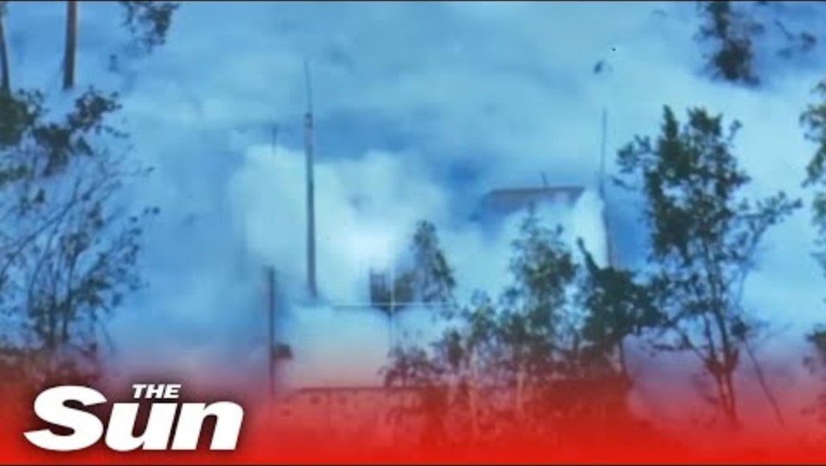
Ammonia – Notable Failures
Russian / Ukraine “Tolyatti-Odesa”, one of the longest ammonia pipelines in the world at 2,500km was destroyed via sabotage in June 2023 in the Russian/Ukraine War

Slide 11
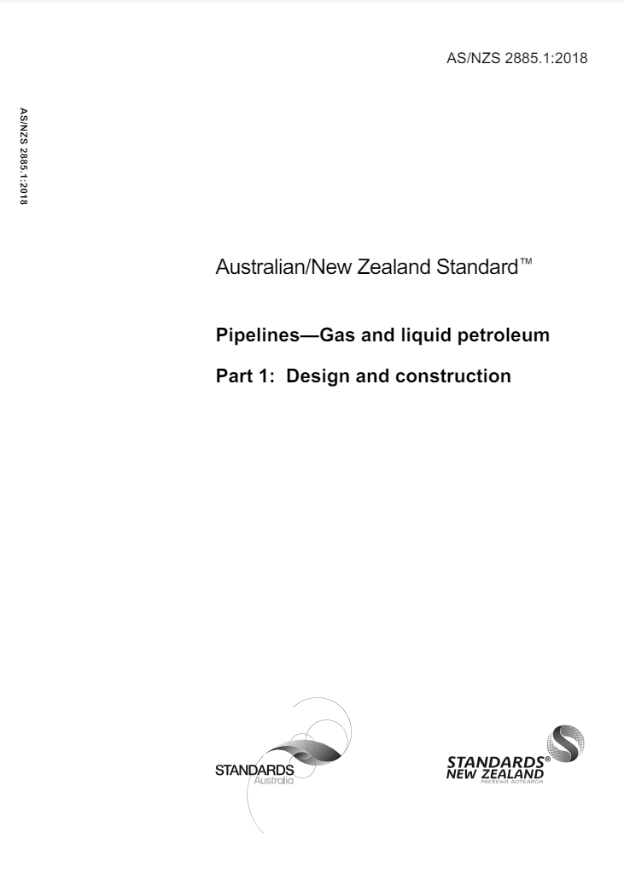
Ammonia – What is Required
Pipeline transportation
  Either refrigerated piping (-33ºC) or,
  > 2MPa
Pipeline materials similar to that of natural gas
Frequent pumping stations to maintain pressure
Modelling of various pipeline scenarios relevant to Australia
Identification and recommendations to be included in AS2885 to cover ammonia

Slide 12
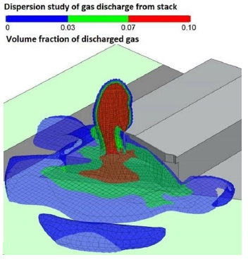
Ammonia – What is Required
FFCRC joint with GPA Engineering and Adelaide University
  Undertaking dispersion and consequence modelling
    Gaussian models
    Integral models
    CFD
  Future
    Focus on Phast with flat terrain, with nominal diameters up to DN600 for a range of scenarios
    Recommendations on equating release to the ‘measurement’ length under AS2885 for a full bore rupture
    Future guidance on applying CFD modelling for inner urban or more complex terrain to be explored
    Further guidance on pipeline design and application of Safety Management under AS2885 to be formalised

Slide 13
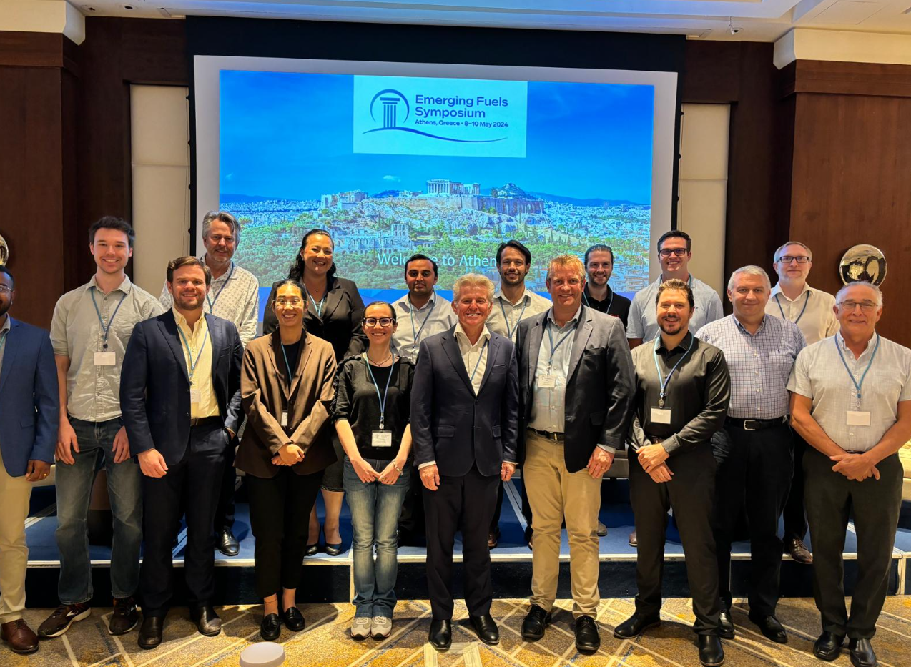
Closing and Thanks
APGA & Craig
Future Fuels CRC & Jeremy / David
Spiecapag Australia
All representatives who gave their time to further our understanding and engagement
Elizabeth, Neville, Morgan & Zach

