Slide 1
Hydrogen Pipeline Systems Code of Practice
Dissemination Workshop March 2025

Slide 2
Seminar Overview
Josh Wickham GPA

Slide 3

Seminar Objectives
Wider dissemination as part of handover FFCRC to APGA
Detailed overview of the CoP content
Highlight key concepts in each subject area
Identify areas of uncertainty or evolving knowledge (including international developments)
FFCRC goal of successful transfer of research to application
Q&A / Feedback
Opportunity for Q&A from the wider APGA membership to CoP author team
Gather feedback from ‘users’ of the document → inform future revisions

Slide 4

Dissemination Format
Section Presentations
Slide presentation by key CoP section authors / contributors
Overview of content, key items to highlight
5 minutes audience Q&A (after each presentation)
Panel Sessions (Two)
35 minute facilitated session (targeted panel questions)
Key issues around design for storage and material testing
10 minutes audience Q&A to the panel
General Q&A
20 minutes audience Q&A
Craig Bonar on the roaming microphone – Don’t be shy. Please ask!
*Any difficult questions left? Please ask tonight at the Melbourne Networking Evening from 6pm*

Slide 5
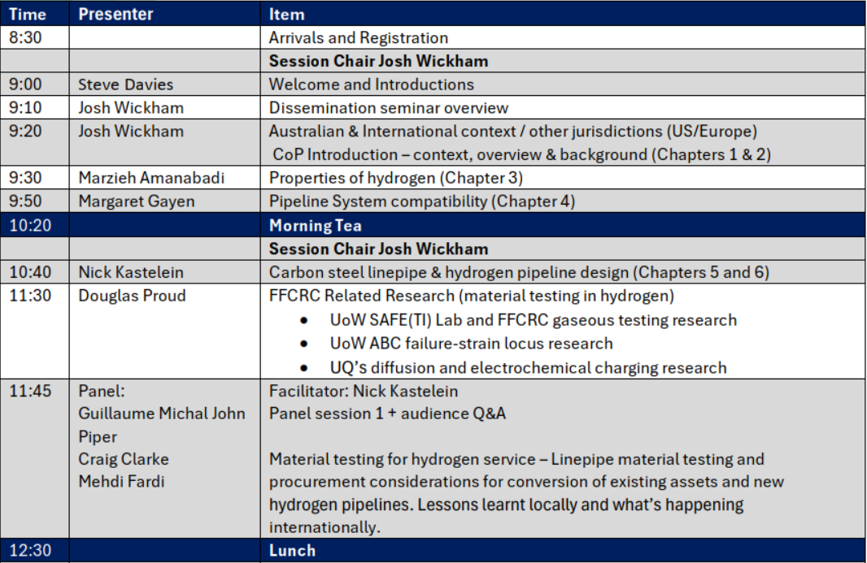
Agenda – Morning Session

Slide 6
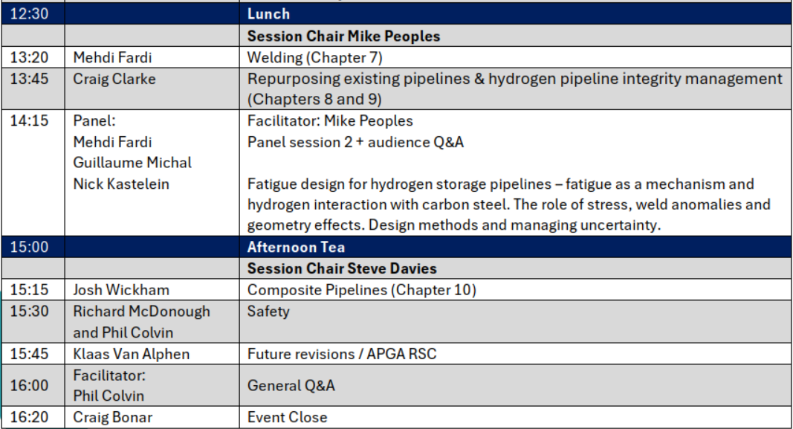
Agenda – Afternoon Session

Slide 7
CoP Overview & Background
Josh Wickham GPA

Slide 8



Acknowledgements
Project number: RP3.2-10, Revision 0
This Code of Practice (CoP) was developed under project 3.2-10 of the Future Fuels Cooperative Research Centre. The CoP was led by GPA Engineering and a cross-industry working group representing operating companies, engineering design representatives, technical regulators, construction representatives and vendor/technology providers.
Lead Authors
Josh Wickham
Nick Kastelein
Margaret Gayen
Sam Hatwell
Mark Lackenby
Craig Clarke*
Dennis Kirk-Burnnand
Richard McDonough*
Contributing Authors & Lead Reviewers
Marzieh Amanabadi
Tom Amrein
Andrej Atrens
Phil Colvin
James Czornohalan
Oliver Day
Cameron Dinnis
Gilles Dour
Amir Esmaeili
Mehdi Fardi
Zachary Hill
Susan Jaques
Raj Jeyarajah
Daniel Meyer-Rodenbeck
Guillaume Michal
Mike Peoples
Klaas Van Alphen
Phil Colvin

Slide 9
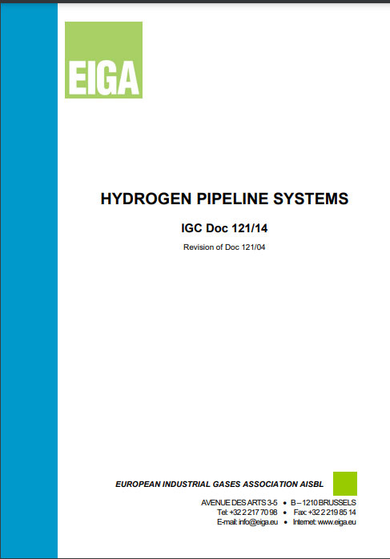


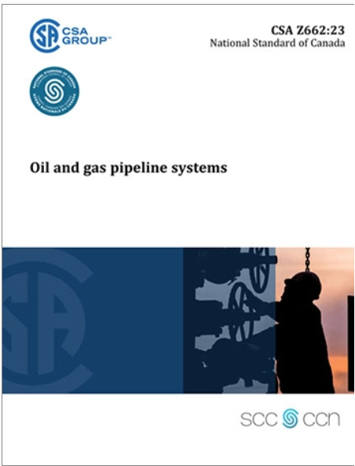
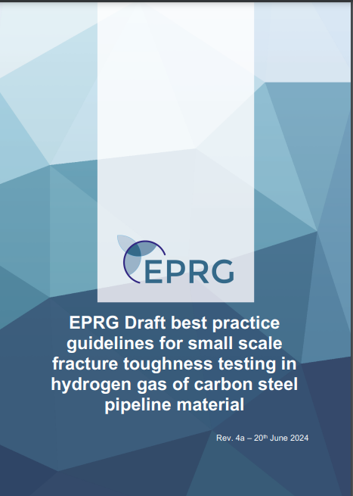



Timeline Code Development
Energy Pipelines CRC (2009 – 2019)
Future Fuels CRC (2018 – 2025)
APGA RSC Ongoing →
EIGA
FFCRC COP Research Proposal
CoP Development
FFCRC COP
1st Rev Published
APGA COP
2nd Rev Published
AS 2885 Series
Adopts H2
IGC Doc 121/14
2008-2014
2019
2021
2022
2023
June2024
Oct 2024
June
2025
2026
202?
ASME B31.12
4th Rev
ASME B31.12
5th Rev
ASME B31.12
1st – 3rd Rev
EPRG Guideline
ASME B31.8
(Adopts H2)
CSA Z662
Aus, US & UK Hydrogen Injection / Blending Trials
CERs
Published

Slide 10
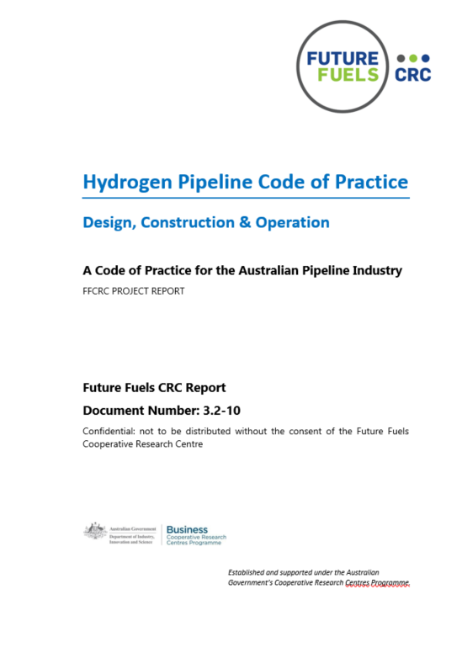
Publication Status
The Hydrogen Pipeline Code of Practice:
Design, Construction and Operation
“Guidance and recommended practice for the design, construction and operation of transmission pipeline systems for transporting hydrogen or blends of hydrogen and hydrocarbon fluids”
https://www.futurefuelscrc.com/project/rp3-2-10-hydrogen-pipeline-code-of-practice-design-construction-and-operation/

Slide 11
Scope Exclusions
High temperature service – e.g. above 100 °C. High temperature “hydrogen attack” (occurs above 200 °C) is not considered a failure mode
Low temperature “cryogenic” service is not addressed, and hence liquid hydrogen transport is not covered.
Submarine pipeline systems, as covered in AS/NZS 2885.4.
Hydrogen derivatives: Ammonia, methyl cyclohexane (MCH) or methanol.
Downstream end-user systems and appliances
Low-pressure piping systems (e.g. distribution systems) and their materials, though the requirements and principles set out are applicable for the design of piping at any pressure.
General Scope
High pressure pipeline systems (generally under the scope of the AS(NZS) 2885 Series for:
  100% hydrogen service
  Blended hydrogen / natural gas service
  New installations (new pipeline systems) and conversion of existing assets to hydrogen service
Key considerations for hydrogen service in transmission pipeline systems, with a specific focus on hydrogen fluid compatibility with pipeline materials and differences compared to hydrocarbon fluids.
Key objective: Enable safe, reliable and efficient transportation and storage of hydrogen in transmission pipeline systems that are required to conform to the AS(/NZS) 2885 series.
Key objective: Establish requirements that are unique to hydrogen and are not addressed in the existing AS(/NZS) 2885 series (i.e. what ‘special’ requirements apply).
Many aspects of the existing AS(/NZS) 2885 series apply without modification.

Slide 12
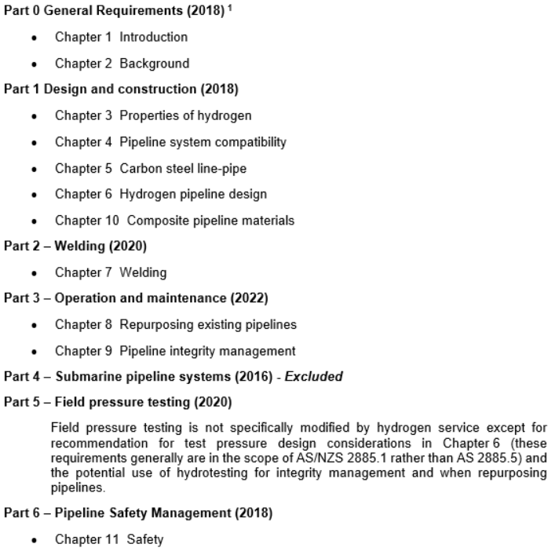
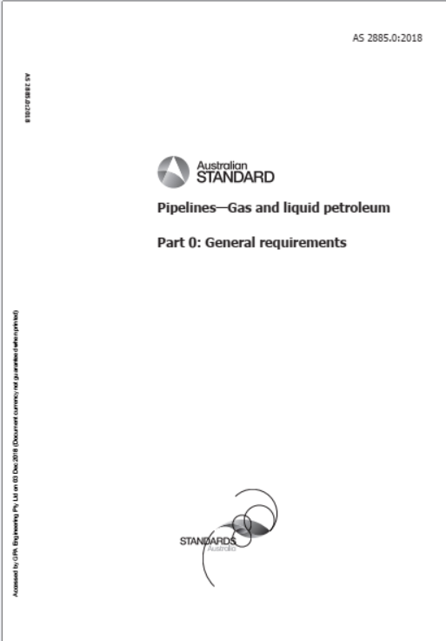
AS(NZS) 2885 Interaction
Key objective: Enable safe, reliable and efficient transportation and storage of hydrogen in transmission pipeline systems that are required to conform to the AS(/NZS) 2885 series.
Key objective: Establish requirements that are unique to hydrogen and are not addressed in the existing AS(/NZS) 2885 series (i.e. what ‘special’ requirements apply).
Many aspects of the existing AS(/NZS) 2885 series apply without modification.

Slide 13

Historical Experience
Hydrocarbon Pipelines
Our knowledge of high-pressure hydrocarbon pipelines is mature.
Design approaches have already been proven and optimised, supported by lessons learnt over decades of experience
Hydrogen Pipelines
Historical experience is limited and generally not at high design factors or cyclic storage conditions
Hydrogen pipelines, however, have not yet achieved optimal design.
The effects of hydrogen on pipeline performance have not all been quantified such that designers can achieve similar performance outcomes to natural gas pipelines
The mechanism of fatigue in service will take many years until we observe actual failure (slowing ability to push boundaries)
Knowledge continues to evolve:
  Focus on code/standards development across multiple jurisdictions
  Continued research (internationally mainly in Europe and US),
  Empirical models are further developed following increasing testing database & more representative testing (beyond laboratory towards full-scale
  Implementation of projects: examine practicality for procurement, seek cost efficiency and management of research gaps.

Slide 14
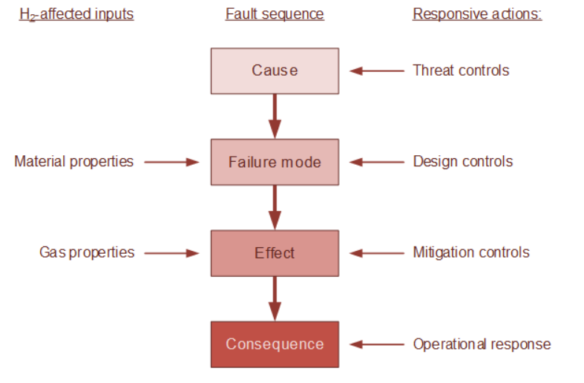
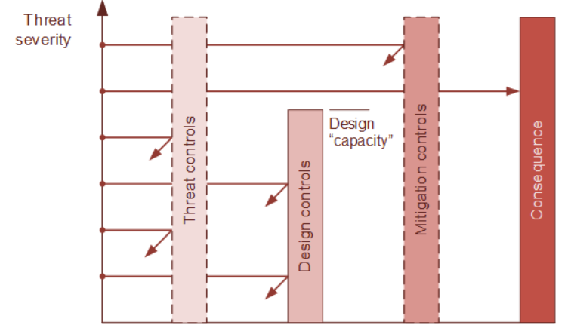
Applying Failure Modes
The code of practice is different to our Australian Standards. This difference is intentional.
Prescriptive recommendations provided – where knowledge/experience supports rules and conservative allowances acceptable
In areas where knowledge gaps exist:
  Detailed commentary, and background information provided
  Information on how these damage mechanisms contribute to a failure mode
  Guidance on how failure modes can be addressed
  Guidance on knowledge gaps and where individual assessment needed
  Framework for new assets & conversion
  A design can seek to control failure through several actions, which either prevent the failure by acting on either the threat or the failure modes, or mitigate the failure by altering its effects.
  A key outcome is the CoP, informs and educates the user, to support informed judgement – it is not a recipe book! Engineering judgement is needed.

Slide 15
Performance Based Design
Performance-based design requires knowledge of failure mode and the control measures, and of the uncertainty and assumptions that underpin that knowledge.
The CoP includes commentary to aid in understanding the assumptions being made, and to refine those assumptions where practicable for a design.
*However it is not exhaustive, due to current limited operating experience and understanding that continues to evolve to close gaps*
Developing performance-based requirements are for function or failure:
  Identify the physical scenario that constitutes the function/failure
  Select the metric(s) that predict occurrence of that function/failure
  Define an acceptable threshold or limit (envelope) for those metrics, including a safety factor to accommodate uncertainty or inaccuracy
  Propose acceptable analysis methods to assess if a design exceeds the acceptable threshold
  Provide conservative assumptions that may be used for analysis in the absence of data, so that a pipeline design can manage uncertainty efficiently
  Identify potential upset conditions that will exceed the acceptable metric/envelope and either re-assess or risk-asses to determine if consequence/residual risk is acceptable.

