Slide 1
Chapter 11 - Safety
Richard McDonough (GPA), Lisa Hein (GPA), Phil Colvin (Jemena)
Notes:
Thanks for welcoming me.
I’m responsible for this brief presentation today, but I just want to start by acknowledging the contributions of Lisa Hein and Phil Colvin to Chapter 11 Safety.

Slide 2
Overview
GENERAL
AS(/NZS) 2885 (and AS 4645) already provides for a range of fluids
  Principles, requirements, guidance
  Natural gas, liquid hydrocarbon, well-stream fluids, HVPLs, CO₂
Hydrogen service
  Specific issues and challenges identified
  Relevant sections of H2CoP referenced
AS(/NZS) 2885 provides a robust framework for hydrogen pipeline safety, so long as specific hydrogen properties are understood and addressed.
Notes:
AS(/NZS) 2885 provides principles, requirements and guidance for pipelines that convey a number of different fluids which exhibit a range of properties which need to be taken into account on a case-by-case basis.
These principles, requirements and guidance are applicable for any flammable fluids. However, where fluid properties are atypical or unusual, specific guidance on their application is provided in the Standard.
Accordingly, the safety section of the hydrogen code of practice identifies which properties of hydrogen specifically relate to assessments required by each of these safety management processes, and why they require specific consideration. It then directs the user to the guidance elsewhere in the Code.
(The detailed guidance has been covered by the presentations today.)
In short, AS(/NZS) 2885 provides a robust framework for hydrogen pipeline safety, so long as specific hydrogen properties are understood and addressed.

Slide 3
Safety in AS(/NZS) 2885
Pipeline Safety Management
Facilities Risk and Hazard Management
Emergency Management
Notes:
The Safety section addresses the hydrogen-specific issues that affect:
Pipeline safety management
Process safety applied to facilities
Emergency management
The presentation will briefly describe key issues addressed under each of these headings.

Slide 4
Pipeline Safety Management
TOPICS
Measurement length
Provisions for high consequence areas
Failure analysis
Risk assessment
Notes:
The main Pipeline Safety Management issues that require a bit of thought when applied to hydrogen service are listed on the screen, and I’ll cover these in the following slides.
In each case, hydrogen introduces complexities that are not present for the typical natural gas pipelines that most of us are familiar with
Therefore, we are challenged to think about how the principles that are the foundation of the safety management process are applied to Hydrogen.

Slide 5


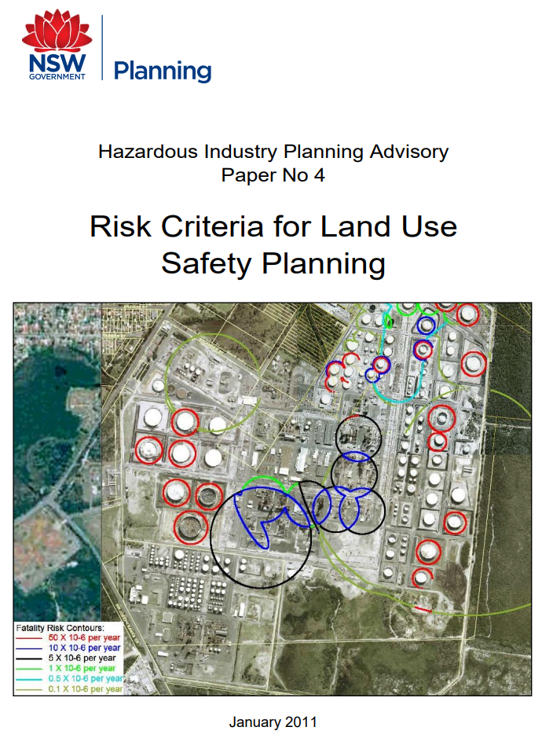
Pipeline Safety Management
MEASUREMENT LENGTH
Location classification and threat control requirements
Principle –
  serious injury distance for full bore rupture
Hydrogen hazards –
  Heat radiation
  Explosion / overpressure
Worst case hazard determines measurement length
Apply measurement length principles to hydrogen, including explosion and overpressure
Notes:
Measurement length is used to determine pipeline location class. This in turn determines many of the design and operations requirements for the pipeline system.
The measurement length is defined by the injury threshold for a full-bore rupture incident. This principle applies to all hazards presented by any fluid conveyed by the pipeline.
For natural gas, this is determined by the serious injury radiation contour from an ignited full bore rupture at MAOP.
For hydrogen, two hazards must be considered:
Radiant heat injury contour
Explosion / overpressure injury contours
The NSW guidance in HIPAP 4 provides injury threshold values for both of these hazards
The worst case defines the measurement length.

Slide 6
Pipeline Safety Management
HIGH CONSEQUENCE AREAS
No rupture
  Requirements are independent of the fluid type
  Hydrogen service determines failure mode
Maximum energy release rate
  Based on heat radiation hazard
  Suggested approach for explosion hazard – injury / fatality contours should not exceed heat radiation
Apply "energy release rate equivalent" for explosion case
Notes:
Provisions for high consequence areas require that the pipeline meet “no-rupture” and maximum energy release rate provisions.
The requirement for “no-rupture” is independent of the fluid contained in the pipeline. However, as has been discussed today, hydrogen affects toughness and therefore propensity for rupture.
The objective of the maximum energy release rate is to restrict the maximum injury and fatality contours either side of the pipeline.
While these restrictions were developed on the basis of radiation contours, in principle they are independent of the hazard causing injury or fatality.
It is proposed that where injury or fatality is a result of a different hazard (e.g. explosion overpressure), the maximum damage to the pipeline permitted is that which results in injury or fatality contours that are equivalent to those for the maximum energy release rate. This will be determined by modelling.

Slide 7


Pipeline Safety Management
FAILURE ANALYSIS
Uncontrolled threats are subject to failure analysis
Hydrogen affects toughness and therefore failure mode
  Rupture more likely for hydrogen than “equivalent” natural gas pipeline
Failure consequence needs to consider explosion / detonation
Notes:
Threats that are not controlled are subject to failure analysis. This requires an assessment of the failure mode and also the failure outcomes which in turn dictate the potential consequences of failure. These factors are documented in a failure scenario that is then subject to risk assessment.
Hydrogen service does not affect resistance to penetration. However, as hydrogen can reduce toughness and therefore critical defect length, rupture is more likely than for the equivalent pipeline transporting natural gas – which means that damage that results in a hole for a natural gas pipeline may result in rupture for a hydrogen pipeline
Consequence assessment for hydrogen service also needs to consider the explosion / detonation hazard.

Slide 8
Pipeline Safety Management
RISK ASSESSMENT
Natural Gas Pipelines
  Severity and frequency informed by >18 million km.years of data (EGIG and DoT)
  Failure mode, ignition probability, fatality probability
  Heat radiation dominant
Hydrogen Pipelines
  Little or no statistical data, so conservative guidance provided
  Ignition probability ~100%, auto-ignition, increased fatality probability
  Explosion consequences > heat radiation consequence (?)
  Refer Thomas Jackson, Assessing and Managing Process Safety Risks for Future Fuels, APGA Conference 2024
Hydrogen service risk > “equivalent” natural gas pipeline risk – add risk controls
Notes:
Failure events are subject to risk assessment, which requires that the consequence of that event and the frequency of that consequence are estimated.
Estimates of consequence and frequency are by nature imprecise. However, for natural gas pipelines we have a significant body of data that informs these estimates, regarding failure mode, ignition probability, fatality probability, (which implicitly account for delayed ignition and opportunity for escape).
We have no such database for hydrogen pipelines. The Code of Practice provides conservative guidance.
We can infer that the consequences of an ignited hydrogen release are likely to be greater than for a natural gas release:
Ignition probability is virtually 100% and immediate ignition is likely to reduce the opportunity for escape
It follows that numbers harmed and probability of harm are likely to increase.
Explosion hazards are an additional factor that need to be assessed and may require specialist modelling. A useful reference is a QRA Case Study for an existing gate station comparing natural gas and Hydrogen Service shown on the slide.
In broad terms, it is likely that the assessed risk for hydrogen pipeline incident will be greater than that for an “equivalent” natural gas pipeline incident, so that additional controls will be required.

Slide 9
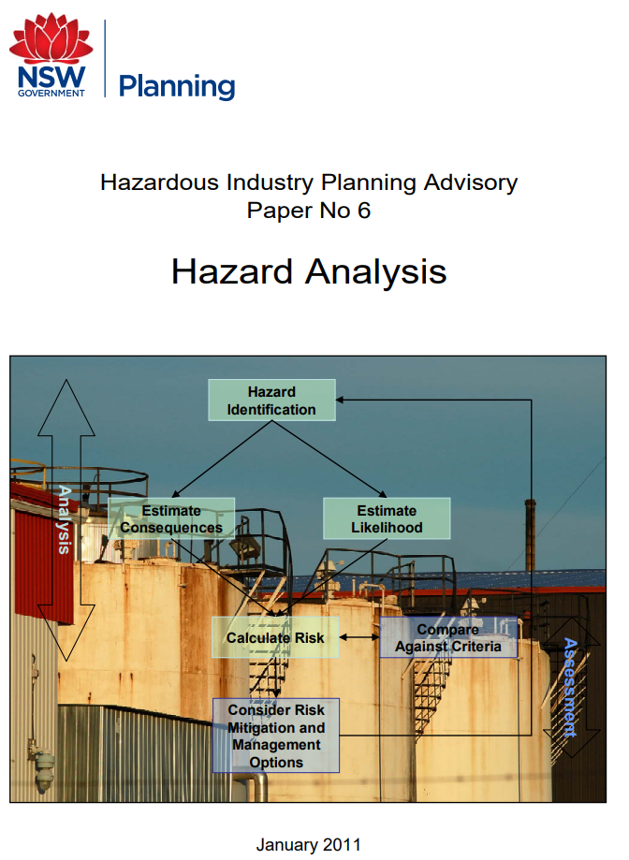
Facilities Risk and Hazard Management
TOPICS
Established Hazard Analysis / Risk Assessment apply
  For example - HIPAP 4 and HIPAP 6
Leak detection and flame detection
  Hydrogen-specific systems required (invisible flame)
  Co-sensitive detectors may be affected (e.g. carbon monoxide)
Control of ignition sources – hazardous area assessment
  Low ignition energy increases ignition probability
Escalation controls
  Protection for heat radiation and blast hazards
Human Factors
  Hydrogen-specific systems, procedures, training
Notes:
Established Hazard Analysis and Risk Assessment process applies to hydrogen facilities.
Issues peculiar to hydrogen are highlighted in the Code of Practice:
Leak detection and flame detection is particularly difficult:
Standard equipment and methods for methane cannot be used.
Hydrogen-specific flame detectors are required to detect flames that may be invisible.
Carbon-monoxide detectors are co-sensitive to hydrogen and activate at low hydrogen concentrations.
Hazardous area assessment needs to account for:
Low ignition energy
Higher volumetric flow rates
Susceptibility to “non-standard” ignition sources – static electricity, mobile phones
Escalation controls – need to take into account hydrogen hazards
Systems, procedures, equipment and training that are specific to hydrogen service need to be developed and in place prior to commissioning.

Slide 10
Emergency Management Considerations
AS 2885.3 Section 11 – Emergency response preparedness
Principles and requirements are clear, but hydrogen-specific issues need to be addressed
Every aspect of the ERP needs to scrutinised and updated so that hydrogen emergencies are successfully managed. Examples:
    Consideration of blast effects (explosion overpressure)
    Avoid confusion between hydrogen systems and natural gas systems, particularly where they are in close proximity (signage, maps, GIS)
    Communication and training protocols, particularly first responders, emergency services
    Hydrogen-specific replacement pipe, fittings, weld procedures...
Notes:
Principles and requirements for emergency management are clearly set out in AS2885.3 but hydrogen-specific issues need to be addressed.
Every aspect of the ERP needs to scrutinised and updated so that hydrogen emergencies are successfully managed. Examples include:
Consideration of blast effects
Avoiding confusion between hydrogen systems and natural gas or other hydrocarbon systems, particularly where they are in close proximity
Communication and training protocols, particularly for first responders and emergency services
Hydrogen-specific replacement pipe, fittings, weld procedures, etc

Slide 11
Conclusion
AS(/NZS) 2885 provides a robust framework for hydrogen pipeline safety
Chapter 11 Safety draws attention to the hydrogen-specific issues that need be understood and accounted for
Conservative guidance is provided where industry experience, knowledge and research is in development
Guidance will be refined as the industry matures
Notes:
AS(/NZS) 2885 provides a robust framework for hydrogen pipeline safety
Chapter 11 Safety draws attention to the hydrogen-specific issues that need be understood and accounted for
Conservative guidance is provided where industry experience, knowledge and research is in development
This guidance will be refined as the industry matures

