Slide 1
Hydrogen Pipeline Systems Code of Practice – wrap up
Dissemination Workshop March 2025

Slide 2
Background
Project Proposal – Industry Need (2021)
AS2885 does not currently provide requirements for hydrogen service, and does not consider the different design and material limitations or the associated conditions to safely accommodate hydrogen as a fluid.
This project will provide industry with a Code of Practice for Hydrogen pipeline design and operation, including pipelines carrying hydrogen/methane blends and existing pipelines that are converted to hydrogen service and covering both carbon steel and composite materials.
A future phase of this project is anticipated at the end of the FFCRC life, to incorporate outcomes of research that has not yet been completed.

Slide 3
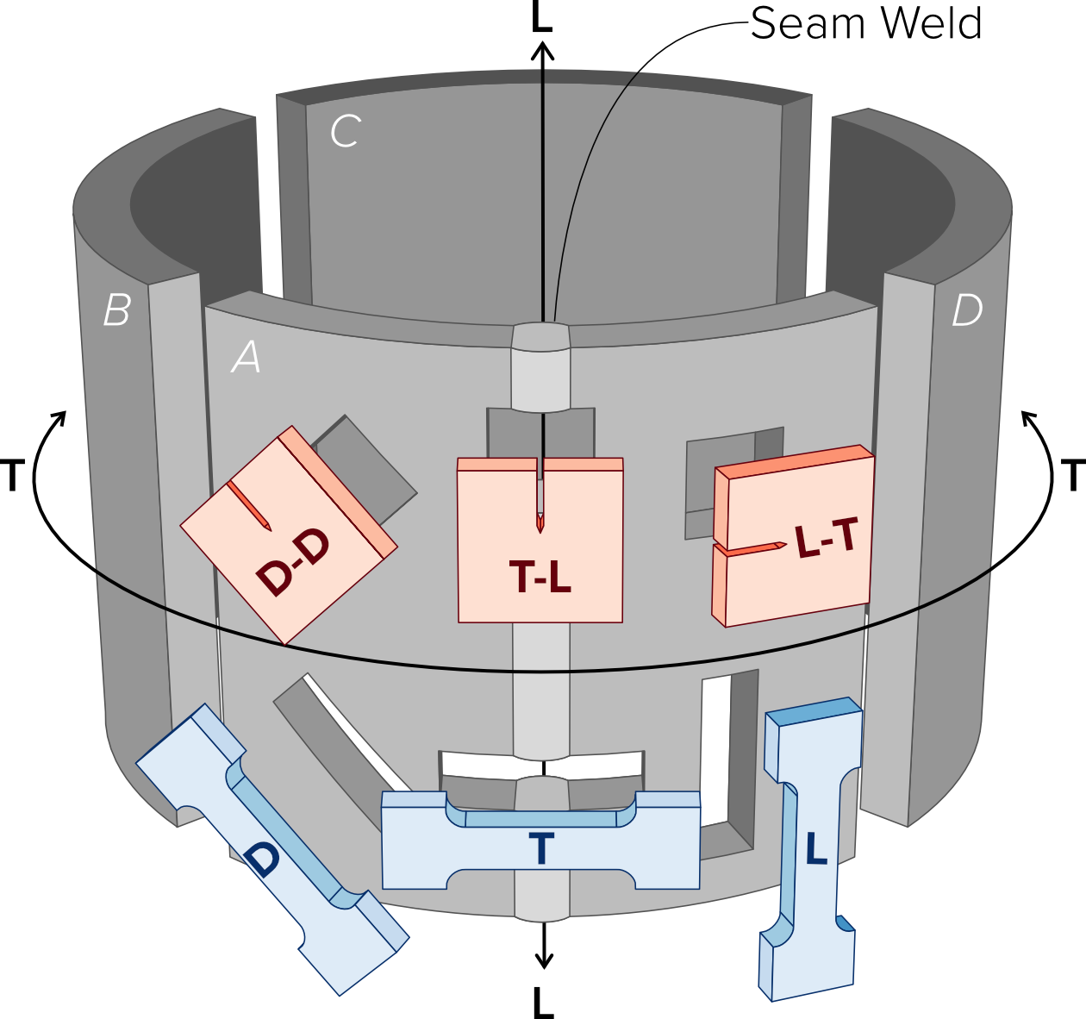
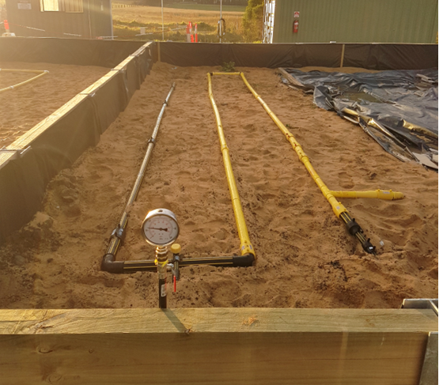

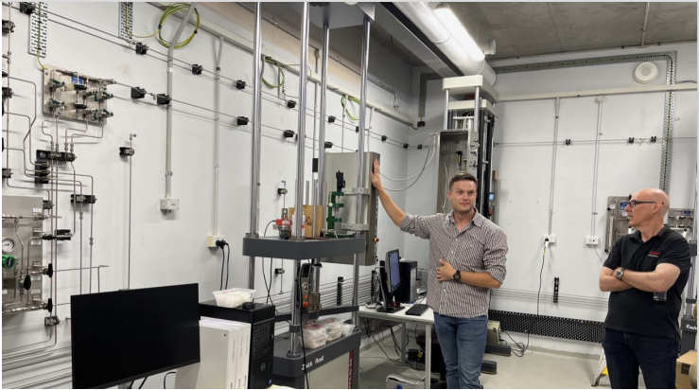
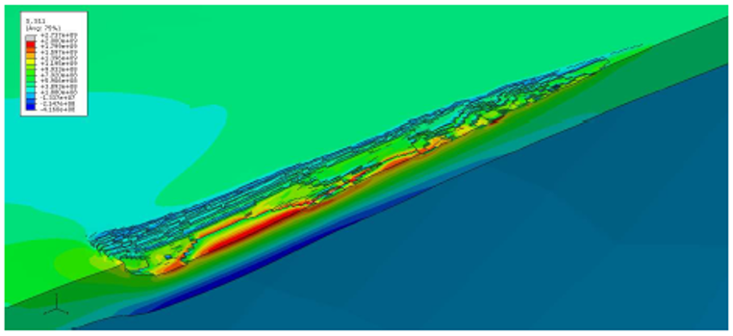
World class research
Industry led research through Future Fuels CRC
Hydrogen distribution grid test bed at Deakin University
Hydrogen materials test lab at the University of Wollongong
Example FE mesh on dent-gouge damage in hydrogen service.

Slide 4
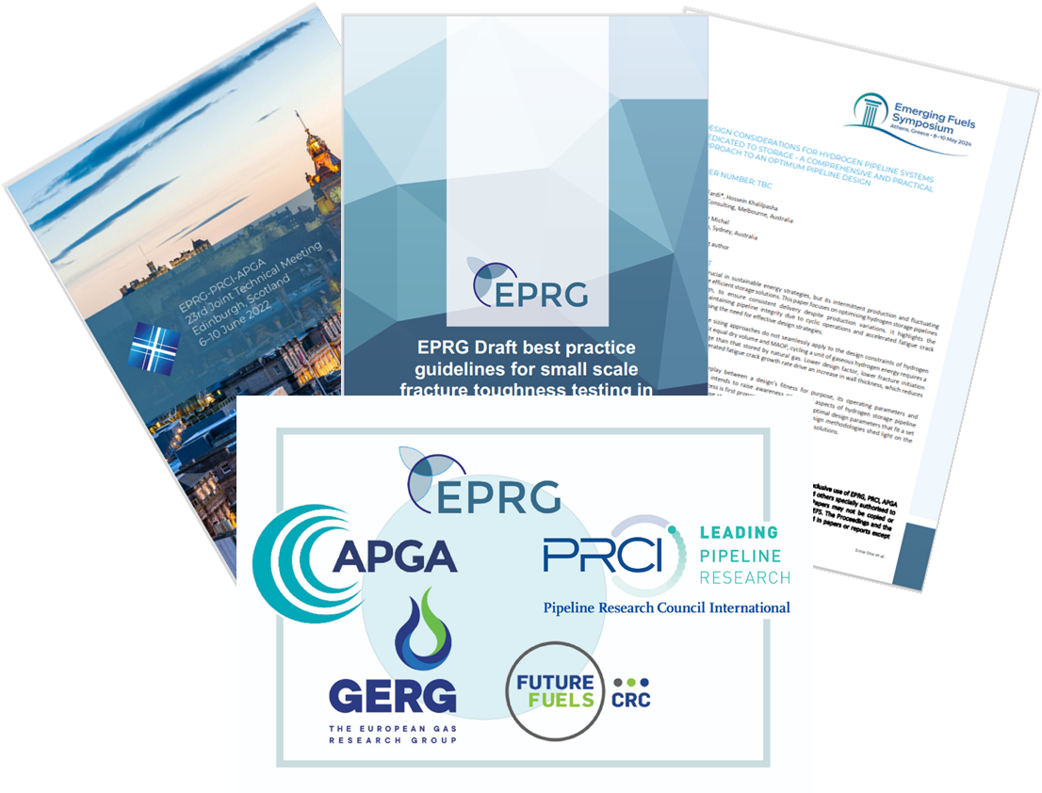
Engineering guidance for hydrogen pipelines
Engineering guidance is constantly developing internationally and not in isolation
ASME B31.12: 2023: Hydrogen Piping and Pipelines
CSA 2024: Assessment of Natural Gas Pipeline Materials for Hydrogen Service
EPRG 2024: Hydrogen Pipelines Integrity Management and Repurposing Guideline White Paper
EPRG 2024: Best Practice guidelines for small scale fracture toughness testing in hydrogen gas of carbon steel pipeline material
PRCI CER 2024: for Pipelines in Hydrogen and Hydrogen Blend Service
FFCRC 2024: Hydrogen Pipeline Systems Code of Practice

Slide 5

Read the instructions
*The CoP is not exhaustive, due to current limited operating experience and understanding that continues to evolve to close gaps*
Chapter 1:
The purpose of this Hydrogen Pipeline Systems Code of Practice (CoP) is to provide guidance based on current knowledge for the design, construction and operation of transmission pipeline systems transporting gaseous hydrogen or blends of hydrogen and hydrocarbon fluids.
Although the CoP may be further developed into a published standard in the future, this current revision of the CoP is not equivalent to a formal, published Australian standard.

Slide 6

Plagiarism warning…..
Josh Wickham’s best late-night work is coming up next

Slide 7
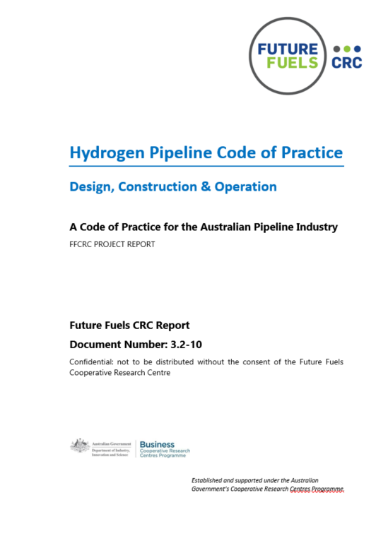
Publication Status
The Hydrogen Pipeline Code of Practice:
Design, Construction and Operation
“Guidance and recommended practice for the design, construction and operation of transmission pipeline systems for transporting hydrogen or blends of hydrogen and hydrocarbon fluids”
https://www.futurefuelscrc.com/project/rp3-2-10-hydrogen-pipeline-code-of-practice-design-construction-and-operation/

Slide 8
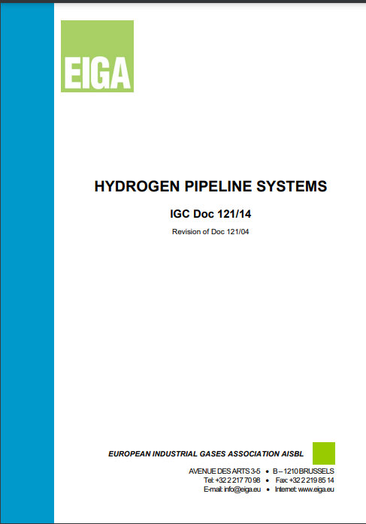


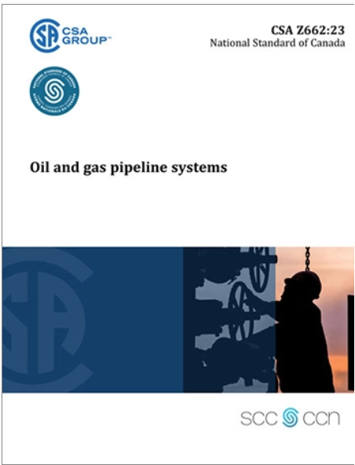
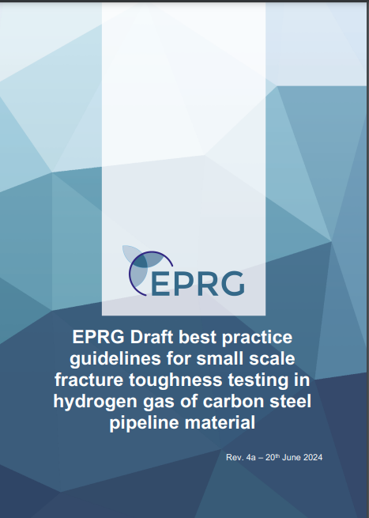



CoP Development Timeline
Energy Pipelines CRC (2009 – 2019)
Future Fuels CRC (2018 – 2025)
APGA RSC Ongoing →
EIGA
FFCRC COP Research Proposal
CoP Development
FFCRC COP
1st Rev Published
APGA COP
2nd Rev Published
AS 2885 Series
Adopts H2
IGC Doc 121/14
2008-2014
2019
2021
2022
2023
June2024
Oct 2024
June
2025
2026
202?
ASME B31.12
4th Rev
ASME B31.12
5th Rev
ASME B31.12
1st – 3rd Rev
EPRG Guideline
ASME B31.8
(Adopts H2)
CSA Z662
Aus, US & UK Hydrogen Injection / Blending Trials
CERs
Published

Slide 9

Industry-research collaboration at its best!
Lead Authors
Josh Wickham
Nick Kastelein
Margaret Gayen
Sam Hatwell
Mark Lackenby
Craig Clarke
Dennis Kirk-Burnnand
Richard McDonough
Contributing Authors & Lead Reviewers
Marzieh Amanabadi
Tom Amrein
Andrej Atrens
Phil Colvin
James Czornohalan
Oliver Day
Cameron Dinnis
Gilles Dour
Amir Esmaeili
Raj Jeyarajah
Daniel Meyer-Rodenbeck
Guillaume Michal
Mike Peoples
Phil Colvin
Mehdi Fardi
Klaas van Alphen

