Slide 1
Chapter 4: Pipeline System Compatibility
Margaret Gayen

Slide 2
Overview
This Chapter outlines the impact of hydrogen on the performance of pipeline system
  Materials,
  Components, and
  Equipment,
  …with the exception of the mainline pipe and welds.

Slide 3
Materials

Slide 4



Materials
Failure Modes
Fugitive Emissions
  Permeation
  Leaks
Degradation
  Hydrogen Embrittlement
  Polymeric and elastomeric –
  swelling and blistering
High-Temperature Hydrogen Attack (HTHA)
Hydrogen Induced Cracking (usually sour wet gas service)
Steel Blistering (exposure to acidic electrolyte)
Chemical reaction

Slide 5
Materials
Metals – Hydrogen Embrittlement
Hydrogen molecules dissociate into atomic form
Hydrogen atoms permeate into the steel
Hydrogen atoms collect at defects
Greater pressure on crack tips
Steel is more likely to crack than deform

Slide 6
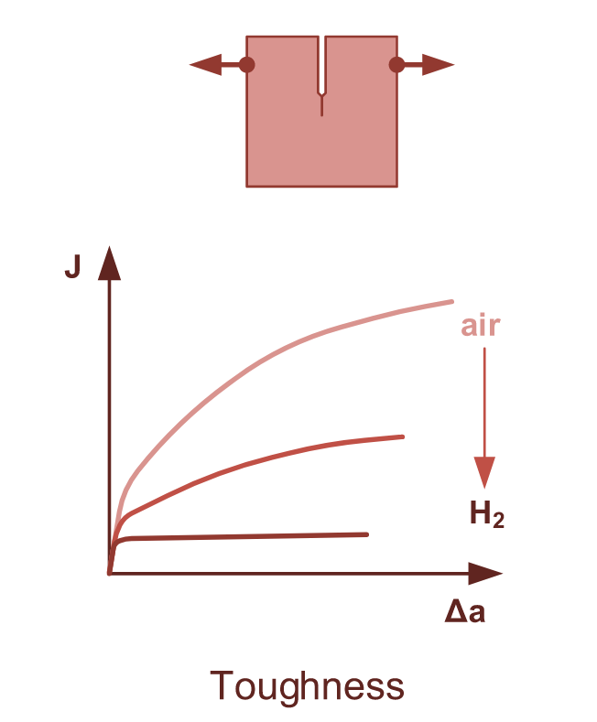
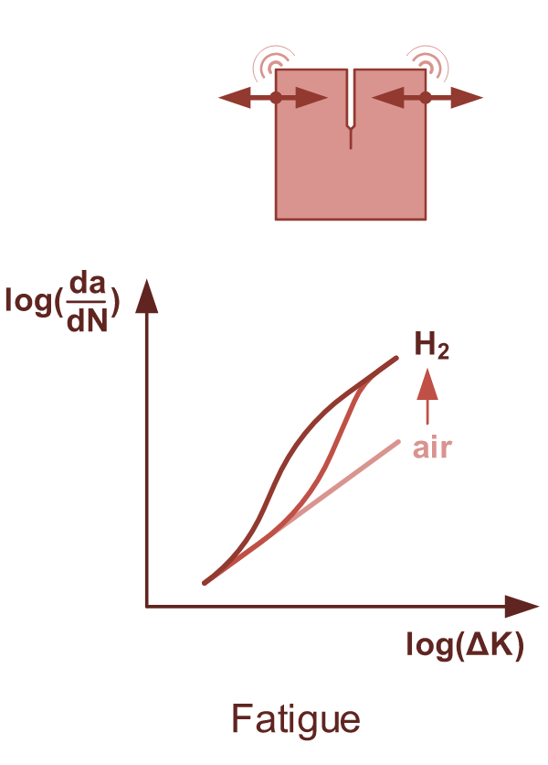
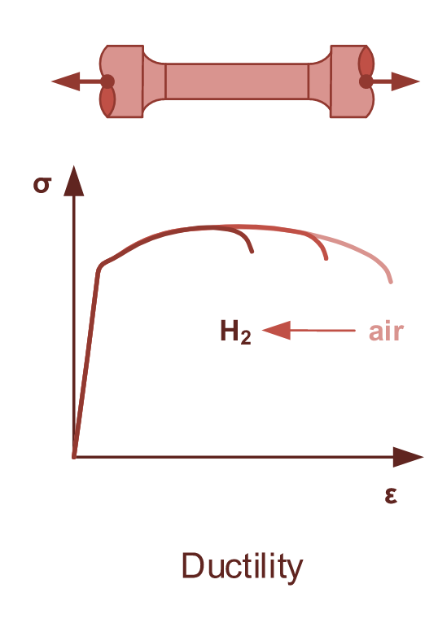
Materials
Metals – Hydrogen Embrittlement

Slide 7
Materials
Metals – Hydrogen Embrittlement
Considered… | Behaviour in hydrogen | Example
“Impermeable” | Microstructures stop HE in the bulk of the material | Austenitic stainless steel
“Resistant” | Have a layer that is impermeable to hydrogen | Aluminium alloys
“Partly susceptible” | React with hydrogen and form brittle phases | Titanium alloys
“Susceptible” | Experience interaction of protons with microstructure at every level, leading to embrittlement | Ferritic steels – including carbon steel
“A bit of both” | Have a phase structure that resists embrittlement, but precipitates make it susceptible | Nickel alloys with nickel content between 10-40 wt%
“Not okay” | Reacts with hydrogen to change microstructure (e.g. form martensite) | Unstable austenitic stainless steel with low nickel content (<7%)
“Also not ok” | Reduction in material properties | Cast iron

Slide 8
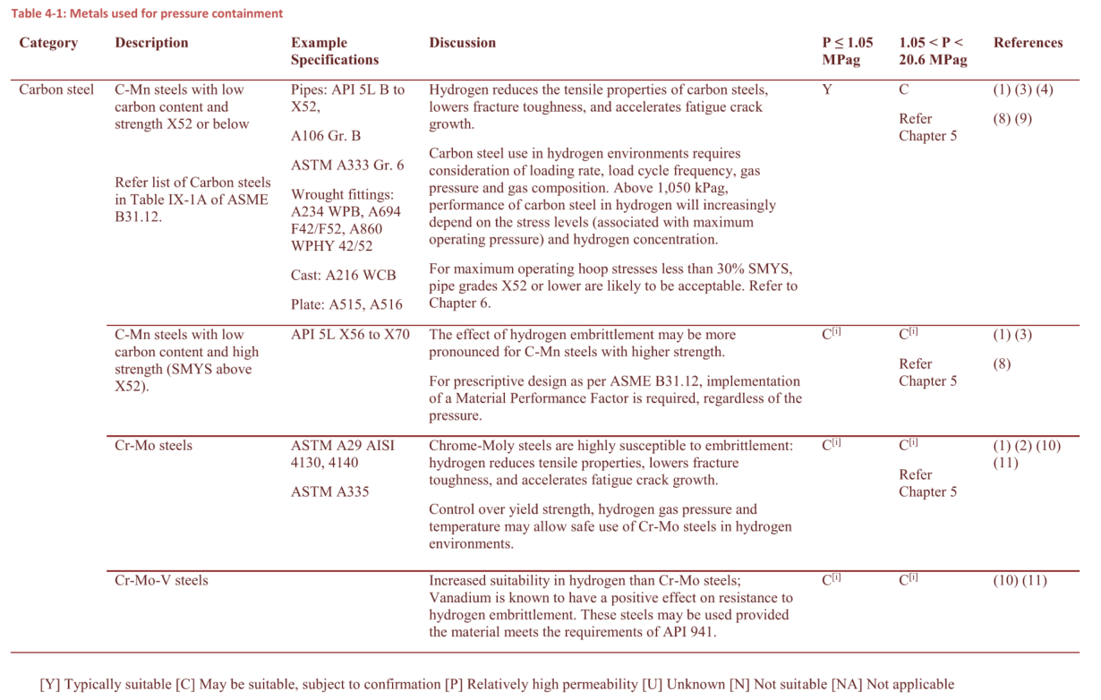
Body text

Slide 9
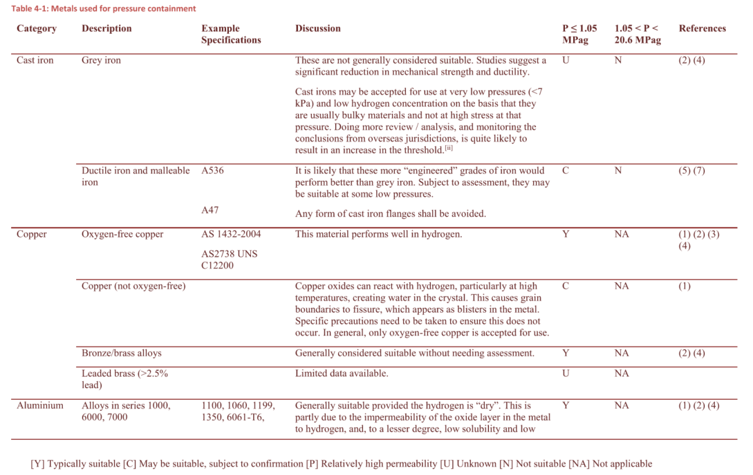
Body text

Slide 10
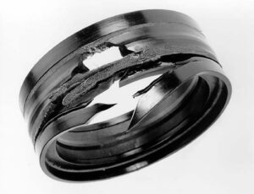


Materials
Polymers and Elastomers
Usually not corroded by hydrogen
Highly permeable
Complicated and diverse materials
Elastomers
Swelling or warping
Rapid gas decompression
Stiffening
Compression setting
Manufacturer dependent
Temperature dependent

Slide 11
Materials
Polymers and Elastomers
Usually not corroded by hydrogen
Highly permeable
Complicated and diverse materials
Elastomers
Swelling or warping
Rapid gas decompression
Stiffening
Compression setting
Polymers
Accelerated slow crack growth
Change in crystallinity
Blister fracture
Manufacturer dependent
Temperature dependent

Slide 12
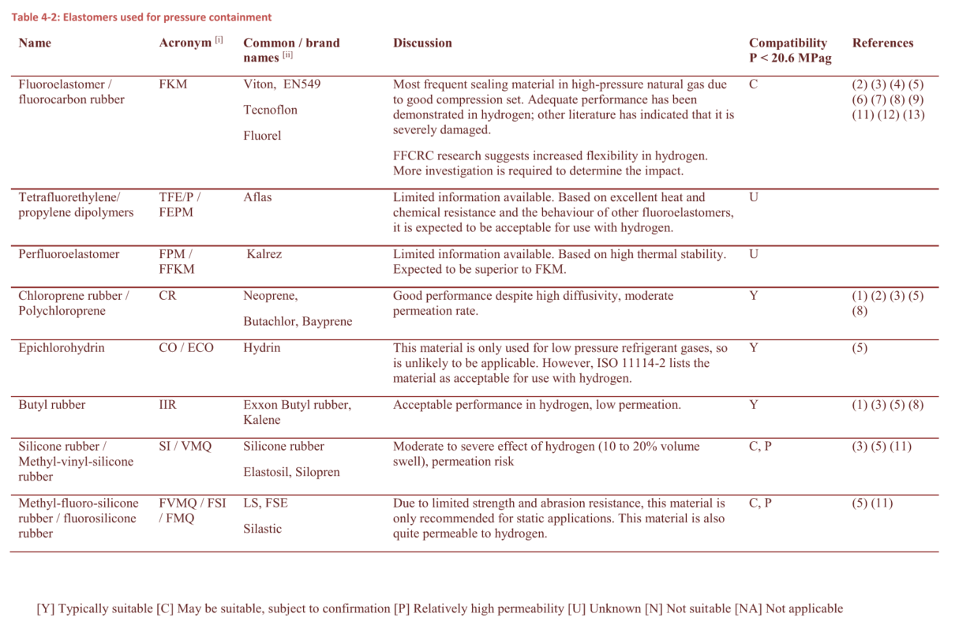
Overview
Body text
Materials are classified as compatible if they are immune or resistant to hydrogen in the application.
  a “compatible” classification does not indicate that the materials will be completely unaffected by hydrogen,
  but it can be expected that they can be used without significant ill effects within the intended operating window.

Slide 13
Materials
[C] - Performance subject to confirmation
Materials that are considered vulnerable to hydrogen may be used considering:
  Required performance
  Severity of hydrogen degradation
  Operating conditions including transient conditions, startup/shutdown
  Condition of the material
  Consequence of failure
  Required service life
  Ability to detect failure if it occurs
  Ability to isolate and replace the component

Slide 14
Materials
Summary
All materials exposed to hydrogen shall be selected based on their required performance, considering
  hydrogen permeation through the material and
  the effects of hydrogen on the material.
Material selection shall consider all normal, transient and upset operating conditions to determine whether the material is suitable.
Where a material’s behaviour in hydrogen is unknown, further testing should be completed:
  Assessing relevant material properties
  In the same service conditions as the application

Slide 15
Components

Slide 16
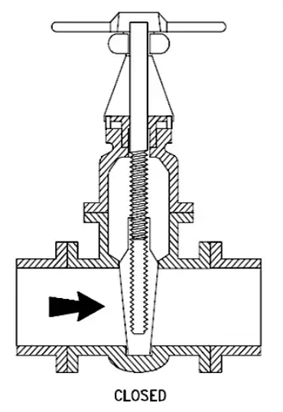
Components
Failure Modes
Leak paths
Functional failures
Material compatibility
https://hardhatengineer.com/gate-valve-types-parts/

Slide 17
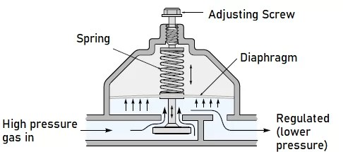
Components
Failure Modes
Leak paths
Functional failures
Material compatibility
https://www.electricalandcontrol.com/pressure-regulators-function-types/

Slide 18
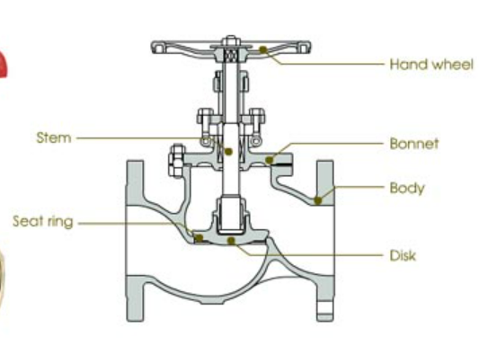
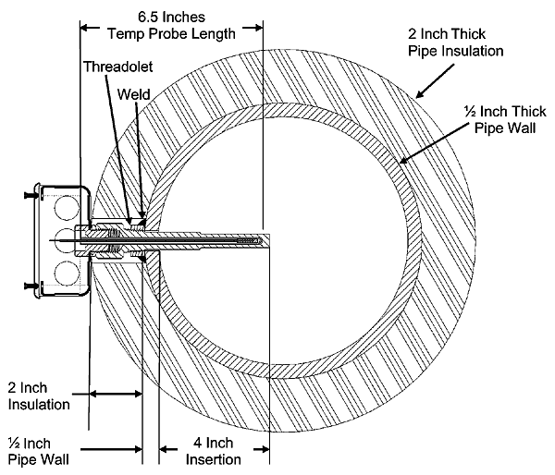
Components
Failure Modes
Leak paths
Functional failures
Material compatibility
https://www.bapihvac.com/application_note/thermowell-and-immersion-probe-installation-overview-application-note/
https://www.plumbingsupply.com/common-plumbing-valve-types.html

Slide 19
Components
Compatibility Assessment
Performance testing
Demonstrated prior experience
Analysis to published methods or standards
Manufacturer’s experience

Slide 20
Equipment
Compressors
Reciprocal compressors
Mature technology
High pressure hydrogen obtainable through multi-stage configurations
Most commercial units in the market are reciprocal
Targeting the smaller volume markets (e.g. vehicle refuelling) and smaller flowrate pipelines
Centrifugal compressors
Preferred for high flow rates, typically required for long distance transmission
Earlier stage of development
Many stage configurations are required to reach a higher pressure
Higher speeds mean special attention to materials of impeller

Slide 21


Summary
Materials Compatibility Tables
Component and Equipment Selection Considerations

Slide 23
Pipeline System Compatibility
Chapter 4

