Slide 1
Carbon steel linepipe & Hydrogen pipeline design
Chapter 5 and Chapter 6

Slide 2
Carbon steel line-pipe
& Pipeline design

Slide 3
Impact on mechanical properties

Slide 4

Tensile properties
Strength is not altered meaningfully.
Loss of Ductility is a reduction of the strain at failure.
As more micro-voids and cracks begin to form, hydrogen begins to contribute to the failure and cause it to occur at a lower load.
(I probably won’t mention this again…)

Slide 5

Fracture resistance
Decreased resistance to fracture exhibited in hydrogen.
The effect relates to strain rate – slower loading is more strongly affected.
This is difficult to measure and to interpret!

Slide 6
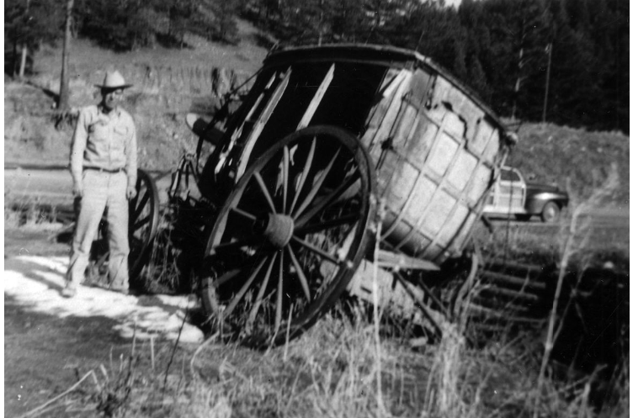
Fracture stages
Increasing resistance with crack growth:
Introducing: the J-R curve
Characterising crack loading:
K Stress intensity factor: Intensity of the stress singularity inferred for a crack tip from a surrounding elastic stress field.
J J-integral: Energy transferred in creation of new fracture surface.
Function of… the force and
the crack size and
affected by work done by prior loading.

Slide 7
Fracture stages
Introducing: the J-R curve
Threshold, K_{th}
  “knee” in the curve
  Scatter in measurements?
“Critical” stress intensity K_{IC}
  Characteristic toughness
  Commonly used in Failure Assessment Diagram (FAD) method to predict failure – e.g. applying API 579 Level 2.
Whole J-R curve
  Use in ductile tearing analysis – e.g. API 579 Level 3
K_{IC}
K_{th}
Slope = 2σ_{y}
0.2mm

Slide 8

Fatigue rate
Hydrogen leads to an acceleration of fatigue crack growth.
The effect is reduced at low cycle ranges.
The effect relates to cycle rate – faster cycling is less affected.
We incorporate ASME CC220 model (SANDIA)

Slide 9

Stage-3 fatigue
Eventually, fatigue becomes fracture
Stage 3 fatigue means there is an upper limit of validity of the HA-FCGR model.
This relates to fracture resistance. The fatigue model would not apply:
  Above K_{max,stage-3} observed in fatigue tests
  Above K_{th} observed in J-R tests
  Above an FAD curve, made using K_{IC}

Slide 10
Steel testing

Slide 11

Grouping the material
PRIMARY GROUPING
Manufacture procedure specification
Pipe material specification – particularly thickness or grade
Manufacturer
SECONDARY GROUPING
Steel heat
Systematic inhomogeneity (e.g. centre-line segregation)
Random inhomogeneity from steelmaking
Apparent inhomogeneity from measurement error
WELD REGIONS
Parent material
HAZ zone
Weld centre-line
Girth and seam weld

Slide 12

Testing requirements
Establish the statistical variation of each material property within each primary group.
Strength – can be tested in air. Loss of ductility will not usually impact design.
Fatigue – is repeatable, so no testing necessarily required.
  Caveat: you may choose to test to determine onset of Stage-3 fatigue
Fracture – required!
  Use of ASTM E1820 to measure fracture resistance
  Some measures to demonstrate test validity, such as:
    Confirming load-rate convergence
    Demonstrating no sub-critical crack growth below K_{IC}, through constant-load or constant-K tests (ASTM E1681?).

Slide 13

Issues with fracture testing
Fracture resistance is a key material property.
Significant complications:
  Appropriate definition of K_{IC} (is 0.2mm the right offset?)
  Testing in a hydrogen atmosphere (or electrochemical charging)
  Adequate control of impurities
  Sufficiently slow testing
  Measuring the crack length
  Specimen type and restraint
Lack of international consensus (yet)
Immaturity of global testing capabilities

Slide 14

It gets worse…
Appearance of cleavage fracture appearance.
  If cleavage fracture occurs, what does it mean for interpretation of results?
  Can we still use Elastic-Plastic fracture mechanics theory?
  Is it “cleavage” or “quasi-cleavage”?
Sub-critical slow crack growth
  Hydrogen Induced Cracking
  Threshold for occurrence may be designated K_{IH}
  Does it occur in gaseous hydrogen? Previous we believed No.
  If yes, then toughness above K_{IH} must be discarded for slow cracking processes.

Slide 15
In design…
(transitioning to Chapter 6)

Slide 16

Fracture control plan
More items should now be included in the FCP…
New Fatigue life
New Failure pressure of PTW defects, for
New Hydrotest effectiveness assessment
Critical Defect Length of through-wall cracks
Arrest toughness of running fracture
New Fatigue life of girth welds
New Girth weld defect tolerance (ECA)

Slide 17

Critical defect dimensions
Part-through-wall (PTW) defects
  Evaluate using API 579 or BS 7910
  Use FAD with K_{IC}, or ductile tearing analysis (if valid)
  but limited to K_{IH}, if sub-critical cracking observed
  Failure is slow, so sub-critical crack growth will limit applicability
  Superimpose residual stress
  Not independent of fatigue life, where relevant
Critical defect length (CDL)
  Failure is fast, so not concerned by slow crack growth, K_{IH}
  Design-stage estimate with NG-18 using K = 110 Mpa(m)^{0.5}
  Otherwise, same methods available as above.

Slide 18

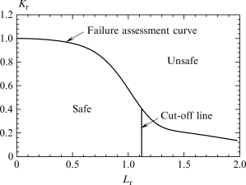
Introducing FAD
Failure assessment diagrams combine crack loading and tensile loading to determine a failure envelope.
Y-axis:
K divided by K_{mat}
X-axis:
σ divided by σ_{yield}
An FAD sits behind NG-18 model – the Dugdale theory. API 579 and BS7910 have more recent formulations.

Slide 19
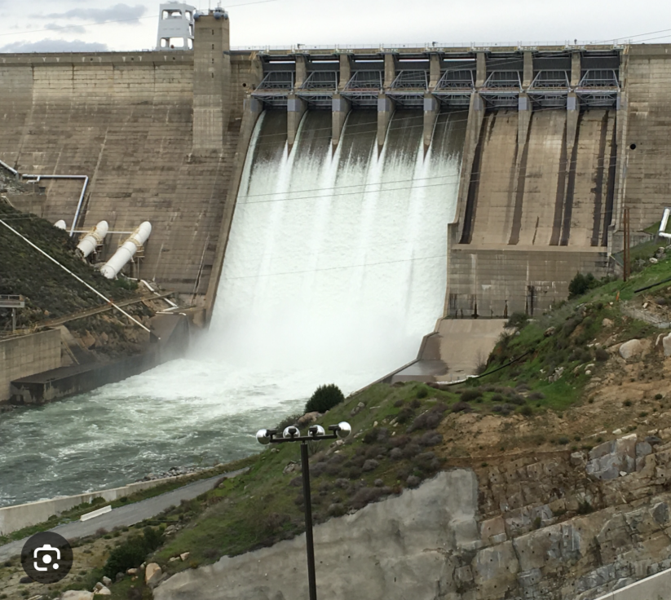
Hydrotest validity
Comparison of critical defects during hydrotest and operation
Hydrotest has higher pressure, but also higher toughness
Hence, it may not be a proof test anymore
(though it often isn’t for girth welds, anyway…)
Comparison should not be at minimum strength, but maximum strength
It should not use minimum toughness in air, but upper-estimate toughness in air (or even infinite toughness condition)
Maximise the hydrotest pressure. Please.

Slide 20
Fatigue analysis
Fatigue screening study, otherwise…
Determine fatigue life of cracks – multiple steps
  Initial defect size – i.e. workmanship, or detection threshold
  Crack loading (stress intensity factor, K) calculation method
  Modification for dimensional discontinuities – ovality, misalignment etc.
  Superposition of residual stress
  Hydrotest survival check
  Crack growth simulation
  Termination condition (Stage-3 fatigue threshold)
  Sensitivity check – in lieu of Safety Factor
Determines: the design life and the inspection interval

Slide 21

Cyclic loading
The load comes from any cyclic operation:
Cycling internal pressure
Cycling temperature – girth welds only
  Process-related temperature cycles
  Pressure-correlated temperature cycles
  Natural seasonal variation
Complex loading is grouped using Rainflow counting and
The combined effect determined using Minas’ rule
For girth welds, the load is also interpreted through the pipe geometry:
Axial force in straight pipe; restrained or unrestrained?
Combine force/bending moment with changes in direction.
This may impose an operating requirement:
Online SCADA monitoring of loads
Non-cycle loads, determine fatigue end-point…
For longitudinal defects,
  Internal pressure only
For girth defects, the load is also interpreted through the pipe geometry:
  Worst pressure-temperature combination
  Ground movement/settlement
  Residual stress from welding
  Remaining stress from bending (elastic)

Slide 22

Crack arrest
Gas Decompression
Decompression is really fast…
In pure hydrogen (not blends)
The steady-state crack tip pressure, is not significantly reduced.
Fracture speed
Embrittlement probably doesn’t have a strong impact.
There is little data, but it supports this…

Slide 23

Steel specification
Not much data
3 principles observed in other sources:
  Assume sour-service is analogous (questionable)
  Consider fundamental principles
  Precedence
Some advice:
  Low strength, low hardness
  Good steel cleanness and quality
But the highest, highest priorities:
  Dimensional control and defect-free
  Residual stress

Slide 24
Piping design

Slide 25


Design codes
The CoP supports ASME B31.12 Section GR and IP for piping design
Note: these are based on ASME B31.3, with specific deviations
Weld defect tolerance (quite tight)
Hardness requirements
Reduced material options

Slide 26

Stress analysis
ASME pipe stress philosophy
ASME B31 series stress analysis philosophy is retained
A factor of 10 is applied to the number of cycles for thermal fatigue assessment
Coupled with weld defect tolerance control, this makes sense…
Pressure-related fatigue
Pressure cycling, where relevant, is not really addressed…
Only available methods will be fracture mechanics approaches, as used for pressure vessels
Lack of seam weld is a common advantage

Slide 27
Other issues

Slide 28

Inhibiting permeation
Can we stop the hydrogen getting into the steel in the first place?
Internal cladding…
Separates the issues of fluid containment and pressure containment.
Must have effective seal
Discontinuous with the pipe
Control H2 accumulation behind the cladding
Complex to install and join
Must manage potential future damage sources
Forfeit ILI capability?
Internal coating…
Effective for pipeline life?
Applied inside welds?
Avoid in-service damage
Quantify benefit?
Beneficial additives
CO2 and O2 have an effect
Not currently supported for durations of life

Slide 29
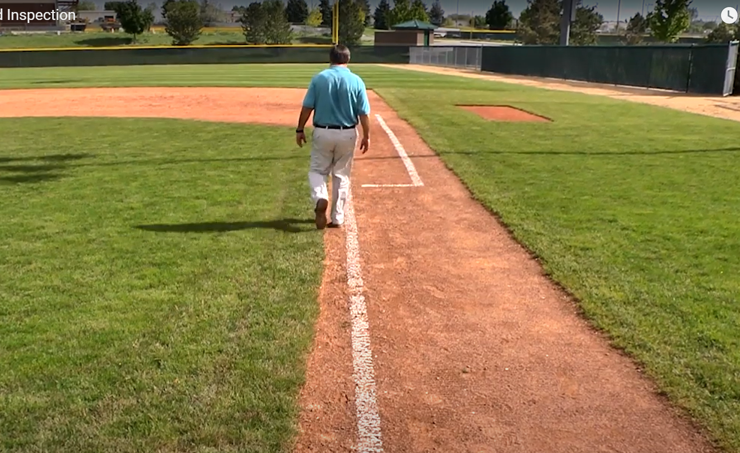
Baseline inspections
If hydrotest is not a proof test, that is not the end of the story
Baseline inspections are… strongly recommended.
They are required if the hydrotest cannot prove the initial condition adequately.
The hydrotest is a rare opportunity to conduct an ultrasonic (UT) ILI
For storage pipelines, consider making the hydrotest infrastructure permanent, for future UT ILI and/or future hydrotest.

Slide 30

Purging and leak testing
Some complexities may be involved
Purging complexities
Velocity available. Is there adequate hydrogen supply to purge?
  If not, consider dilution, rather than displacement purging.
  Actually… consider vacuum dilution purging.
Stratification is a strong driving force:
  Density is 1/8th natural gas, 1/15th air.
  Not unmixing, but they never mixed in the first place
Avoiding flammable mixtures:
  Requires quite a bit more nitrogen at 20:1 ratio
Leak test recommendations
Leak test with air/nitrogen during commissioning
Leak test in-service at the end of commissioning
Potentially, leak-test with Helium

Slide 31

Vent design
Actually, this is from Chapter 3
Design guidance:
Slow-opening valves
Internal radius on vent exit
Earthed and equipotential
Away from ignition sources
Exclusion of personnel from radiation/blast zones, or
Prove that auto-ignition is not expected

Slide 32

Any Questions?

