Slide 1
Section 8
Repurposing Existing Pipelines

Slide 2
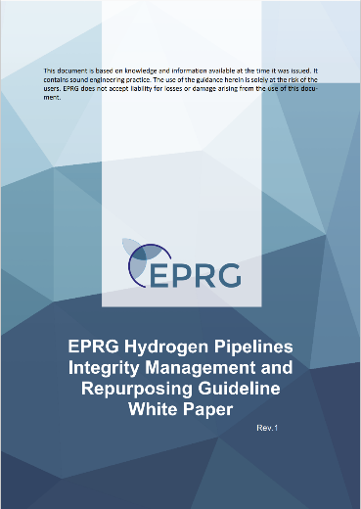
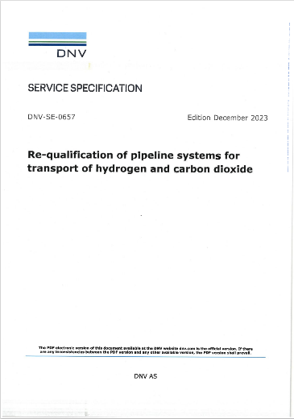
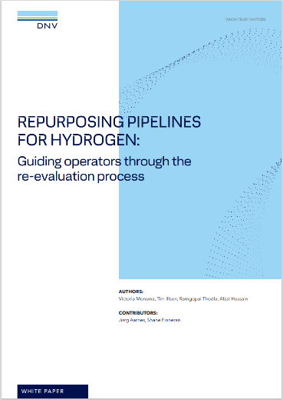
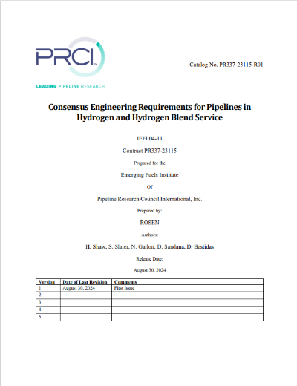
Overview
Section 8.1 - Principals
Repurposing offers a cost and schedule effective option to support hydrogen developments
All pipelines will be suitable to transport hydrogen within some defined operating envelope.
Operating envelope determined through consideration of susceptibility of pipeline to each relevant failure mode identified in the Code of Practice
Themes common within the Section:
  Change of service AS2885.3 Section 10, AS/NZS 2885.6 Section 5.5.4 (SMS)
  Approach consistent with AS/NZS 2885.1 Section 9 MAOP Upgrade
  Counter to new pipeline design, we start with fixed asset which will drive the safe operating envelope
  →The pipeline line pipe will drive operating envelope
  As assessment gets more granular - consider cost benefit

Slide 3
AS2885 Requirements
Section 8.2 – AS/NZS 2885 Requirement
AS 2885.3-2022 Section 10 requires an assessment of the change according to an established change management system.
Key Considerations
  Management of risk to the public, property, environment or to the pipeline.
  The characteristics of the line pipe in hydrogen
  The physical condition of the pipeline and fitness for service in hydrogen
  The operating conditions and original design basis.
  Stations and equipment
  Adequacy of operational controls
AS/NZS 2885.6 requires a Change of operating conditions SMS when there is a change in operating conditions as identified in AS2885.3 Section 10, which includes change of process fluid.

Slide 4
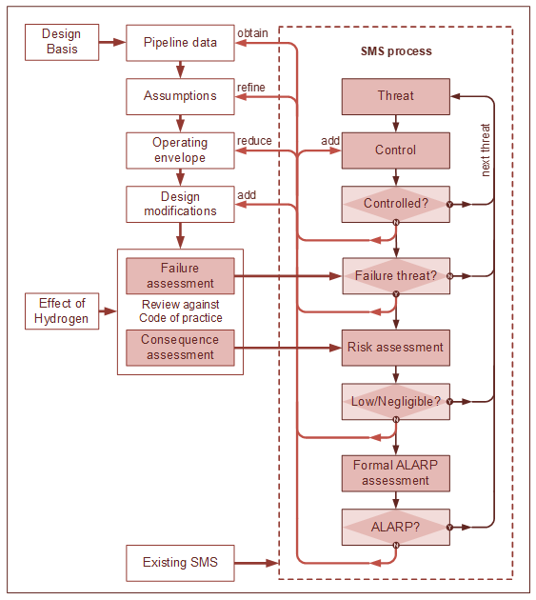
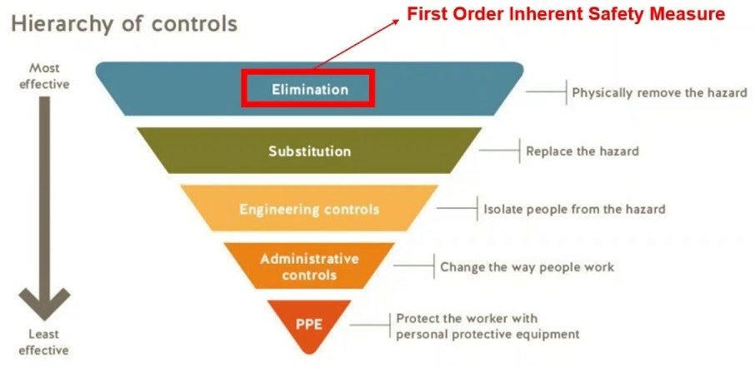
Repurposing Process
Section 8.3 Requalification Process
Section 8.3.1 – Pipeline Repurposing Design Basis
Section 8.3.2 – Assessment
Section 8.3.3 – Checklist
Section 8.3.4 – Safety in Design
Figure 8‑1: Pipeline repurposing evaluation process

Slide 5
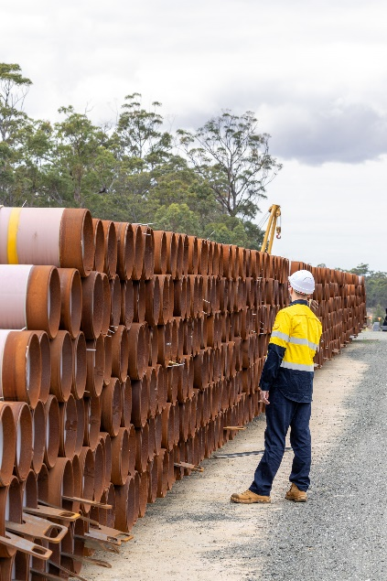
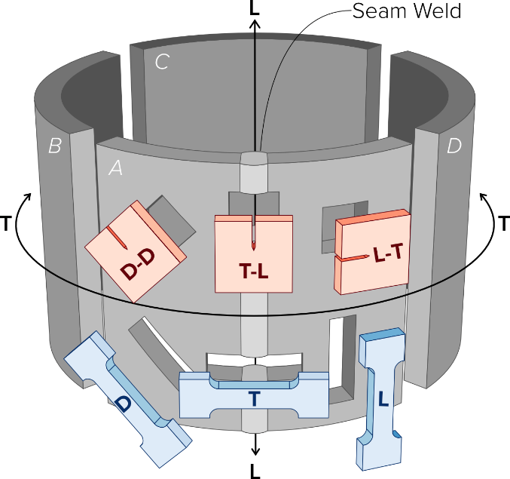
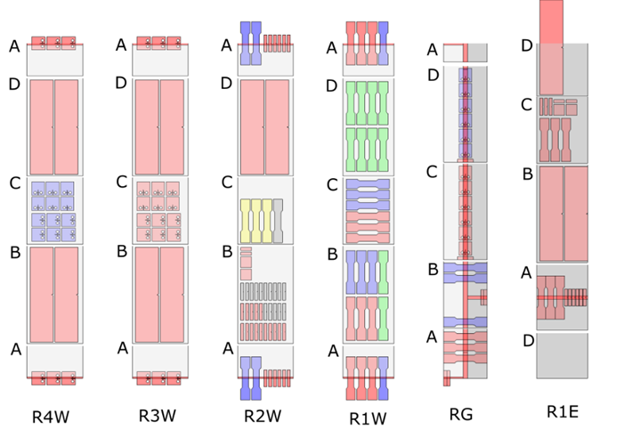
Line Pipe
Section 8.4 – Line Pipe
Section 8.4.1 – General considerations
Section 8.4.2 – Required Data
Section 8.4.3 – Measurement of Properties
Section 8.4.4 – Fitness for Service Assessment
For most pipeline systems, the line-pipe is the critical component determining the allowable operating envelope.
Like new pipelines – a profile of the pipeline material properties (pipe population characteristics) must be determined.
Section 5.6 describes materials testing requirements and statistical review of measured data
A pipeline design should not be assumed to comply with current standards.

Slide 6

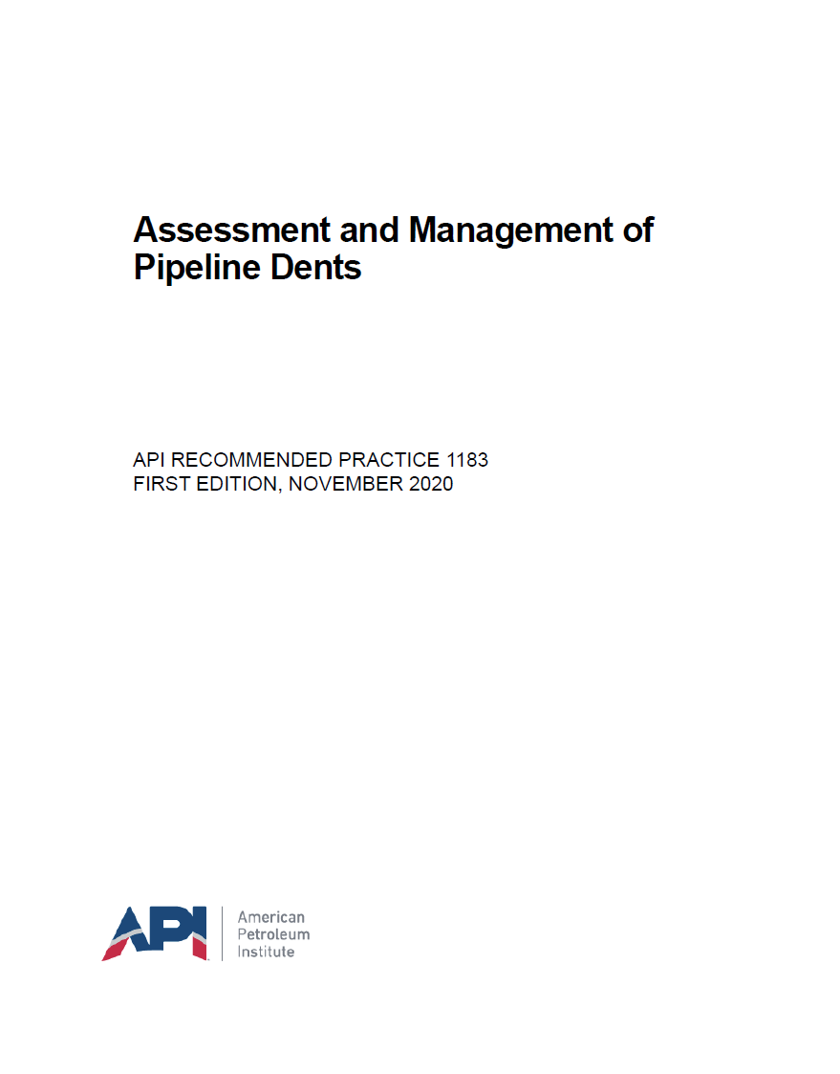
Fitness for Service
Section 8.4.4 – Fitness for Service Assessment
Detailed assessment of pipeline condition and impact of hydrogen
  Identify potential defects that were previously acceptable but that may fail after conversion to H₂ service.
Condition assessment data should consider actual pipeline condition and all hydrogen related mechanisms that may change in H₂ service
In addition to AS 2885.3 Section 5.6, the following are also highlighted:
  Review of all condition assessment and inspection records
  Revision of past assessments of deterioration rate
  Re-analysis of existing Anomalies including those that were previously assessed and accepted
  Confirmation of the suitability of existing pipeline repairs in hydrogen service.
  Assessment of pipeline modifications made since original construction

Slide 7
Assemblies
Section 8.5 – Assemblies Components & Equipment
Requalifying pipeline components and equipment in the pipeline
  Assessment against Chapter 4
Approaches:
  Manufacturers Data and Information
  Prior Service History
  Component Design Assessment
Considerations
  Materials compatibility (Section 4.2.1.3)
  Leaks and leak paths
  Function (incl. consequence of failure or failure to operate)
  Condition (incl. fitness for service)
  Cost benefit of replacement

Slide 8
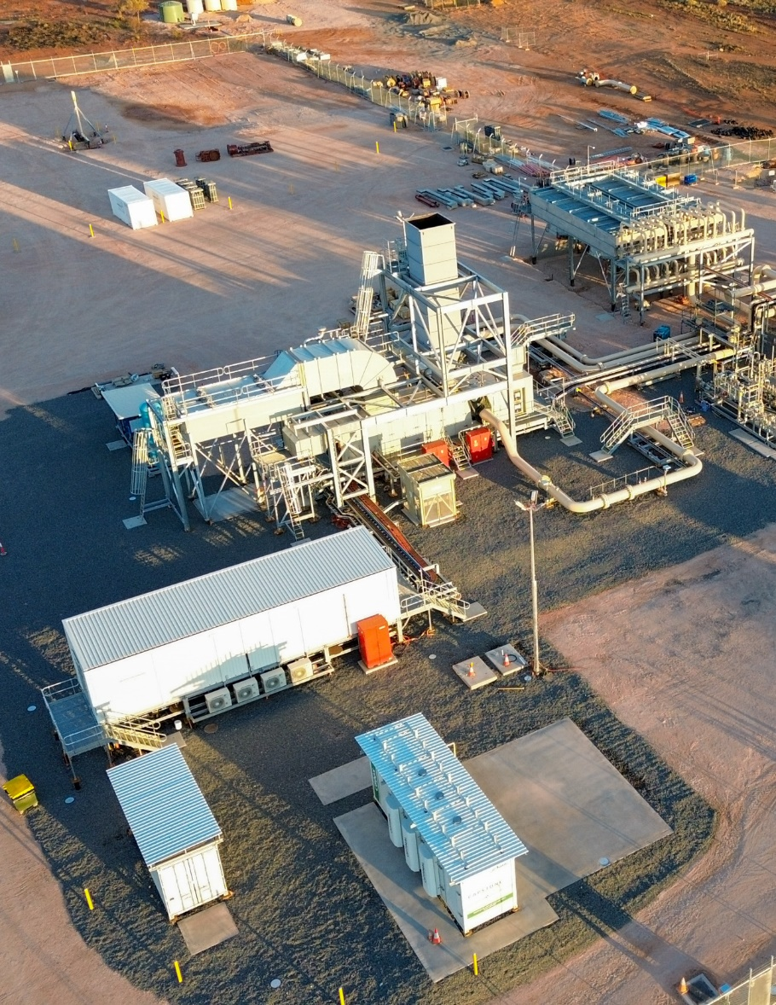
Facilities
Section 8.6 – Stations and Facilities
Stations and facilities must also be reviewed against the guidance of the Code
  Incl. Sections 6.4 and 6.5, and Chapter 4
Specific considerations discussed include:
  Hydraulics, piping design, flow induced vibration
  Stress Analysis, flexibility, and fatigue
  Suitability of equipment and instrumentation – materials compatibility, design, functional performance
  Hazardous area and electrical equipment classification
  Station operational control – e.g. use of pneumatic control, changes in response times, functional safety
  Venting and blow down including, overpressure, operational and maintenance venting

Slide 9


Documentation
Section 8.7 – Pipeline Documentation
General – documentation / records management should follow AS2885 requirements
  AS 2885.3 Section 10 (and Change Management 2.3.2.6)
  General Requirements: AS / NZS 2885.1 Section 13
Code of Practice provides general guidance (prompt list):
  Documents that will require update for hydrogen / hydrogen blends
  Documents likely to require update
Specific note is given to update of operation and maintenance systems and procedures, and pipeline management systems
A change management system should be followed and appropriate tracking register used to assist MoC

Slide 10
Section 9
Pipeline Integrity Management

Slide 11

Principals
Section 9.1 - Overview
Chapter defines the requirements for integrity management of hydrogen pipelines
Outlines supplementary requirements to AS 2885.3 that should be applied in hydrogen service
  Pipe wall integrity and anomaly assessments
  Fitness for service assessment
  Operation and maintenance activities
  Defect repair
  Pipeline integrity assessment methods (e.g. inspection, testing)
There is key knowledge gaps in industry understanding of anomaly assessment methods – acknowledged that many existing empirical assessment methods may not be suitable for hydrogen pipelines

Slide 12
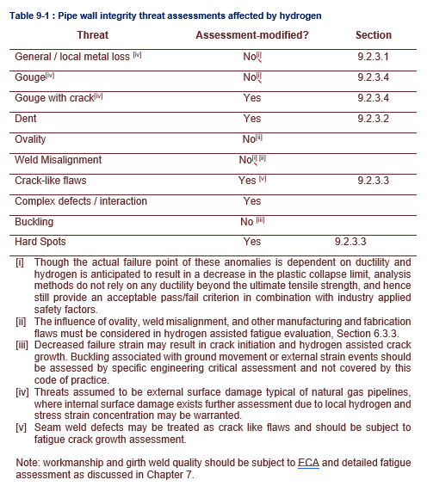
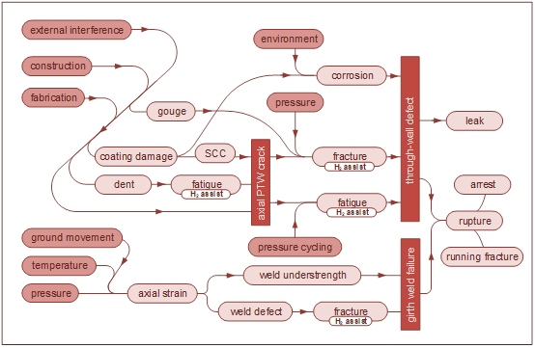
Pipe Wall Integrity Threats
Section 9.2 – Pipe wall integrity threats
Figure 9.1 – Overview of line-pipe wall integrity threats and failure modes

Slide 13
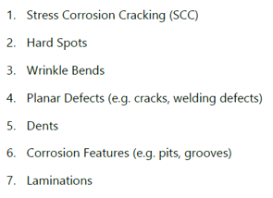
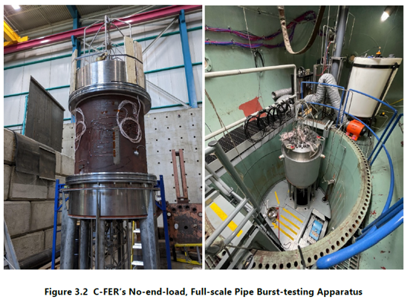
Evolving Knowledge
Section 9.2.2 – Available Research
Current anomaly assessment practices AS2885.3 Section 9 – many of these are empirical methods based on full scale testing
  these methods lack validation for hydrogen.
Anomaly assessment methods independent of toughness, ductility, or fatigue resistance may remain applicable.
Several research initiatives are addressing this knowledge gaps:
  Full-scale fatigue testing by EPRG
  PRCI full-scale testing program on 7 typical pipeline defects
  Full scale and sub scale testing by industry projects and JIP
H2CoP recommends the use of detailed fracture mechanics based approaches (API 579 / BS 7910) where uncertainty exists.

Slide 14
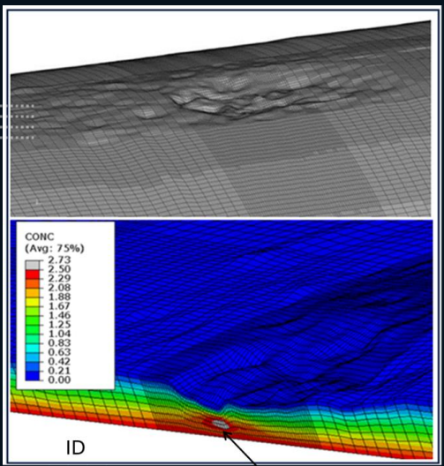
Corrosion Metal Loss
Section 9.2.3 – Anomaly Assessment Methods
Metal loss due to external corrosion
  Corrosion rate likely not affected by hydrogen
Indirect effects include hydrogen concentration increase at locally thin areas
  Reduction in tensile ductility reduces collapse pressure
ASME B31.12 GR-5.3.2 notes that remaining strength of pipelines can be determined in accordance with ASME B31G
H2CoP does not proposed to alter the assessment methods for general local (non-complex) metal loss in the pipe body.
Complex corrosion – e.g. dent + corrosion, corrosion on girth weld
  API 579 Level 3 assessment using actual material properties
Review of Integrity Threat Characterisation Resulting from Hydrogen Gas Pipeline Service, DOT/PHMSA Project 693JK32210013POTA
EPRG Guidelines | Level 1 | Level 2A / 2B | Level 3
Volumetric Defects | Net Section Stress < Yield Strength B31.G / DNV-RP-F101 | Per Level 1 | API 579 Annex 2D using actual tensile test data
EPRG Hydrogen Pipelines Integrity Management and Repurposing Guideline White Paper Rev.1

Slide 15
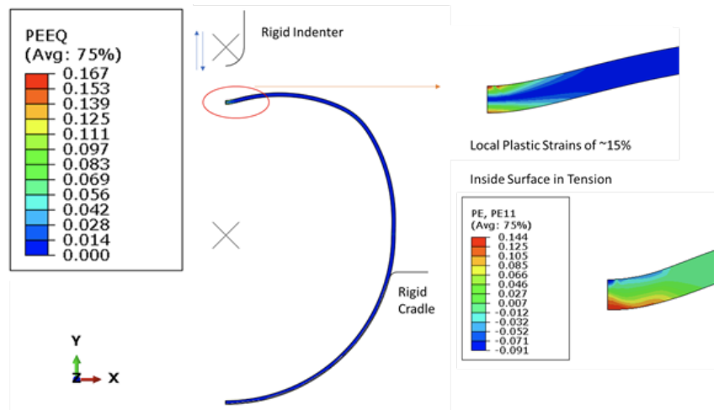
Dents and Geometric Anomalies
Section 9.2.3 – Anomaly Assessment Methods
Test data shows a relationship between stress triaxiality and hydrogen sensitivity
  The stress state may result in a higher concentration of hydrogen and decrease in failure strain.
The H2CoP generally recommends the requirements of ASME B31.12 be applied, for example:
  Plain Dents: Plain dents in the pipe body should be assessed using a dent strain calculation, dent strain should not exceed 2%.
  Dents on Welds: All dents on welds should be assessed by ECA.
  Cracked Dents: Dents that contain cracks are unacceptable.
  Corroded Dents: the H2CoP limits depth and length of corrosion in dents, dents should be subject to fatigue assessment.
Literature Survey on Repurposing Pipelines for Hydrogen Service, DOT/PHMSA Contract Number: 693JK322RA001
EPRG Guidelines | Level 1 | Level 2A / 2B | Level 3
Dents / Dent-Gouge | Allowable strain 2% for H2 service for plain dents | Per Level 1 | API 579 Annex 2D using actual tensile test data
EPRG Hydrogen Pipelines Integrity Management and Repurposing Guideline White Paper Rev.1

Slide 16
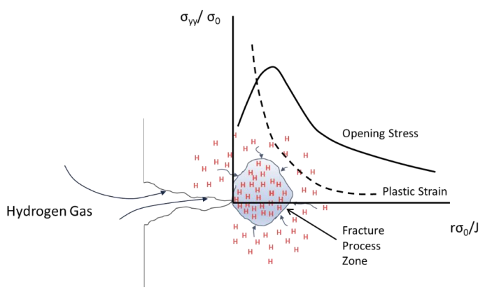
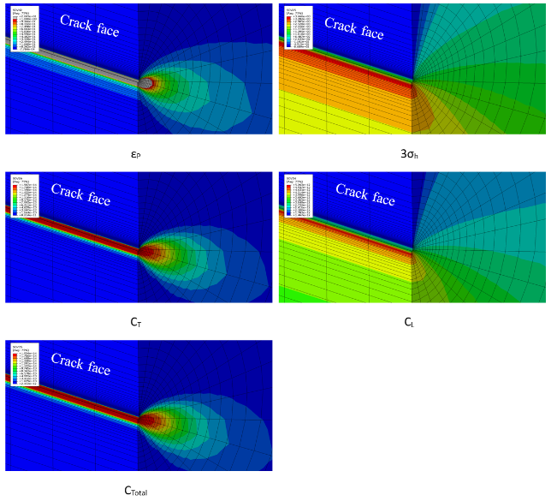
Crack-Like Flaws
Section 9.2.3 – Anomaly Assessment Methods
Crack-like anomalies pose a significant risk for hydrogen pipelines and must be assessed for fracture and fatigue crack growth.
A reinspection interval must be defined based on the predicted crack growth rate as well as the actual pressure cycling.
Crack-like features include: environmental cracking, weld anomalies, metallurgical anomalies etc.
H2CoP recommends assessment using fracture mechanics methodologies using API 579 Level 2 or 3 fracture assessment and fatigue life assessment.
Review of Integrity Threat Characterisation Resulting from Hydrogen Gas Pipeline Service, DOT/PHMSA Project 693JK32210013POTA
EPRG Guidelines | Level 1 | Level 2A / 2B | Level 3
Crack-Like | N5/N10 Notch | Per Level 1 / Fatigue Life Assessment | ECA using API 579 and actual tensile test data
EPRG Hydrogen Pipelines Integrity Management and Repurposing Guideline White Paper Rev.1

Slide 17
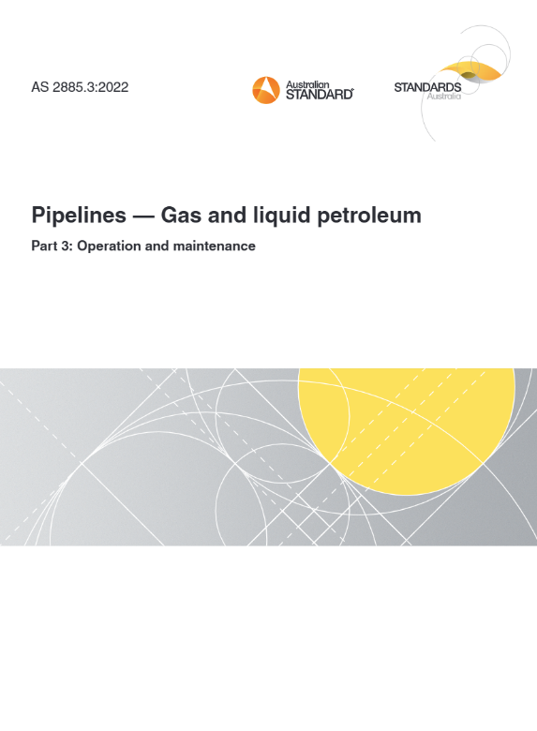
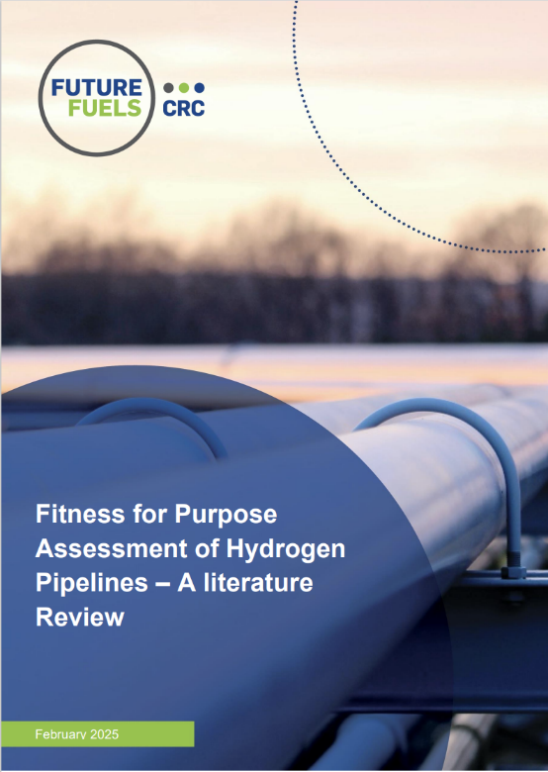
Fitness for Service
Section 9.3 – Fitness for Service Assessment
H2CoP recognises AS2885.3 Section 5.6 – Fit for Purpose Assessment
H2CoP recommends an initial reassessment period of 5-years rather than 10
  Interval should be established at commissioning.
The FFS must demonstrate the pipeline is fit for purpose and safe to operate to the end of its stated design life.
Requires consideration of known and potential degradation mechanisms
  Pipeline condition and rate of degradation
  Review operational data, condition monitoring, and inspection findings.
  Planned integrity management activities
  SMS-identified integrity related threat controls
  Reconfirm the suitability of inspection intervals for all integrity inspection activities

Slide 18
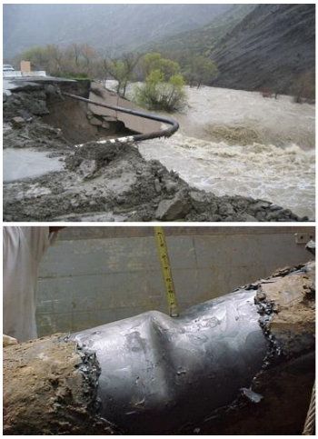
Operations and Maintenance
Section 9.4 – Operation and Maintenance Activities
Coating and CP Surveys – Section 9.4.1
  Overpotential + Internal H₂ Flux
  Low coating damage risk
Gas quality monitoring and sampling – Section 9.4.2
  Monitoring blended service
  Contaminants
Leak detection – Section 9.4.3
  Leak management plan – leak locations and inspection frequency
Ground movement – Section 9.4.4
  Strain damage exacerbated by hydrogen
  Ground movement threats – SMS and PIMP
Review of Integrity Threat Characterisation Resulting from Hydrogen Gas Pipeline Service, DOT/PHMSA Project 693JK32210013POTA

Slide 19
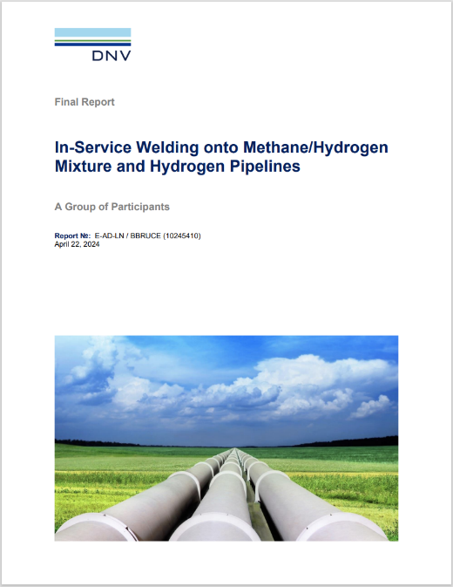
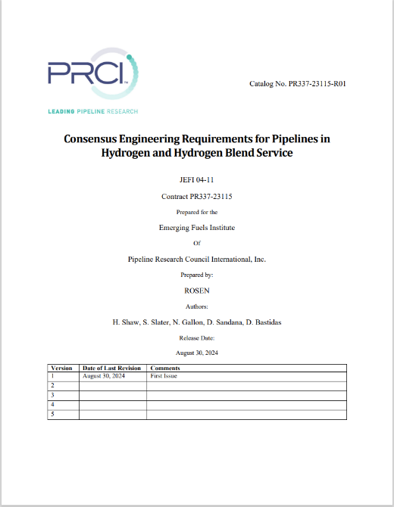
Pipeline Repair
Section 9.5 – Pipeline Repair
H2CoP Refers to AS2885.3 Sections 9.5 and 9.6, notes the following additional considerations
Welding (ref. Section 7.4)
  Potential for hydrogen related weld cracking
  Weld hardness
Avoidance of stress concentrators that may act as crack initiation sites – exacerbated by hydrogen
  Pressure cycling considerations for fatigue loading
Long term compatibility of repair materials and components (ref. Chapter 4)

Slide 20
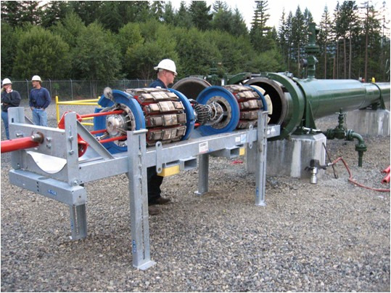
Integrity Assessment Techniques
Section 9.6 – Integrity Assessment Techniques
Provides additional guidance to AS 2885.3 Section 6.5
In Line Inspection
  Notes ILI may be more broadly applied for hydrogen pipelines due to degradation mechanisms
    References Appendix C regarding crack detection technology
  Notes additional considerations of tool materials, velocity control, tool efficacy for the damage mechanism of interest
Hydrotest
  Re-hydrotesting to re-baseline the minimum pipeline condition
  Provides guidelines where hydro-test used for defect sizing
Section provides guidance on assumptions to be made in FFS assessment if no crack-like indications identified in inspection

