Slide 1


Greenhouse Gas Emissions Reduction in Pipeline Systems
Emerging Fuels Symposium – Learnings from Greece 2024
Morgan Grace
26 June 2024

Slide 2
Greenhouse Gas Emissions
Greenhouse gases (GHGs) contribute to the greenhouse effect and global warming. Reducing GHG emissions will aid with the goal set by the Paris Agreement to keep the global average temperature to below 2°C above pre-industrial levels.
Sources of greenhouse gas emissions
  Burning fossil fuels (coal, oil, and natural gas)
  Industrial processes
  Agricultural activities
  Waste management and treatment
Global Warming Potential (GWP)
  A way to compare the global warming impact of various gases in the atmosphere
  CO₂ is used as the benchmark for comparison
Greenhouse Gas | GWP
Carbon dioxide (CO₂) | 1
Methane (CH₄) – fossil origin | 29.8
Methane (CH₄) – non-fossil origin | 27.2
Nitrous oxide (N₂O) | 273
Major Greenhouse Gases
Carbon dioxide (CO₂)
Methane (CH₄)
Nitrous oxide (N₂O)
Fluorinated gases
GWP is based on a 100-year time period. Source: IPCC AR6 (2021).
Methane is a potent GHG with a much higher global warming potential than CO₂ over a shorter time frame.
Carbon dioxide equivalent (CO₂e)
  The most common method of comparing GHGs
  Calculated by taking the GWP and multiplying it by the mass of the gas being emitted.
Notes:
Brief overview of greenhouse gas emissions and their impact on the environment.
Introduction to the focus on methane (CH4) emissions from gas pipelines.
- GWP change over time: to account for changes in radiative properties, atmospheric lifetimes, and indirect contributions of the different gases.
- Difference between non-fossil origin and fossil origin:
- CH4 lifetime: 12 years; CO2 lifetime: centuries (hard to quantify because it’s cycled between the atmosphere, oceans and land biosphere)
https://www.dcceew.gov.au/climate-change/emissions-reduction/net-zero
https://erce.energy/erceipccsixthassessment/
https://www.iea.org/data-and-statistics/charts/sources-of-methane-emissions-2022-3

Slide 3
Greenhouse Gas Emissions in Oil & Gas
  GHG are primarily driven by the energy sector, contributing to >70% of global emissions
Sources of global methane emissions (2022)
0
50
100
150
200
Mt CH4
Global Greenhouse Gas Emissions by Sector (2020)
Wetlands
Natural
Agriculture
Anthropogenic
Energy
133
Oil
22%
Transport
Waste
Natural gas
24%
Energy in buildings
Other
Coal
3%
Bioenergy
Energy in industry
Biomass burning
Source: IEA (2023).
33%
Energy in agriculture & fishing
2%
Unallocated fuel combustion
  Methane is notably emitted from natural gas production and distribution, as well as from agriculture (especially livestock) and waste management.
11%
8%
Fugitive emissions from energy
Energy
Waste
Industrial processes
Agriculture, forestry & land-use
According to the IEA (2023), the annual investment required to reduce emissions is close to the total value of the captured methane that could be sold. Related methane emissions from O&G could be reduced by almost 75% at nearly no net cost to the global oil and gas industry.
Source: Climate Watch, The World Research Institute (2020).
  Efforts to reduce methane emissions from this sector are crucial due to methane's high GWP.
  Reducing leaks and improving the efficiency of natural gas production and distribution are key strategies in mitigating these emissions.
Notes:
https://ourworldindata.org/ghg-emissions-by-sector
https://www.iea.org/reports/the-oil-and-gas-industry-in-net-zero-transitions/executive-summary
https://www.iea.org/energy-system/fossil-fuels/methane-abatement
https://www.iea.org/data-and-statistics/data-tools/greenhouse-gas-emissions-from-energy-data-explorer

Slide 4
Legislation and Commitments
  Australia has signed up to the Global Methane Pledge to cut emissions by 30% by 2030.
  Australia also has its own target to reduce emissions to 43% below 2005 levels by 2030, and net zero by 2050.
  National Greenhouse and Emissions Reporting (NGER) Scheme
  Australia’s emissions, electricity consumption and generation monitoring and reporting scheme.
  This includes a Safeguard Mechanism.
National overview of reported emissions
Emissions (Mt CO₂e)
NGER requires reporting of facilities emitting:
> 25 Mt of CO₂e (scope 1 and 2 emissions) per year
Production of 100 TJ or more of energy per year
2017-18
2018-19
2019-20
2020-21
2021-22
2022-23
Scope 1 emissions
Scope 2 emissions
Consumption of 100 TJ or more of energy per year
  For scope 1 emissions in 2022-23, decrease of 0.9% from the previous reporting year mostly due to decrease in emissions from electricity generation.
  For scope 2 emissions in 2022-23, decrease of 8% from the previous reporting year due to due to reductions in electricity grid emissions intensities.
Source: CER (2024)
Notes:
jh
https://cer.gov.au/markets/reports-and-data/nger-reporting-data-and-registers/2022-23-published-data-highlights

Slide 5
The Safeguard Mechanism
  Safeguard Mechanism facilities (SMF) emissions limit is known as a baseline. The decline rate to all facilities is 4.9% per year to 2030 (the next decline rate will be set by 2027).
  Applies to industrial facilities emitting >100 Mt of CO₂e per year
    Currently 219 facilities from transport, mining, manufacturing, transport, oil, gas and waste sectors (produces ~30% of Australia’s GHG emissions)
  Total emissions from SMFs are required to reduce over time, measured on a 5-year rolling average.
  Net emissions thresholds for all SMFs should not exceed:
Safeguard Mechanism Credits (SMCs)
  Facilities gain a credit for each tonne of CO₂e emissions below their baseline.
  SMC units are tradeable, incentivising SMFs to reduce emissions.
  Safeguard facilities that earn SMCs can:
    Sell them to other safeguard facilities
    Surrender them to stay within their baseline
    Retain them for future use until 2030
  Amendments to the Safeguard Mechanism forcing declining emissions baselines - this is no longer adequate.
Between 2020-2030
In 2030
In 2050
< 1,233 Mt CO₂e
< 100 Mt CO₂e
0 Mt CO₂e
Notes:
The Safeguard Mechanism is a key component of Australia's policy framework to manage emissions from large industrial facilities, including gas pipelines. It sets baseline emission limits for facilities to ensure emissions do not exceed historical levels. Facilities exceeding their baseline can be required to purchase carbon credits to offset excess emissions.
219 facilities covers: transport, mining, manufacturing, transport, oil, gas and waste sectors (produces ~30% of Australia’s GHG emissions)
Threshold for 2020-2030 emissions: provides more than 200 Mt of abatement by 2030.
There is a fourth method, which is direct measurement of emissions from the source, however this is not available as a current MD
1. https://www.dcceew.gov.au/sites/default/files/documents/safeguard-mechanism-reforms-factsheet.pdf

Slide 6
Measurement Determination (MD)
  Provides the methods and criteria for calculating emissions and energy data and is updated annually.
  For NG transmission, there are three methods for calculating emissions:
Measurement Determination NGER Methods:
Method 1
Simple calculation based on a standard emissions factor per length of pipeline
Method 2
Uses emissions factors for specific components, varying the amounts of gas/condensate or hours of operation
Method 3
Method 4
Actual measurement of emissions from source
  Currently gas facilities, SMF or not, are reporting estimated emissions, as there is no useful method under NGERs to report higher order (directly measured) emissions.
  Except for vent related opportunities, methane opportunities require NGER Method 3 to take credit for the reduction.
  Some Australian operators are rolling out direct measurement technologies.
  The current NGER reporting scheme doesn’t allow for a reduced emission factor for renewable gas.
    The Climate Change Authority’s 2023 review of NGER recommended the development of market-based methods for renewable gases.

Slide 7
Emissions Mitigation in Pipeline Systems
Gas pipelines in Australia contribute to methane emissions, primarily through leaks and venting during operation and maintenance. While it can be hard to capture methane emitted during emergency events, other areas can be targeted, as well as ensuring the maintenance and integrity measures remain up to date.
Reduce system pressures where network allows to marginally reduce system leakage
Reduce/ eliminate emissions by revising blowdown and venting procedures
Identify devices that are designed to intermittently/ continuously emit gas and replace or eliminate option
Ensure proper methane destruction when flaring
Mobile flaring during planned blowdowns
Organise a purchase agreement for renewable gas (e.g., biomethane, H2 blend)
Capture vented gases and recompress or use to generate electricity
Optimise maintenance approach to eliminate unnecessary work that would cause gas leakage
Initiate regular Leakage Detection and Repair (LDAR) program (transition from hours-based to risk-based maintenance)
Notes:
How much CH4 (%) is released during flaring / jet fires?

Slide 8
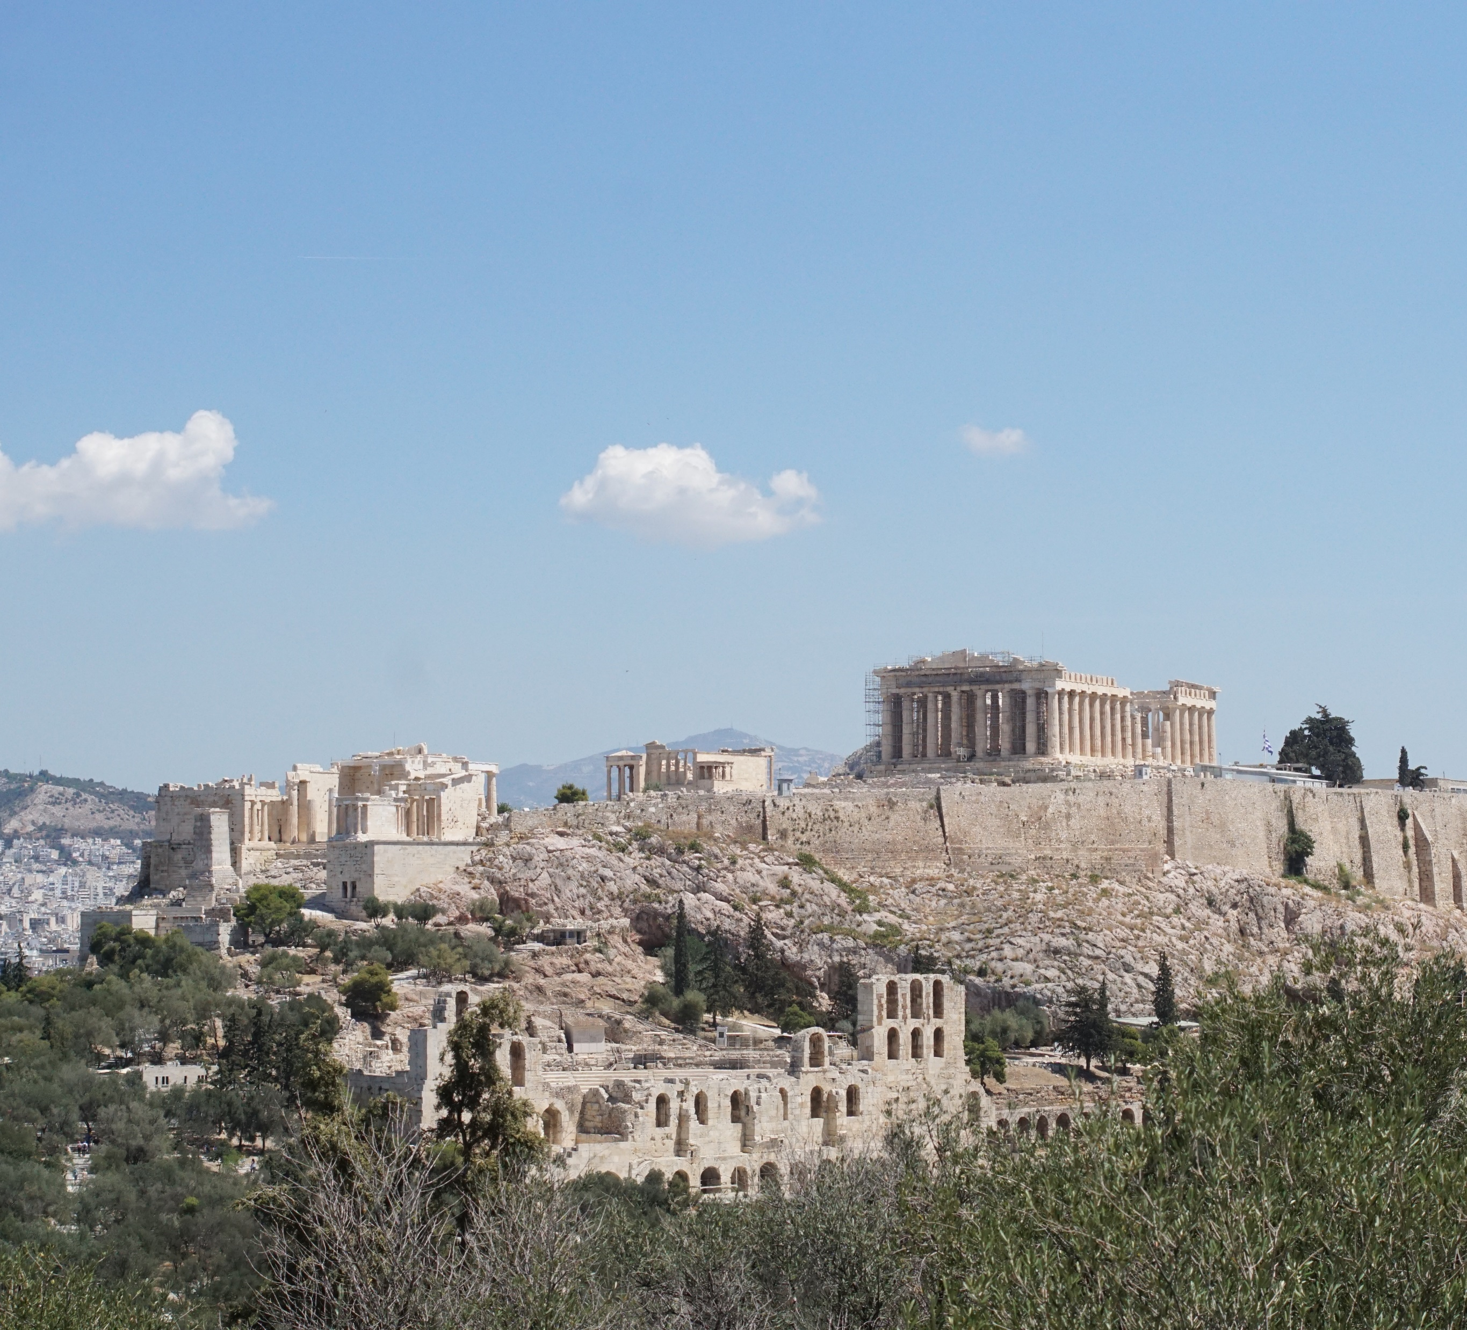
Conclusion
  Have industry in Australia & NZ and overseas work together on sustainable technical solutions to reduce GHG emissions
  Further develop techniques to locate, quantify and certify emissions
  Develop methods within NGER to enable companies to meet their obligations - hence changes to methods for fugitive emissions from gas
  Renewable gases need to be certified
Notes:
Australia faces significant challenges in reducing greenhouse gas emissions, particularly methane from gas pipelines. Through robust legislation, commitments to international agreements, and the implementation of the Safeguard Mechanism, Australia aims to mitigate climate impacts. By focusing on improved monitoring, maintenance, and adopting emerging technologies, the country can achieve substantial emissions reductions in both gas and hydrogen pipeline systems, contributing to global climate goals.

Slide 9
Contact Details:
Morgan Grace
E: morgan.grace@worley.com

