Slide 1
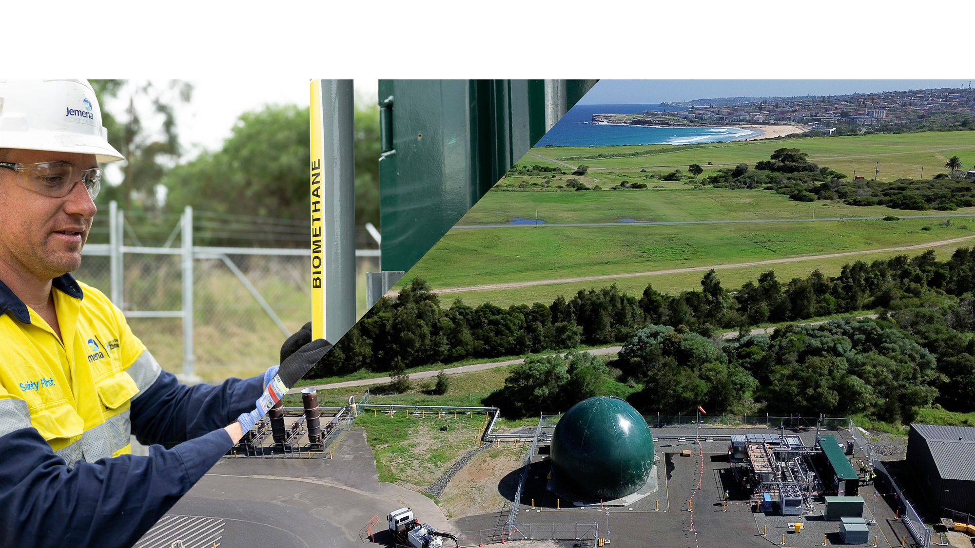
Malabar Biomethane Facility Early Operation & Lessons Learned
  Jarad McInnes, Project Manager, Zinfra - Projects & Infrastructure
  APGA Renewable Gas Symposium – 22nd February 2024

Slide 2
Agenda
Introduction
Malabar Biomethane Injection Project Overview
Construction: Challenge and Solutions
Initial Operations: Lessons Learned
Renewable Gas Certification
Future Outlook and Opportunities
Conclusion

Slide 3
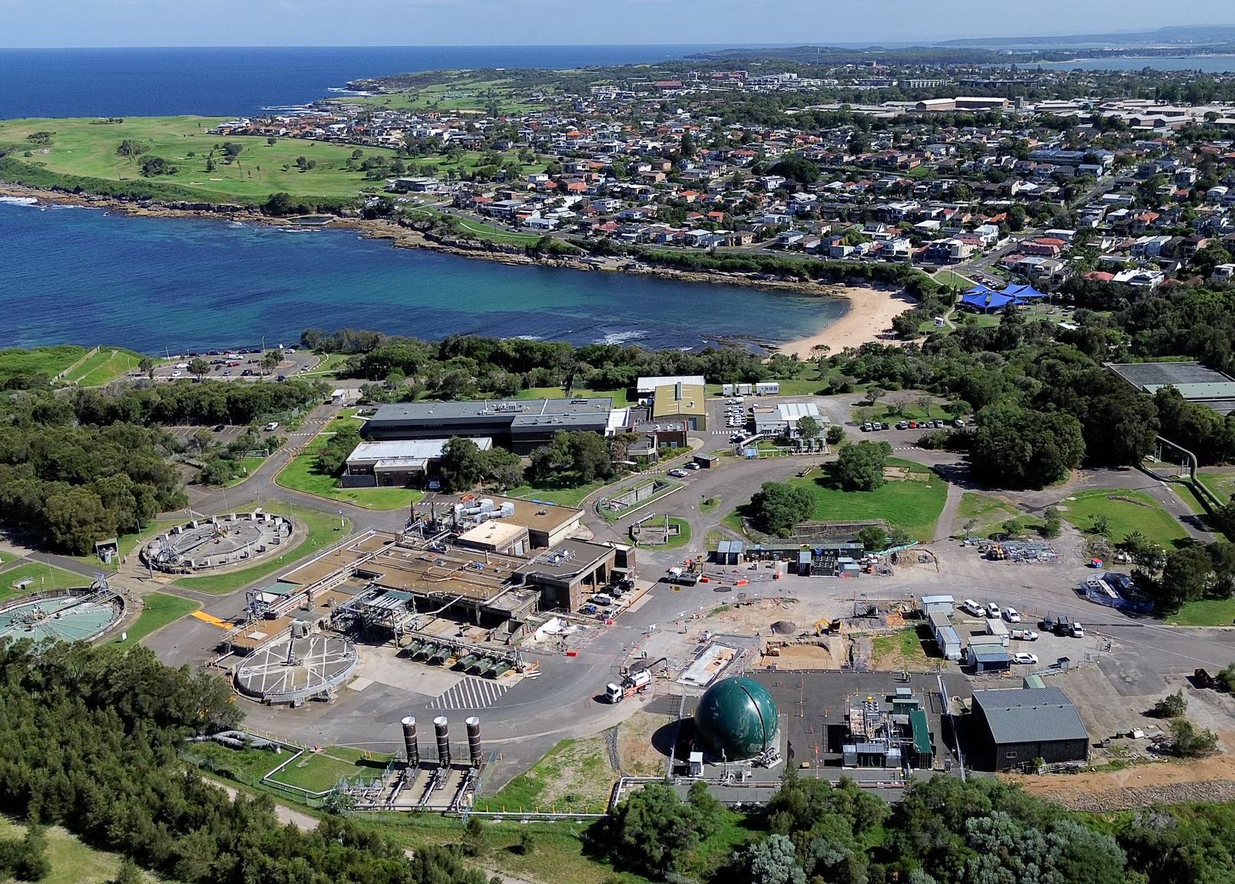
Australia’s First Biomethane-to-Gas Network Project
Project Overview
The Malabar Biomethane Injection Project is a groundbreaking initiative that injects renewable biomethane into the Jemena Gas Network in New South Wales.
Jemena and Sydney Water collaborate to produce biomethane at the Malabar Water Resource Recovery Facility in Southeast Sydney.
The project involves upgrading biogas from the anaerobic digestion process at Malabar to high-quality biomethane for injection into Jemena’s gas distribution network.
The project is jointly funded by Jemena and the Australian Renewable Energy Agency (ARENA).
Notes:
Wastewater Catchment: Population of 1.86 million, Area of 68,247 hectares.

Slide 4

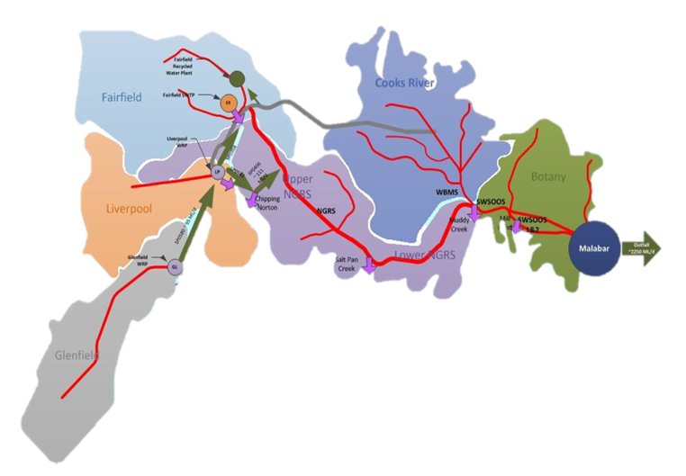
Australia’s First Biomethane-to-Gas Network Project
Feedstock Source
The feedstock for biomethane production comes from Sydney Water’s Malabar Water Resource Recovery Facility (WRRF).
This facility serves a wastewater catchment area with a population of approximately 1,860,000 people.
Renewable Gas Production
Currently, the Malabar facility is scheduled to produce 95TJ of renewable biomethane per annum.
There is potential to scale up to around 200TJ annually.
Renewable Gas Demand
Jemena worked closely with GreenPower to help establish Australia's first renewable gas certification.
Jemena found very high demand from the market for the biomethane product to assist in energy transitions.
Notes:
Wastewater Catchment: Population of 1.86 million, Area of 68,247 hectares.

Slide 5
Biomethane Upgrader Production
Waste Gas Burners
(Sydney Water)
Biogenic
CO2
Anaerobic Digestion
(Sydney Water)
Malabar Biomethane Upgrader Project (Jemena)
Biogas
Biogas Storage
Pretreatment System
Compression
Membrane Upgrader
Gatekeeper
New Gas Receipt Point (JGN)
Jemena Gas Network (JGN)
Biomethane
Biomethane
Membrane Recycle Biogas
Renewable Gas Certification
Gas Customers
Electricity Generation Cogen Units
(Sydney Water)
Startup & Off Spec Biogas
Heat
Electricity
Notes:
Biomethane Upgrader
Pretreatment: Cooling Skid and Chiller Unit, Activated Carbon Vessels
Compressor:
Membrane Upgrader: Separates CO2 and CH4 using patented 3-stage membrane technology.
Gating System: Gas Chromatograph, Analysers and Control Valves
Buffer Storage
Balance of Plant
Inlet Receipt Station
HV & LV Switch rooms
Custody Transfer Station

Slide 6
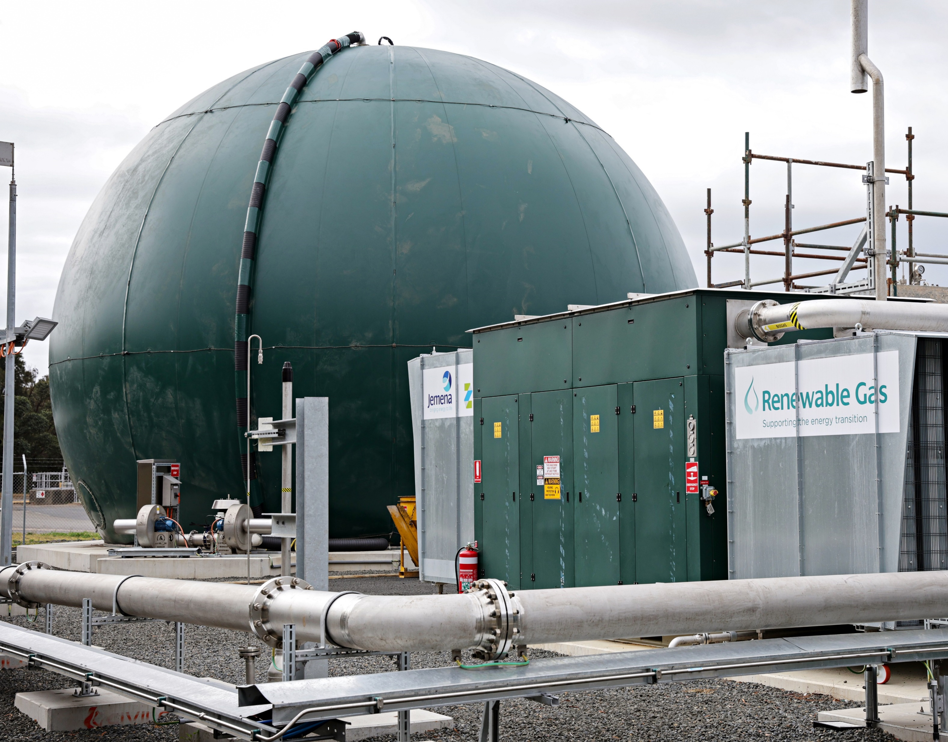
Planning Phase: Challenges and Solutions
  Environmental Considerations
    Construction delivered under Sydney Water Construction Licence and execution of lease to delineation from Sydney Water avoids disruption of ongoing operations.
    Early and ongoing community engagement was crucial, involving local community members via Sydney Water Community Engagement Groups to facilitate mechanisms of informing progress and receiving feedback.
    Considerations of Sustainable Construction Practices in line with Zinfra’s Infrastructure Sustainability Council Membership.
  Regulatory Compliance
    Regulatory Approvals were investigated in detail for each phase design, construction, operation identify that approvals were consistent with Jemena’s existing licence and conditions detailed within the Review of Environmental Factors for the Project.
    Although Malabar is an unregulated facility, Jemena applied its standards for a regulated (i.e. AS2885) gas facility regardless, opportunity to optimise design on future plants.
Notes:
Current Biodome has 1200SCM of Buffer Storage operating ramp speed from 35% to 100% fill

Slide 7
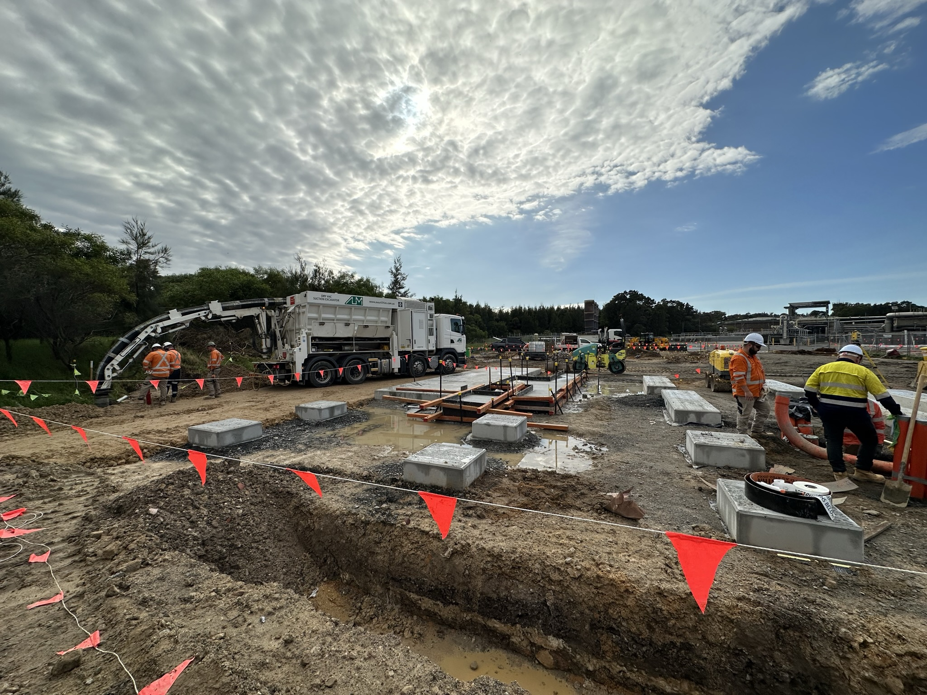
Delivery Phase: Challenges and Solutions
  Engineering and Design Challenges
    Optimum location for the Upgrader is centralised to the Anaerobic Digesters for heat recovery.
    Biodome was included late in the design phase to optimise the recovery during low flows, consideration of the Anaerobic digesters as buffer storage.
    Awareness of clashes with European design codes and was prepared to rectify these in-country.
  Commissioning and Integration
    The concept of a package upgrader may limit end-to-end Factory Testing; ensure allowance for extensive Site Testing.
    Zero outages of the Malabar WRRF for bringing the Biomethane facility online, achieved by early issuance of the Operation Protocol during the commissioning.
Notes:
For example, European vendors did not provide all information required for Australian pressure vessel registration, which took additional support from Jemena to ensure compliance

Slide 8
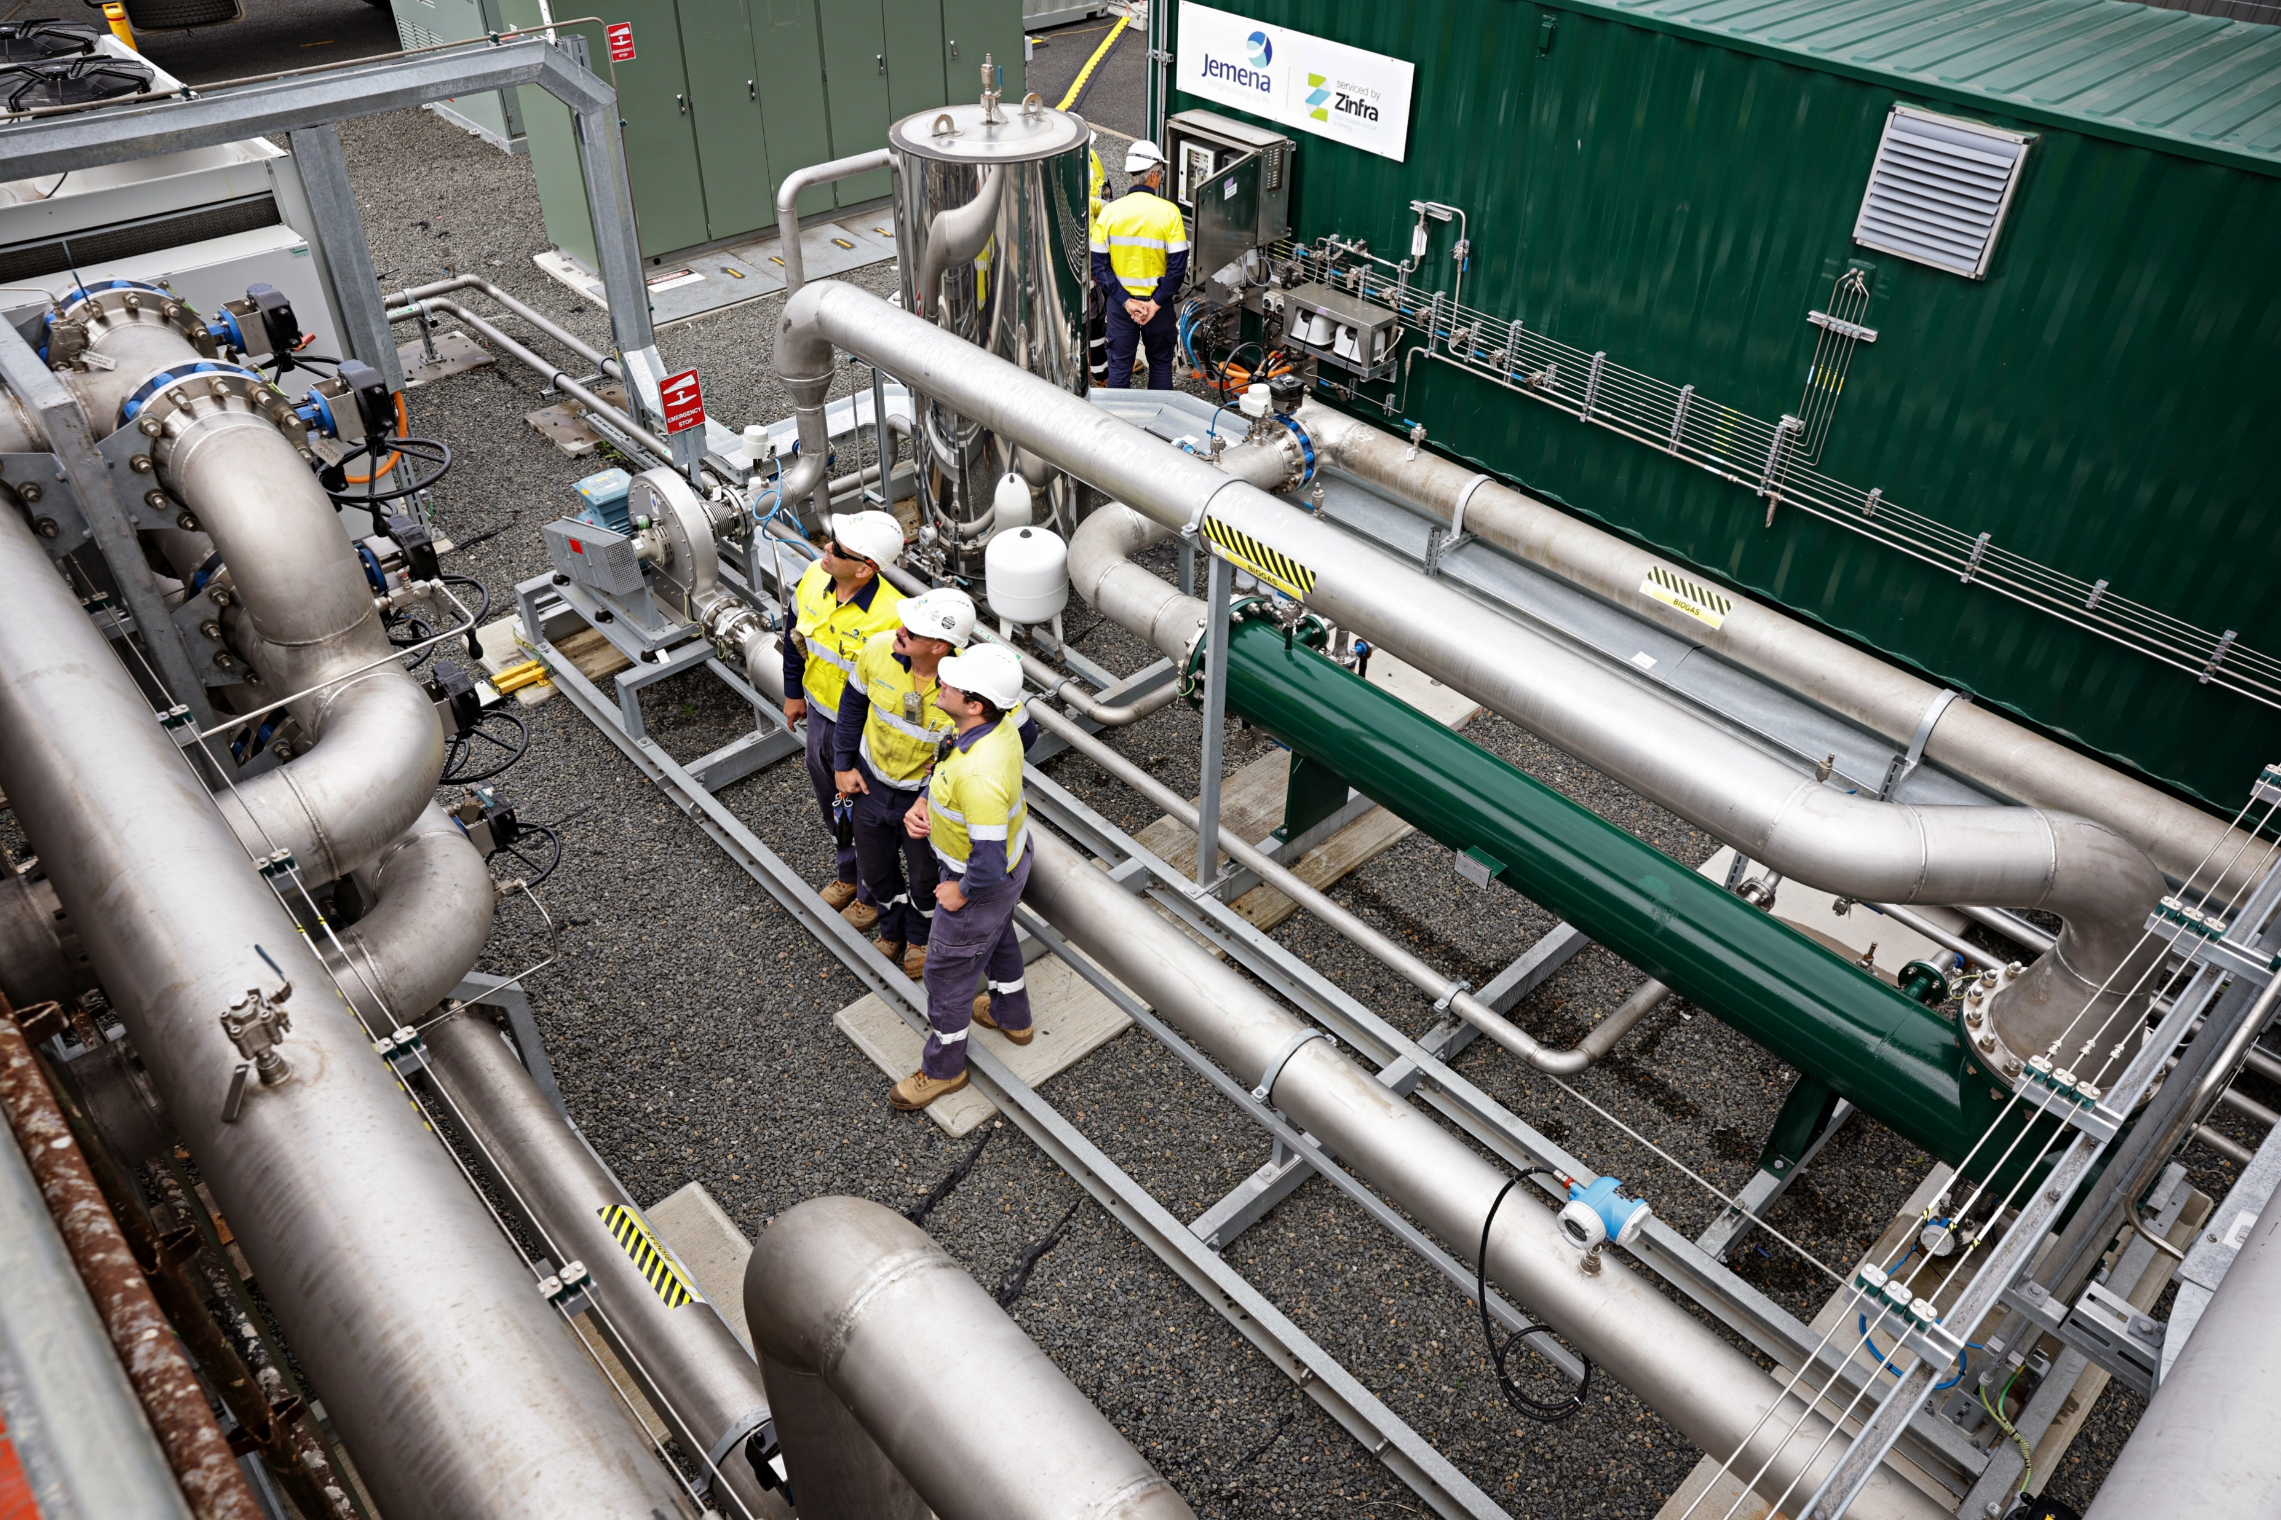
Initial Operations: Lessons Learned
Technical Performance of the Upgrader
  Pretreatment Activated Carbon Consumption
    Increase in activated carbon used due to higher H2S loading led to large increase in operating cost.
  Calibration Gas: Key Operational Consumable
    Required for Gas Analyser to Monitor and Automate Upgrader System.
    Lead times on Calibration Gas Orders.
  Siloxane + VOCs Detection
    Post Treatment minimal traces of Siloxanes + VOCs via testing of Biomethane and Biogenic CO₂ Streams.
    Routine monitoring via Compressor Lubricant.
Notes:
Removal of H2S and other contaminants (VOCs and siloxanes)
2020 Baseline Data indicated H₂S 600-1200ppm (peak 1400ppm)
2023 Production Data H₂S 1000-1200ppm (peak 1800ppm)
1.5x increase Activated Carbon Consumption
25% of the levelized cost of biomethane

Slide 9
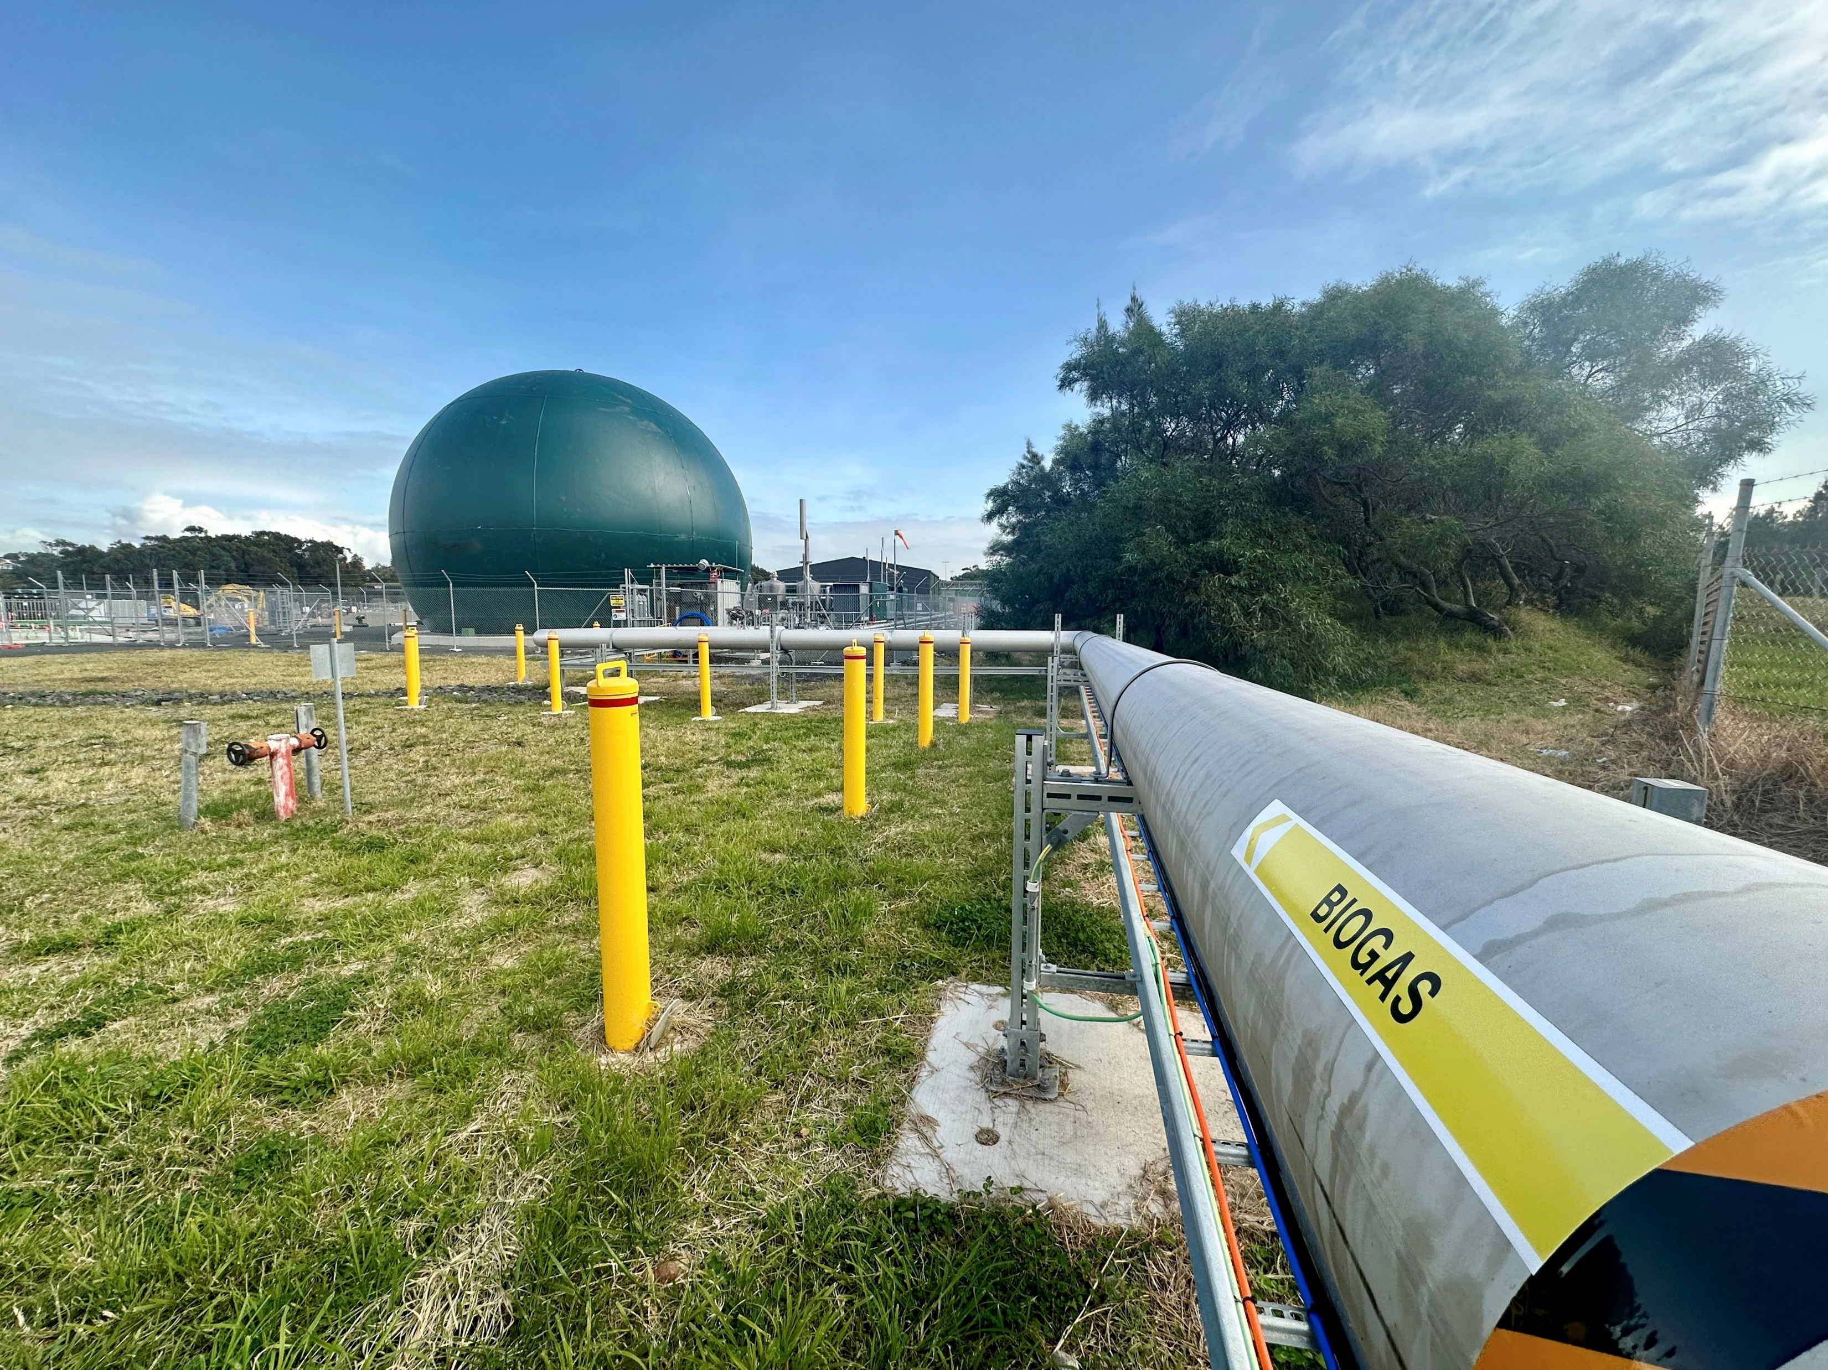
Initial Operations: Lessons Learned
Operational Efficiency and Optimization Strategies
  Sydney Water Partnership
    Optimize Anaerobic Digesters and Waste Gas Burner and inlet control set points to reduce biogas flaring.
    Implemented a system to manage gas inlet flows on behalf of Sydney Water to ensure no lag in flow control and therefore maximise biomethane production.
Integration with existing infrastructure
    Future Installation should evaluate opportunities for heat recovery from gas compressor (e.g. for Anaerobic Digestion).
    Shared pre-treatment with Cogen applications would lead to higher-quality fuel gas to Cogen units and thus extend their operating life.

Slide 10
Renewable Gas Certification
Role of Renewable Gas in Decarbonization
First registered renewable gas facility under GreenPower’s Renewable Gas Certification.
Attaining ISC Rating for sustainable construction practices provides the holistic attitude for the idea of sustainable energy.
Embracing continuous
improvement, we leverage global expertise and economies of scale through our strategic partnerships.
Understanding of Lifecycle Impact of Biomethane production including the assessment of Feedstock.
Contribute to the renewable energy targets of Jemena's customers.
Economic Viability and Cost-Effectiveness Comparison of Natural Gas vs Biomethane.
Market Potential for Biomethane Products and other waste products like Biogenic Carbon Dioxide and Digestate.

Slide 11
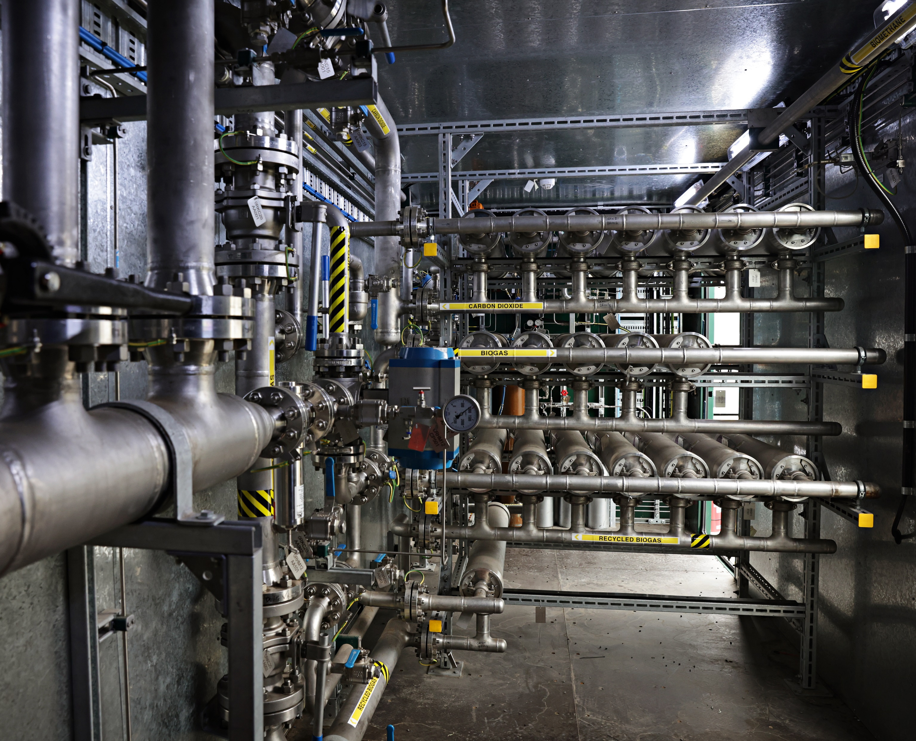
Future Outlook and Expansion Opportunities
  Biomethane Opportunities
    Scaling up Biomethane Production, Malabar has a surplus capacity for additional Biogas production.
    CO₂ Applications: CO₂ liquefaction systems or Methanation.
    Potential for replication in other regions for further Renewable Gas connections.
    Bioenergy is a community of multiple industries, and the establishment of a Code of Practice for Bioenergy should be considered for consistency across industries.
    Constraints
    Limitation of available Australian Bioenergy Suppliers and Products, creating high cost and risk operating facilities.
    Policy and regulatory settings also government support is essential to promoting new energy.

Slide 12
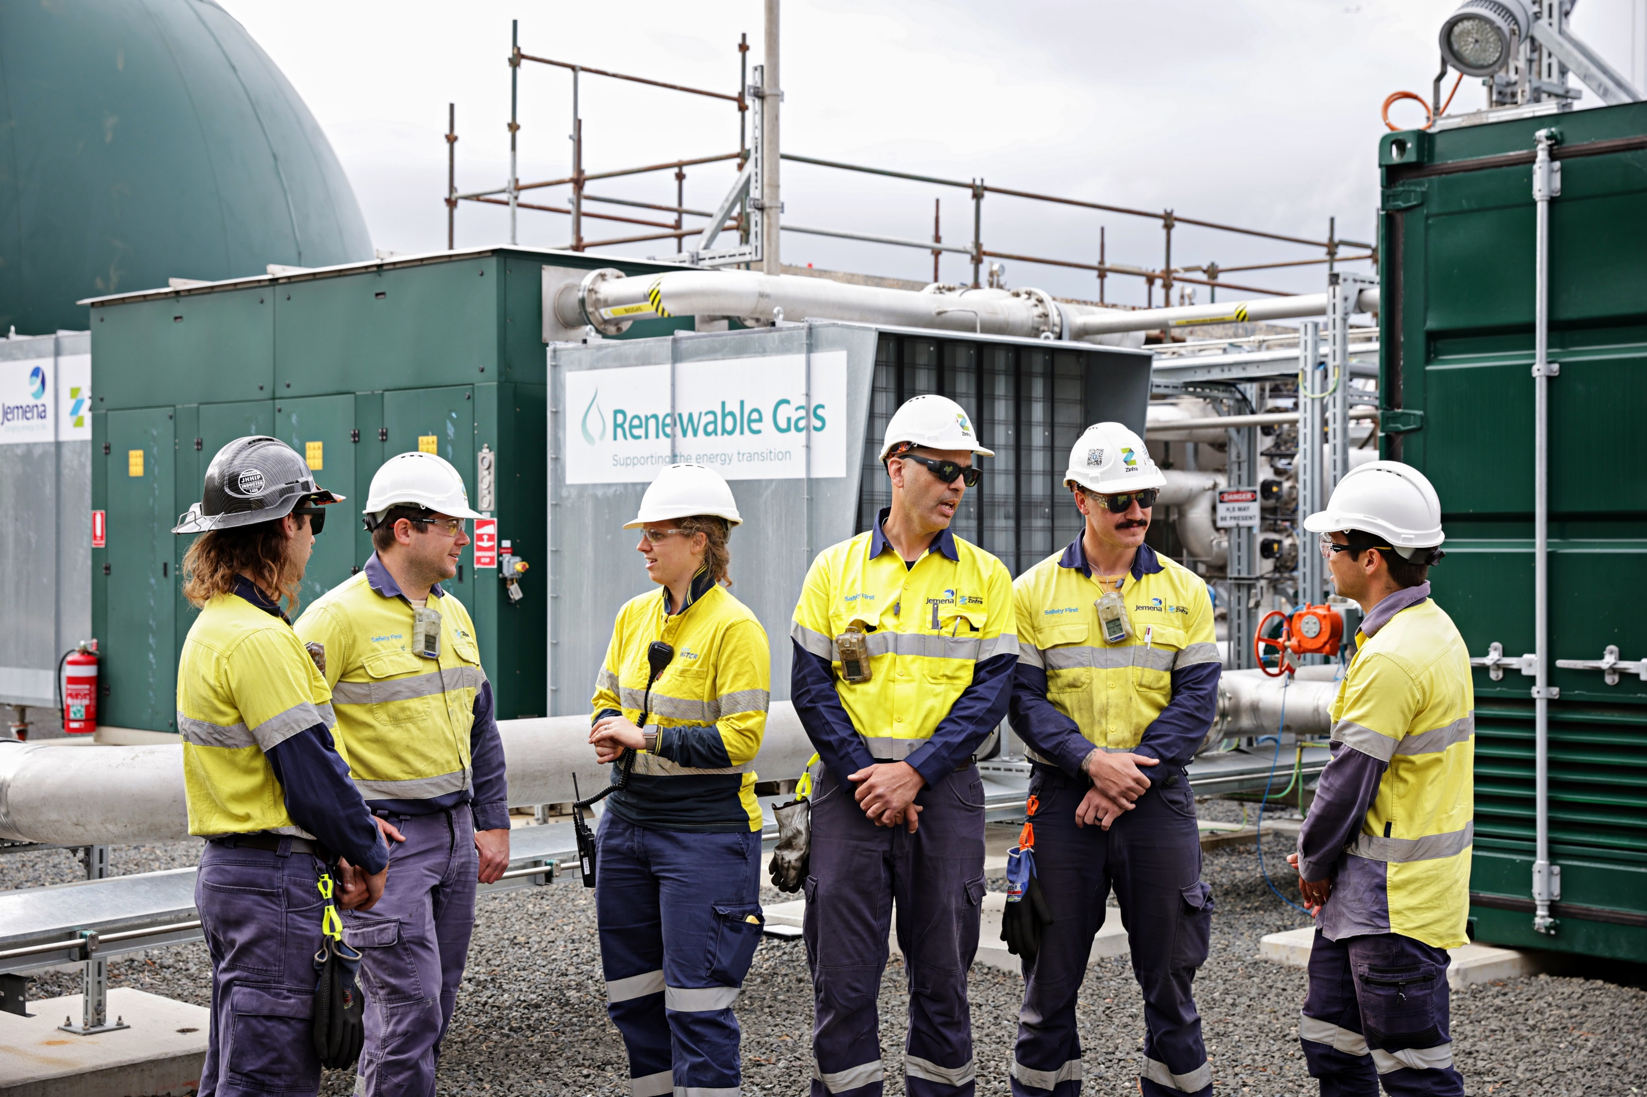
Conclusion
  Australia’s first biomethane upgrading plant
    Demonstrated Renewable Gas production, both technically and commercially.
    Started the development of a renewable gas market through a certification system.
    Increased uptake of biomethane technology by the Australian waste industry.
Notes:
Key Achievements: Highlight that the project marks Australia's first successful biomethane upgrader, demonstrating the technical and commercial viability of renewable gas production.
Impact on Renewable Gas Market: Emphasize the development of a renewable gas market through a certification system and the increased uptake of biomethane technology in the Australian waste industry.
Vision for the Future: Outline the vision for expanding biomethane upgrading in Australia, including scaling up production, exploring CO2 applications, and the potential for replication in other regions to further renewable gas connections.
Lessons Learned and Recommendations: Briefly mention the project's lessons learned regarding technology, partnerships, and regulatory compliance, and suggest considerations for future projects to improve efficiency and impact.

Slide 13
Questions
Notes:
How would you proceed with the next project?
This question aims at understanding the strategic approach and planning considerations for future biomethane or similar renewable energy projects, emphasizing the importance of lessons learned from the Malabar project.
Integrated design with partner:
It suggests collaboration and integration as a key focus, asking how future projects might enhance design processes through closer partnerships, possibly with equipment manufacturers, project partners, or stakeholders.
Engage directly with equipment subvendors:
This question indicates the need for direct engagement with suppliers and subvendors to streamline procurement, customization, and troubleshooting processes for specialized project equipment.
Identify site:
This is about the criteria and strategic considerations for choosing locations for future biomethane projects, taking into account factors like proximity to feedstock sources, infrastructure, and regulatory environments.
Gas Operators perspective Fringes of Network providing reinforces supply and reducing risk to customers:
It focuses on how gas operators view the integration of biomethane projects within the broader network, particularly at the edges where such projects can enhance supply reliability and reduce risks.
From Feedstock perspective Agricultural Waste and Water supplies should be overlayed with Network infrastructure:
This question delves into the logistical and strategic considerations of aligning feedstock availability (e.g., agricultural waste, water treatment outputs) with the existing gas network infrastructure for efficient biomethane production and distribution.

